Slide 1
Hunting for Dark Matter with ANAIS-112: latest results and ongoing work
Jaime Apilluelo Allué
on behalf of the ANAIS collaboration

Slide 2
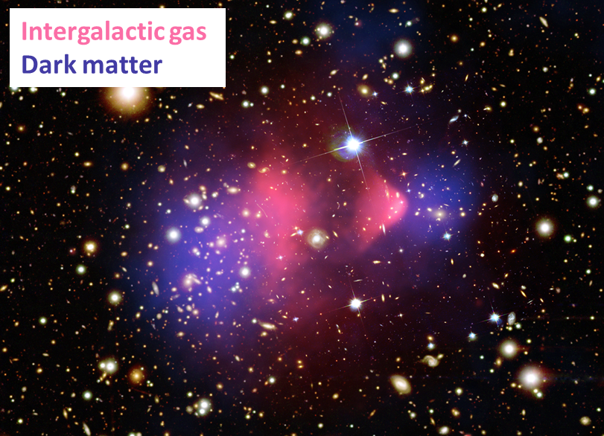
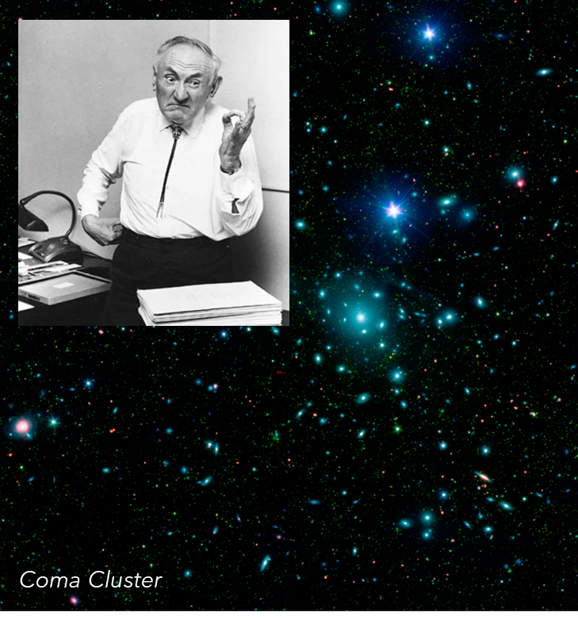
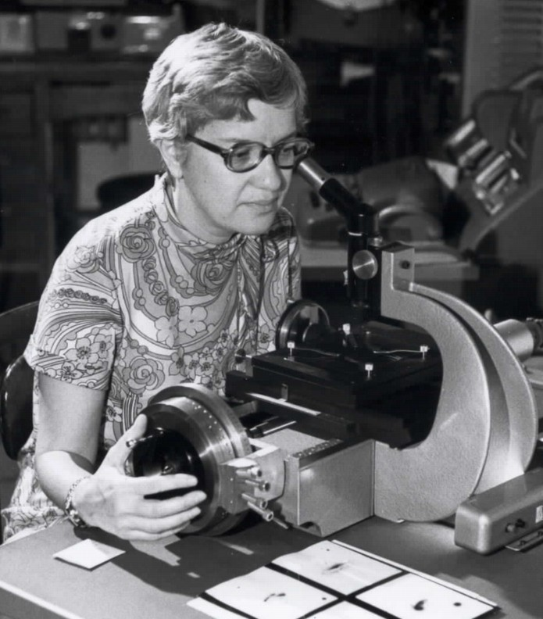
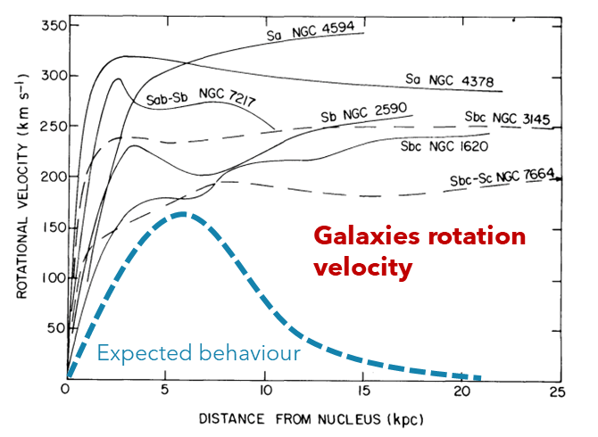
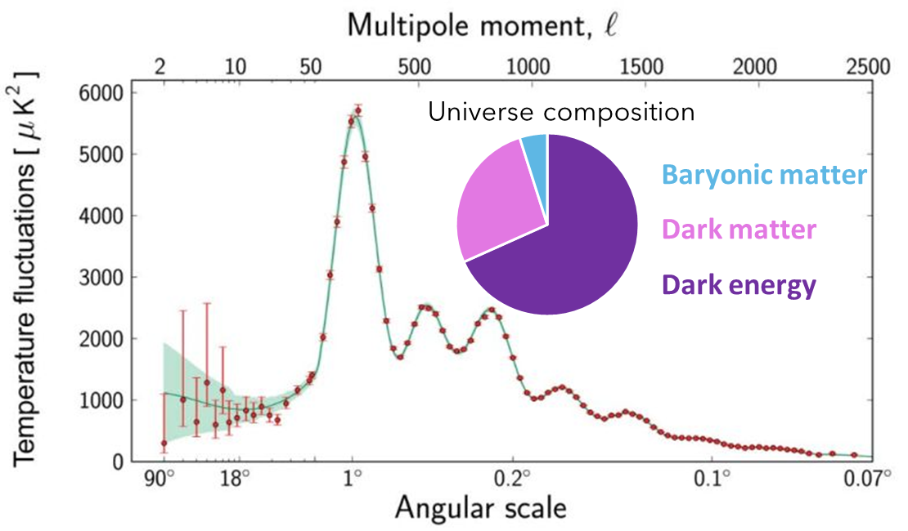
Dark Matter
Multiple evidences of the presence of dark matter from experimental observations since the 30s.
Bullet Cluster

Slide 3
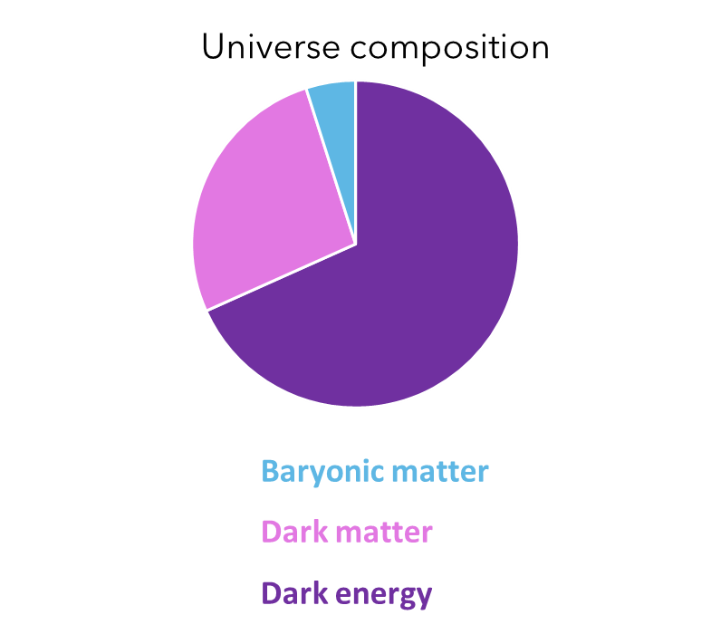
Dark Matter
What is DM?
Massive particles.
Non-baryonic.
Without electromagnetic interaction or very weakly coupled to the photon.
Weak self-interactions.
Weak interactions with baryons.
Axions
WIMPs
Sterile neutrinos
SuperWIMPs
Primordial black holes
…
Marc Schumann 2019 J. Phys. G: Nucl. Part. Phys. 46 103003

Slide 4
Dark Matter
What is DM?
Massive particles.
Non-baryonic.
Without electromagnetic interaction or very weakly coupled to the photon.
Weak self-interactions.
Weak interactions with baryons.
WIMPs (Weakly Interacting Massive Particles)
Mass range: 1 – 10⁵ GeV/c²
σ_{WIMP-Nucleon}: 10⁻⁴¹ – 10⁻⁵¹ cm²
WIMP candidates arise naturally in many extensions of the Standard Model, as SUSY theories
Its thermal production can explain the dark matter abundance of the universe.
Axions
WIMPs
Sterile neutrinos
SuperWIMPs
Primordial black holes
…

Slide 5
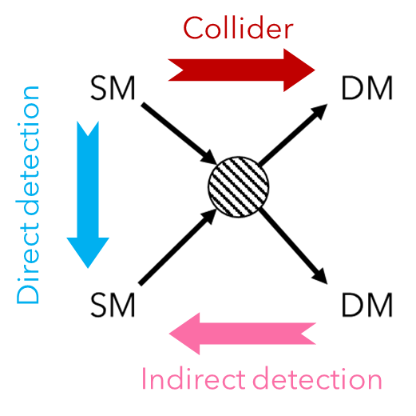
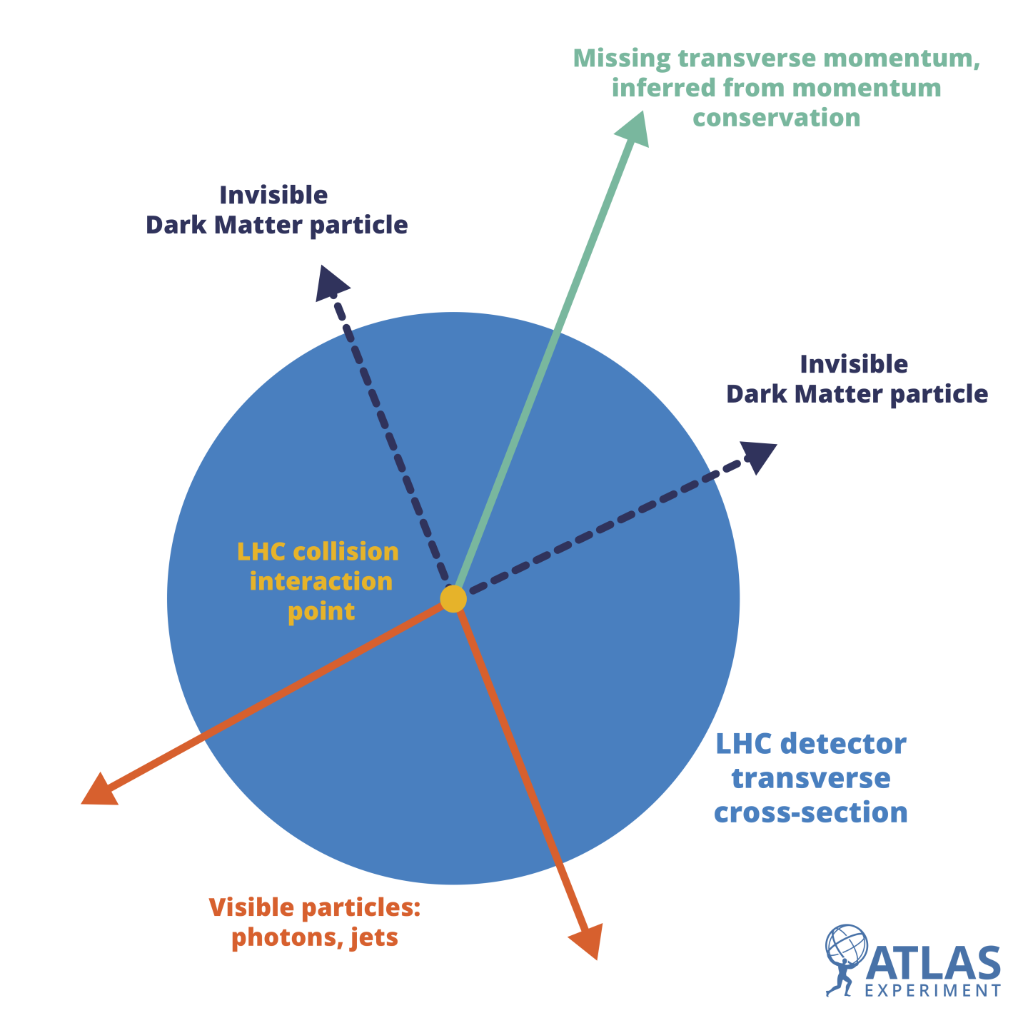
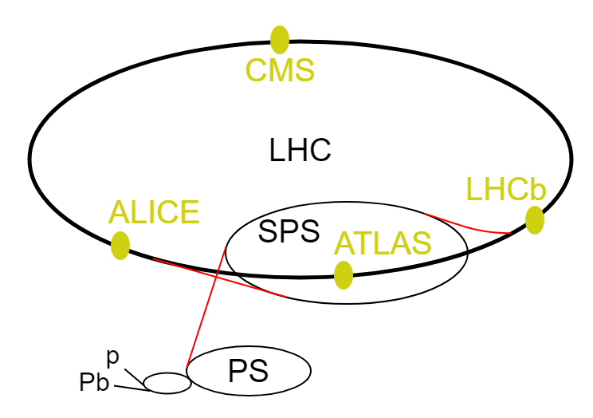
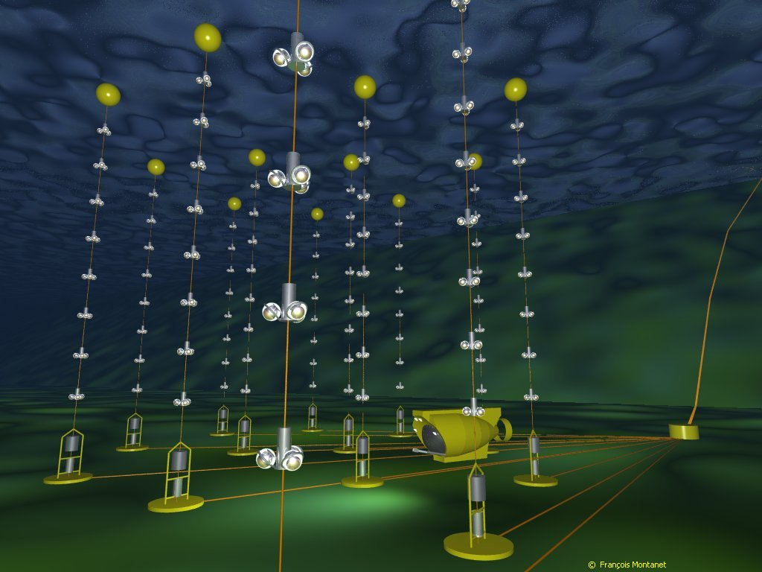
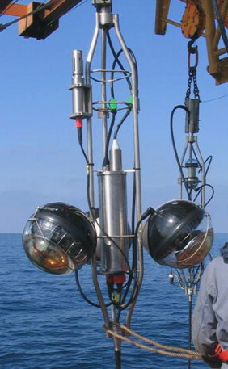
Dark Matter: detection
Looking for Dark Matter production at LHC.
Aiming to detect SM particles produced by the annihilation/decay of DM particles.
For example: neutrino telescopes.
ANTARES: ν telescope placed at the bottom of the Mediterranean sea.

Slide 6
Dark Matter: detection

Slide 7
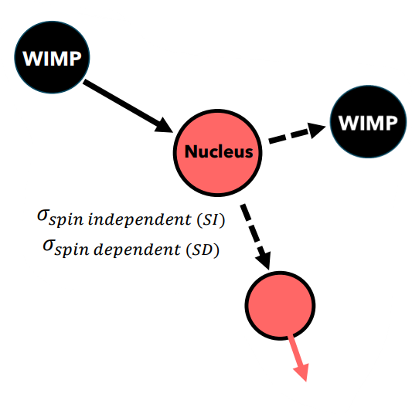
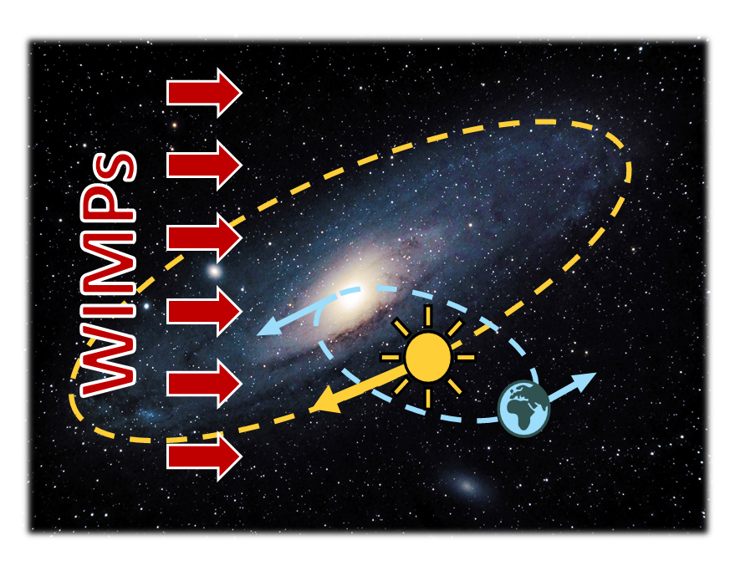
Dark Matter: direct detection
Nuclear scattering
$$\frac{dR}{dE_{nr}}=\frac{ρ_{0}M}{m_{N}m_{χ}}\int_{v_{min}⁡}^{v_{max}}{vf\left(v\right)\frac{dσ}{dE_{nr}}dv}$$
Expected interaction rate
$ρ_{0}$= local dark matter density
$M$= target mass
$m_{N}$= nucleus mass
$m_{χ}$= WIMP mass
$f(v)$= normalized WIMP velocity distribution
Dependency with the relative velocity between WIMPs and nuclei.
$v_{max}$= maximum velocity
$v_{min}$= minimal detectable velocity (limited by the energy threshold of the experiment)
We can detect the nuclear recoil.
Main interaction channel:
elastic scattering WIMP-nucleus
Due to the rotation of Earth in the Solar System and the movement of it inside the Milky Way, the velocity of DM particles relative to Earth varies seasonally, producing an annual modulation in the rate of nuclear recoil events.
Maximum relative velocity: June
Minimum relative velocity : December
Period: 1 year
Event search: nuclear recoil.
DM signal search: annual modulation.
Which kind of experiment can we design to look for this signal?

Slide 8
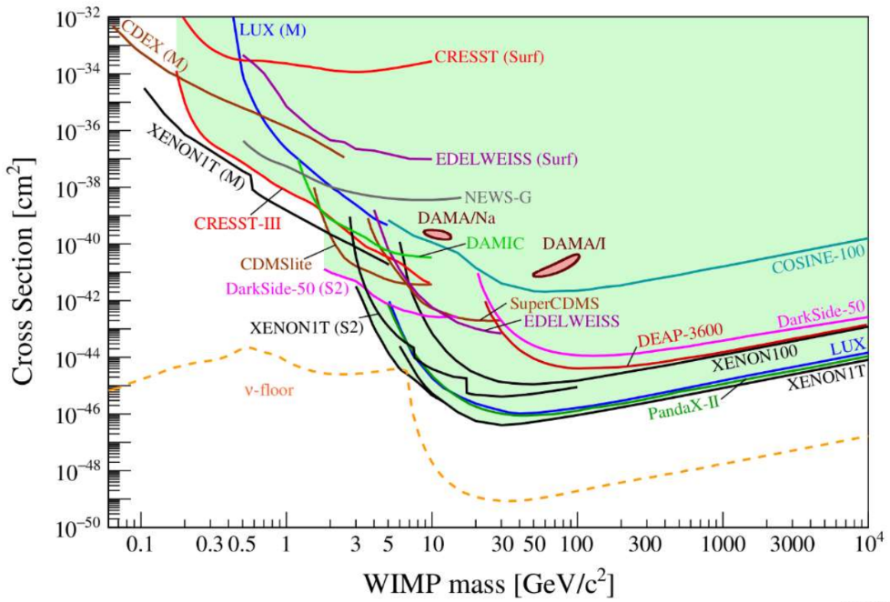
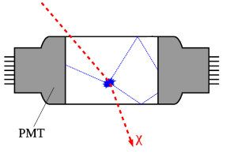
Dark Matter: direct detection
Experimental status
Multiple detection techniques and different targets $→$ complementary searches in the parameter space of WIMPS:
Cryogenic detectors: SuperCDMS (Si,Ge), Edelweiss (Ge), CRESST (CaWO₄)…
Noble liquid detectors: DarkSide (Ar), XENON, PandaX, LUX-ZEPLIN (Xe)…
Other techniques: Si-CCDs (DAMIC), scintillating crystals (ANAIS, COSINE), bubble chambers (PICO)…
APPEC DM Report (2021)
Scintillator detectors
Particle energy deposition → scintillation light → photon detector (usually PMTs).
Collected photons
∝
Deposited energy.
Status of searches for spin-independent elastic WIMP-nucleus scattering

Slide 9
Dark Matter: direct detection
Experimental status
Multiple detection techniques and different targets $→$ complementary searches in the parameter space of WIMPS:
Cryogenic detectors: SuperCDMS (Si,Ge), Edelweiss (Ge), CRESST (CaWO₄)…
Noble liquid detectors: DarkSide (Ar), XENON, PandaX, LUX-ZEPLIN (Xe)…
Other techniques: Si-CCDs (DAMIC), scintillating crystals (ANAIS, COSINE), bubble chambers (PICO)…
APPEC DM Report (2021)
DAMA/LIBRA, a experiment based on NaI(Tl), observes an annual modulation and claims to have detected dark matter.
R.Bernabei et al Universe 2018, 4(11), 116
Status of searches for spin-independent elastic WIMP-nucleus scattering
More sensitive experiments have ruled out this signal in the considered scenarios, but comparison is model-dependent because they use different target.

Slide 10
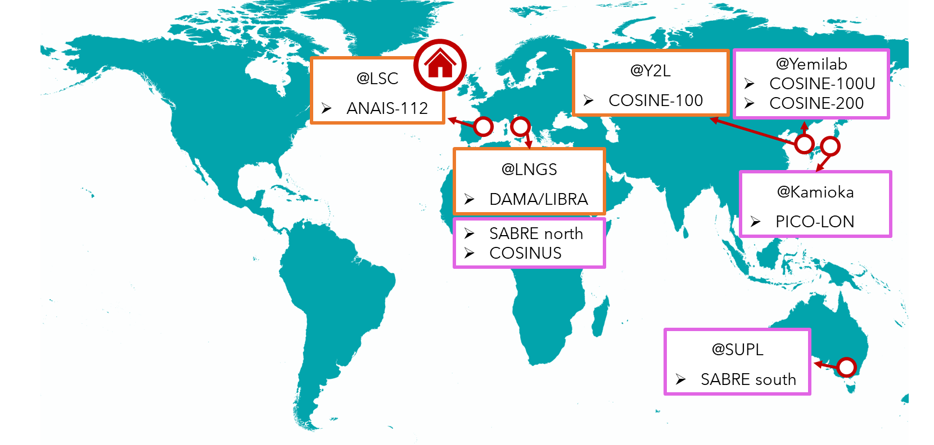
NaI detectors
Multiple experiments around the world working with NaI(Tl) detectors.
Operating/finished experiments
Next experiments

Slide 11
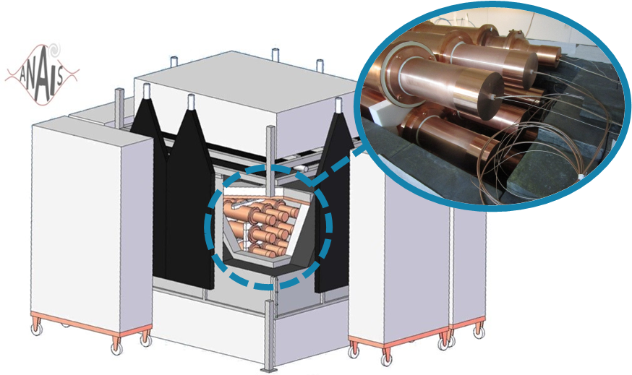
ANAIS-112
Annual Modulation with NaI Scintillators
Direct dark matter detection experiment.
9 ultrapure NaI(Tl) crystals 12.5 kg (112.5 kg) in 3 × 3.
Each crystal is coupled to two high QE PMTs.
High light collection: 15 phe/keV.
Placed at Canfranc Underground Laboratory.
Taking data since 3rd August 2017.
GOAL: establishing a model independent test of DAMA/LIBRA results on the annual modulation signal.
ROI: [1-6] and [2-6] keV
R.Bernabei et al Universe 2018, 4(11), 116

Slide 12
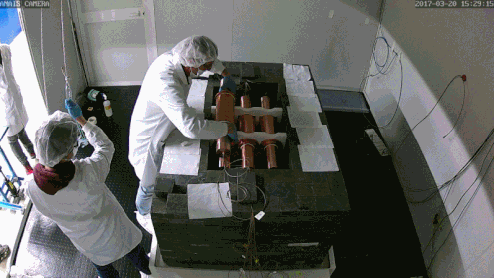
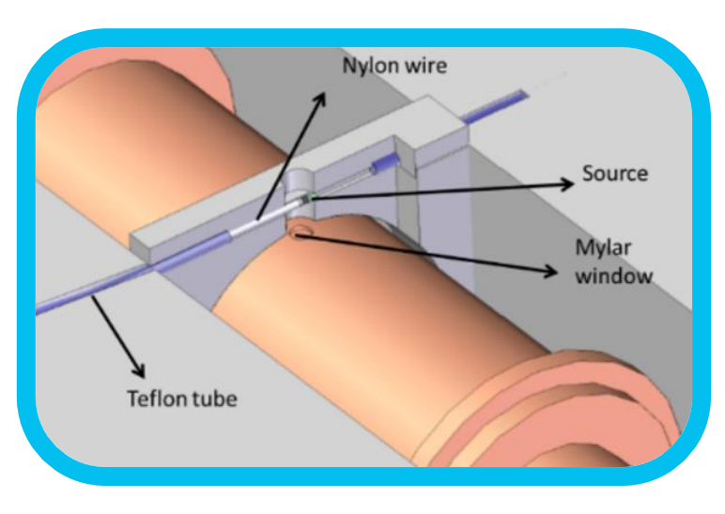
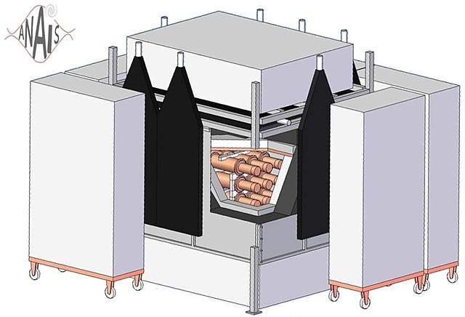
ANAIS-112
Shielding configuration
Energy calibration
Low energy calibration: our ROI is from 1 to 6 keV.
Modules equipped with a mylar window: external source of ¹⁰⁹Cd (producing 3 peaks below 100 keV).
Calibration with internal sources (selected by coincidence with a HE gamma):
K-40: 3.2 keV and 1460.8 keV $γ$
Na-22: 0.9 keV and 1274.5 keV $γ$
Neutron shielding: mixture of PE/water tanks with 40 cm of thickness.
Gamma shielding: 10 cm of ancient Pb + 20 cm of Pb.
Anti-Rn box: filled with N2 gas.
Muon vetoes: plastic scintillators around the inner detector → events arriving within 1 s from the detection of a µ are removed.

Slide 13
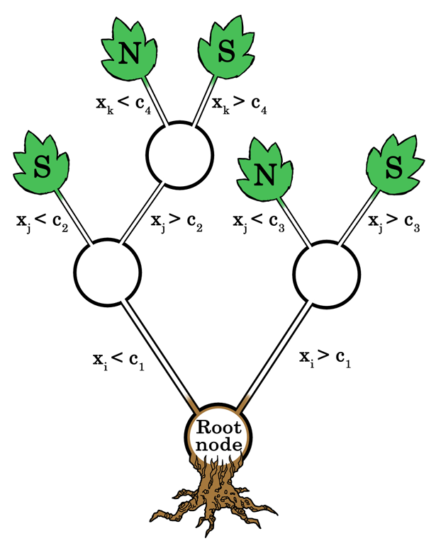
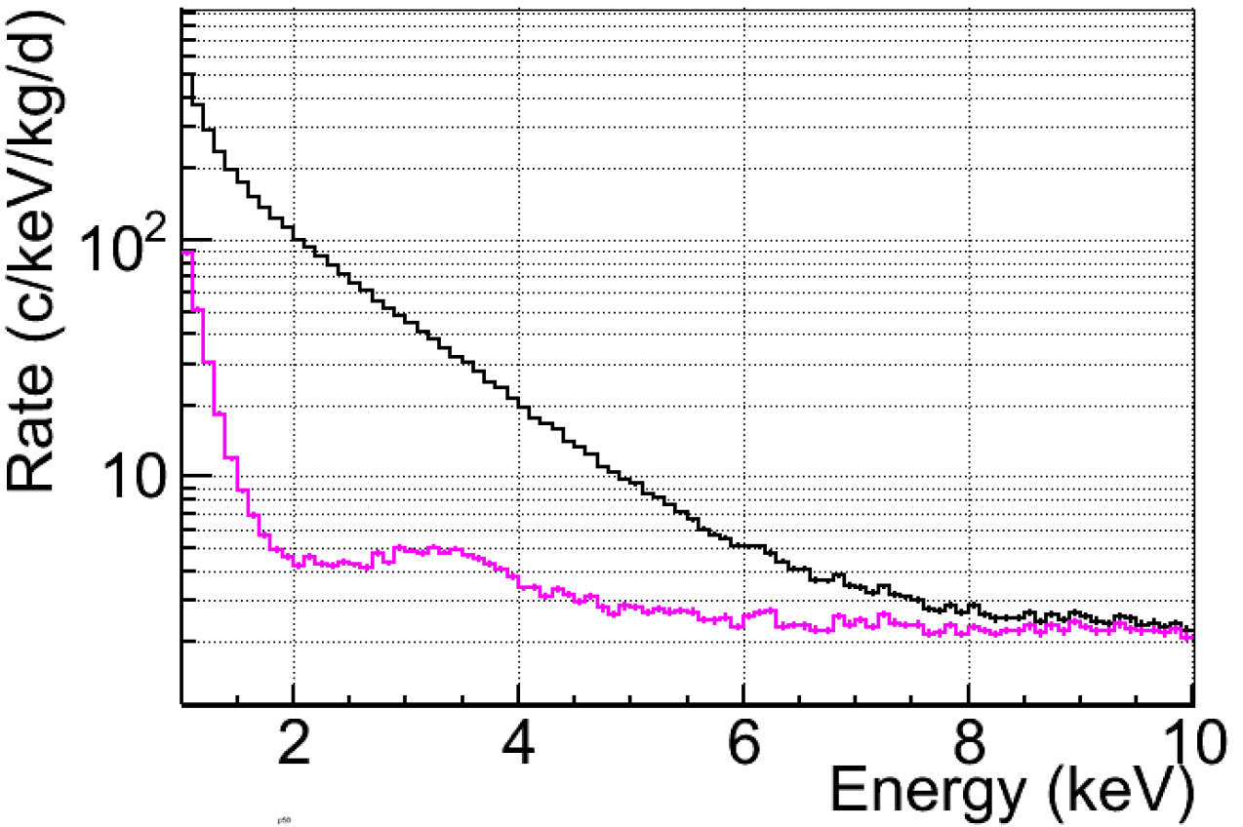
ANAIS-112: event selection
At present ANAIS-112 sensitivity is constrained by anomalous light events attributed to the PMTs:
They are dominating the event rate below 10 keV.
Classification method based on BDT (Boost Decision Trees).
Use of 15 parameters defined for the detector signal: taking into account the pulse shape and the assymetric light sharing between both PMTs.
Training populations:
Signal population: neutron calibrations of ANAIS (same signal as the expected for WIMPs → nuclear scattering) made with a Cf-252 source.
Noise population: blank module events.
Measured spectrum
Spectrum after conventional event selection
BDT
scheme
This filtering protocol improves the event selection and its efficiency, but it still limits the energy threshold to 1 keV.
I. Coarasa et al JCAP11(2022)048

Slide 14
ANAIS-112: modulation analysis
Model independent test
GOAL: establishing a model independent test of DAMA/LIBRA results on the annual modulation signal.
We look for the anual modulation in the same energy regions, [1-6] and [2-6] keV, and we fix its period (1 year) and phase (2nd June).
The modulation is searched with a simultaneous fit of the 9 detectors in 10-day bins, following a $χ^{2}$ minimization:
$$χ^{2}=\sum_{i,d}{\frac{{\left(n_{i,d}−μ_{i,d}\right)}^{2}}{σ_{i,d}^{2}}}$$
$n_{i,d}$ = number of events in time bin $t_{i}$ for detector $d$
$σ_{i,d}$ = statistical uncertainty associated to $n_{i,d}$
$$μ_{i,d}=\left[R_{0,d}\left(1+f_{d}φ_{bkg,d}^{MC}\left(t_{i}\right)\right)+S_{m}\cos\left(ω\left(t_{i}−t_{0}\right)\right)\right]M_{d}ΔEΔt$$

Slide 15
ANAIS-112: modulation analysis
Model independent test
GOAL: establishing a model independent test of DAMA/LIBRA results on the annual modulation signal.
We look for the anual modulation in the same energy regions, [1-6] and [26] keV, and we fix its the period (1 year) and phase (2nd June).
The modulation is searched with a simultaneous fit of the 9 detectors in 10-day bins, following a $χ^{2}$ minimization:
$$χ^{2}=\sum_{i,d}{\frac{{\left(n_{i,d}−μ_{i,d}\right)}^{2}}{σ_{i,d}^{2}}}$$
$n_{i,d}$ = number of events in time bin $t_{i}$ for detector $d$
$σ_{i,d}$ = statistical uncertainty associated to $n_{i,d}$
$$μ_{i,d}=\left[R_{0,d}\left(1+f_{d}φ_{bkg,d}^{MC}\left(t_{i}\right)\right)+S_{m}\cos\left(ω\left(t_{i}−t_{0}\right)\right)\right]M_{d}ΔEΔt$$
Background contribution:
Constant component (long-life isotopes and noise).
Decaying component (based on MC simulations).
Modulation signal expected by DM detection. Phase and period fixed, amplitude ($S_{m}$) as a free parameter.
Mass of the detector, energy and time intervals considered in the analysis.

Slide 16
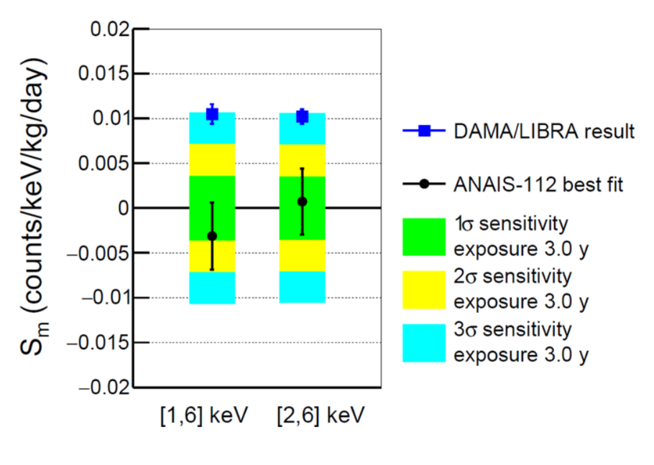
ANAIS-112: latest results
3 year analysis (using BDT filtering protocol)
Modulation amplitudes compatible with zero at ∼ 1σ.
Best fit incompatible with DAMA/LIBRA at 3.7 (2.6) σ for [1-6] ([2-6]) keV.
Sensitivity: 2.8 σ for [1-6] and [2-6] keV.
I. Coarasa et al. Communications Physics volume 7, n 345 (2024)

Slide 17
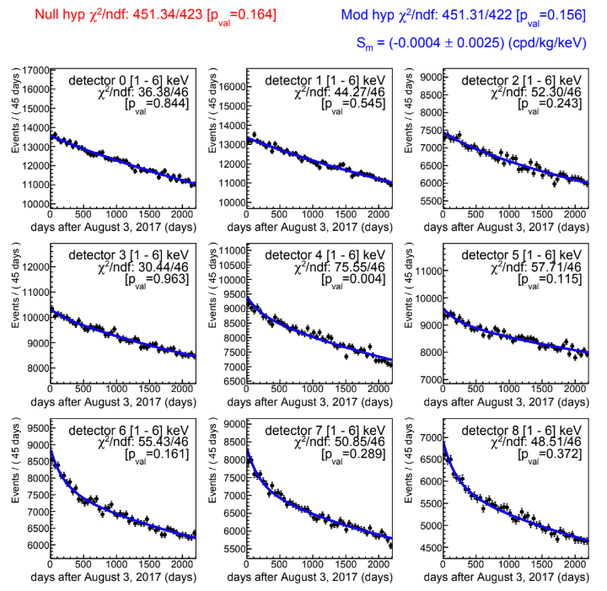
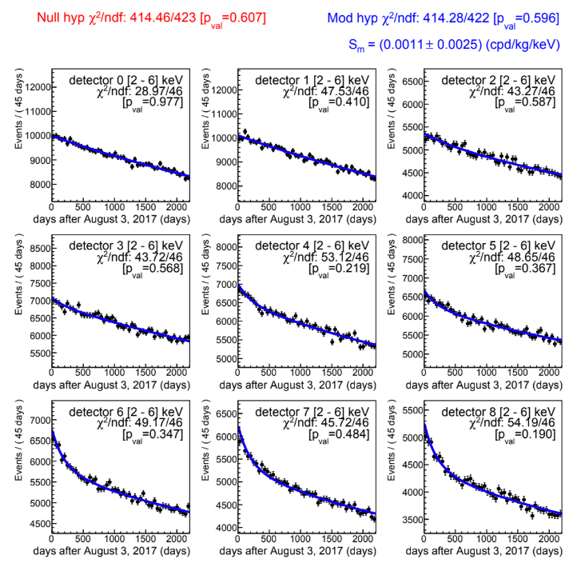
ANAIS-112: latest results
6 year analysis (using BDT filtering protocol): background fit to event rate of the nine modules.
[1-6] keV
[2-6] keV
Publication in preparation (internal reviewing)

Slide 18
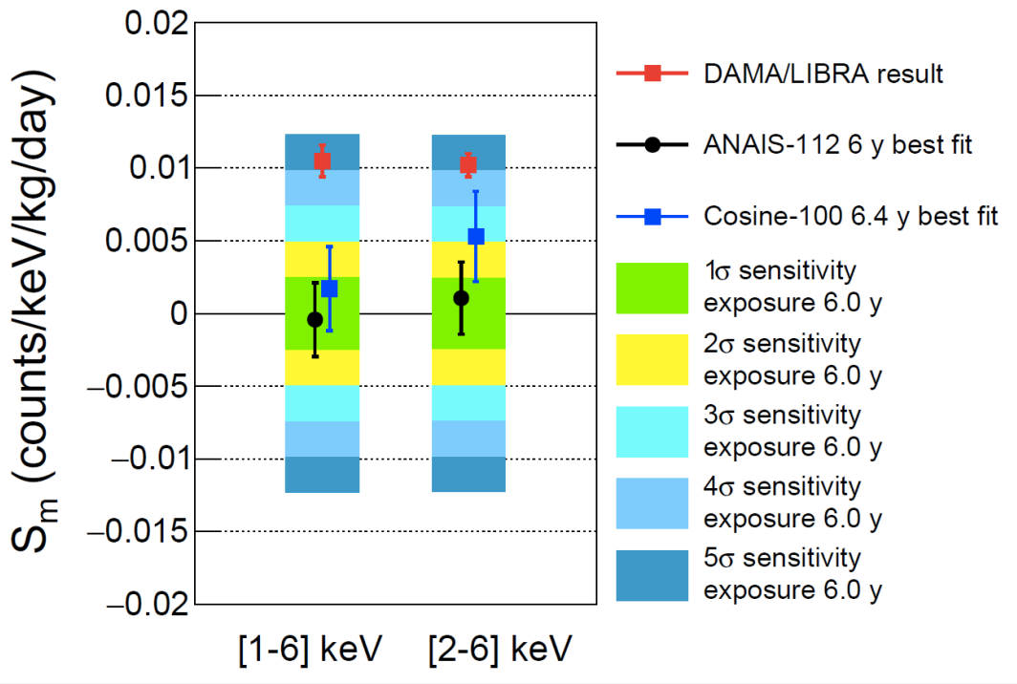
ANAIS-112: latest results
3 year analysis (using BDT filtering protocol)
6 year analysis (using BDT filtering protocol)
Modulation amplitudes compatible with zero at ∼ 1σ.
Best fit incompatible with DAMA/LIBRA at 3.7 (2.6) σ for [1-6] ([2-6]) keV.
Sensitivity: 2.8 σ for [1-6] and [2-6] keV.
Modulation amplitudes compatible with zero at ∼ 1σ.
Best fit incompatible with DAMA/LIBRA at 4.0 (3.5) σ for [1-6] ([2-6]) keV.
Sensitivity: 4.2 (4.1) σ for [1-6] ([2-6]) keV.
I. Coarasa et al. Communications Physics volume 7, n 345 (2024)
Publication in preparation (internal reviewing)

Slide 19
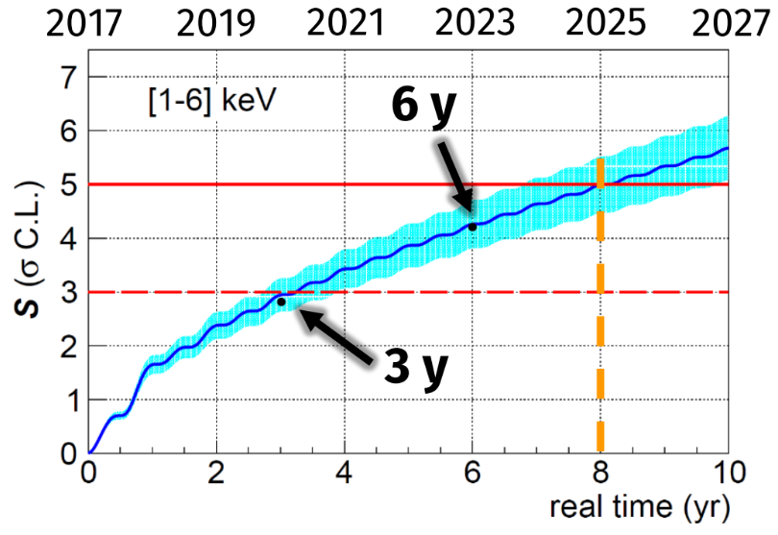
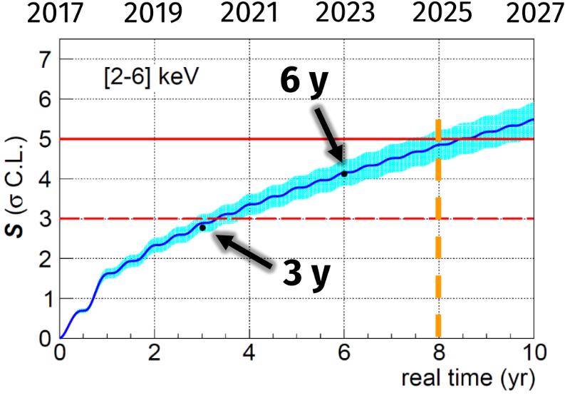
ANAIS-112: latest results
6 year analysis (using BDT filtering protocol)
Publication in preparation (internal reviewing)
We expect to achieve 5 σ sensitivity by the end of 2025 (8 years of data taking).
Open data available for independent analysis at Dark Matter Data Center $→$ 3 year annual modulation analysis and the reanalysis can be downloaded at:
https://www.origins-cluster.de/odsl/dark-matter-data-center/available-datasets/anais
6 year analysis will be included in the near future.

Slide 20
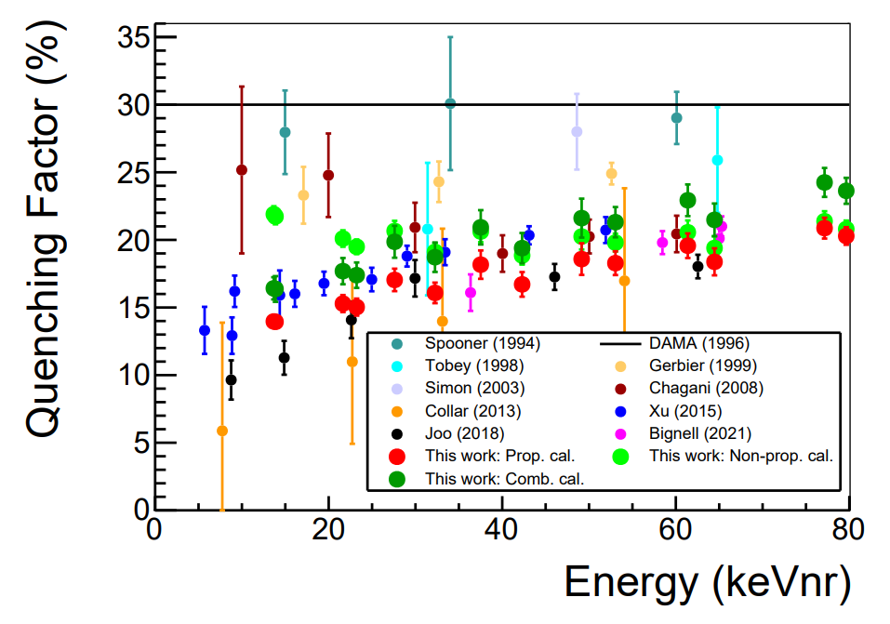
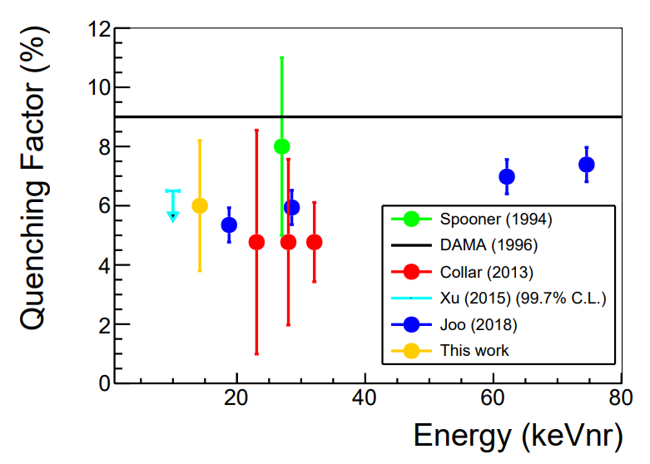
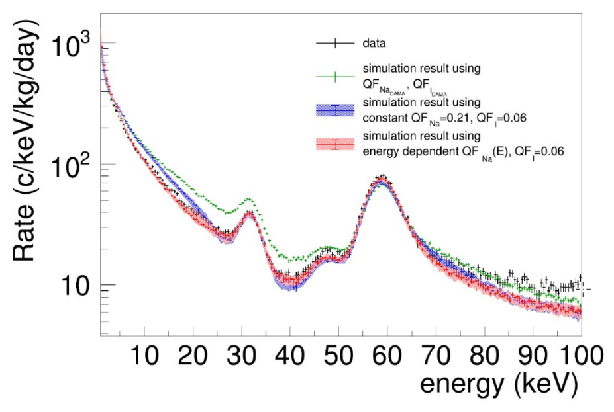
ANAIS-112: the QF systematic
Is ANAIS directly comparable with DAMA/LIBRA?
D. Cintas et al, Phys. Rev. C 110 (2024) 014613
$$QF_{Na}$$
$$QF_{I}$$
Calibration with electron recoils!
In a scintillator, the amount of light produced by a electron recoil (ER) is much larger tan a nuclear recoil (NR) of the same energy.
DM is expected to produce NR, therefore experiments must be compared in the NR-energy scale, which requires a precise knowledge of the QFs.
DAMA
DAMA
$$QF=\frac{L_{nr}}{L_{er}}$$
Energy dependent QF favoured by the studies made with ANAIS data.
Mean values obtained at TUNL:
$$Q_{Na}=\left(21.2±0.8\right)\%$$
$$QF_{I}=(6.0±2.2) \%$$
Values lower than the DAMA/LIBRA measurement.
QF determination for ANAIS−112 crystals ongoing following two approaches:
Direct measurements at TUNL (Duke University, US).
Comparing neutron calibration data taken in ANAIS-112 at LSC with 252Cf source with MC simulation.
T. Pardo et al., PoS(TAUP2023)078

Slide 21
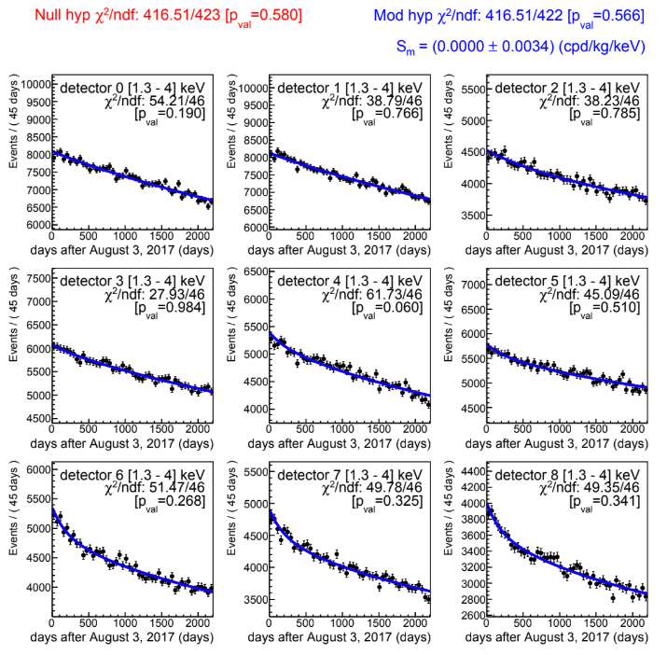
ANAIS-112: the QF systematic
6 year analysis (using BDT filtering protocol): background fit to event rate of the nine modules.
Considering for ANAIS the QF given by TUNL measurements
Corresponding energy range in ANAIS for nuclear recoils in the 2-6 keV range in DAMA/LIBRA.
[2-6] keV
[1.3-4] keV
Compatible results in both cases with the absence of modulation.
Publication in preparation (internal reviewing)

Slide 22
ANAIS-112: ongoing work
ANOD (Anais NO Dead time)
New parallel DAQ system in ANAIS-112 (CAEN DT5730).
Bigger digitization window: 1.25 µs → 8 µs.
For the moment, we have been reading only 4 modules (8 channels) → we expect to improve the identification of anomalous scintillation events and then, increase our sensitivity.
A new digitizer with 32 channels (CAEN VX2730) that will allow us to digitize the full detector (9 modules) and the blank module has been installed yesterday.
Pulse shape parameters
$$P1=\frac{\sum_{100 ns}^{600 ns}{A_{i}}}{\sum_{0 ns}^{600 ns}{A_{i}}}$$
Scintillation
+
Assymetric noise events
Scintillation
$$μ_{p}=\frac{\sum_{p}{A_{p}·t_{p}}}{\sum_{p}{A_{p}}}$$
Assymetric noise events

Slide 23
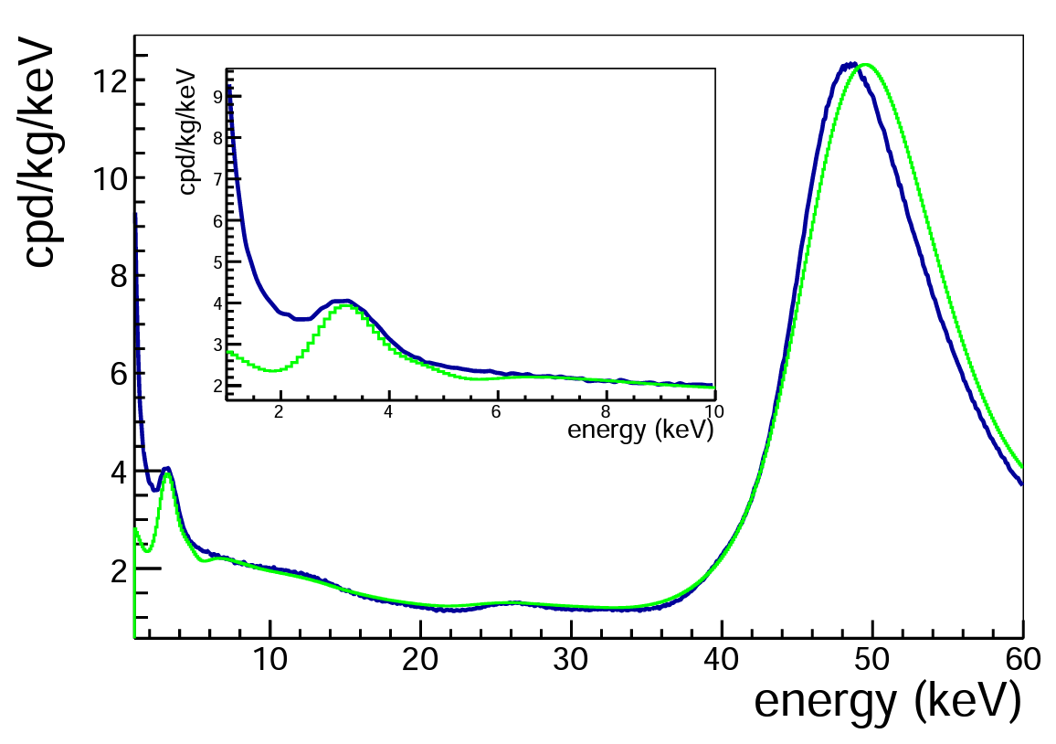
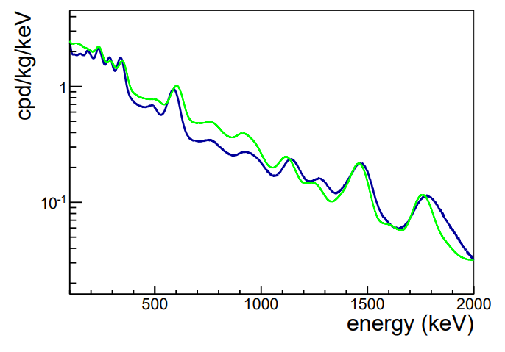
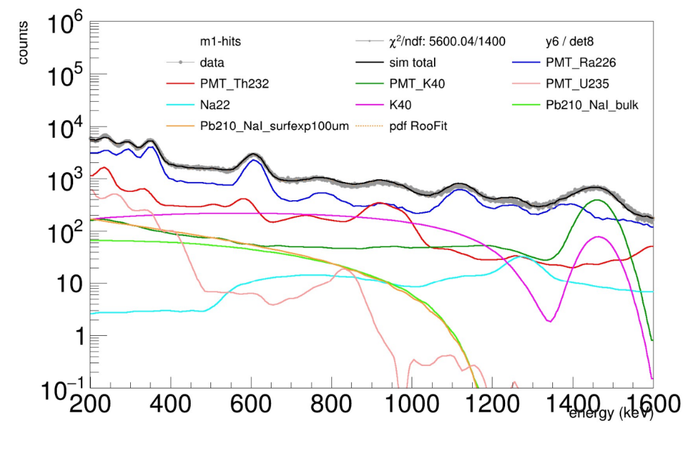
ANAIS-112: ongoing work
J. Amaré et al, Phys. Rev. D 103 (2021) 102005
Improving the background model
Having a good model of the background of the experiment is a key point in the analysis of the modulation signal.
First background model based on MC simulations using Geant4.
No data fit
ANAIS-112 data
Bkg model
Updated background model:
Extended geometry and more detailed description of PMTs.
Multiparametric fit using RooFit considering different simulated contributions from all sources (9 crystals + 18 PMTs + other components.)

Slide 24
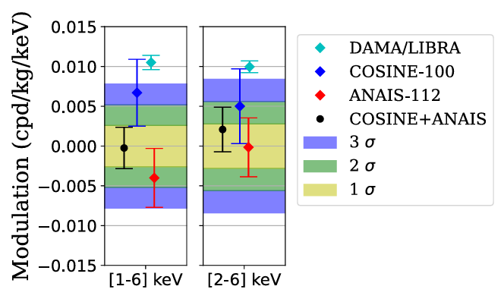
ANAIS-112: ongoing work
Combined ANAIS + COSINE 3 year
ANAIS-112 and COSINE-100 are compatible NaI(Tl) experiments trying to solve the DAMA/LIBRA puzzle.
Separate treatment of experiment backgrounds allows for direct combination of residuals.
Combined annual modulation search provides 3σ sensitivity to DAMA for 3-years data
Publication in preparation
S.Hollick, @IDM2024

Slide 25
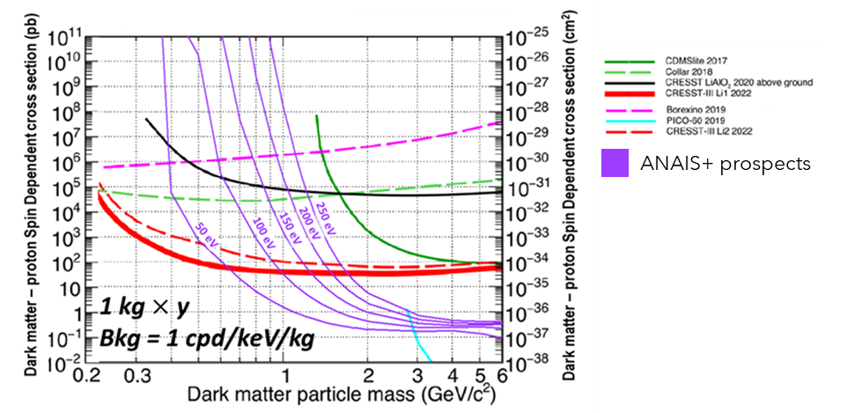
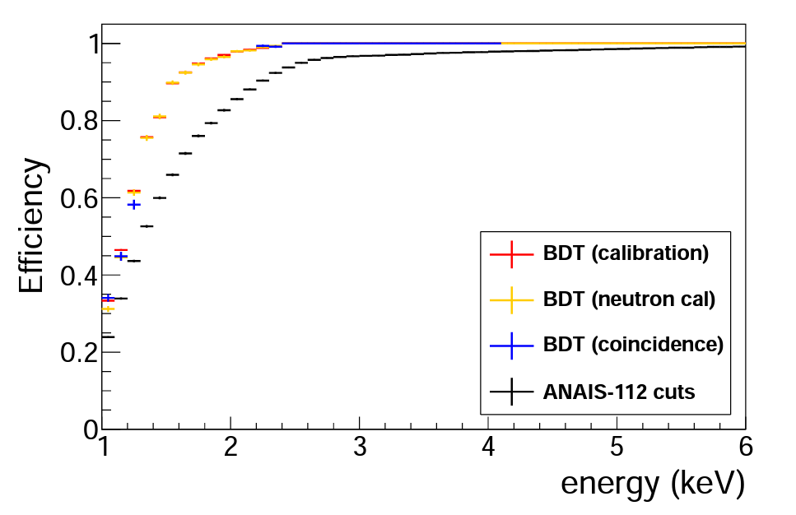
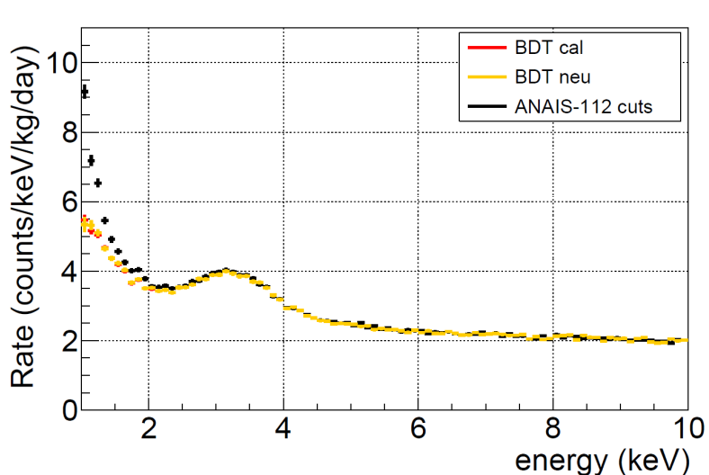
ANAIS-112: ongoing work
ANAIS+
MAIN GOAL
Lower the energy threshold Eth <0.5 keV in NaI detectors
At present ANAIS-112 sensitivity is constrained by anomalous light events attributed to the PMTs:
They are dominating the events rate below 10 keV.
Aggressive filtering has been developed to remove them, but efficiency is low (even after improvements by new ML procedure) and limits the energy threshold.
Testing DAMA/LIBRA result overcoming the systematics from the uncertainties in the scintillation quenching factors.
Good sensitivity to light WIMPs even with a reasonable exposure and background level.
Also interesting for neutrino detection via coherent elastic neutrino-nucleus scatterings (CE$ν$NS).
Measured spectrum
Spectrum after event selection
Energy threshold limited to 1 keV.
Sensitivity projections of ANAIS+ for spin dependent proton WIMP interaction considering different energy thresholds and a background level of 1 cpd/keV/kg.
I. Coarasa et al JCAP11(2022)048

Slide 26
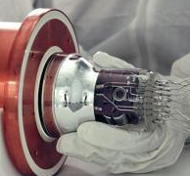
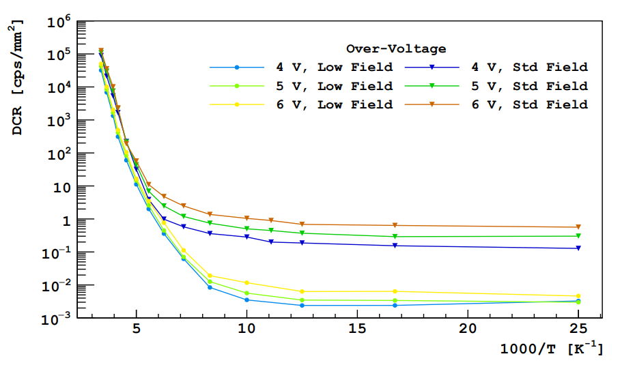
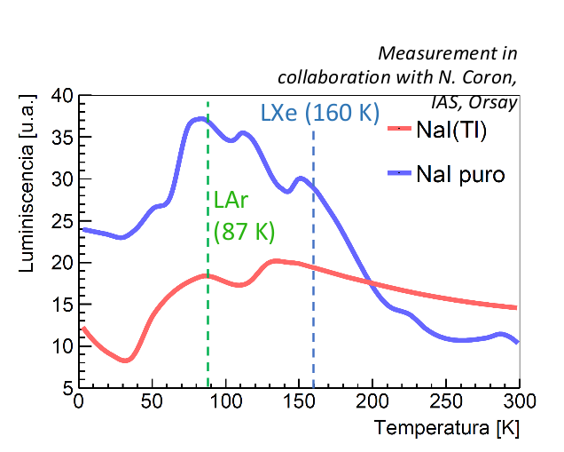
The ANAIS+ Project: Collaboration between Universidad de Zaragoza - CIEMAT - LNGS
How can we reduce the Eth?
ADVANTAGES
High QE (≈40 %).
High radiopurity (lower bkg).
Low operating voltage ($\sim$ 10’s V).
No Cherenkov/HV arc-discharges emissions.
MAIN DRAWBACK
High dark current rate (depending on the model, typically $\sim$ 50 - 1000 kHz/mm² at room T).
Working at low temperatures (100 K) → lower dark current than in PMTs.
Replacement of PMT by SiPMs for the light detection
5 – 6 orders of magnitude reduction at 100 K
At this temperature, pure NaI become an interesting target as its light yield is expected to increase at the level or above the NaI(Tl) at room T.
F. Acerbi et al., IEEE Transactions on Electron Devices, vol. 64, no. 2, pp. 521-526, Feb. 2017

Slide 27
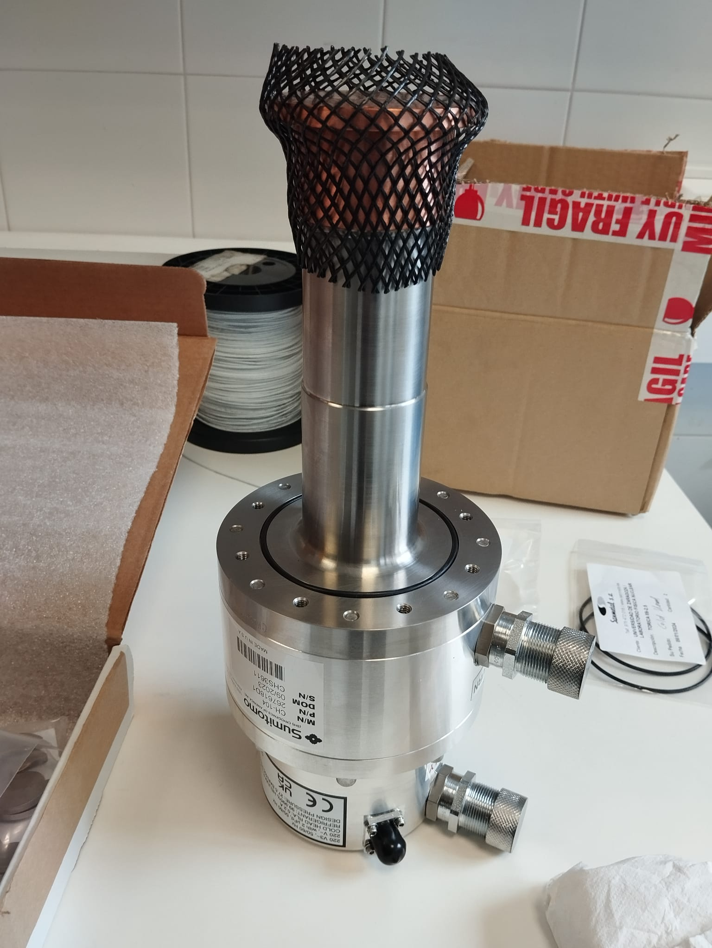
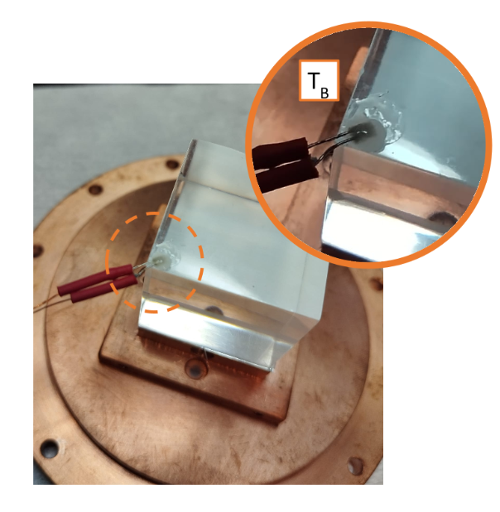
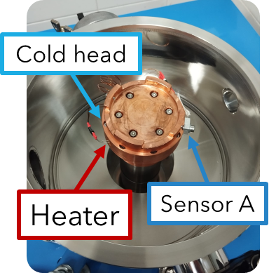
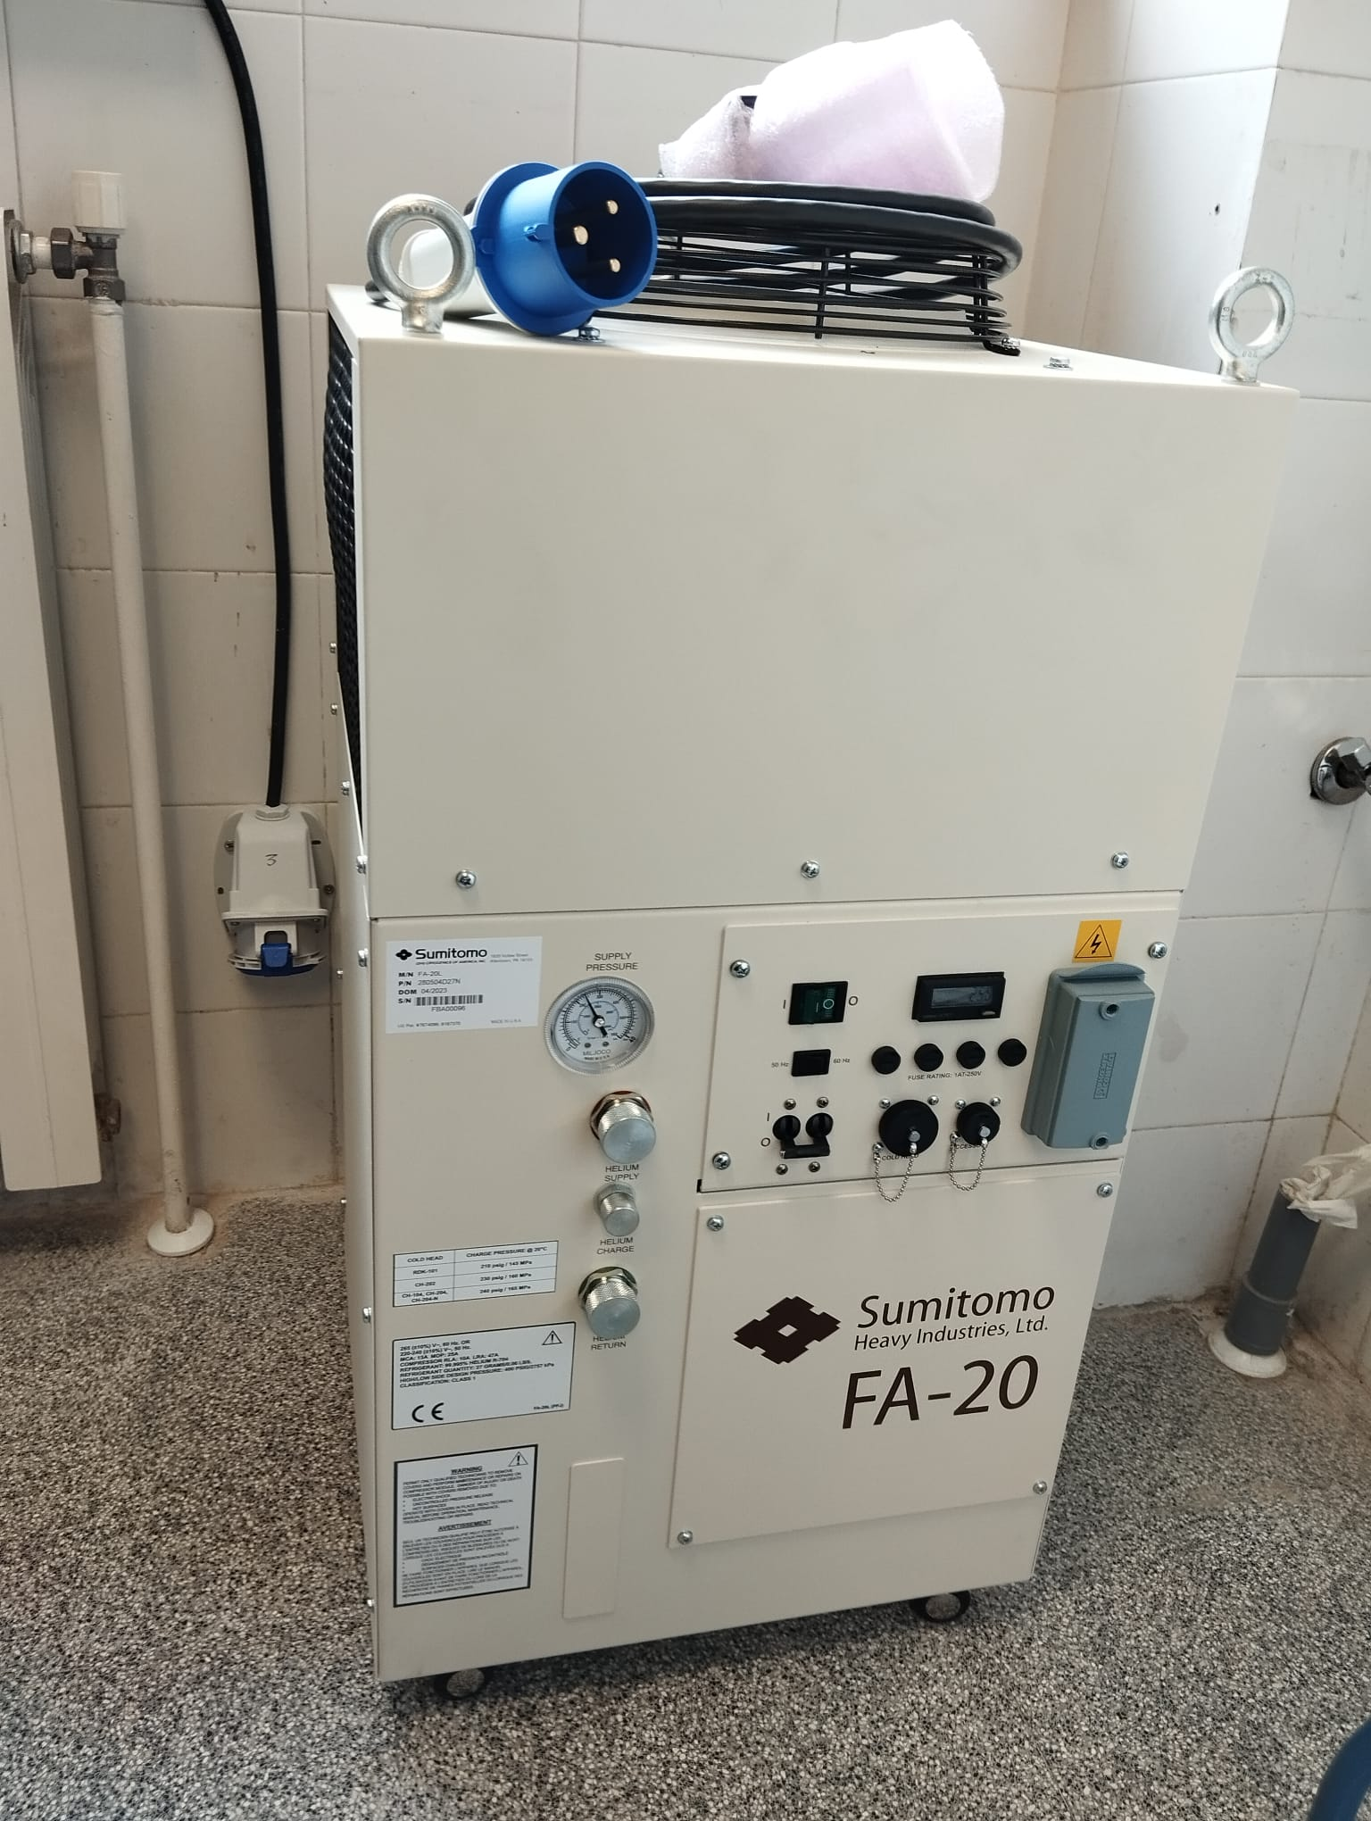
The ANAIS+ Project: Collaboration between Universidad de Zaragoza - CIEMAT - LNGS
Cryogenic installation
Two PT-100 temperature sensors: A (next to cold head), B (inside the detector, in contact with the NaI crystal).
Sensor A is used to set a constant temperature thanks to the controlled heater output.
It is also possible to control the cooling rate, which is important to avoid damages in the NaI crystals.
Cryocooler + He Compressor
Capability to reach T<30 K.
Sensor B
Dry cryostat

Slide 28
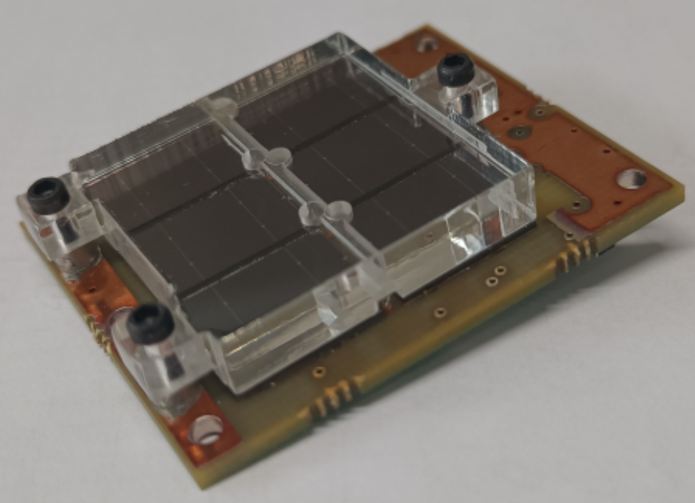
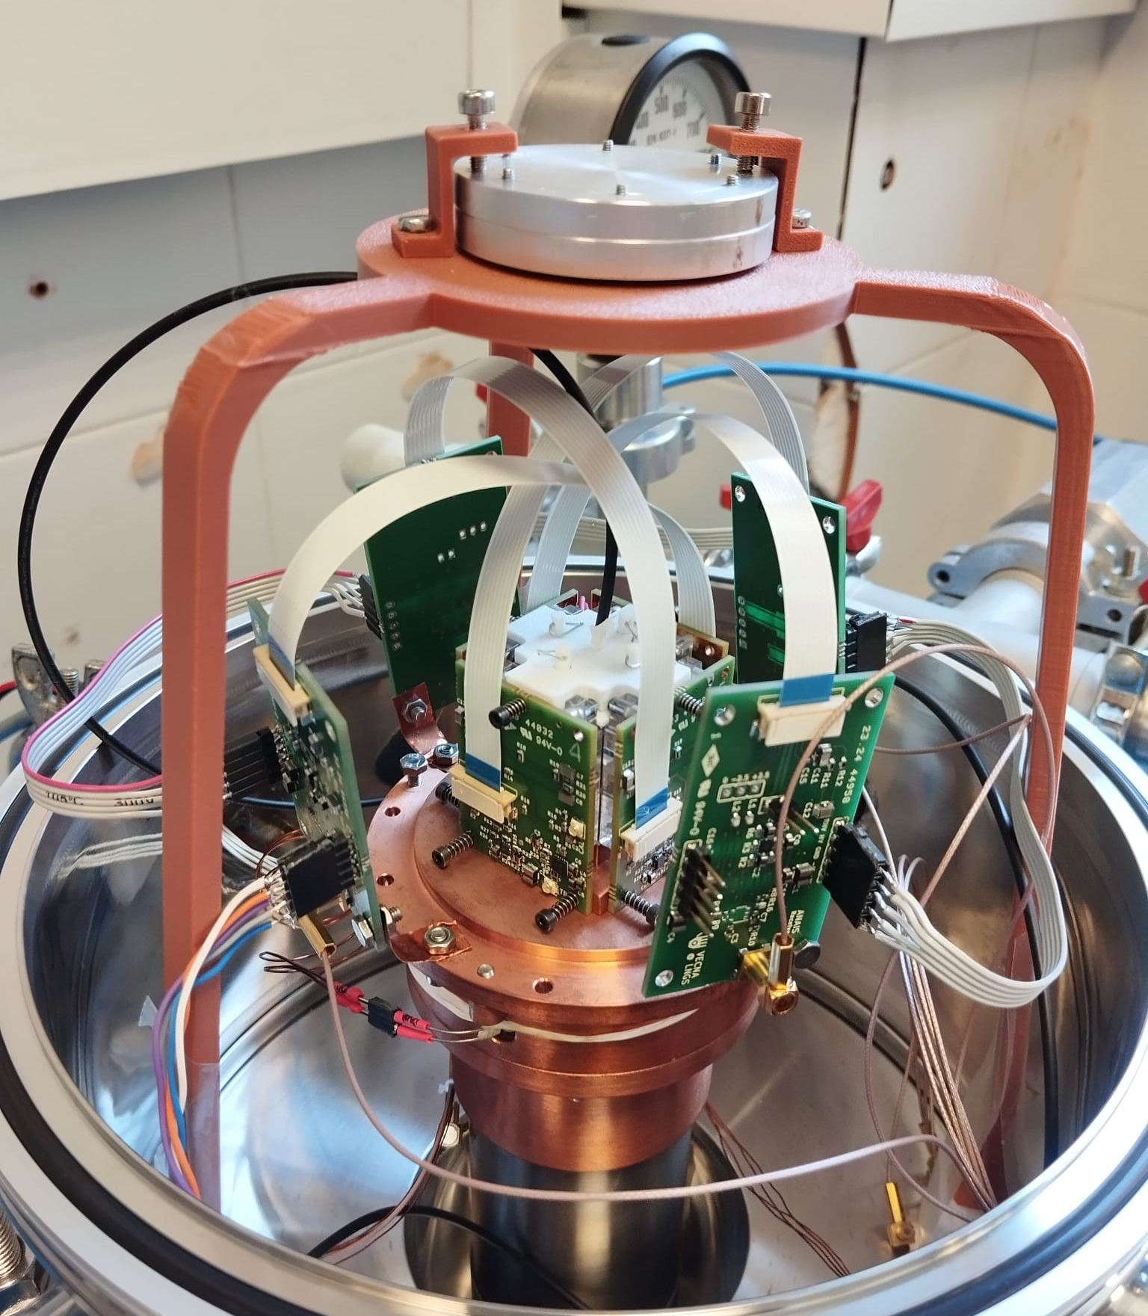
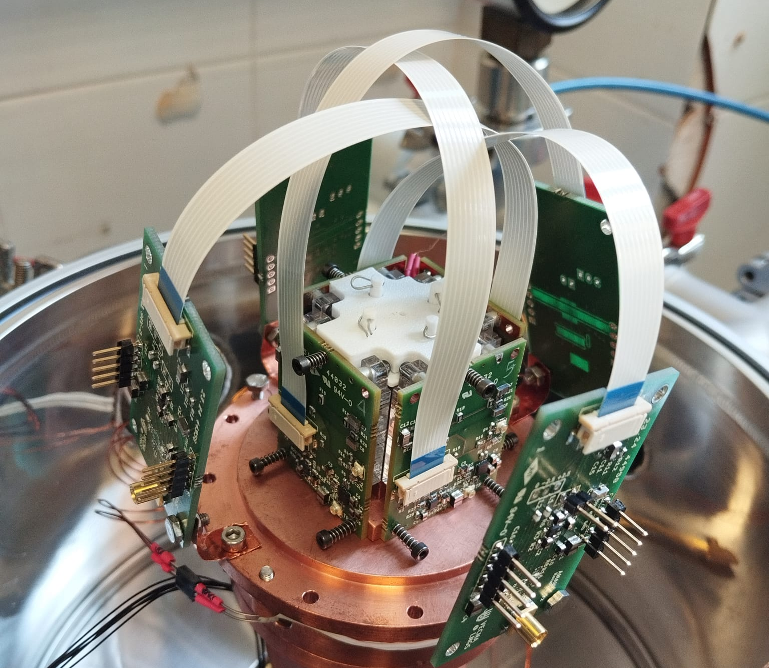
The ANAIS+ Project: Collaboration between Universidad de Zaragoza - CIEMAT - LNGS
ANAIS+: ^{tiny}OCTOPUS
SiPMs + electronics designed and produced at LNGS (A.Razeto and I.Kochanek)
CsI(Tl) crystal (not hygroscopic)
Receiver boards to extract the SiPMs signal

Slide 29
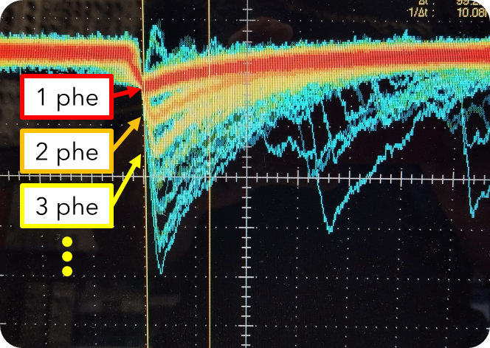
The ANAIS+ Project: Collaboration between Universidad de Zaragoza - CIEMAT - LNGS
ANAIS+: ^{tiny}OCTOPUS
Single photoelectron response: signal calibrated using a LED injected via optical fiber.
Radioactive sources: Ba-133 and Cs-137
Increase of LC for higher Vov.
Important decreases of LC for CsI(Tl) at lower temperatures (as observed for the NaI(Tl)).

Slide 30
The ANAIS+ Project: Collaboration between Universidad de Zaragoza - CIEMAT - LNGS
ANAIS+: ^{tiny}OCTOPUS
Single photoelectron response: signal calibrated using a LED injected via optical fiber.
Radioactive sources: Ba-133 and Cs-137
Increase of LC for higher Vov.
Important decreases of LC for CsI(Tl) at lower temperatures (as observed for the NaI(Tl)).

Slide 31
The ANAIS+ Project: Collaboration between Universidad de Zaragoza - CIEMAT - LNGS
ANAIS+: ^{tiny}OCTOPUS
Production of a Cu case to hold NaI crystals
Studies on the use of PEN for wavelength shifting
Testing the ANAIS+ prototype in a liquid Ar tank (in collaboration with CIEMAT):
Acting as thermal bath for stabilizing the temperature.
Enabling the operation inside a 4$π$ active veto.
Collaborating in the production of high radiopurity NaI crystals to minimize internal background contributions (⁴⁰K, ²¹⁰Pb).

Slide 32
Summary
• ANAIS-112 is an experiment conceived to study and establish a model independent comparison with the positive signal on annual modulation given by DAMA/LIBRA. It started the data taking in 2017 at the Underground Laboratory of Canfranc and has worked smoothly since then.
• The analysis of 3-year of data has been carried out introducing a machine-learning technique to improve the event classification. No modulation is observed, discarding DAMA/LIBRA result with $≈3 σ$ sensitivity.
• The latest results, analysing 6-year of data, are consistent with previous results, being incompatible with DAMA/LIBRA at $≈4 σ$ sensitivity. We expect to reach $5 σ$ at the end of 2025.
• These results are leading the DAMA/LIBRA test, but they are affected by an important systematic, the scintillating QF of NaI(Tl).
• Multiple lines of work are ongoing:
Studies on the QF of the detector.
Improvements on the background model.
Use of a new parallel DAQ that allows us to better identify noise events via Pulse Shape Discrimination.
Collaboration with COSINE experiment for data combination.
We are working in the R&D project ANAIS+, with first prototypes in development, that could increase the sensitivity of NaI experiments and allow the exploration of new regions of the WIMP sector and other interesting process.

Slide 33
Merry Christmas!

