Slide 1
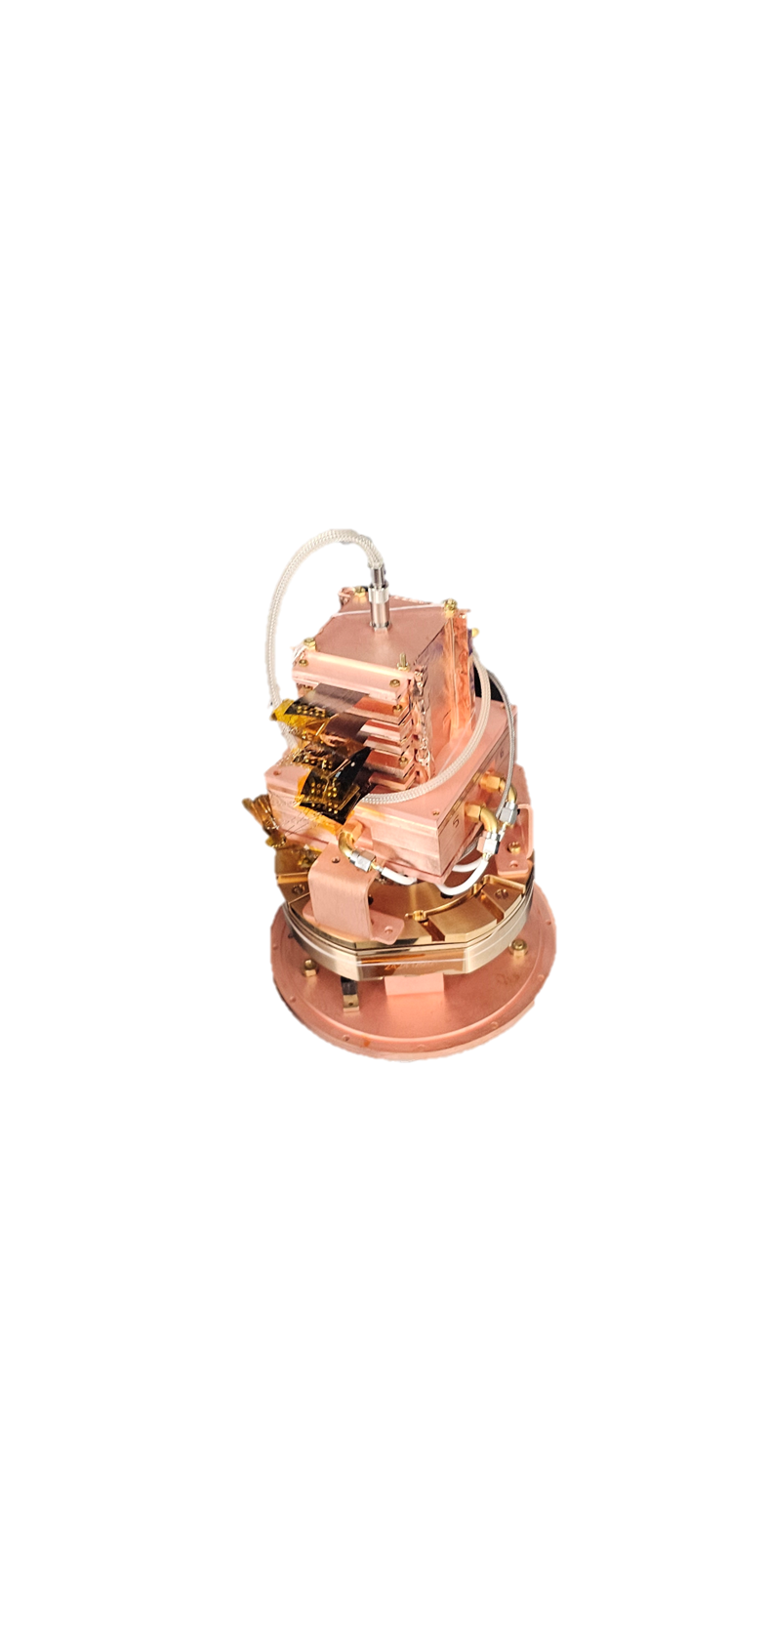
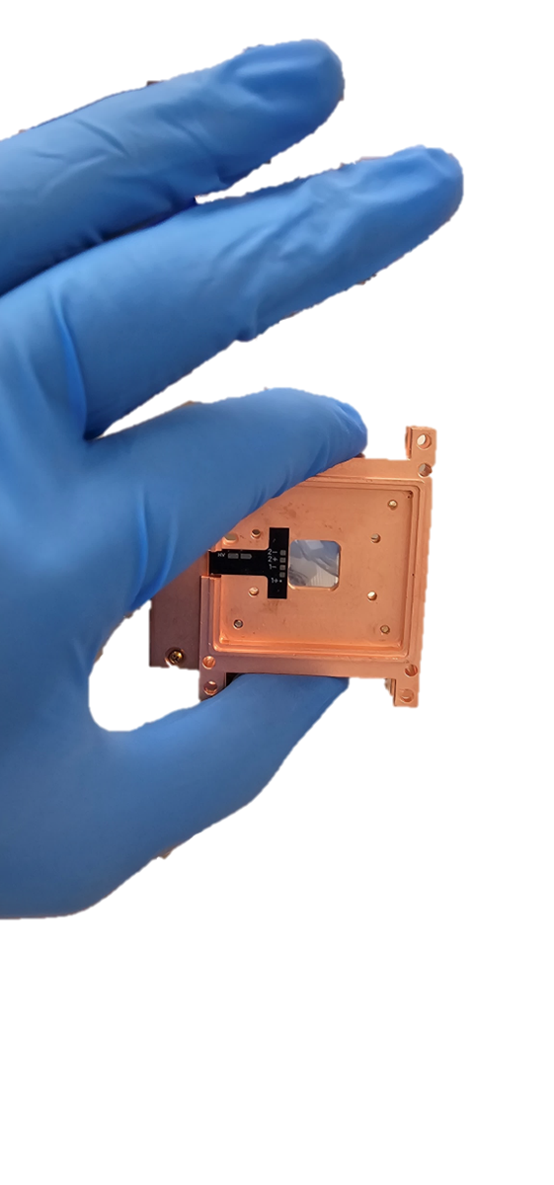

Technology Advances in the SuperCDMS HVeV Program
Position Dependent Calibration and Carbon Based Substrates
Aviv Simchony

Slide 2

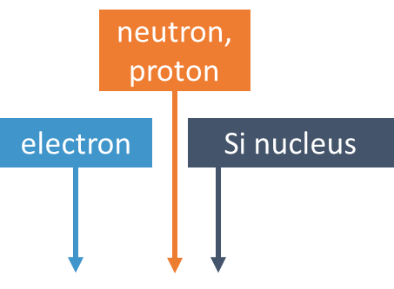
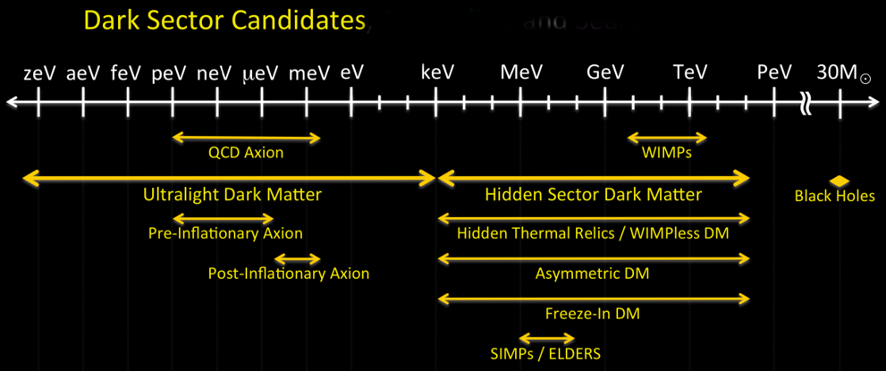
Highlights of HVeV Science
Direct detection of hidden sector dark matter candidates requires pushing the boundaries of energy resolution
HVeV-R4 has set competitive limits in the subGeV mass range
Small scale R&D versions of these detectors allow rapid prototyping and pave the way for higher sensitivity searches
We have Run 5 results! See Kyle Kennards talk tomorrow at 16:00 for first unveiling
Preliminary

Slide 3
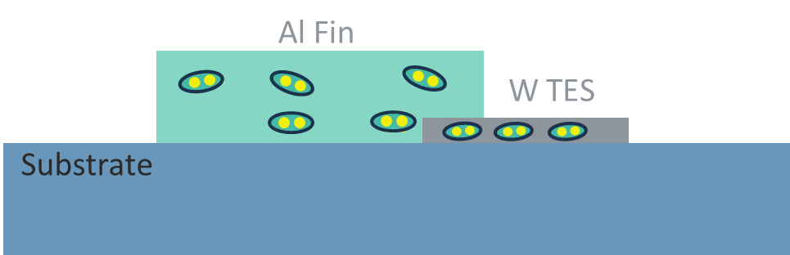

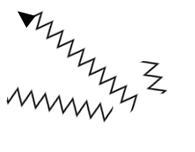



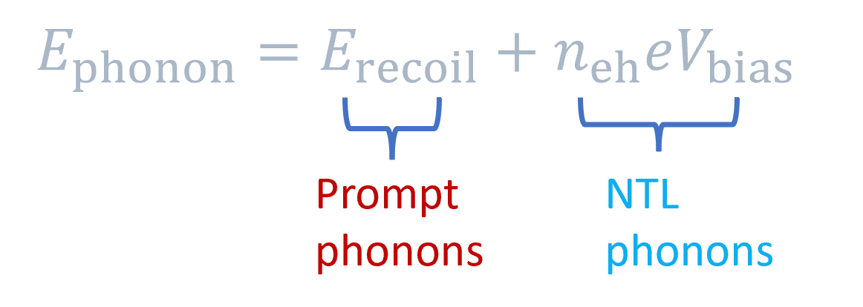
Operating Principle
When a particle scatters off the substrate, it can trigger an ionization event or generate athermal phonons. The resulting electron-hole pairs are accelerated by the applied electric field, producing additional phonons via the Neganov-Trofimov-Luke (NTL) effect
-
+

Slide 4

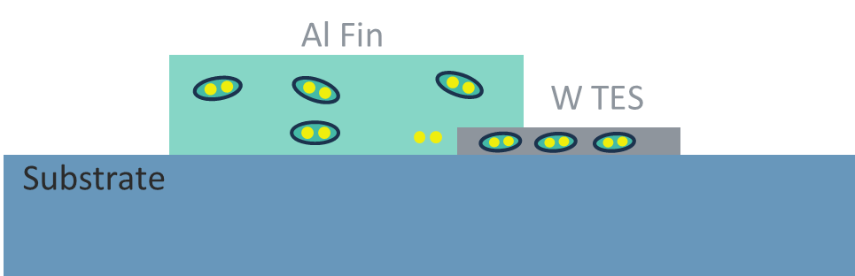
Operating Principle
When a particle scatters off the substrate, it can trigger an ionization event or generate athermal phonons. The resulting electron-hole pairs are accelerated by the applied electric field, producing additional phonons via the Neganov-Trofimov-Luke (NTL) effect
Generated phonons are absorbed by the Al fin, which breaks Cooper pairs to form Bogoliubov quasiparticles

Slide 5
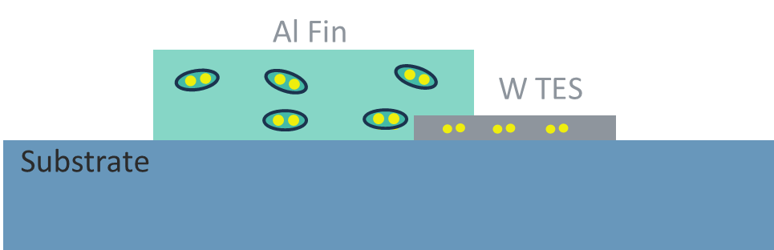
Operating Principle
When a particle scatters off the substrate, it can trigger an ionization event or generate athermal phonons. The resulting electron-hole pairs are accelerated by the applied electric field, producing additional phonons via the Neganov-Trofimov-Luke (NTL) effect
Generated phonons are absorbed by the Al fin, which breaks Cooper pairs to form Bogoliubov quasiparticles
Quasiparticles travel to the W TES, where they are downconverted into lower energy quasiparticles due to the lower gap - trapping them

Slide 6
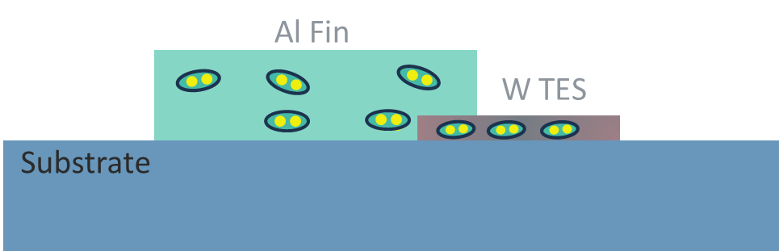

Operating Principle
When a particle scatters off the substrate, it can trigger an ionization event or generate athermal phonons. The resulting electron-hole pairs are accelerated by the applied electric field, producing additional phonons via the Neganov-Trofimov-Luke (NTL) effect
Generated phonons are absorbed by the Al fin, which breaks Cooper pairs to form Bogoliubov quasiparticles
Quasiparticles travel to the W TES, where they are downconverted into lower energy quasiparticles due to the lower gap - trapping them
Cooper pairs recombine, heating the TES and producing a pulse

Slide 7

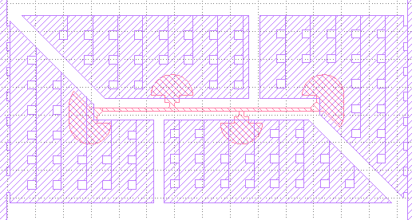
HVeV Detector Design
Two channels of parallel QETs with similar TES volumes
Al backside grid to allow high voltage biasing
inner channel
outer channel

Slide 8
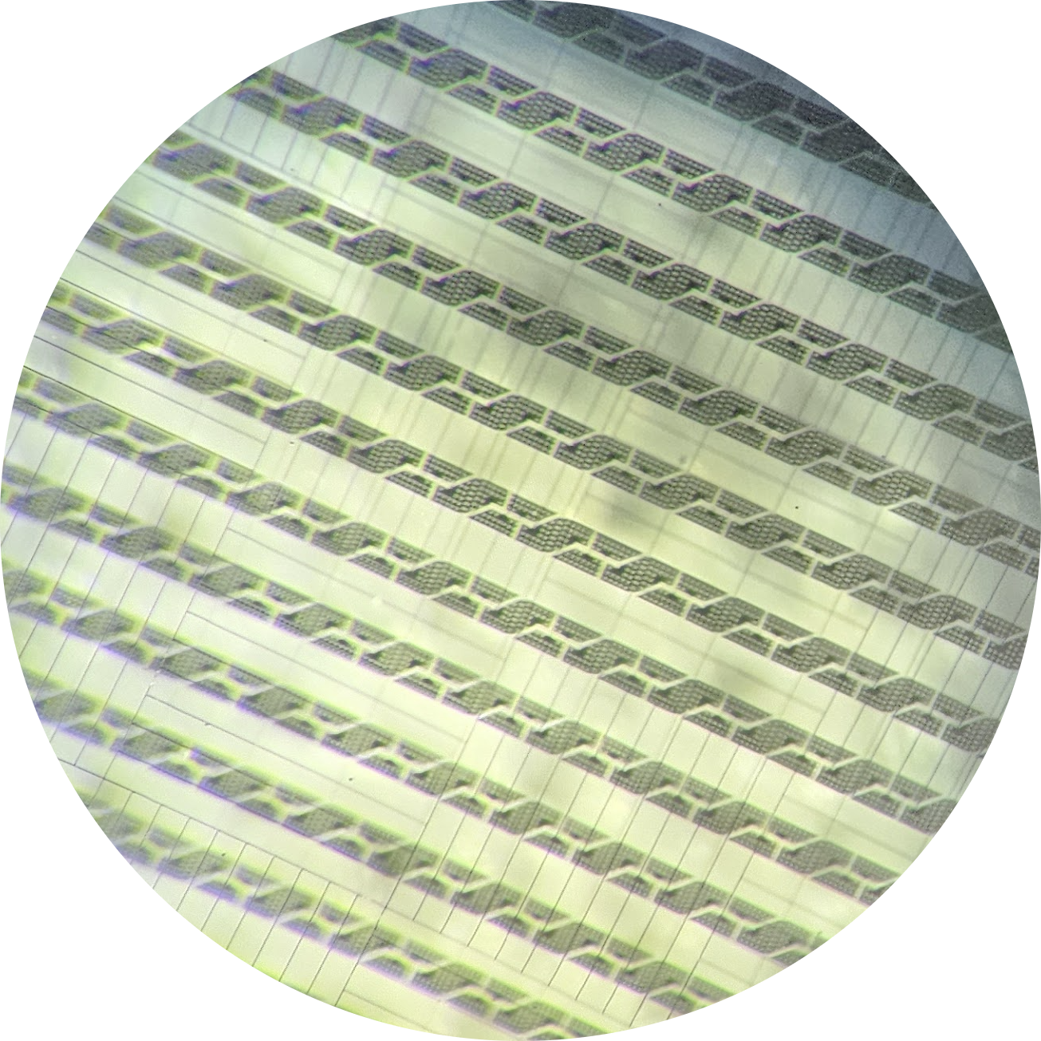
Fabrication Process
Double sided fabrication process with 30 nm Al backgrid for HV biasing
40nm W tuned to 35-65mK Tc sputtered and TESs patterned using maskless photolithography and dry etch
600nm Al sputtered and patterned with a combo wet-dry etch
Typically this has been done on 4” and 2” wafers, however all steps have been tested individually on chip scale. Integration remains a challenge

Slide 9
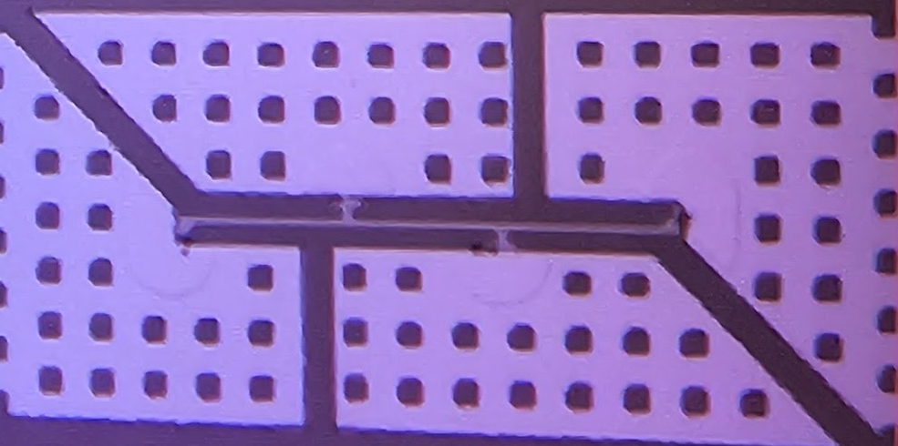
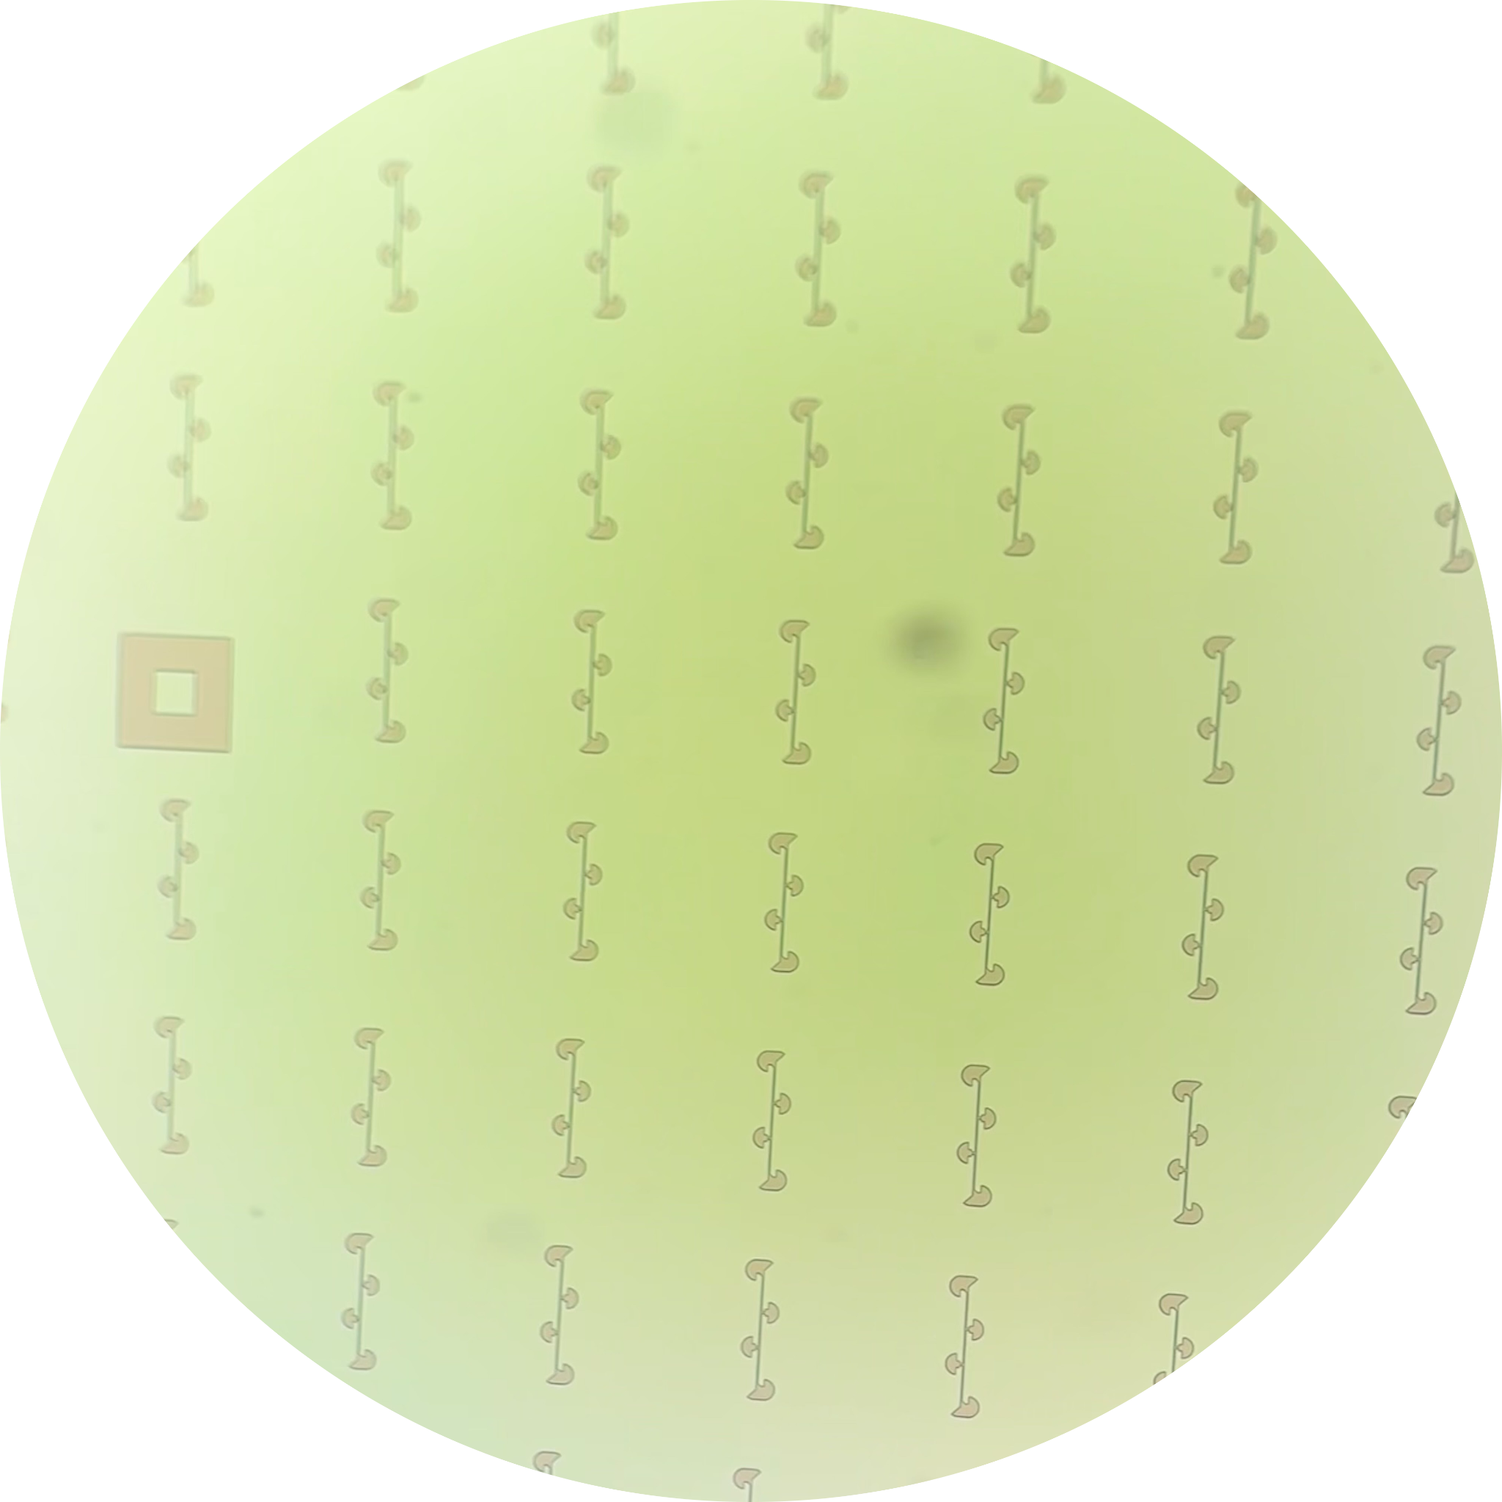
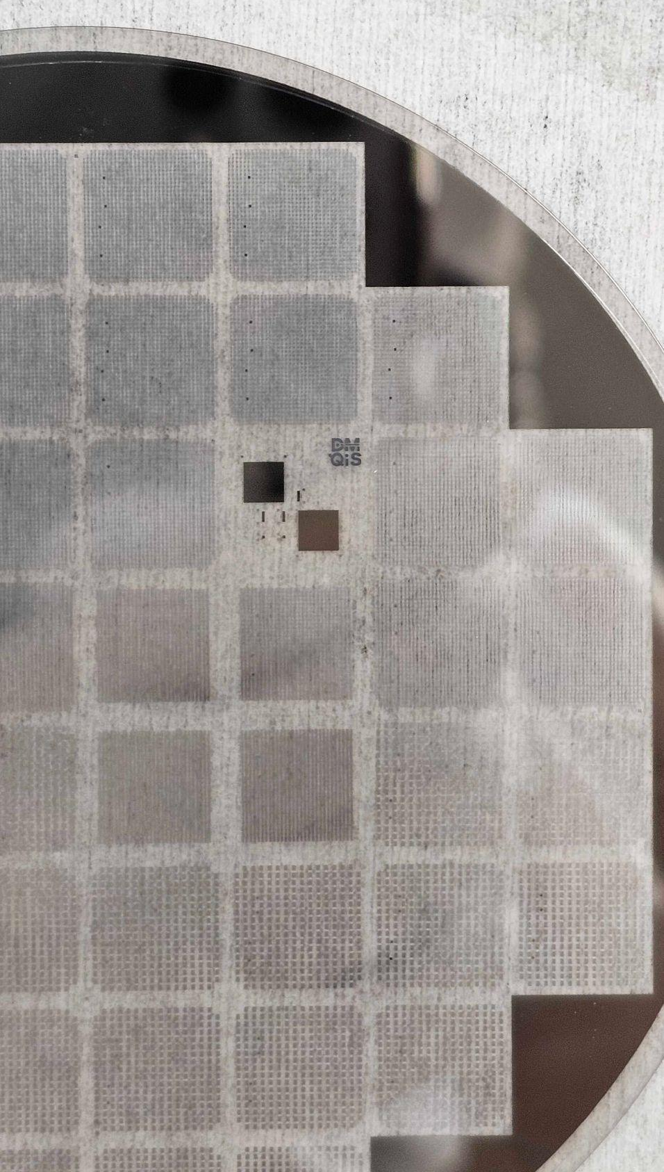
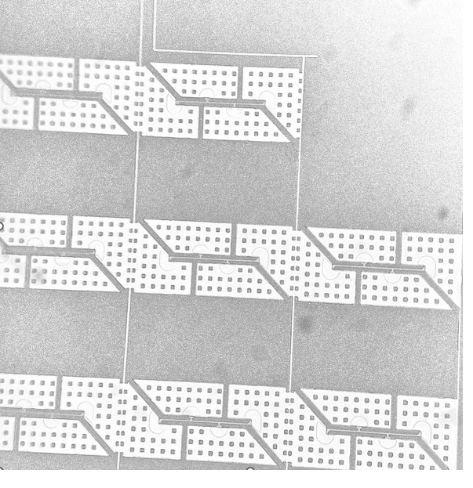
Fabrication Process

Slide 10
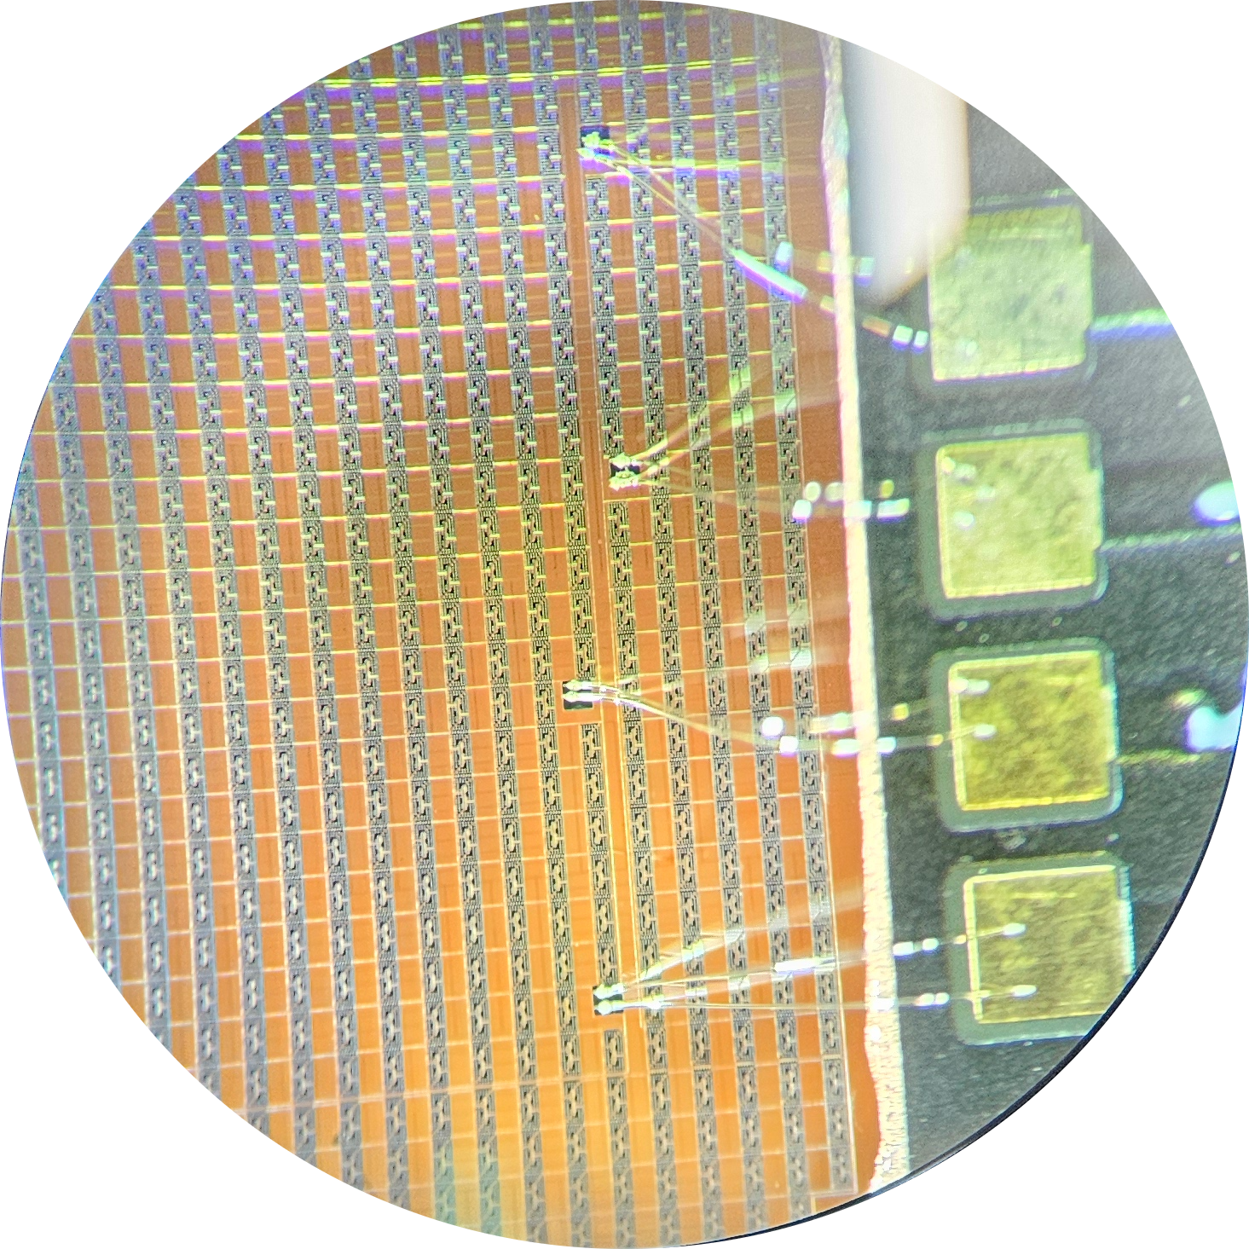
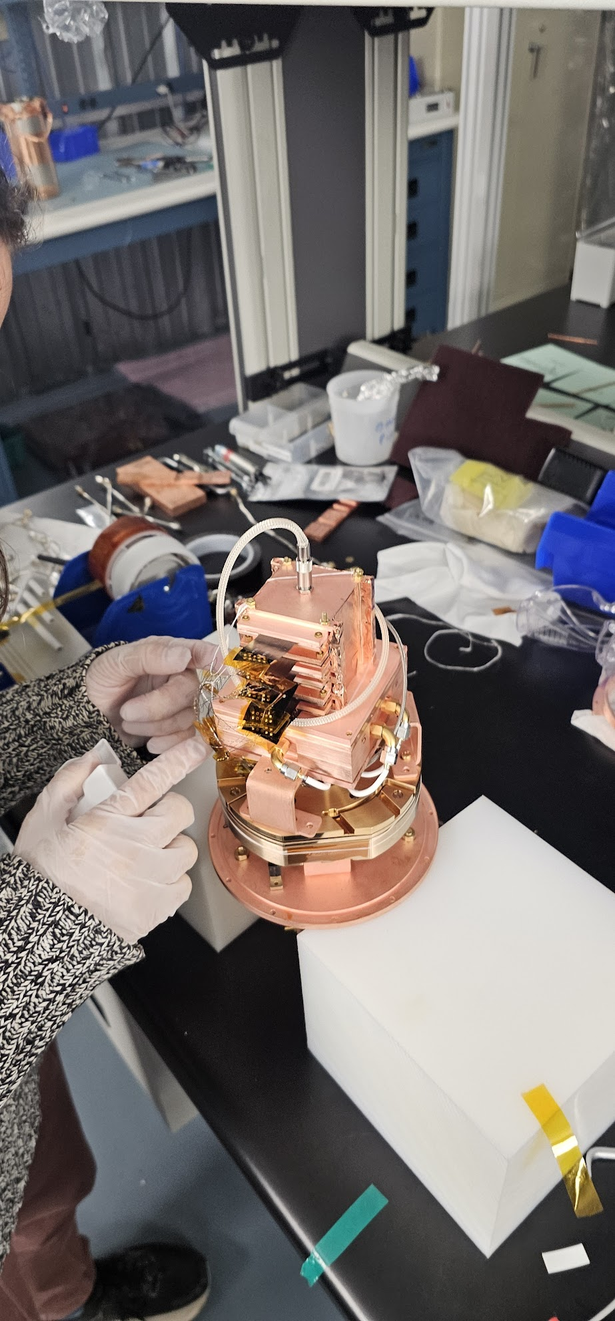
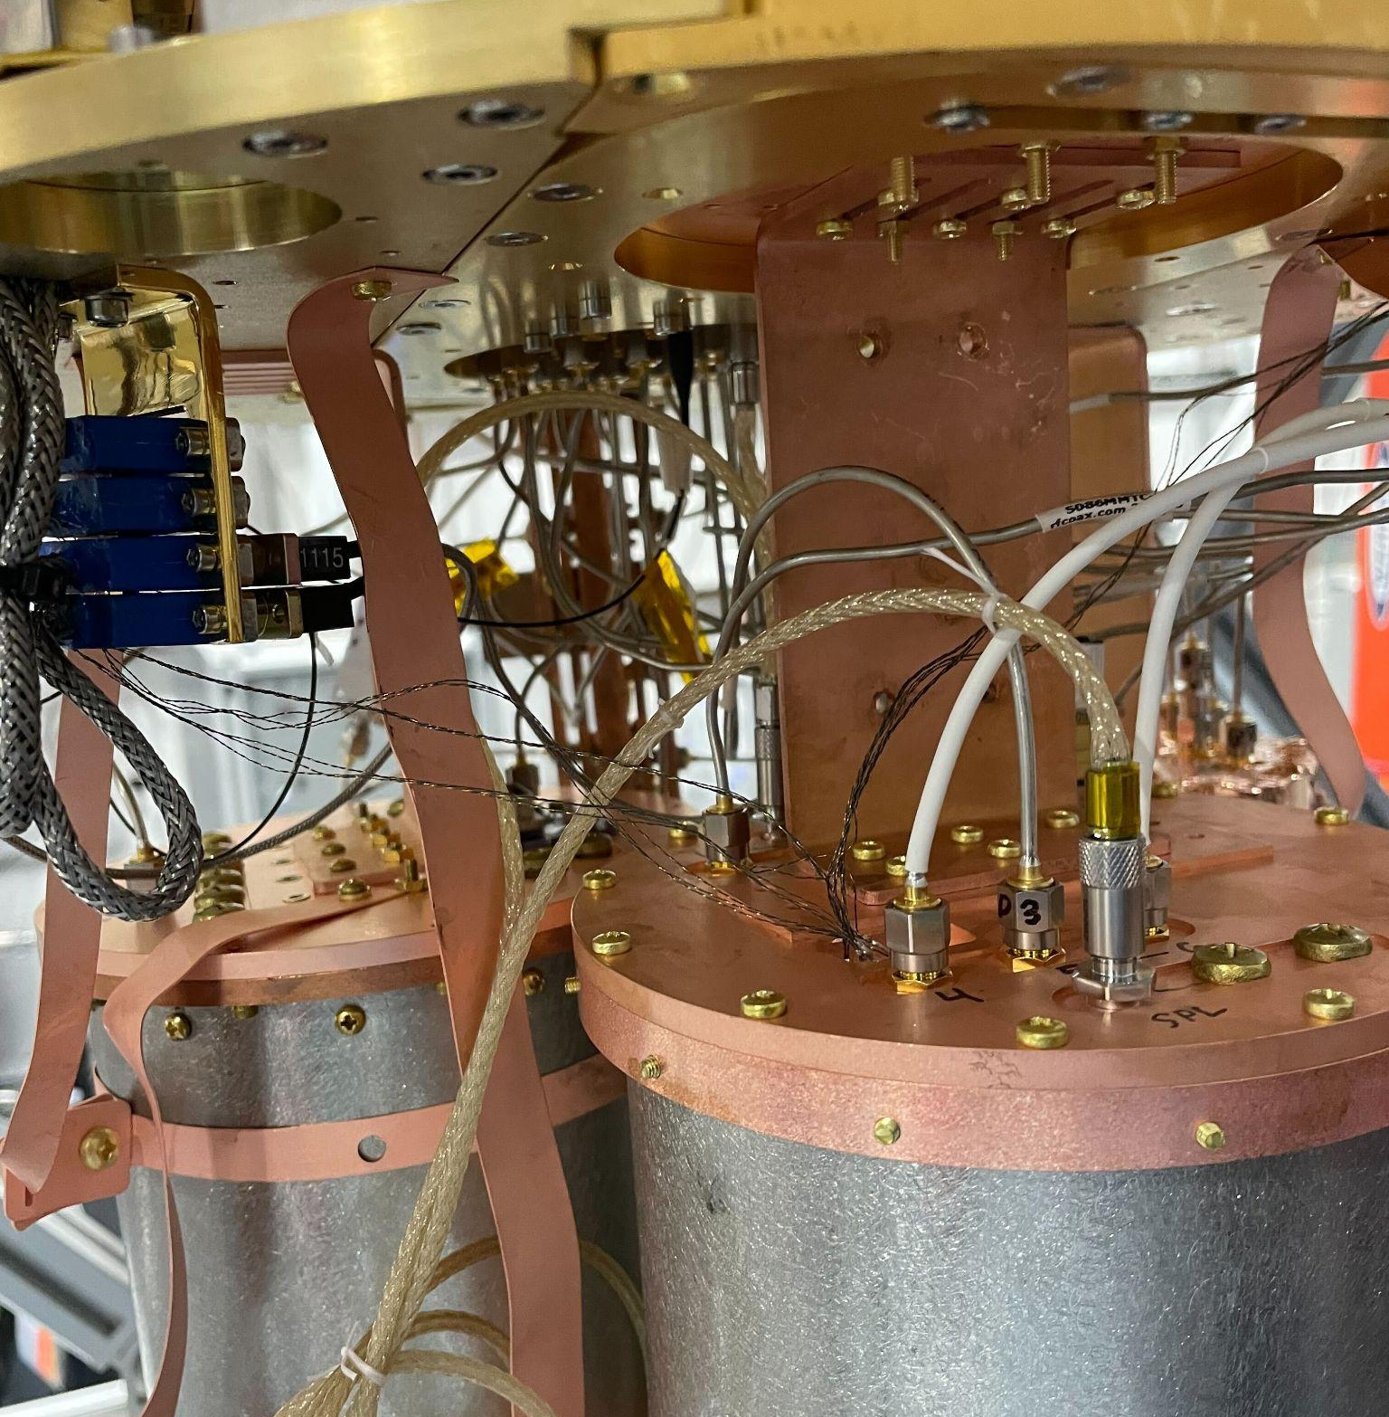
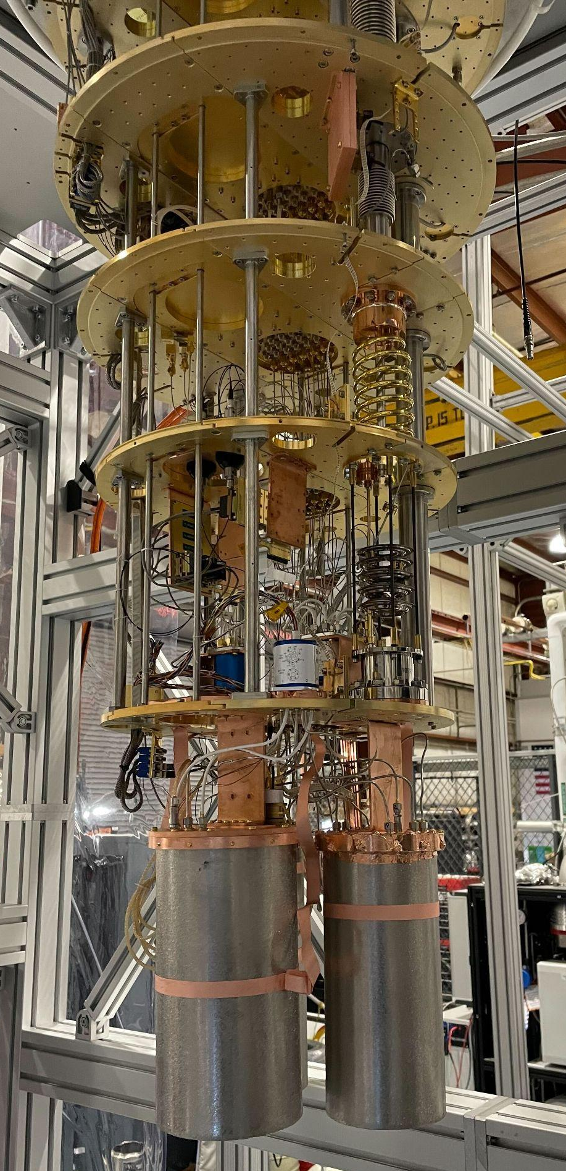
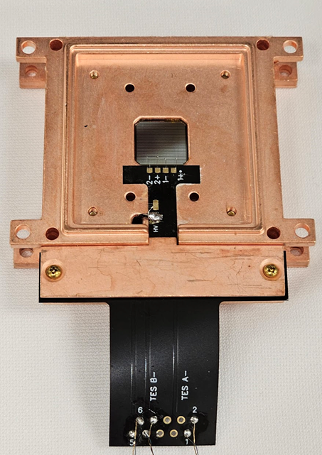
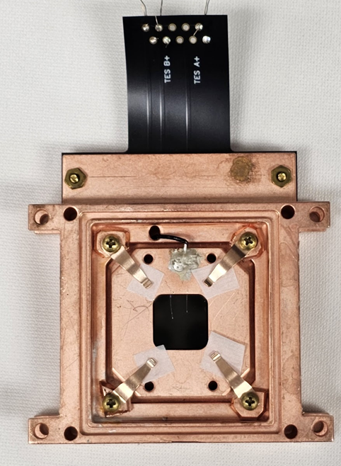
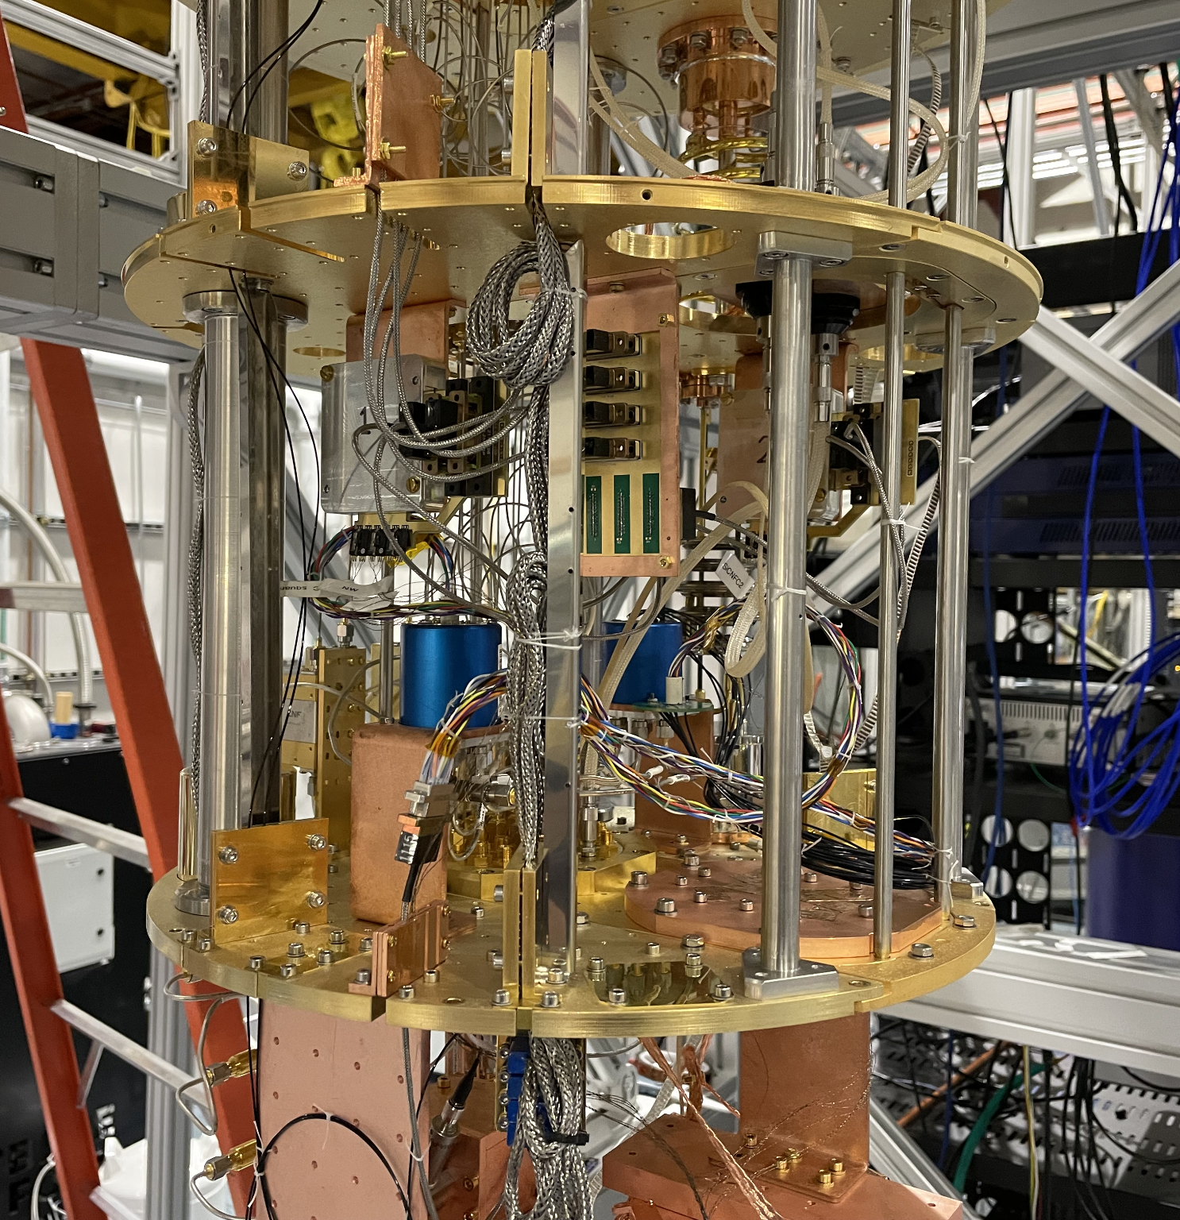
Measurement Setup
s

Slide 11
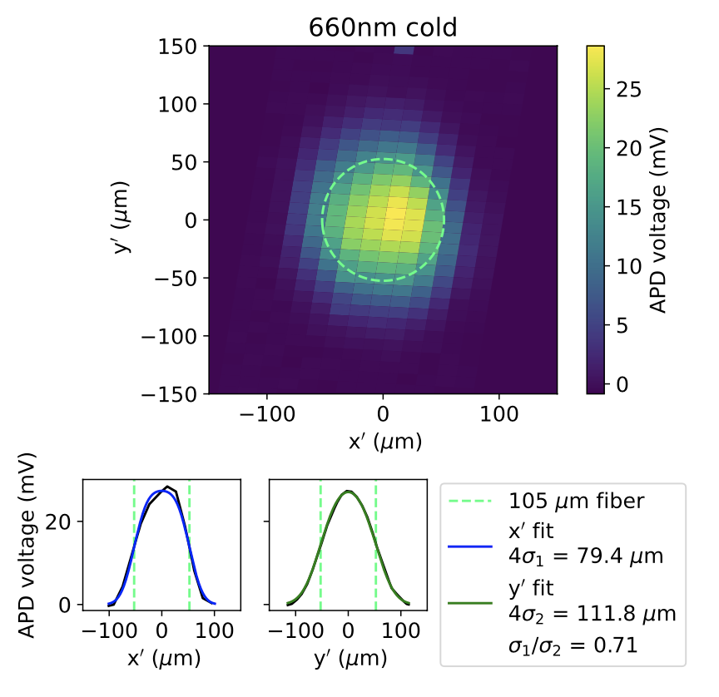
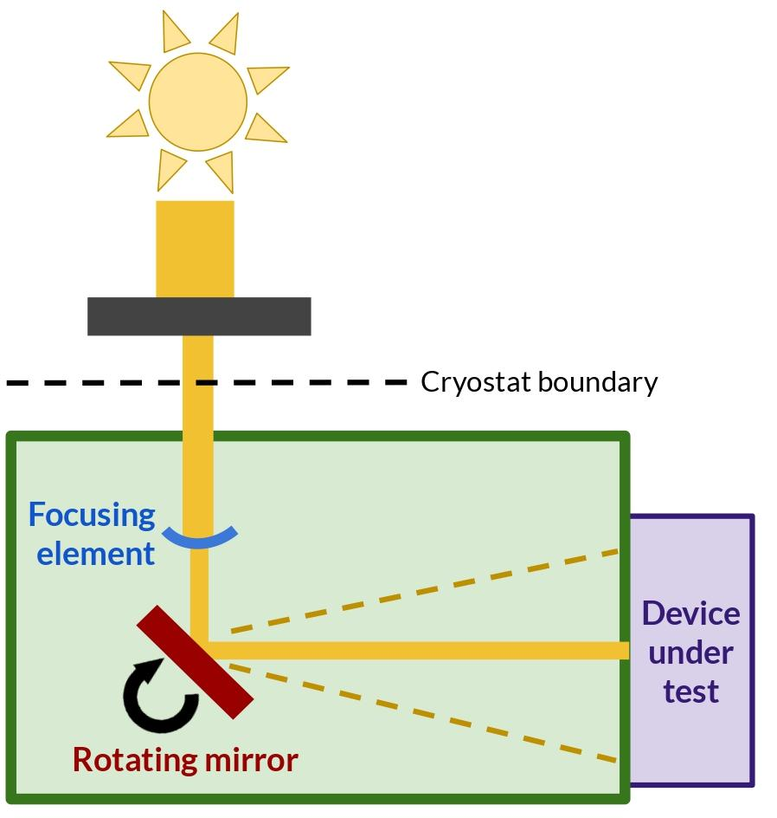

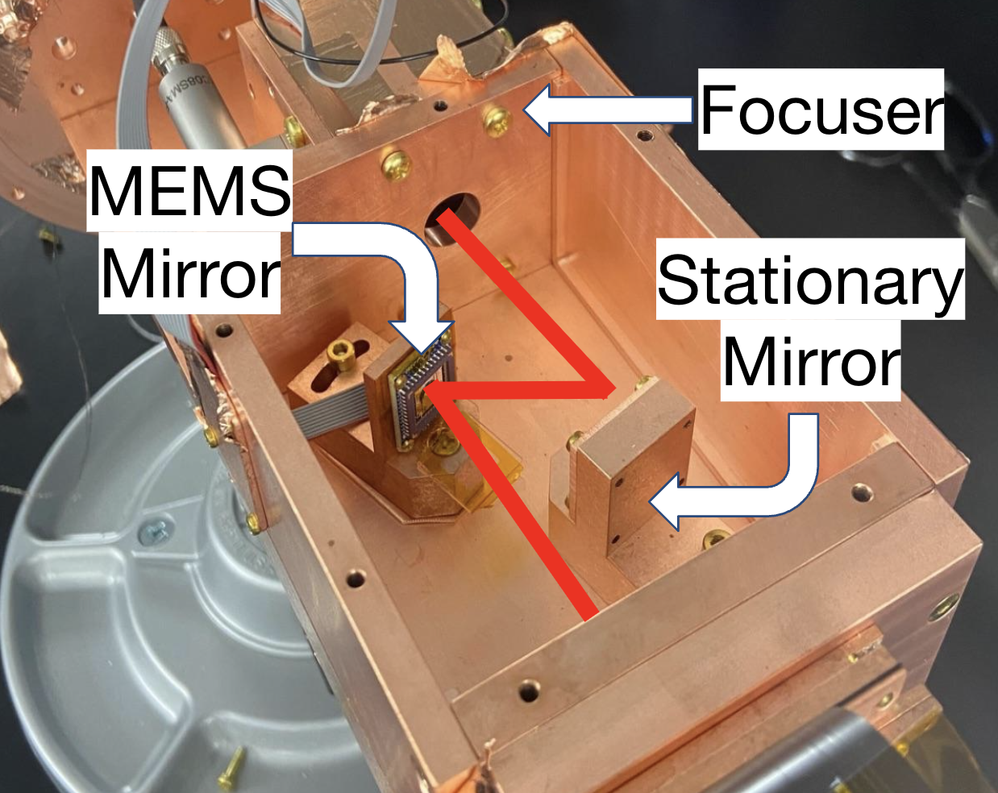
MEMS v.2 system
Micro-electro-mechanical system (MEMS) mirror-based calibration system
Compact cryogenic optical beam steering
At 10 mK:
~100 μm spot size
~4.5 μs pulse width
3 cm x 3 cm scan range
1.2 - 4.5 eV photon energy
near 0 power dissipation
Ref: N. Tabassum et. al, “Broadband Optical Modulation and Control at Millikelvin Temperatures”, 2025.

Slide 12
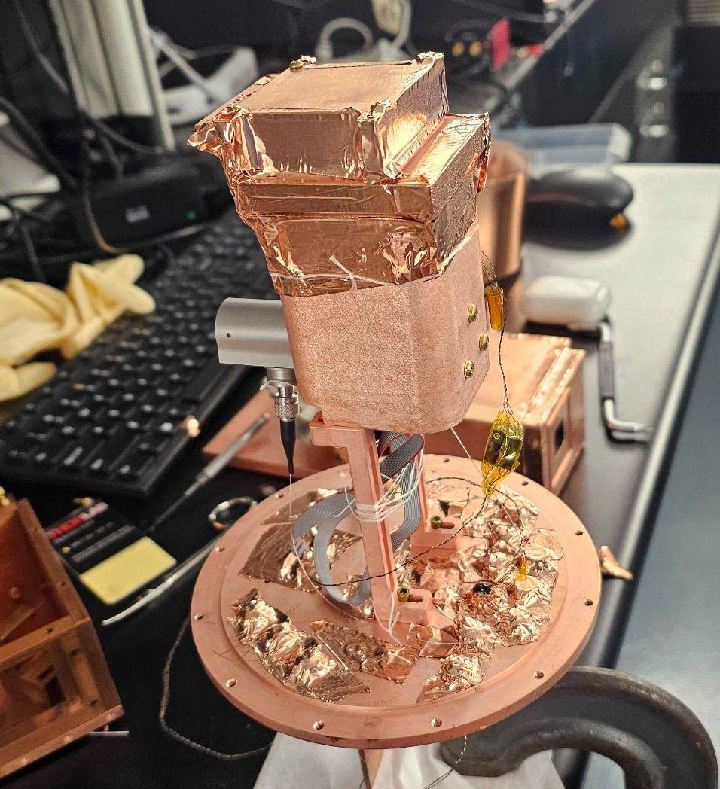
MEMS v.2 system v3 system
Micro-electro-mechanical system (MEMS) mirror-based calibration system
Compact cryogenic optical beam steering
At 10 mK:
~100 μm spot size
~4.5 μs pulse width
3 cm x 3 cm scan range
1.2 - 4.5 eV photon energy
near 0 power dissipation
Ref: N. Tabassum et. al, “Broadband Optical Modulation and Control at Millikelvin Temperatures”, 2025.

Slide 13
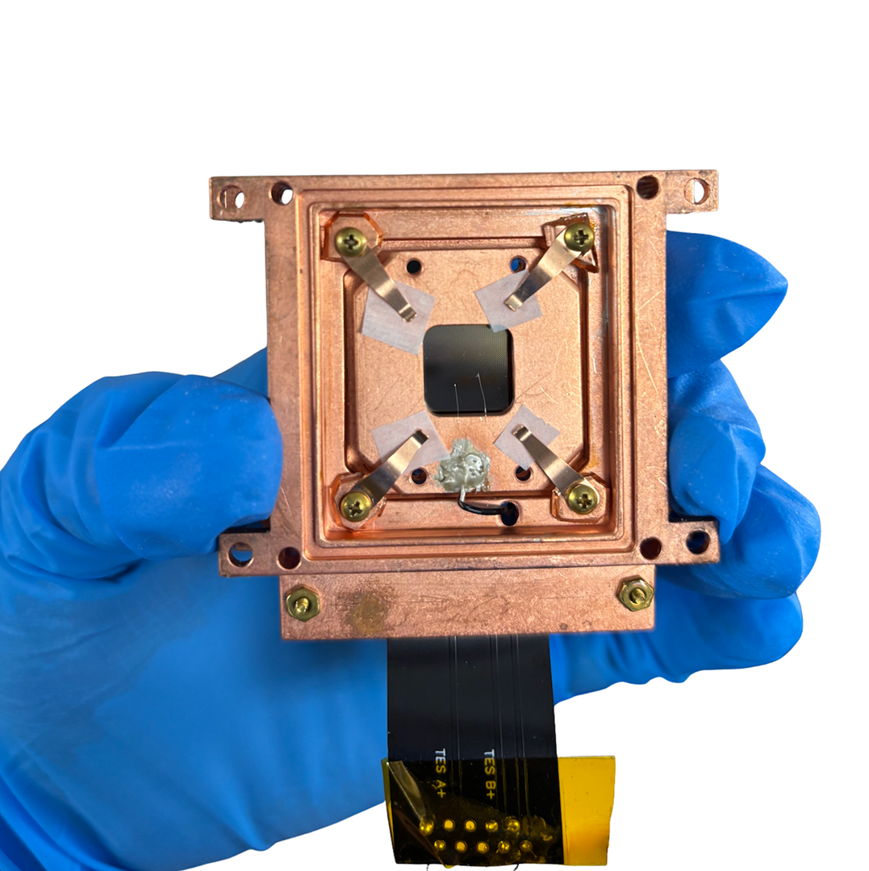
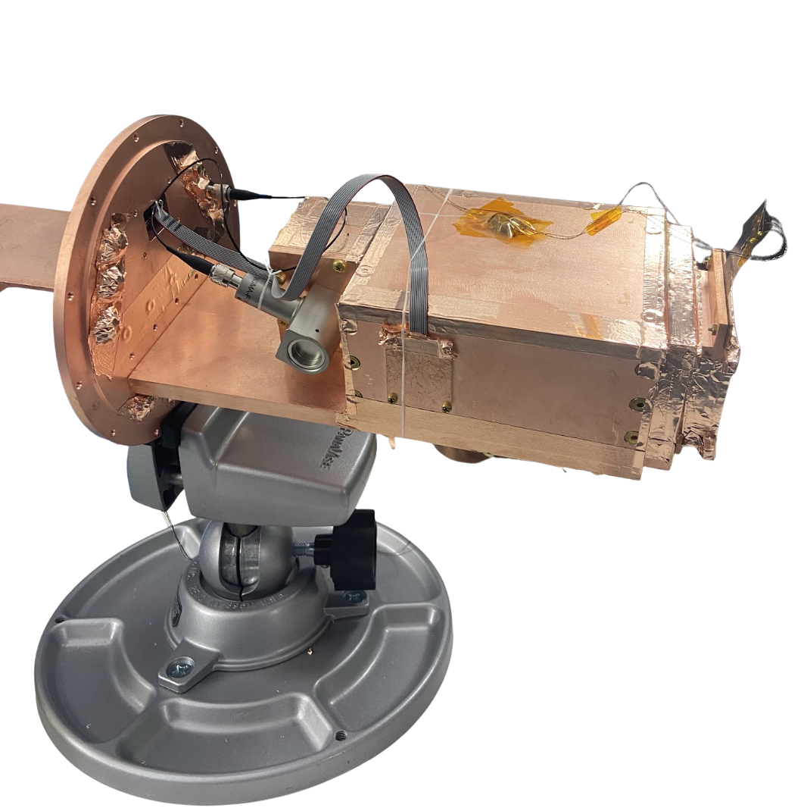
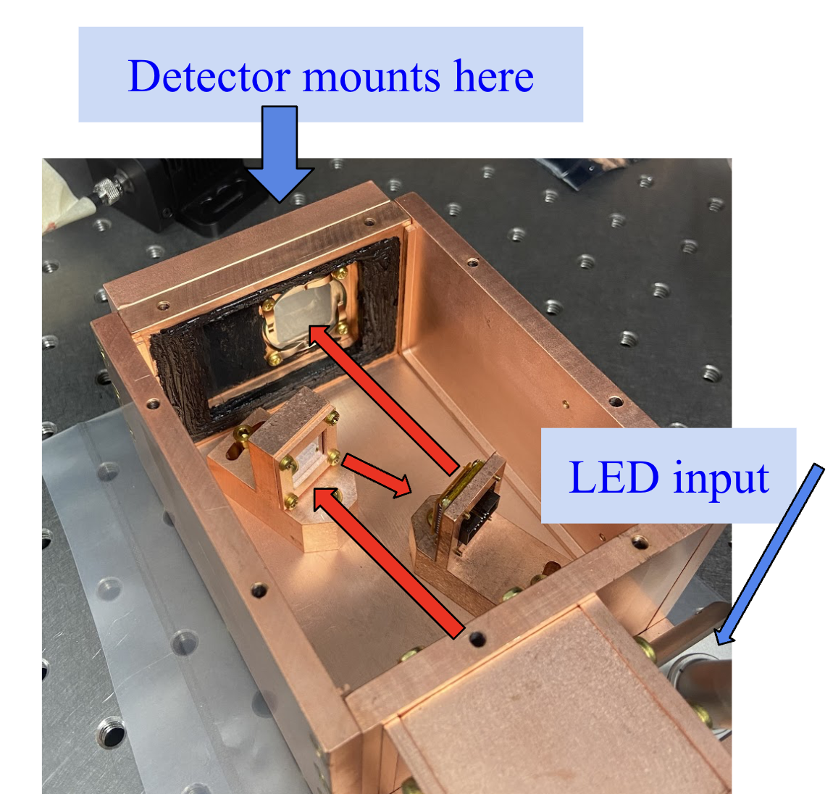
MEMS + HVeV Data
Data taken:
Full detector: 1-2 minutes of data taken with LED pulsing at ~500/7000 points across detector
HV bias: 0 / 50 / 90 / 100 V
LED wavelength: 365/ 625 nm

Slide 14
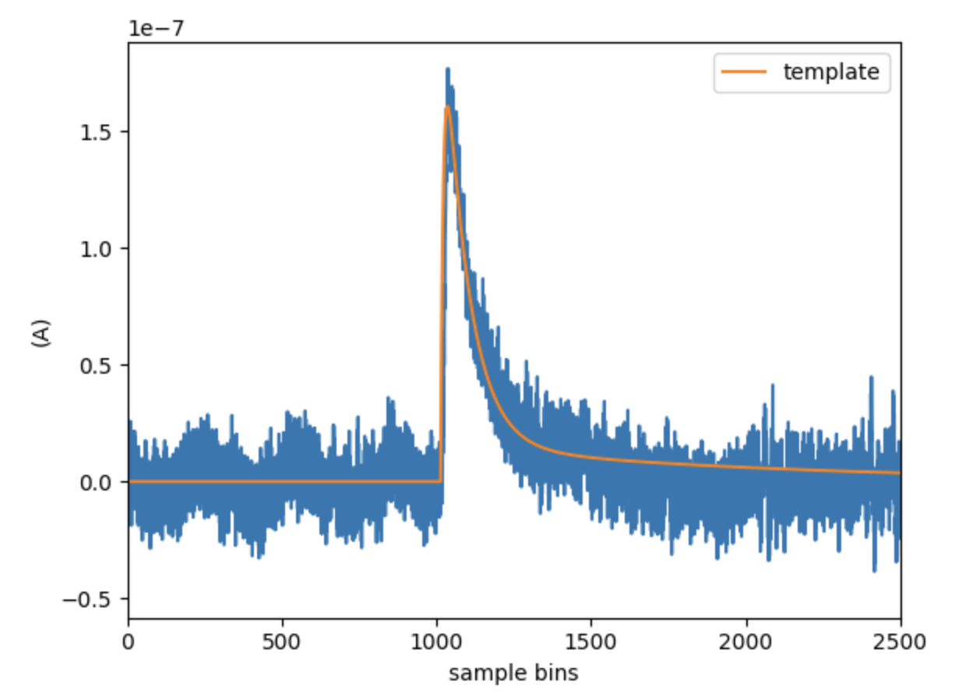
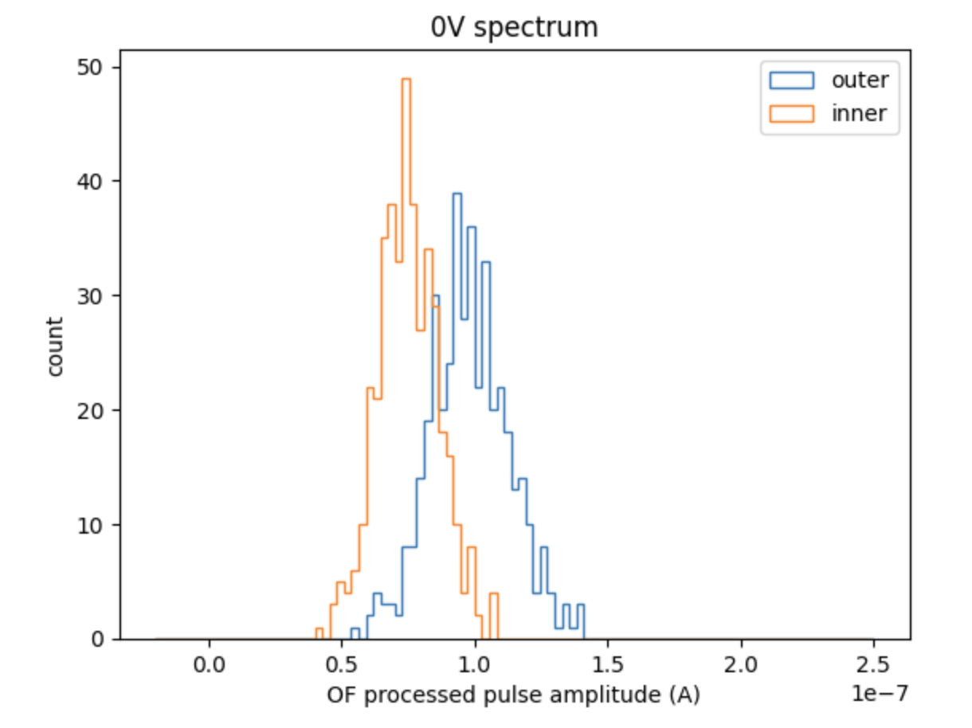
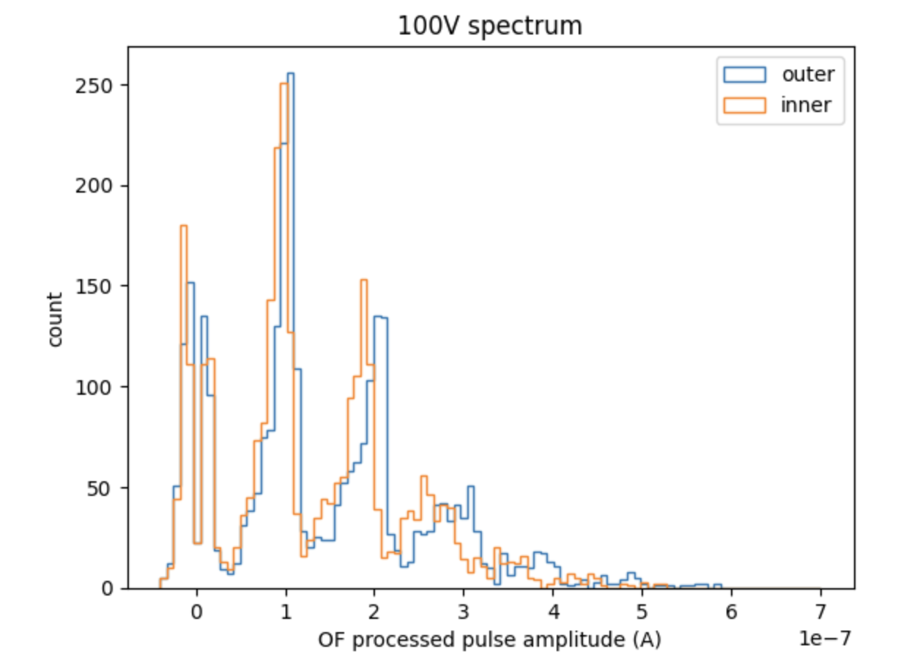
MEMS + HVeV Data
Data processing:
Data recorded continuously and triggered offline with triggers in coincidence with LED pulses
Events fitted with an optimal filter assuming a pulse template
Data quality cuts
WORK IN PROGRESS
WORK IN PROGRESS

Slide 15
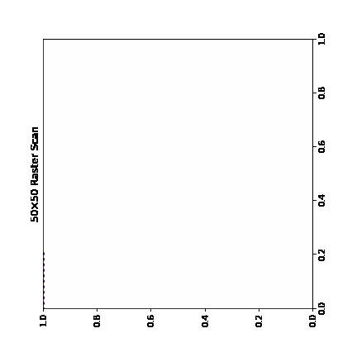
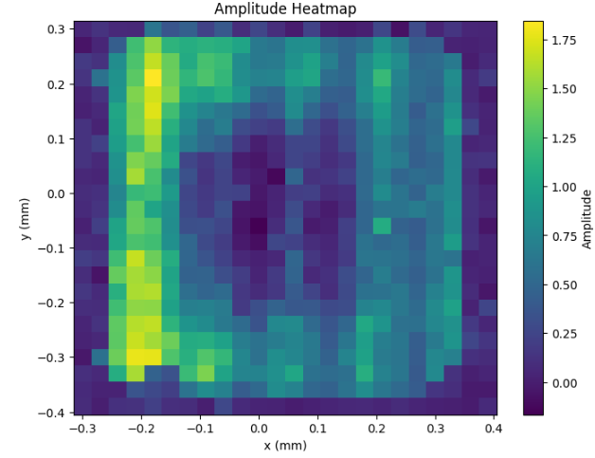
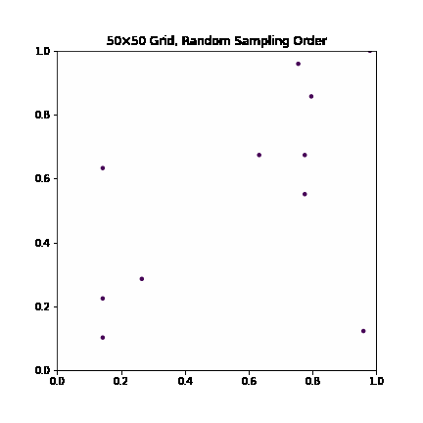
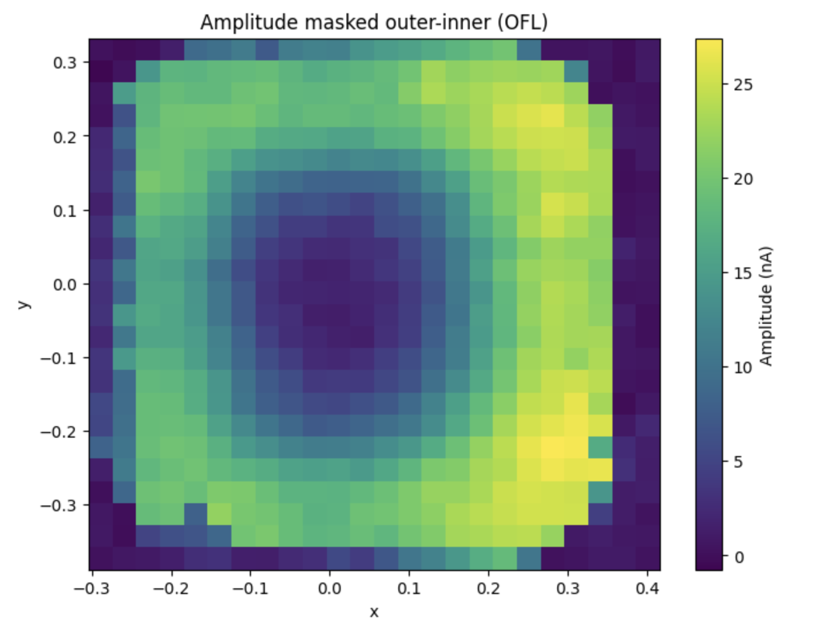
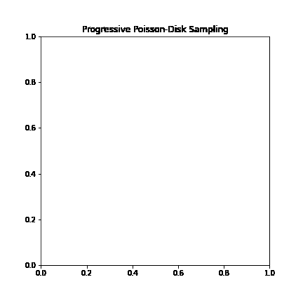
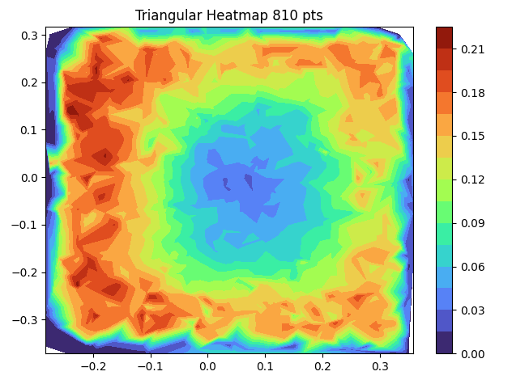
Scanning methods
Regular raster
Random Raster
Poisson disk sampling

Slide 16
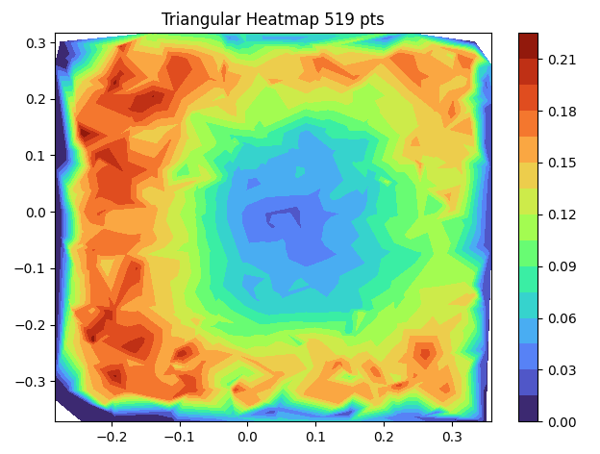
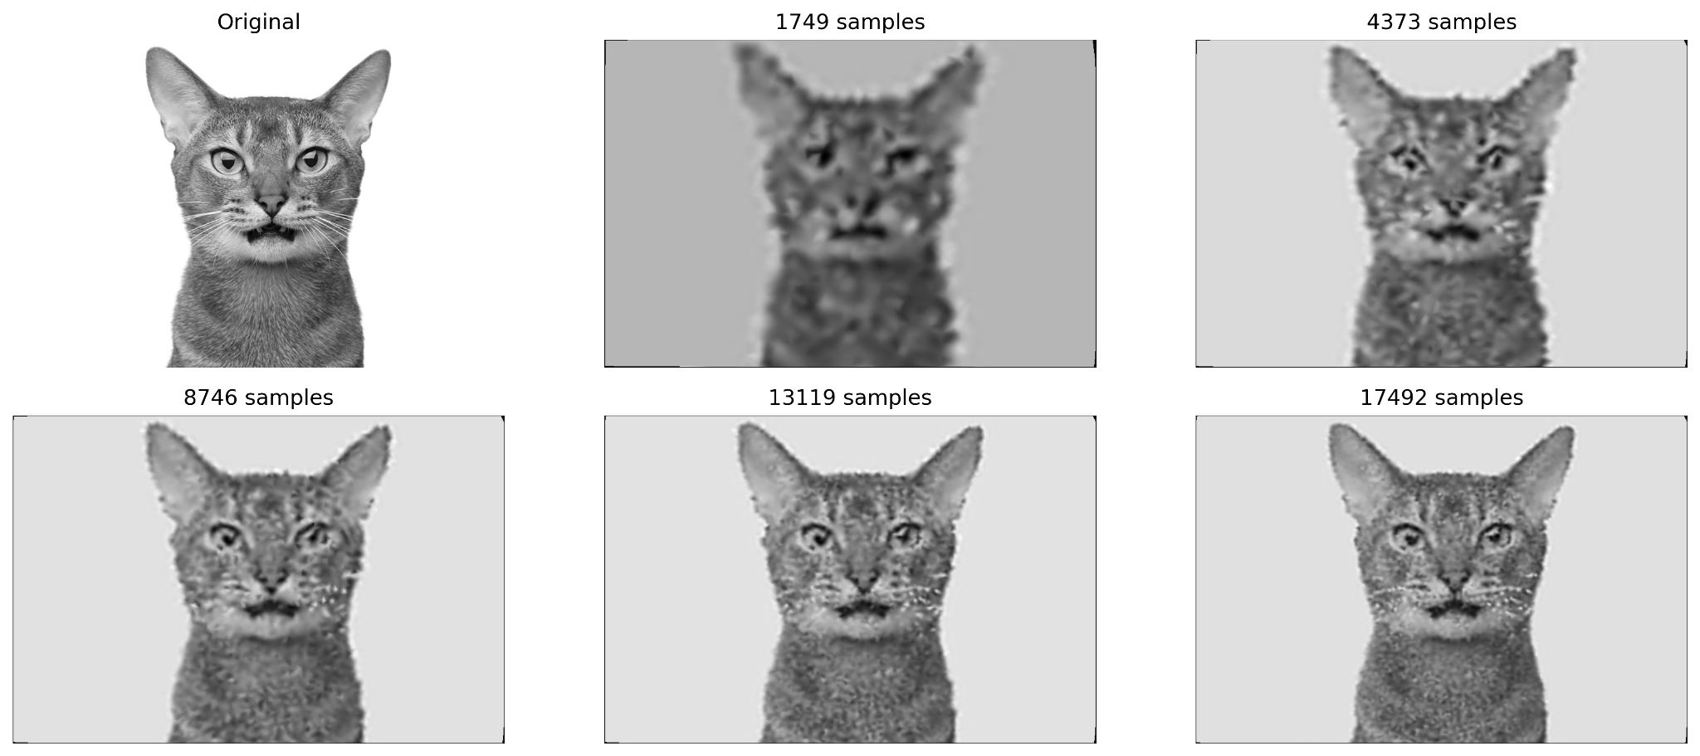
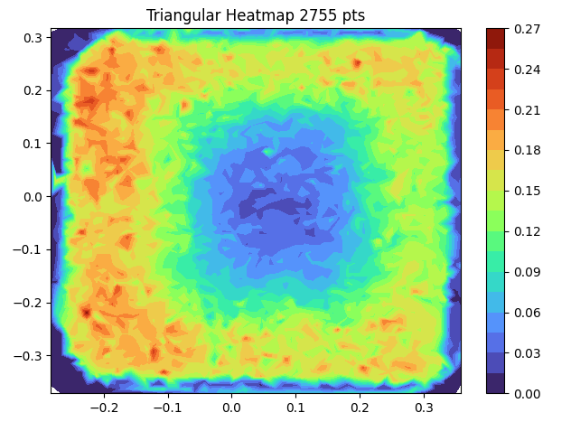
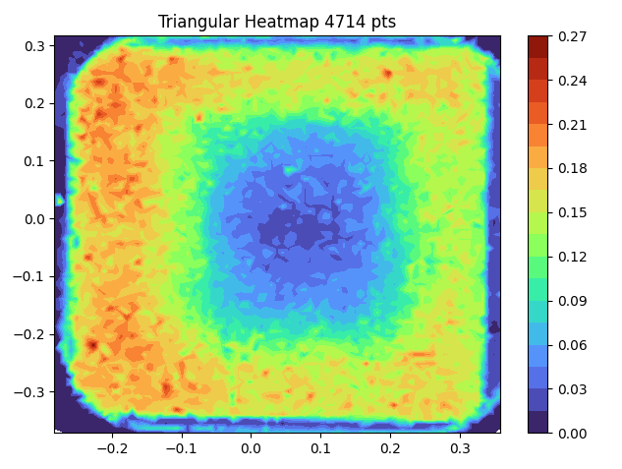
Poisson Disk Sampling

Slide 17
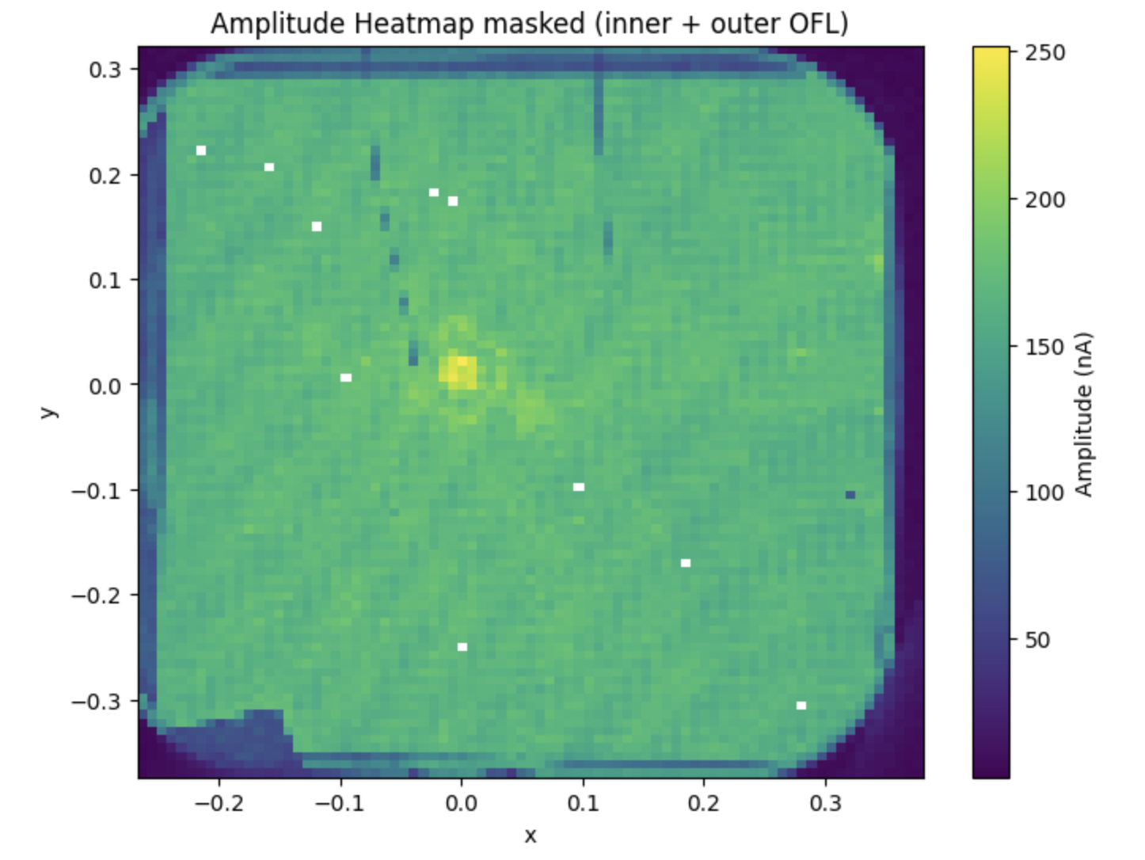
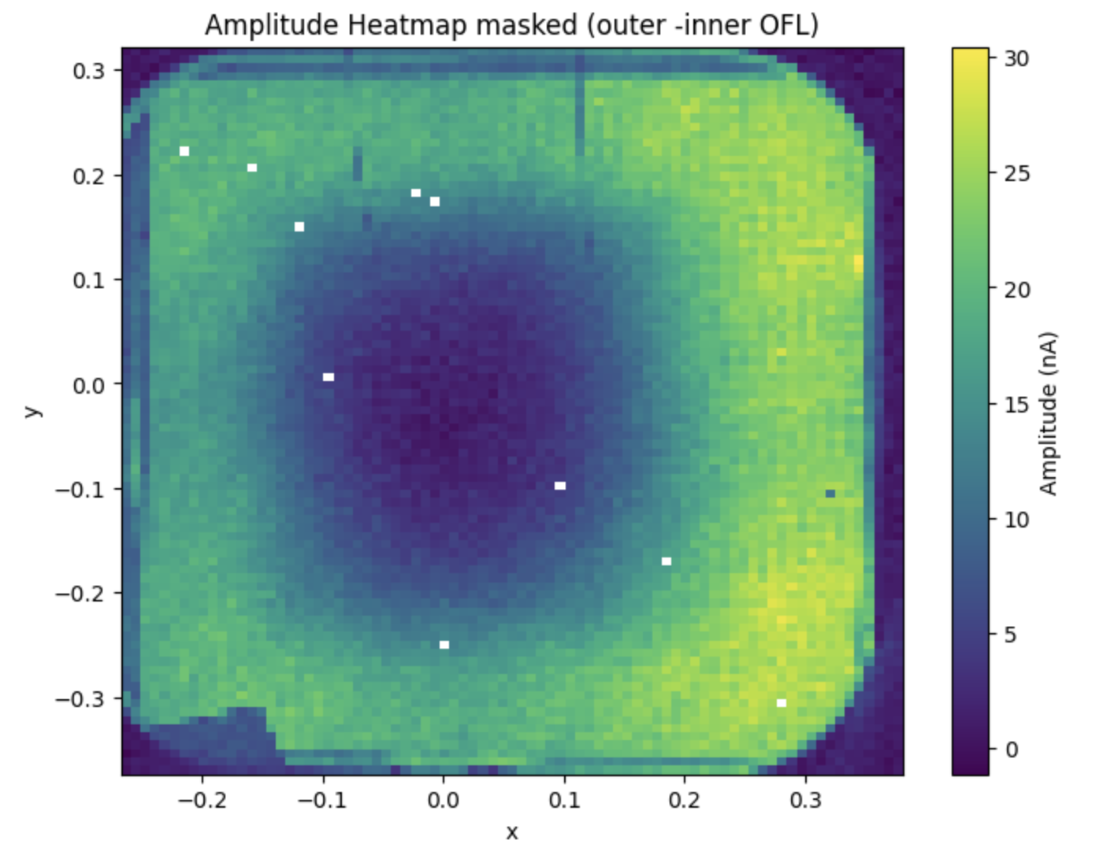
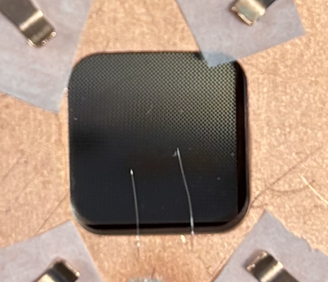
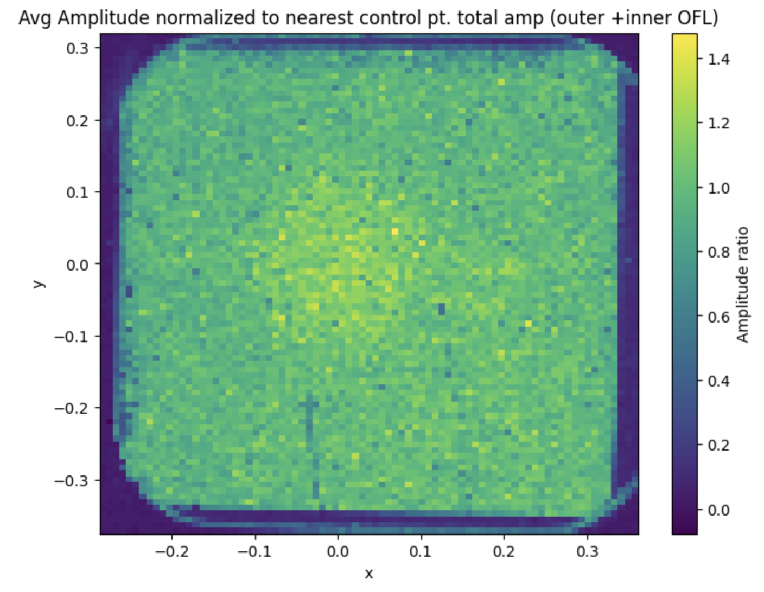
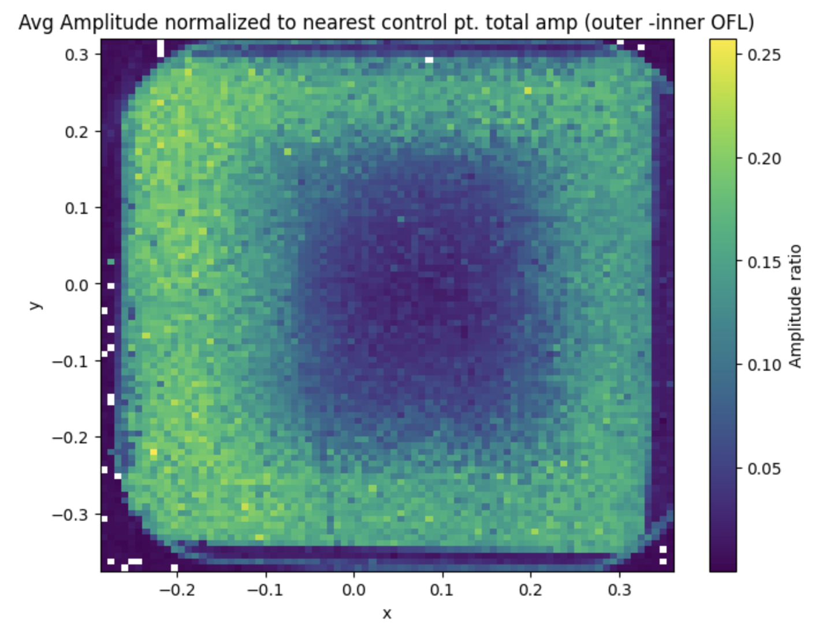
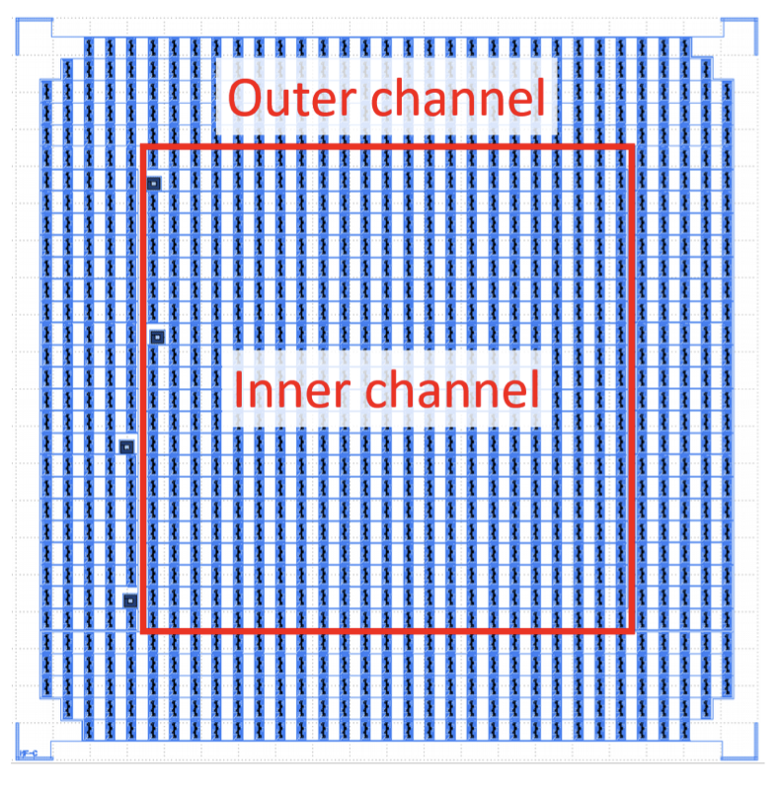
MEMS + HVeV Preliminary Analysis
Pulse Amplitude maps:
0V:
100V:
WORK IN PROGRESS
WORK IN PROGRESS

Slide 18
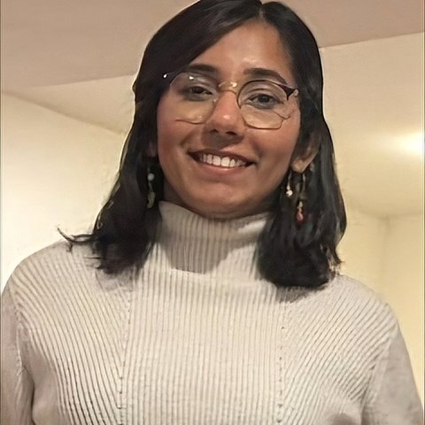


MEMS + HVeV Preliminary Analysis
Credit: A. Pradeep
Pulse arrival times w.r.t trigger
Pulse integral, phonon collection efficiencies, energy calibration…
Pulse rise times
WORK IN PROGRESS
WORK IN PROGRESS

Slide 19







Position reconstruction
Amplitude difference between inner and outer channel provides a reasonably good sense of the distance of the source of the pulse from the center of the detector, allowing us to make cuts
ML techniques provide slightly enhanced radius estimation
Results appear to be Random Rin agreement with G4CMP simulations
WORK IN PROGRESS
WORK IN PROGRESS
WORK IN PROGRESS
Hope Fu
DMQIS grad student
Qihua Wang
DMQIS grad student
Credit: Q. Wang

Slide 20



G4CMP Simulations
Credit: C. Stone-Whitehead
Single 2.0 eV photon per event
Lumped outer and inner channel geometry
4 x 10 x 10 mm Si crystal (1,0,0)
R=1 (0.1% loss) at side walls, Pabs=1 at channels
Phonon can reflect 1000 times before being killed
0V
HV
WORK IN PROGRESS
WORK IN PROGRESS

Slide 21


Carbon Based Substrates
Light carbon nuclei provide better kinematic match for sub-GeV dark matter candidates
Polar structure and different polytypes of SiC could enable directional searches arxiv:1807.10291
High energy long-lived phonon modes shown in diamond promise excellent phonon collection efficiency and increased sensitivity
High band gap allows for higher voltage bias with minimal leakage current
Time (ms)
arxiv:2409.19238

Slide 22

TES Performance
Decorrelated noise fits well to ideal TES, and indicates ~5eV resolution assuming 30% phonon collection efficiency

Slide 23



Shot Noise Calibration
LED was pulsed at different intensities and wavelength
Pulse’s amplitude estimated with offline optimal filter
Energy resolution is calculated by fitting the variance of resulting peaks -
LED Intensity

Slide 24

NTL effect (or lack thereof)
In most measurements, SiC detectors don’t seem to show NTL effect
Substrate polarization and surface defects could explain poor charge mobility
Si detectors on same system show expected amplification of charge events
Higher grade SiC and RIE pre-cleaning showed no improvement

Slide 25


Shot Noise Calibration - results
Net detector resolution measured at 5.1eV
Phonon collection efficiency is ~30%

Slide 26

Next steps
Fabrication of lower Tc SiC detectors could enable a competitive dark matter search
Diamonds have been acquired and r&d has begun on chip scale fabrication on them
Higher channel count detectors for better position reconstruction and potential LEE probing, 2cm 4 channel detectors already fabricated and calibrated, expect MEMs results soon
Careful Analysis of MEMs results could illuminate phonon loss channels

Slide 27








Thank You!
Collaborators
Ry Cyna
Weigen Peng
Ziqing Hong
Inwook Kim
Geonbo Kim
Harris Kagan
Funding
Kyle Kennard
Enectalí Figueroa-Feliciano

Slide 28

Measurement Setup
Detectors are mounted in light-tight enclosures and stacked in a tower mounted on a vibration-isolation stage
The tower is placed in a light-tight cryoperm shield, providing magnetic shielding and additional EM radiation shielding
External LED attached to fiber feedthrough shines on back of detectors
Current through TES is read out with SQUID amplifiers

