Slide 1


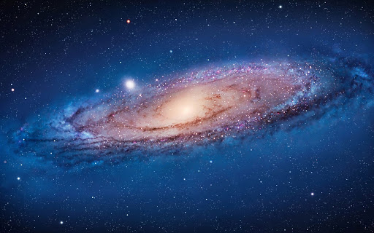
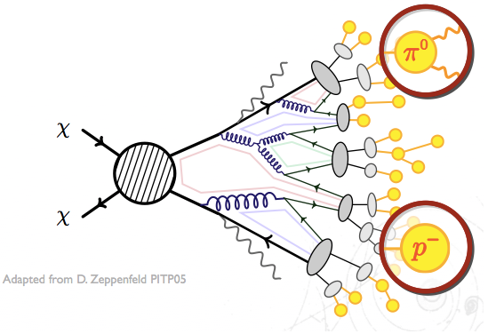

Cosmic Rays in the search for Dark Matter
χ
q
q
χ
Pedro de la Torre Luque --- pedro.delatorre@uam.es
Ramón y Cajal fellowship (UAM - Madrid)
IDM, Zaragoza – 2/6/2026

Slide 2
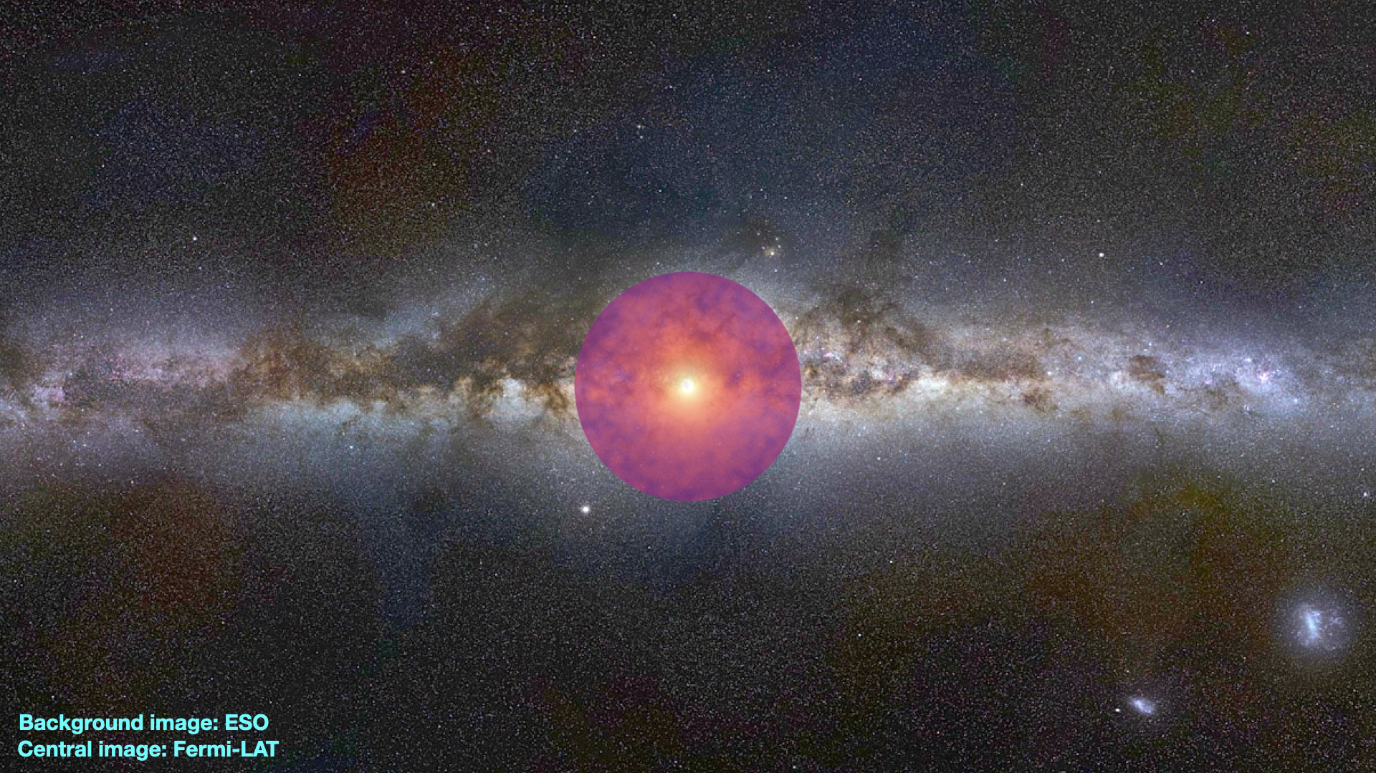

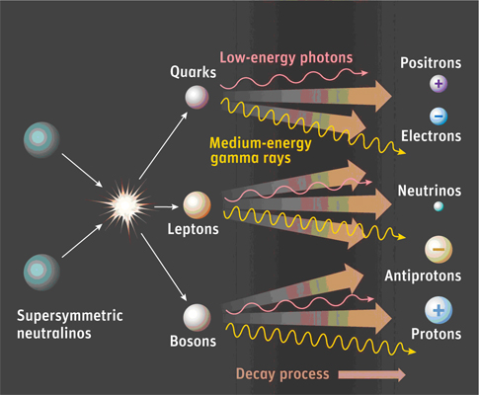
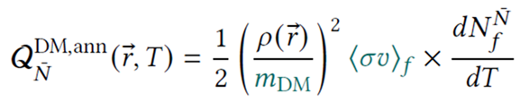

CR Antiparticles in the Galaxy
Common DM Candidates, such as WIMPs, must produce same number of particles and antiparticles in their decay/annihilation. Observing the direct products of dark matter would reveal its nature and origin
Positrons and antiprotons have long been considered critical channels for dark matter searches: Many simple extensions of the SM lead to well-motivated dark matter candidates
CRs are guaranteed sources of antiparticles, through interactions with the ISM. Production mainly depends on: - Time that CRs stay in the Galaxy (diffusion coefficient) - Probability of producing the antiparticle (cross sections)
$$CR$$
Notes:
produce them in detectable amounts for our experiments
such as the bino, neutral wino or neutral Higgsinos expected to couple to quarks

Slide 3
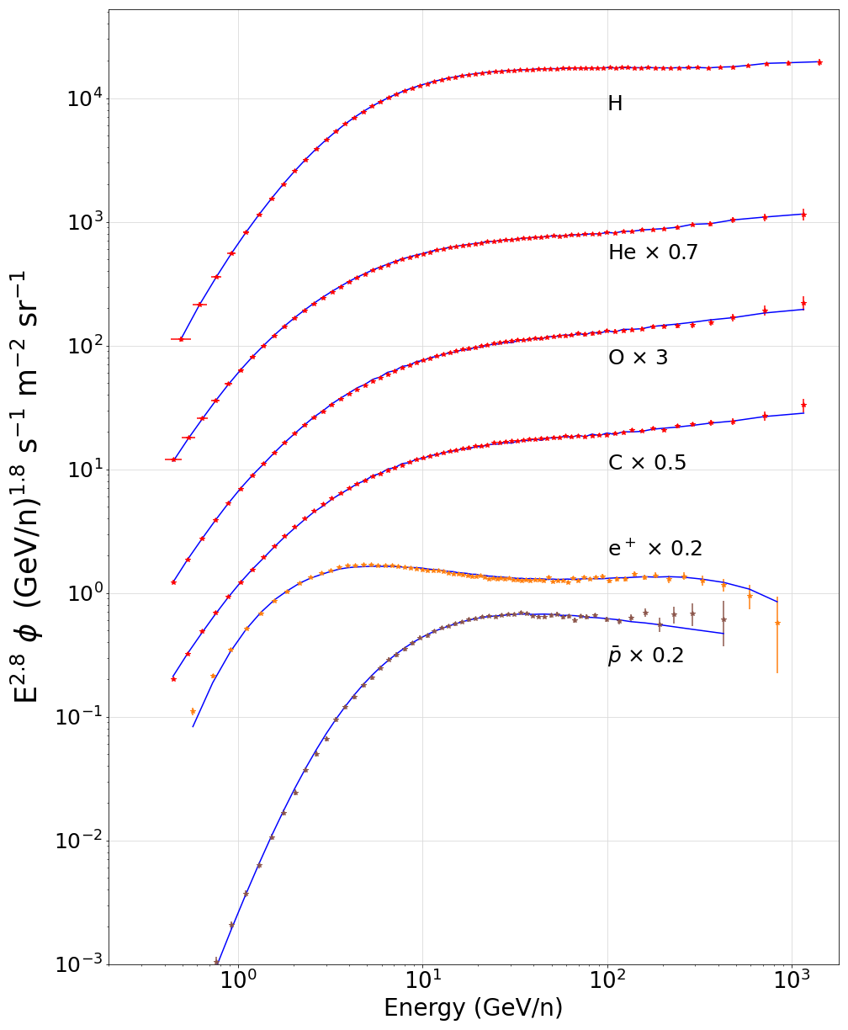
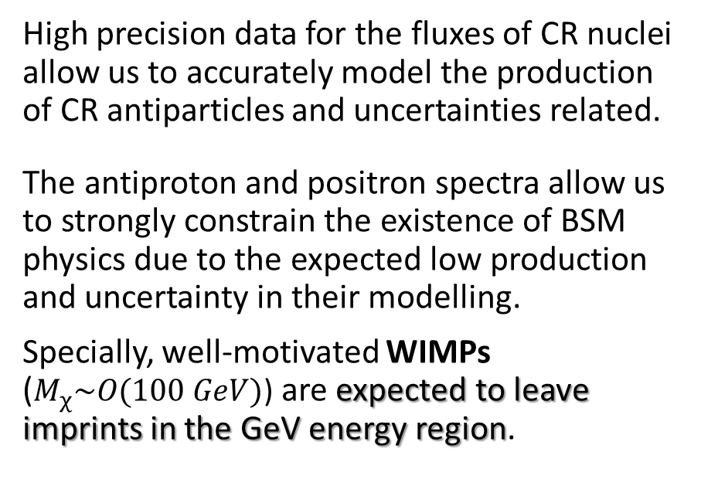

Antiparticles as a tool to identify signals of BSM physics
Flux of CR nuclei and antiparticles (data from AMS-02)
High precision data for the fluxes of CR nuclei allow us to accurately model the production of CR antiparticles and uncertainties related.
The antiproton and positron spectra allow us to strongly constrain the existence of BSM physics due to the expected low production and uncertainty in their modelling.
Specially, well-motivated WIMPs ($M_{χ}\sim O(100 GeV)$) are expected to leave imprints in the GeV energy region.
$$CR$$

Slide 4

Antiparticles as a tool to identify signals of BSM physics
Flux of CR nuclei and antiparticles (data from AMS-02)
High precision data for the fluxes of CR nuclei allow us to accurately model the production of CR antiparticles and uncertainties related.
The antiproton and positron spectra allow us to strongly constrain the existence of BSM physics due to the expected low production and uncertainty in their modelling.
Specially, well-motivated WIMPs ($M_{χ}\sim O(100 GeV)$) are expected to leave imprints in the GeV energy region.
$$CR$$
χ
q
χ
q

Slide 5
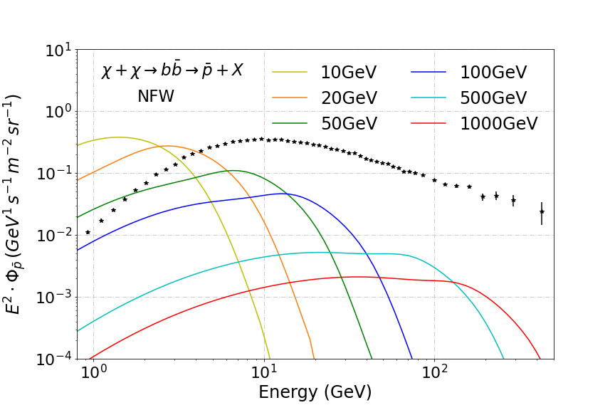
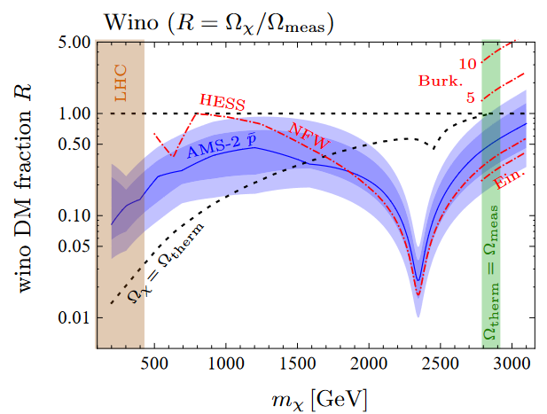

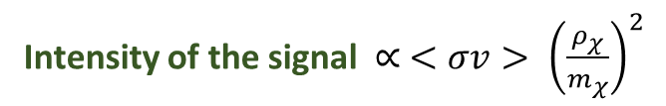
DM production - Primary antiprotons
Indirect DM searches with antiprotons (similarly to what happens with other astroparticles) are either intended for specific particle models (wino, Higgsino, etc) or for a generic WIMP that is modelled as a neutral-colorless resonance that couples to the SM through specific channels (bb, tt, ττ, etc )
Intensity of the signal $∝ <σv> {\left(\frac{ρ_{χ}}{m_{χ}}\right)}^{2}$
$$<σv> =3·{10}^{−26} cm^{3}/s$$
Cuoco+, JCAP 1804 (2018) no.04, 004

Slide 6
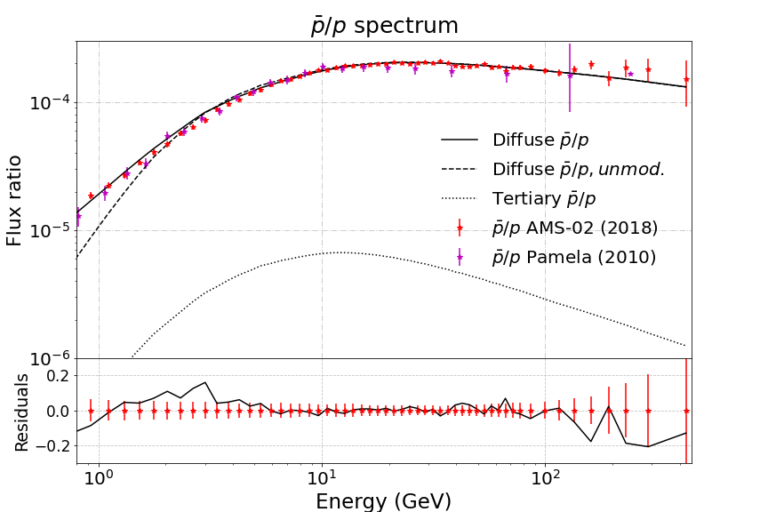
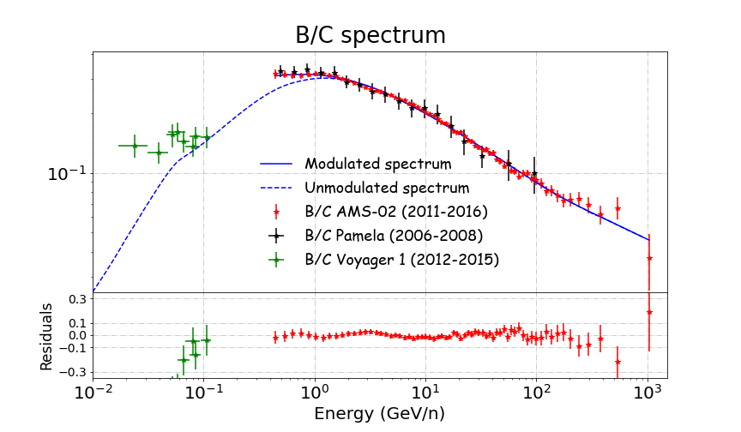


Cosmic-ray production Secondary antiprotons
Combined fits with other secondary CRs allows us to estimate the diffusion coefficient more accurately. The whole CR network must be accurately modelled
Main production channel: p + p → p + p + p + p
He still accounts for almost 30% of the production and heavier CRs must contribute to more than 10%
Diffusion coefficient
$\frac{ ϕ\text{sec}}{ϕ\text{pr}} \sim$σ(E)/ $D\left(E\right)$
Production cross sections
PDL et al JCAP03 (2021) 099
Secondary:
Tertiary:

Slide 7
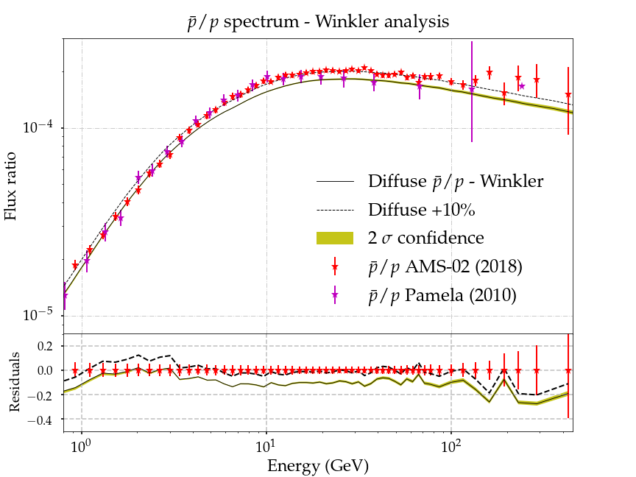
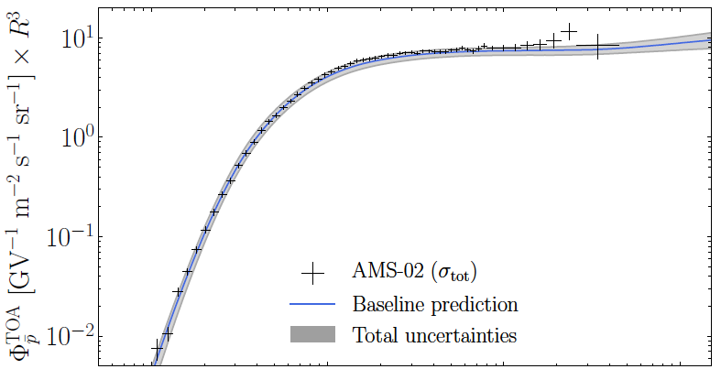
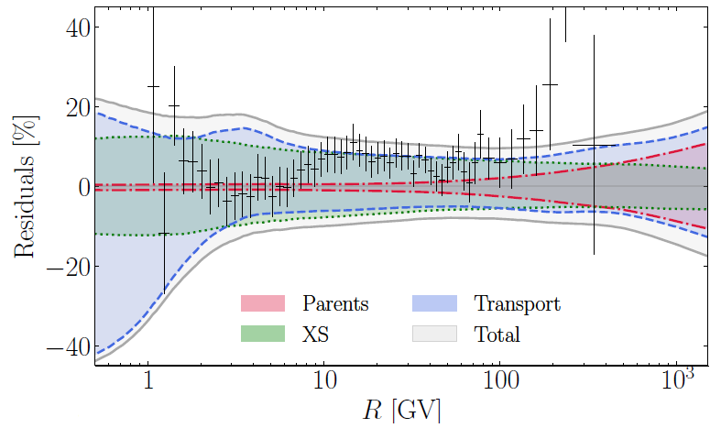
Cosmic-ray antiproton (secondary) production
Antiproton observations are fully compatible with a secondary origin. All secondary CRs can be well explained after accounting for cross sections and propagation uncertainties
PDL JCAP 11 (2021) 018
Boudaud+ PRR 2, 023022 (2020)
Cross sections are derived from parameterizations fitted to scarce data, which lead to uncertainties ~ 10-20%
Notes:
How should the cross sections be modified (deformed) from their actual state?

Slide 8
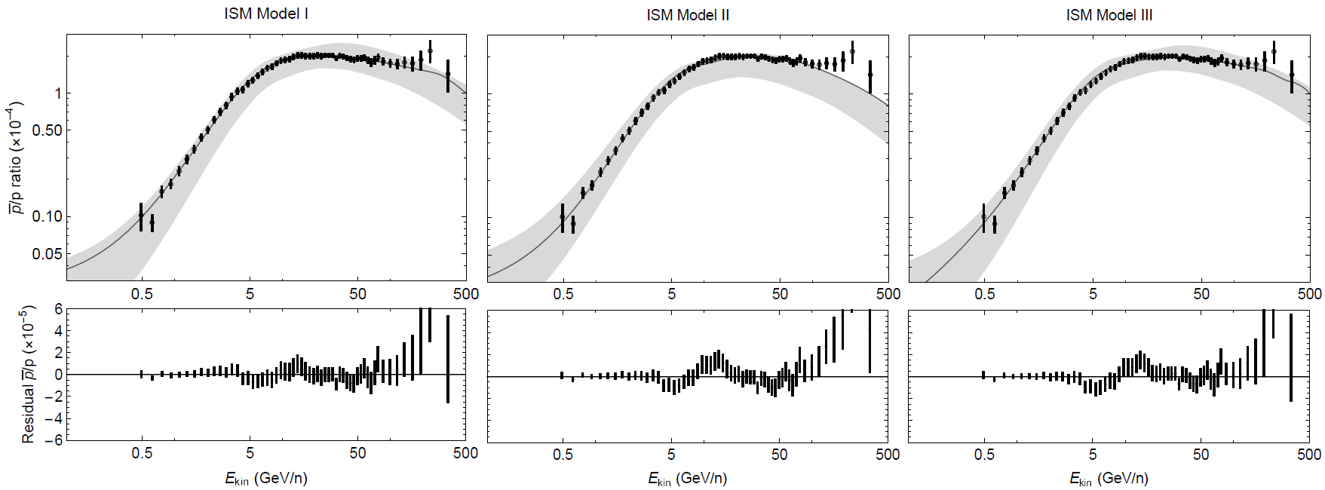
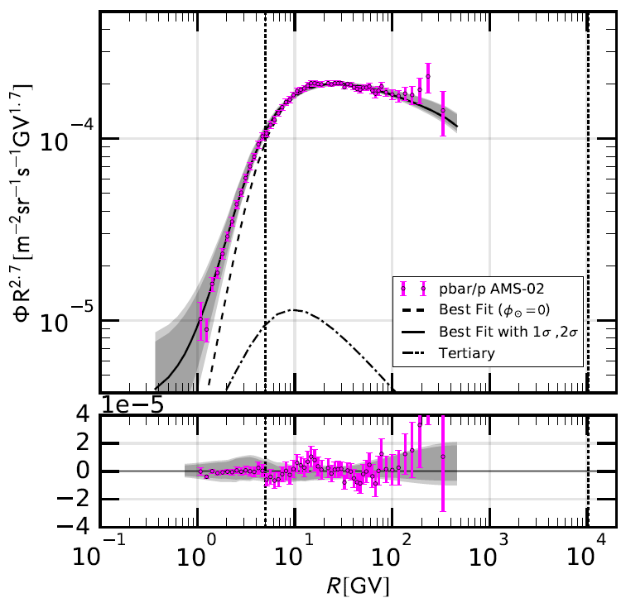

The Antiproton excess
$$CR$$
Recent studies have claimed the possibility of an excess of data over the predicted flux at around 10-20 GeV, which can be the signature of dark matter annihilating or decaying into antiprotons
p_{CR} + p_{ISM} → p
χ + χ → p
Cuoco et al PRL 118, 191102
Cholis, Linden, Hooper PRD 99, 103026

Slide 9
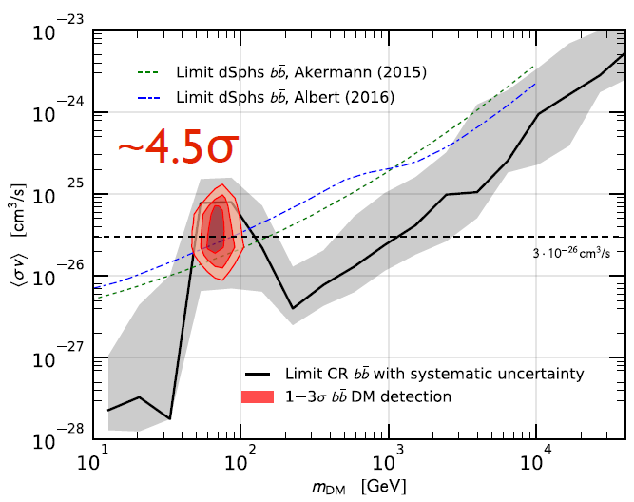
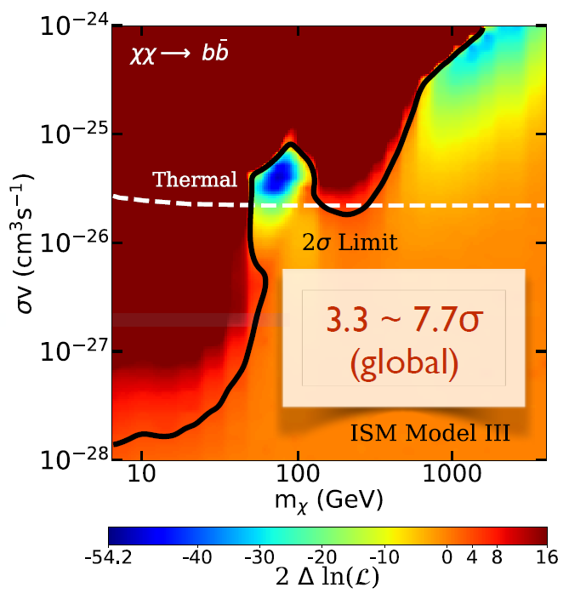
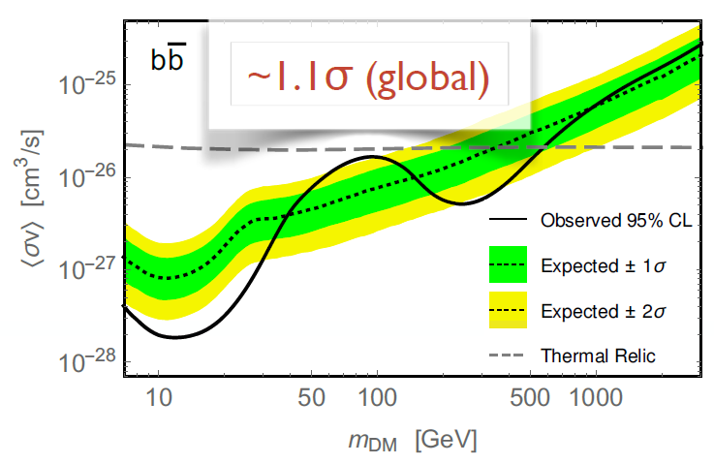
The Antiproton excess
$$CR$$
Recent studies have claimed the possibility of an excess of data over the predicted flux at around 10-20 GeV, which can be the signature of dark matter annihilating or decaying into antiprotons
p_{CR} + p_{ISM} → p
χ + χ → p
Cuoco, Kramer, Korsmeier 2017
Reinert, Winkler 2018
Hooper, Cholis, Linden 2019
9

Slide 10
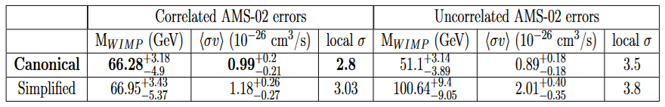
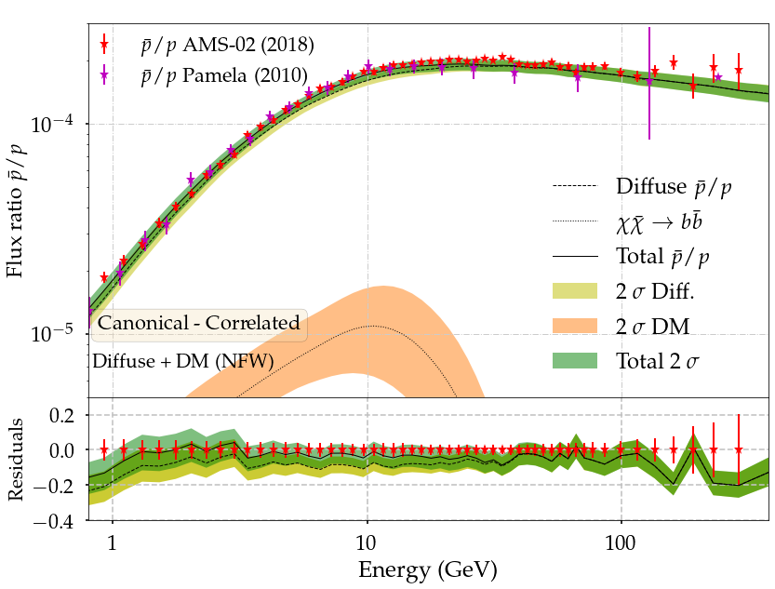
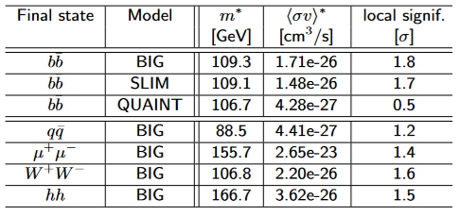
The difference from excess to fluctuation
Detailed DM searches found different sources of uncertainties difficult to avoid in current studies: Cross sections, correlated errors, diffusion model … A statistical evaluation of the signal shows that there is no significant excess in the data (maximum of ~2σ global)
PDL+, JCAP 05 (2024) 104
PDL et al JCAP 05 (2024) 104
Calore+, SciPost Phys. 12, 163 (2022)

Slide 11
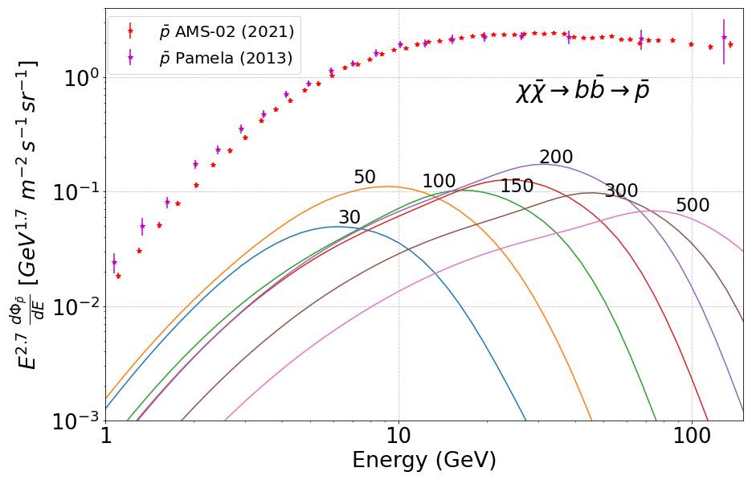
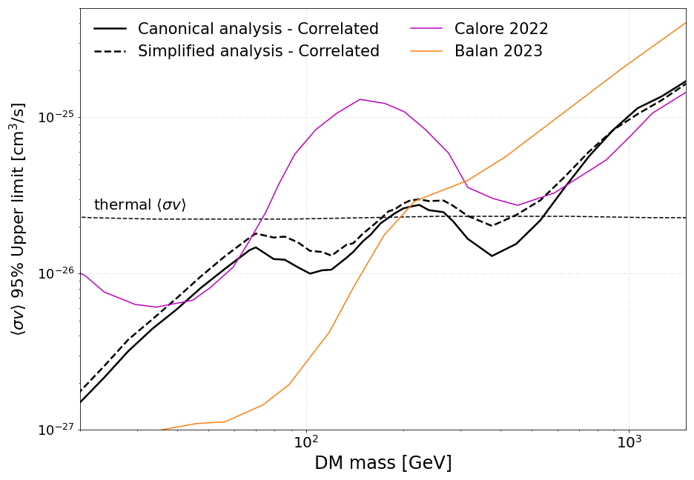
Dark matter bounds from antiproton analyses
Maximal DM-induced signal (at 95% CL)
(bb channel)
No excess found in the latest p analyses
Leading constraints for WIMPs annihilating into hadronic final states, and able to rule out the thermal relic cross sections for masses below ~200 GeV
PDL et al JCAP 05 (2024) 104
Notes:
Leaving clear that is not easy at all to identify DM signals in the antiproton spectrum

Slide 12
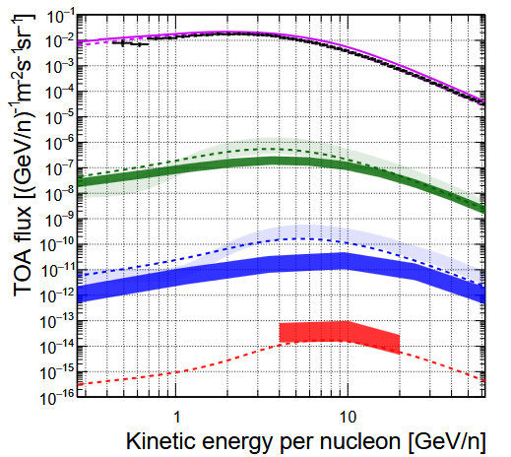
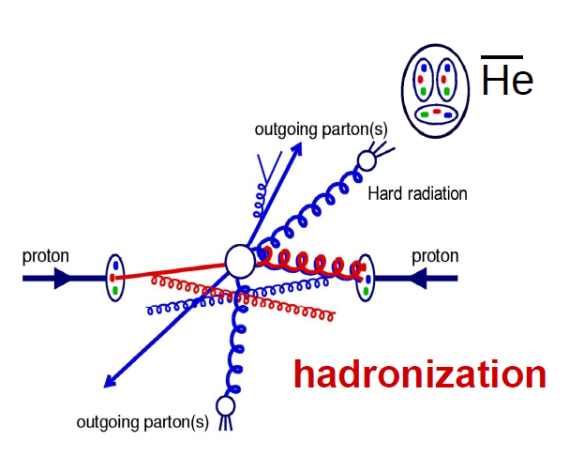

The window to prove (or disprove) many possible astrophysical excesses
Anti-nuclei as the dark matter smoking gun
Secondary antinuclei produced from homologous interactions as for p, but highly suppressed (due to coalescence)!
Antiprotons
Antideuterons
Anti-³He
Anti-⁴He
Shukla PRD 102, 063004 (2020)

Slide 13
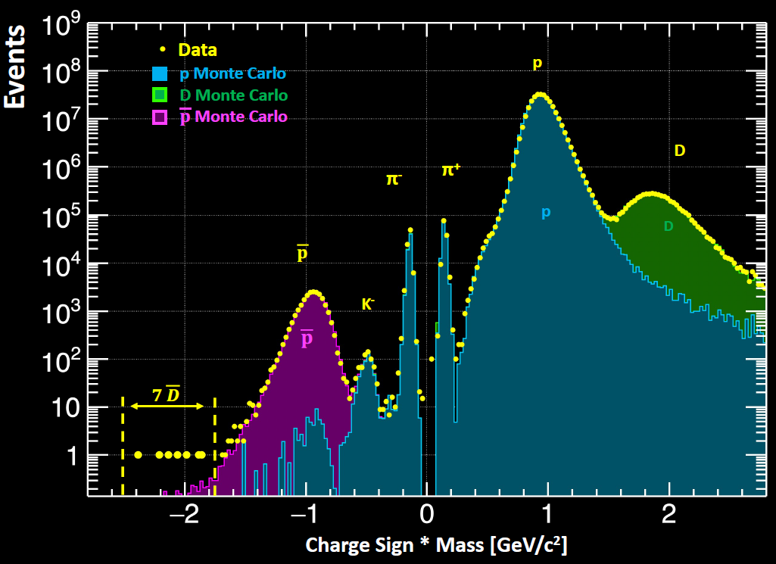
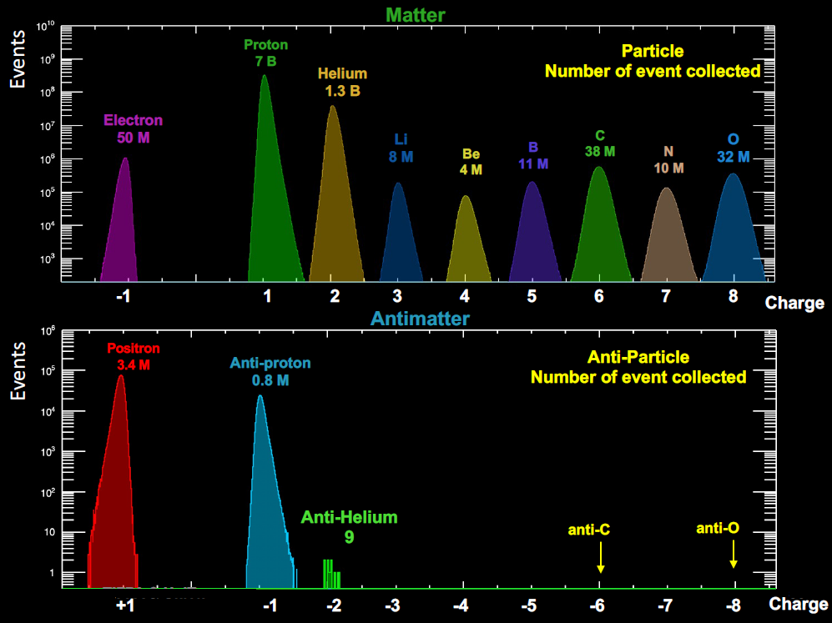
ANTI-NUCLEI: AMS-02 mass-charge spectra
Paolo Zuccon MIAPP 2021

Slide 14
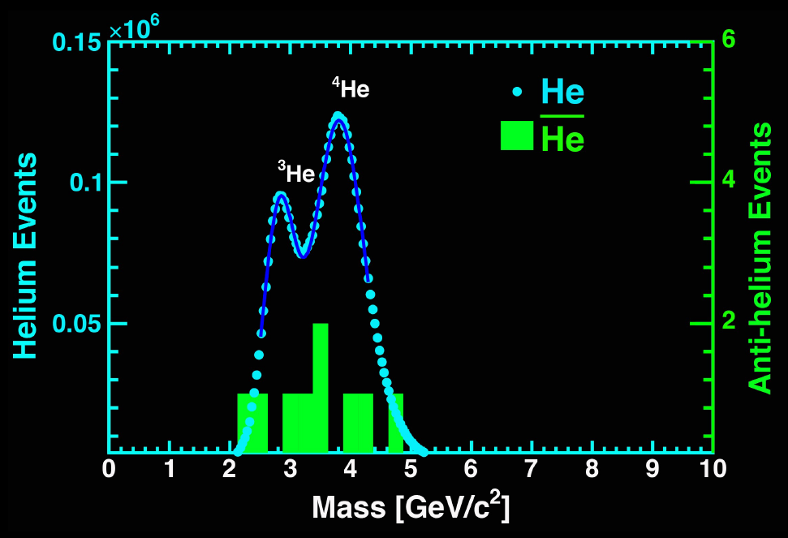
ANTI-NUCLEI: AMS-02 mass-charge spectra
Paolo Zuccon MIAPP 2021

Slide 15


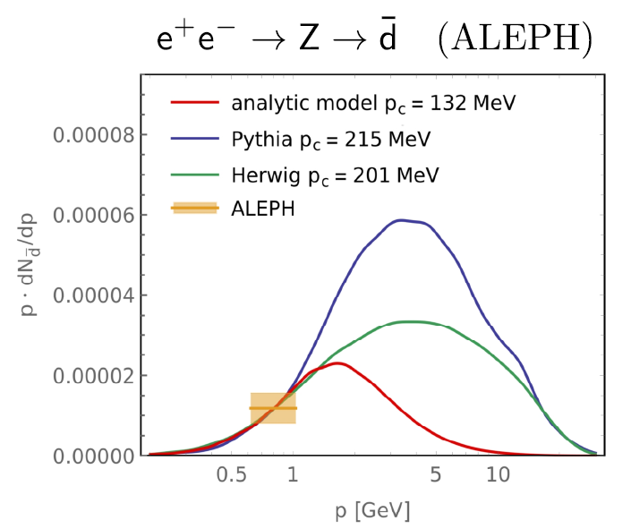
Formation of anti-nuclei
Simplest coalescence model: Factorised coalescence
But antineutrons and antiprotons are produced uncorrelated!
Other treatments, mostly based on Monte Carlo event generators, like Pythia, are used to account for correlations.
The main requirement is that the nucleons coalesce if they are close enough in space and momentum.
Other approaches have used the Wigner formalism, which allows to compute the coalescence probability in an event-by-event basis
2404.13114, 2006.16251, 2012.04352, 2411.04815
Notes:
Coalescence parameter may depend on many kinematical parameters, including the size of the projectile and target. ignores spatial information ignores wavefunctions ignores quantum mechanics; depends on an ad hoc parameter that is fitted to very scarce data in very limited channels
two nucleons moving ultra-relativistically in the same direction can still bind if their relative momentum is small.

Slide 16
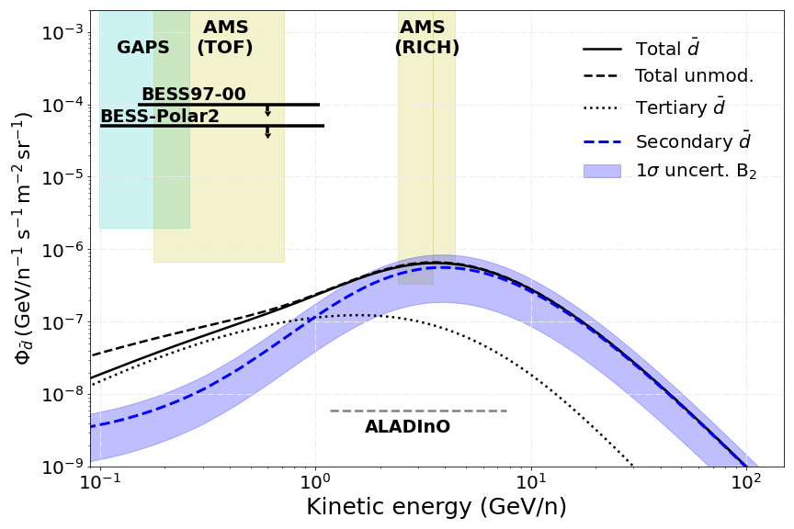
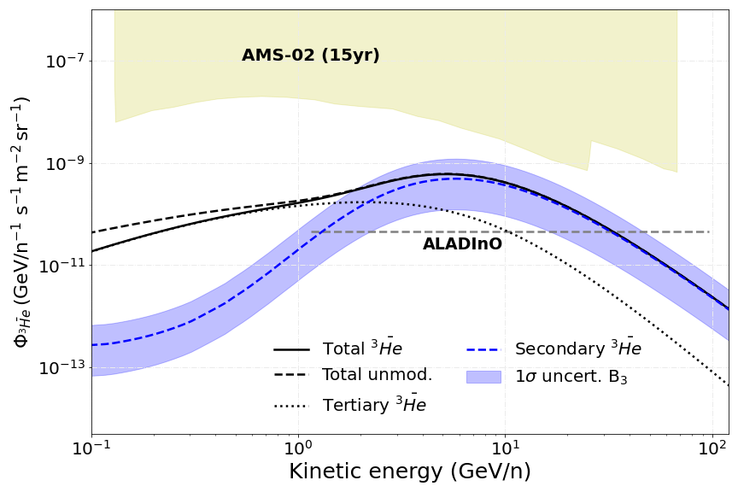
Astrophysical production
$$CR$$
CR + ISM → He, d
Can we explain the AMS-02 measurements without invoking any exotic source?
Main uncertainty is the coalescence parameter; the rest of uncertainties are under ~10%
We expect to have measurements of the d flux in the next years!! But no He until ALADInO or AMS-100 (foreseen to 2039)
PDL et al, ArXiv: 2404.13114

Slide 17
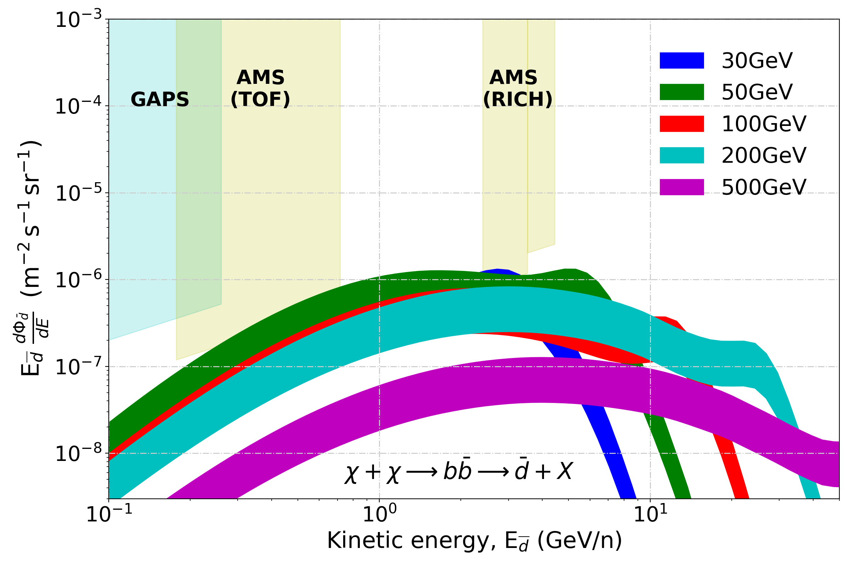
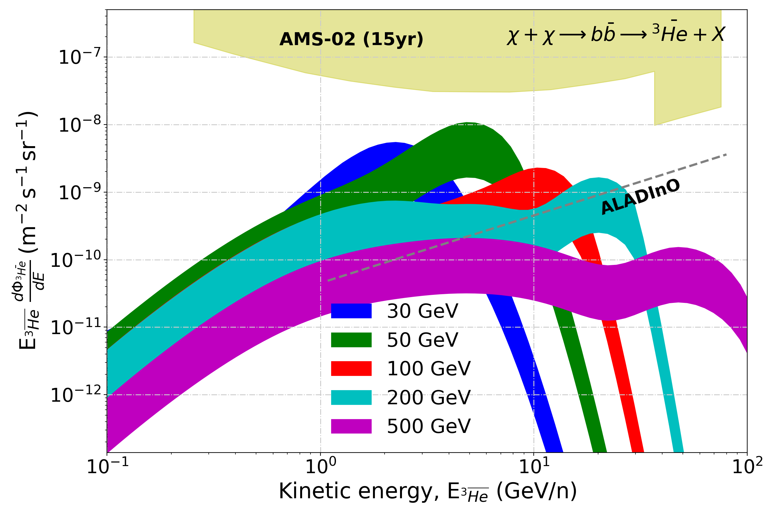

DM production: Upper Limits
q
χ
He, d
q
χ
Maximal antinuclei flux allowed from our antiproton bounds. Even in optimistic cases, it seems we cannot explain the detection of a single antihelium-3 event by AMS-02, And clearly, we are unable to explain any detection of antihelium-4 by AMS-02…
PDL et al, ArXiv: 2404.13114
Notes:
But a non detection would actually yield similar limits to those from antip

Slide 18
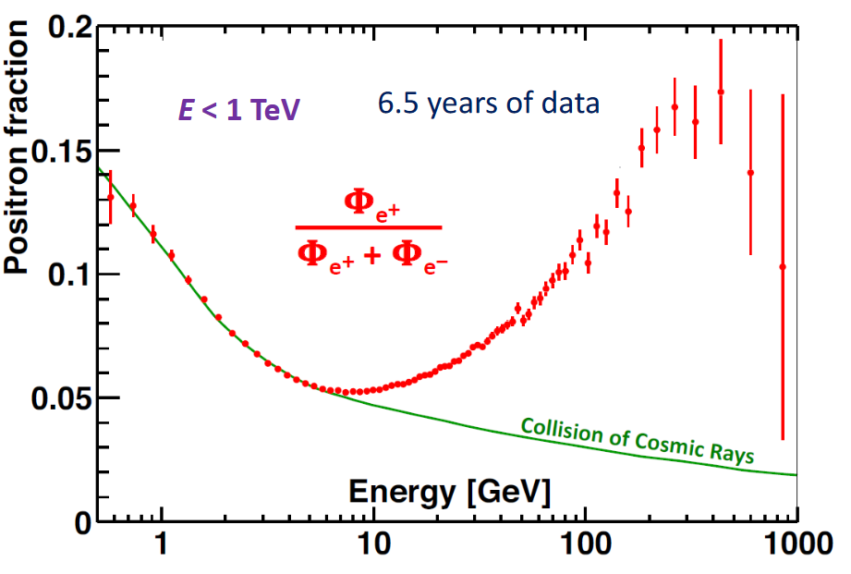
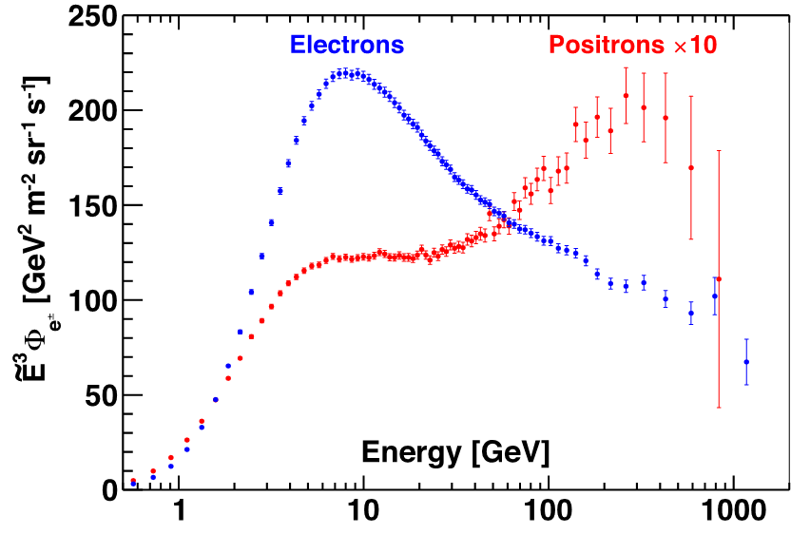

The positron spectrum
AMS-02 Collab.
The Pamela experiment showed a clear rise in the detected flux of positrons, which requires a new source of positrons. What is this source of $e^{+}$?

Slide 19
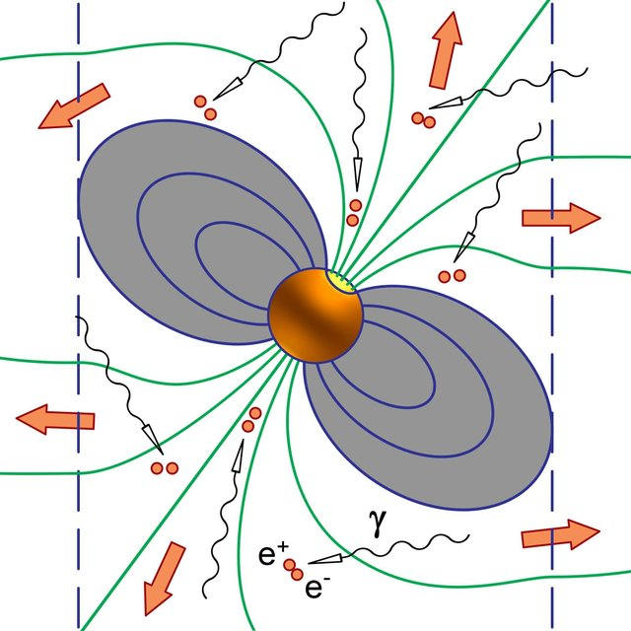
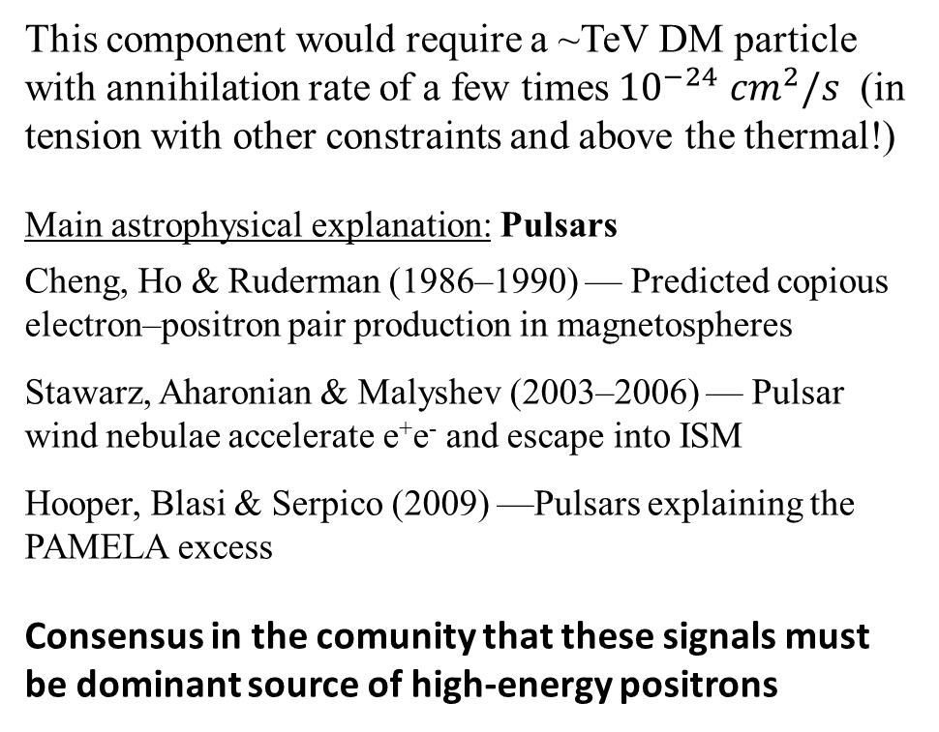
The positron excess
An astrophysical source of cosmic-ray positrons (and electrons) was not considered: Nearby pulsars
This component would require a ~TeV DM particle with annihilation rate of a few times ${10}^{−24} {cm}^{2}/s$ (in tension with other constraints and above the thermal!)
Main astrophysical explanation: Pulsars
Cheng, Ho & Ruderman (1986–1990) — Predicted copious electron–positron pair production in magnetospheres
Stawarz, Aharonian & Malyshev (2003–2006) — Pulsar wind nebulae accelerate e⁺e⁻ and escape into ISM
Hooper, Blasi & Serpico (2009) —Pulsars explaining the PAMELA excess
Consensus in the comunity that these signals must be dominant source of high-energy positrons
Notes:
Not yet “cosmic-ray positrons at Earth”, but:
established pulsars as powerful pair factories

Slide 20
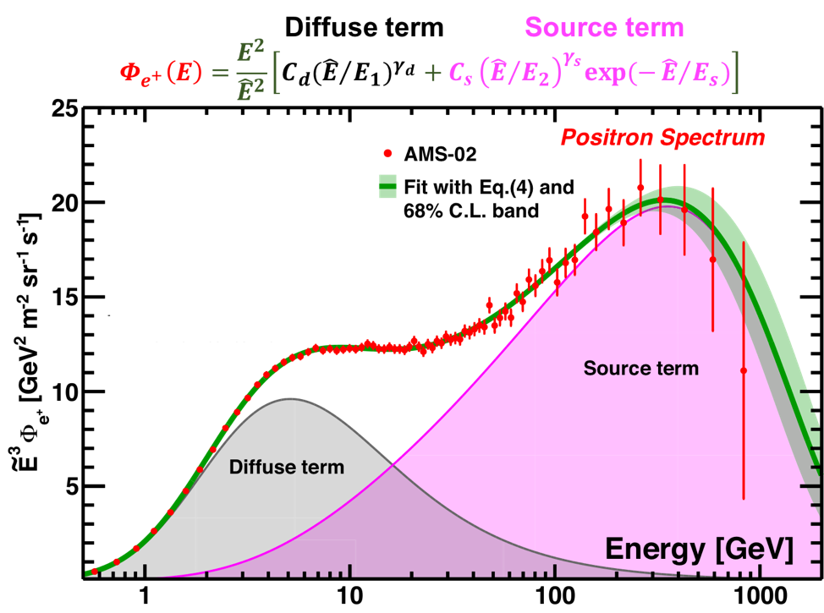


Production of positrons and DM identification
While conventional DM scenarios appear disfavoured, sub-dominant DM contributions may still be hidden.
But the stochastic nature of the PWN emission makes it difficult to find signatures of DM at high energies
The low energy (diffuse) part might allow us to identify DM signals more easily, but it is uncertain by a factor of a few -- halo height, diffusion coefficient, Solar modulation, Cross sections (e.g. 2305.02958).
AMS-02 Collab.
$$χ→e^{+}e^{−}$$
PWN $→e^{+}e^{−}$
Notes:
Sub-halos has been proposed as a way to mitigate this tension (boost factors of ~1000), but it seems also unlikely that this can work without screwing up other observables

Slide 21
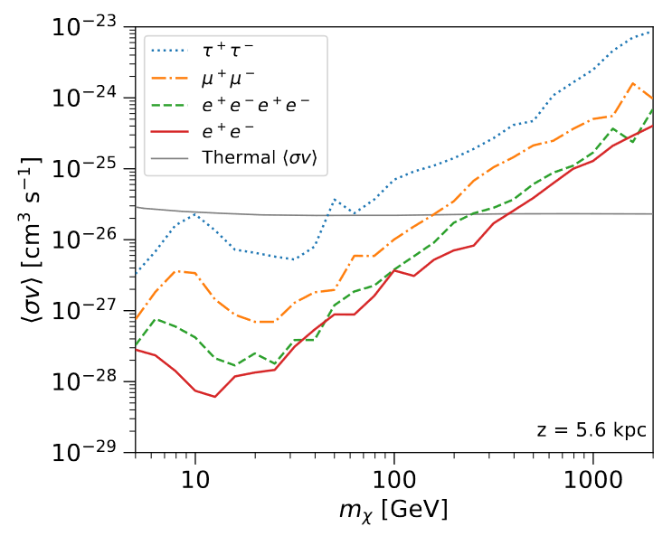
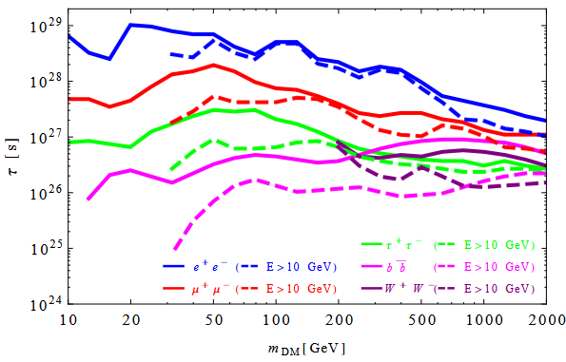



WIMP constraints from positron data
e⁺
χ
e⁻
χ
Leading constraints for leptonic channels, except for production of taus
Ibarra et al PRD 89, 063539 (2014)
Jhon & Linden JCAP12 (2021) 007
See also Krommydas & Cholis PRD 107,023003 for tests on DM identification with positron data
Notes:
Looking to the near future, the AMS-02 collaboration promises that they’ll be able to provide a data point near the TeV, that can help us understand better the positrón spectrum

Slide 22
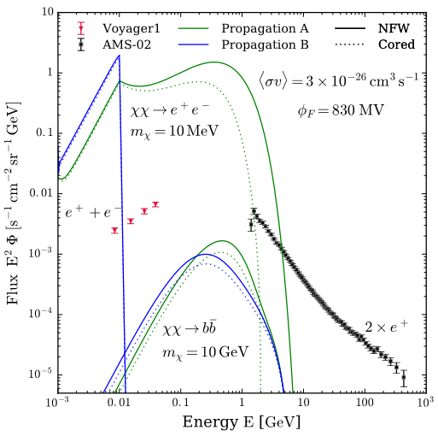
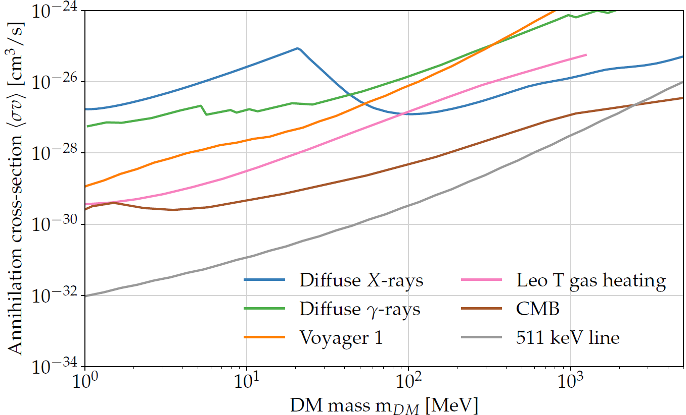
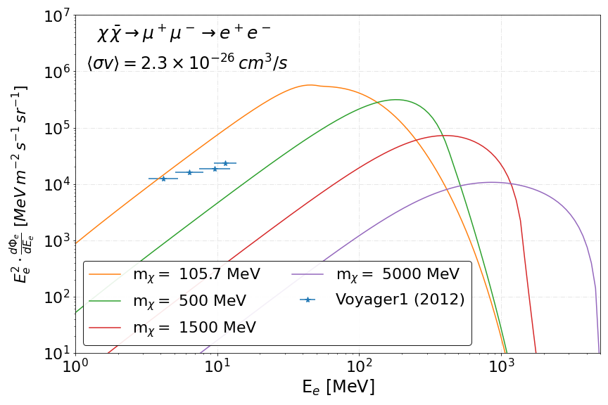
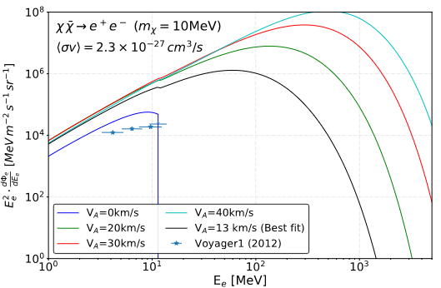
Beyond WIMPs: Sub-GeV DM
Voyager-1 provides the total e⁺e⁻ data in the 2-50 MeV range, very valuable for probing the injection of MeV positrons in the Galaxy
These measurements are unaffected by solar modulation, but propagation uncertainties are large (especially due to uncertainties in the level of reacceleration and the halo height)
AMS-02 can still constrain positrons reaching energies above a few hundred MeV, although this analysis requires a careful treatment of solar modulation
Boudaud et al 1612.07698
PDL et al 2311.04979

Slide 23
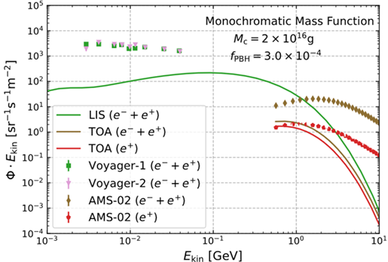
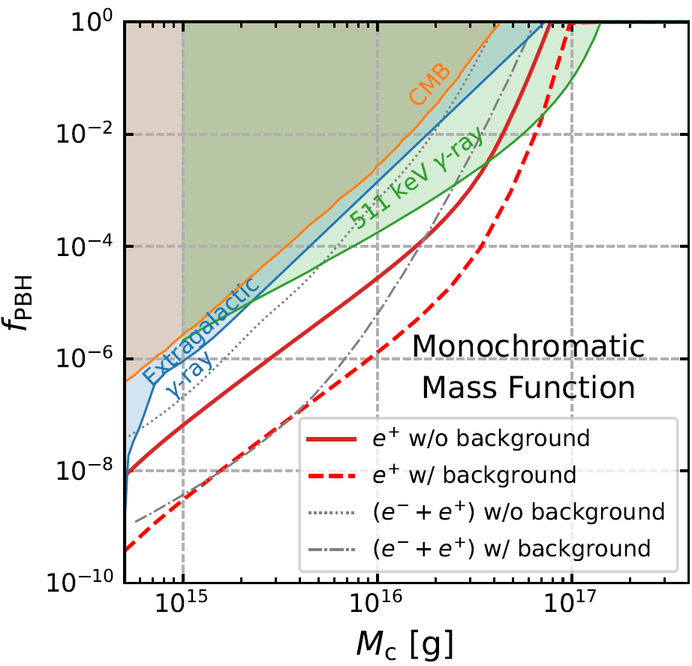
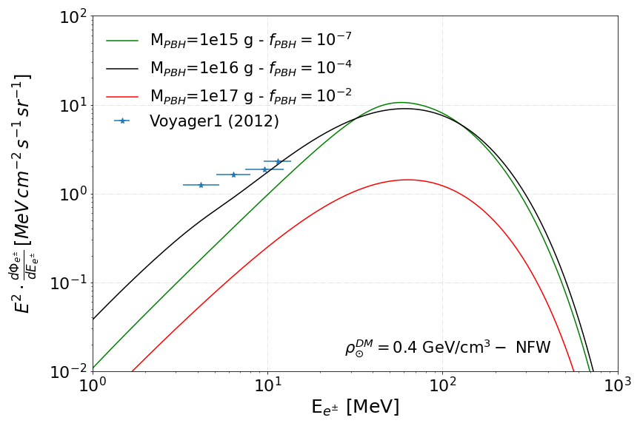
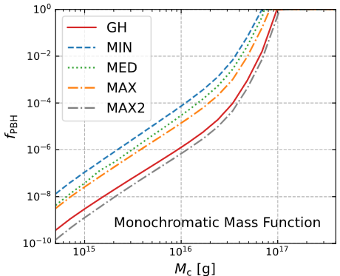
Beyond WIMPs: Light PBHs
Light (asteroid-mass) primordial black holes evaporate via Hawking radiation, injecting low-energy electrons and positrons into the ISM, following a thermal grey-body spectrum
If PBHs constitute a fraction of the DM, Voyager-1 and AMS-02 can probe their emissions and constrain their abundance
Under realistic propagation scenarios, these constraints are the strongest for PBHs with masses in the 10¹⁵-10¹⁷ g range
Huang et al 2403.04987
Huang et al 2403.04987
(Propagation uncertainties)
PDL et al
2406.11949
AMS-02 data
Huang et al 2403.04987

Slide 24




Beyond WIMPs: Light PBHs
Herms et al JCAP02(2017)018
Evaporation of light (asteroid-mass) PBHs could also produce antiprotons and antinuclei Barrau et al. A&A 398, 403–410 (2003)
Herms et al JCAP02(2017)018
PBH evaporation can produce large quantities of antinuclei, along with photons, neutrinos, electrons, …
Current limits make antiproton emission from Hawking radiation not observable by the current instruments, since this requires too low PBH masses
De Romeri et al
2505.04692
Notes:
Ap observations were used to set upper limits on (i) the local PBH explosion rate, (ii) the fraction of the Universe’s mass into PBHs, and (iii) the average density of PBHs in the Universe.

Slide 25





CR-Boosted DM, BSM particles produced in the ISM, …
Low-mass DM can be up-scattered by CRs and detected by direct detection experiments: Unique way to detect recoils thanks to CRs. Even CR interactions with the ISM and the atmosphere producing DM.
Probing CR-DM direct scattering though features in the CR
Constraints on ALPs produced in SNe
PDL et al
2307.13731
Cappiello et al
1810.07705
Notes:
Many BSM particles can be constrained in the same way (e.g. sterile neutrinos) Not only ALPs may be produced similarly in the core of such extreme systems…

Slide 26
Conclusions
Cosmic Rays in the search for Dark Matter
Antiproton observations seem to be in good agreement with the rest of CRs. There is an interesting hint for an excess, but still, it isn’t significant enough. Antiproton measurements lead to very strong constraints on WIMPs
Antinuclei are a very promising channel to study signals from dark matter and constrain our current WIMP models – At reach in the next decade! Exciting preliminary detection of anti-helium seems to challenge our models… WIMP production seems insufficient… need of invoking exotic scenarios
Positron excess compatible with pulsars, which require a more complex modelling Very strong constraints on leptonic channels. Higher energy data will be very relevant
Asteroid mass PBHs or sub-GeV DM strongly constrained with Voyager-1
A good modelling of the CR distribution allow us to study DM direct scattering and overcome problems with sub-GeV DM in direct detection experiments
Pedro de la Torre Luque – 02/06/2026 pedro.delatorre@uam.es
Notes:
Publication of AMS-02 correlation matrix or upcoming GAPS data may help us. for WIMPs coupling to quarks

Slide 27
BACK UP

Slide 28


An open question related to antiprotons
Paolo Zuccon MIAPP 2021

Slide 29

The current generation of detectors provides accurate measurements on the spectra of Galactic cosmic rays leaving many open questions
We focus in the GeV-TeV part, where diffusion dominates and WIMPs can leave imprints in CR antiparticles

Slide 30



Injection of CRs by sources
G. Peron et al 2020 ApJL 896 L23
CRs are accelerated in shocks - Like those found in SNRs, star clusters or PWNe
Then, they are injected to the interstellar medium where they can interact with gas and magnetic fields
Diffusive shock acceleration (inspired in the Fermi mechanism) explains the power law distribution of CR particles

Slide 31


Galactic cosmic rays are accelerated in astrophysical sources (presumably SNRs) and propagate throughout the Galaxy for millions of years due to scattering with plasma waves. Occasionally they interact with ISM gas producing secondary nuclei through spallation.
Secondary CRs offer a sensitive tool to infer the propagation properties of CRs in the Galaxy
AMS-02 collab. 2018
Turbulence confines CRs within the Galaxy for Myrs
CR trajectory
Magnetic field line
Notes:
Meaning that secondary CRs are extremely sensitive to the propagation parameters

Slide 32







Antiprotons and propagation
Secondary-to-primary ratios (e.g. B/C) are key to evaluate the propagation parameters
N_{pr} ∝ Q_{pr}(E)/D(E)
N_{sec} ∝ Q_{sec}(E)/D(E)
Q_{sec} $=Γ$∝ N$\text{pr}$(E) σ(E)
$\frac{\text{N}\text{sec}}{\text{N}\text{pr}}= \frac{\text{Q}\text{sec}}{\text{Q}\text{pr}} \sim$σ(E)/$D\left(E\right)$
$$Q=\frac{∂N}{∂E}q(x, y, z)$$
$$Γ∝N_{pr} n_{gas}{ σ}_{pr→Ap}$$
A precise estimation of the antiproton flux requires a careful analysis of several CR species and nuclear cross sections
Notes:
A last thing: There is another parameter, the halo height, which controls the propagation volume (where DM the products of DM ann. Or decay can reach Earth). This parameter is also usually determined from other secondary CRs, which suffer from similar uncertainties related to cross sections

Slide 33


Injection of CRs by sources
PDL et al JCAP 07 (2022) 07
In Galactic CR studies, the injection spectrum is parametrized as a (broken) power-law and the distribution of sources follow SNR distrib.
PDL et al JCAP 07 (2022) 07

Slide 34

Lepton energy losses
$$\frac{∂E}{∂t}=\left(\frac{∂E}{∂t}\right)Coul,Ioniz+\left(\frac{∂E}{∂t}\right)IC, Bremss,Sync$$
Strong & Moiskalenko 1998 ApJ 509 212
$e +N →e^{′}+γ$’ + N
Ionization, Coulomb and bremsstrahlung energy losses depend on the gas distribution and are subdominant above the GeV

Slide 35



Lepton energy losses
IC and Synchrotron losses impede high energy electrons and positrons travel long distances!
$e +γ →e^{′}+γ$’
Cerri+ JCAP10(2017)019
$e→e^{′}+γ$’
Lipari & Vernetto PRD 98 (2018)

Slide 36
Positron propagation horizon
GeV-TeV $e^{−}$ are dominated by the emission from local sources!
CALET Collab. IDM 2022
Manconi et al PRD 2020

Slide 37



Dark matter in the Galaxy
Extensive evidence for the existence of a “substance” that determines, through its gravitational pull, the dynamics and structure of Galaxies and larger objects: Dark matter
Expected to be concentrated around the Galactic Center and to interact with conventional matter very feebly
What’s dark matter?
A new particle? (best motivated is the WIMP)
Black holes?
MOND?
Many other possibilities…
Cirelli+ (2012) arXiv:1012.4515

Slide 38


Primary antiprotons
Indirect DM searches with antiprotons (similarly to what happens with other astroparticles) are either intended for specific particle models (wino, Higgsino, etc) or for a generic WIMP that is modelled as a neutral-colorless resonance that couples to the SM through specific channels (bb, tt, ττ, etc )

Slide 39



Primary antiprotons
Indirect DM searches with antiprotons (similarly to what happens with other astroparticles) are either intended for specific particle models (wino, Higgsino, etc) or for a generic WIMP that is modelled as a neutral-colorless resonance that couples to the SM through specific channels (bb, tt, ττ, etc )

Slide 40


Primary antiprotons – The effect of diffusion

Slide 41


DM production - primary antiprotons
The uncertainty in the galactic DM distribution affects the predicted fluxes, roughly independently of energy. The difference between the flux for a cored and a peaked profile is ~ factor of a few for annihilating DM, and much smaller for decaying DM.
Cirelli+ (2024) arXiv:2406.01705
Cirelli+ (2024) arXiv:2406.01705

Slide 42







Antiproton cross sections
$·(2+ ΔIS+2$ $Δ$_{Λ})
Kappl & Winkler, 2019 ; arXiv:1408.0299
A. Reinert, M. W. Winkler, 2017 ; arXiv:1712.00002
42

Slide 43


Channels of secondary antiproton production

Slide 44


Antiproton parameterizations
Phys. Rev. D 96, 043007 (2017)

Slide 45

AMS-02 reveals the origin of antiprotons
Recent analyses demonstrate that antiproton observations are fully compatible with a secondary origin and all secondary CRs can be well explained considering cross sections uncertainties – However, including also DM production is still preferred in the fit for a WIMP with mass around 70 GeV with annihilation rate close to the thermal relic one…
PDL et al JCAP 05 (2024) 104
PDL. et al JCAP 05 (2024) 104

Slide 46


Antiproton excess and Galactic centre excess
GC excess points to a WIMP of about 50 GeV and$<σv>$ close to thermal relic cross section
Di Mauro, PRD 103, 063029 (2021)
Cholis et al PRD 99, 103026

Slide 47

Dark matter bounds from antiproton analyses
Maximal DM-induced signal (at 95% CL)
(bb channel)
Leading constraints for WIMPs annihilating into hadronic final states,
Compatible with GCE? See Di Mauro & Winkler PRD 103, 123005 (2021)
PDL et al JCAP 05 (2024) 104
Notes:
Leaving clear that is not easy at all to identify DM signals in the antiproton spectrum

Slide 48


Antiprotons in the Galaxy – More possibilities
SNRs accelerating antiprotons
Inhomogeneous diffusion coefficient
Mertsch+ . 2020 Phys. Rev. D 104, 103029
Feng+ PRD 94, 123007 (2016)
(Also: Zhao+ arXiv:2109.04112)

Slide 49

Antiprotons in the Galaxy – More possibilities
SNRs accelerating antiprotons
Inhomogeneous diffusion coefficient
Mertsch+ . 2020 Phys. Rev. D 104, 103029
Tovar-Pardo, PDL, Sanchez-Conde arXiv:2405.12918

Slide 50


Consequences of inh. diffusion for DM signals?
While we see that the secondary to primary ratios harden slightly, we do not find any significant difference in DM signals for masses below the TeV
Tovar-Pardo, PDL 2024 ArXiv:2405.12918

Slide 51



Systematics in AMS-02 data
Including the correlation of AMS-02 systematic errors sizeably affects significance and properties of the DM signal → Need of covariance matrices!
Heisig+,Phys. Rev. Research 2, 043017 (2020)
Notes:
Ap spectra need less grammange (D₀), than the rest of ratios.

Slide 52



Systematics in AMS-02 data

Slide 53


Systematics in AMS-02 data
Including the correlation of AMS-02 systematic errors sizeably affects significance and properties of the DM signal → Need of covariance matrices!
P.D.L. JCAP 11 (2021) 018
Notes:
Ap spectra need less grammange (D₀), than the rest of ratios.

Slide 54

Potential of anti-nuclei to reveal the existence of BSM physics
Flux of CR nuclei and anti-nuclei (data from AMS-02)
p + p → p + p + p + ap + n + an
$$CR$$
Shuckla, MIAPP 2021

Slide 55



Formation of anti-nuclei
Simplest coalescence model: Factorised coalescence
Antineutrons and antiprotons are produced uncorrelated
Coalescence parameter can be approximated from the coalescence momentum, p₀
(anti)nucleons with low relative momentum merge to form (anti)nuclei
Anti-D $\left|∆p\right|<p0$
Anti-He

Slide 56

Formation of anti-nuclei
Coalescence parameter may depend on many kinematical parameters, including the size of the projectile and target
Martin Winkler, MIAPP 2021

Slide 57

Propagation setup
Propagation code: github.com/tospines/Customised-DRAGON-versions/Custom_DRAGON2_v2-Antinuclei/
Implementation of anti-nuclei dark matter and secondary production in DRAGON2
Cross sections derived from analytical coalescence model. Using fits of antiproton (antineutron) production from Winkler, JCAP 02, 048 (2017)
DM spectrum at production derived from Pythia 8.2 simulating a neutral colourless resonance. Space and momentum (p_{c}) conditions for coalescence. Also including production from anti-hyperons
Inelastic cross sections and tertiary production computed extrapolating antiproton parametrizations
PDL et al, ArXiv: 2404.13114

Slide 58

A few ways to boost the DM antihelium yield
1806.09303
Coalescence momentum is significantly larger that the one that we infer from current measurements?
Given the scarcity of measurements, there have been different ways to compute the coalescence momentum
Estimating the coalescence momentum from the deuteron-helium binding energies - Carlson et al. (2014; 1401.2461)
Coalescence momentum dependent on energy - Diego Gomez et al. (2018; 1806.09303)
Theory-based treatments, including particle correlations and size-dependent p_{c} - Kachelriess et al (2021; 2012.04352)

Slide 59

A few ways to boost the DM antihelium yield
1806.09303
Diffuse reacceleration boosts the signals? (with the plus of promoting low energy antinuclei to higher energies)
Cholis, Linden, Hooper (2020; 2001.08749)

Slide 60


A few ways to boost the DM antihelium yield
1806.09303
Production of anti-lambda particles can be much higher than we thought? (not possible for ⁴He!)
Winkler &Linden (2 020; 2020.16251)
In tension with new LHCb measurements See ArXiv:2504.07172
Credit: Martin Winkler

Slide 61

A few ways to boost the DM antihelium yield
1806.09303
Dark matter mediators can significantly boost the signal, depending on its mass
Playing with the decay channel and the mediators one can boost significantly the antihelium signal, enhancing more the ⁴He than ³He. However, to reach the observed levels one needs something beyond WIMPs…
Winkler & Linden (2020; 2020.16251)
Notes:
Can further boost antihelium formation through the inclusion of a dark mediator that lies just above the antihelium mass.

Slide 62


How to explain the AMS-02 He detection?
Winkler et al 2211.00025
Our standard predictions do not explain total He events and foresee a ratio He-4/He-3 of ∼ 1/1000
Only a few ideas proposed so far:
Galactic anti-clouds (Poulin et al. 1808.08961) (see also 2304.04623)
Stability and cosmological implications must be revised
QCD-Like Dark sector (Winkler, PDL, Linden 2211.00025)
Can explain AMS-02 observations but need some tuning
Fireball anti-nucleosynthesis (Fedderke et al. 2402.15581)
Fireballs must be very stable for long times and carry negative . net antibaryon number

Slide 63
A solution: QCD-Like Dark sector
Winkler, PDL, Linden ArXiv:2211.00025
The observation of antihelium-4 is much harder to explain because standard models predict a production ratio ∼ 1/1000
A strongly coupled dark sector can produce a “dark parton shower”, generating high multiplicity of “dark pions”. These would subsequently decay into SM quarks through, e.g., the Higgs or top portals, triggering a hadronic shower.
Simulated with Pythia as
This could have escaped detection at LHC and it offers a pathway to look for excesses in the ditop channel

Slide 64


QCD-Like Dark sector
From factorized formula: $N_{A}∝{\left(N_{p}\right)}^{A}$

Slide 65



Matter-antimatter asymmetry
“..We must regard it as an accident that the Earth (and presumably the whole solar system), contains a preponderance of negative electrons and positive protons. It is quite possible that for some of the stars it is the other way about, these stars being built up mainly of positrons and negative protons..” P. Dirac, Nobel Lecture 1933
If these events come from anti-stars or similar systems, we could see them in gamma-rays… Poulin et al. PRD 99 (2019) 023016 show that within these limits, there can be enough anti-stars to explain the observed total amount of antihelium events
Dupourqué et al. PRD 103, 083016 2021
Possible anti-stars systems
Notes:
Have we seen signatures of the anti-world? In the Big Bang equal quantities of matter and antimatter must be created: The laws of physics are quite symmetric
However, there are many open questions:
How are these systems stable?
How do they evolve to supernova?
How can these systems explain the antihelium isotope ratios?
Why aren’t there complex systems made of antimatter?
“Thus, we have ruled out a B = 0 universe with domains smaller than a size
comparable to that of the visible universe. It follows that the detection of
Z > 1 antinuclei among cosmic rays would shatter our current understanding
of cosmology, or reveal something unforeseen in the realm of astrophysical
objects” (Cohen, De Rujula, Glashow Astrophys.J.495:539-549,1998) (see slide 18 of https://agenda.infn.it/event/10546/contributions/3664/attachments/2651/2936/2016-BERTUCCI-CRIS-July.pdf)

Slide 66


The positron excess
An astrophysical source of cosmic-ray positrons (and electrons) was not considered: Nearby pulsars
This component would require a ~TeV DM particle with annihilation rate of a few times ${10}^{−24} {cm}^{2}/s$ (in tension with other constraints and above the thermal!)
Main astrophysical explanation: Pulsars
Cheng, Ho & Ruderman (1986–1990 series) — Predicted copious electron–positron pair production in magnetospheres
Stawarz, Aharonian & Malyshev (2003–2006) — Pulsar wind nebulae can accelerate electrons/positrons and escape into ISM
Hooper, Blasi & Serpico (2009) — first widely cited on pulsars explaining the PAMELA excess
Consensus in the comunity that these signals must be dominant source of high-energy positrons
Manconi et al ArXiv: 2001.09925
Notes:
Not yet “cosmic-ray positrons at Earth”, but:
established pulsars as powerful pair factories

Slide 67
The cross section problem
Positrons mainly produced from p+p interactions, but also He and heavier CRs are also involved and produce positrons!
Orusa et al PRD 105 (2022) 12
AMS-02 Collab.

Slide 68

Production of positrons and DM identification
The stochastic nature of the PWN emission makes it difficult to find signatures of DM at high energies:
Sharp features can be easily masked by PWN contribution
High masses contributing to the e+ spectrum at those energies
Easier to spot DM signals at low E
Diffusion process
Magnetised halo
Nearby Galactic environment
Solar modulation
Cross sections
AMS-02 Collab.
$$χ→e^{+}e^{−}$$

Slide 69

Production of positrons and DM identification
The stochastic nature of the PWN emission makes it difficult to find signatures of DM at high energies:
Sharp features can be easily masked by PWN contribution
High masses contributing to the e+ spectrum at those energies
Easier to spot DM signals at low E
Diffusion process
Magnetised halo
Nearby Galactic environment
Solar modulation
Cross sections
AMS-02 Collab.
$$χ→μ^{+}μ^{−}$$

Slide 70

Production of positrons and DM identification
The stochastic nature of the PWN emission makes it difficult to find signatures of DM at high energies:
Sharp features can be easily masked by PWN contribution
High masses contributing to the e+ spectrum at those energies
Easier to spot DM signals at low E
Diffusion process
Magnetised halo
Nearby Galactic environment
Solar modulation
Cross sections
AMS-02 Collab.
$$χ→τ^{+}τ^{−}$$

