Slide 1
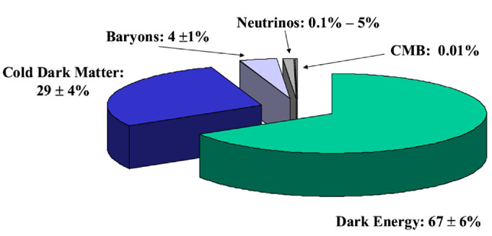
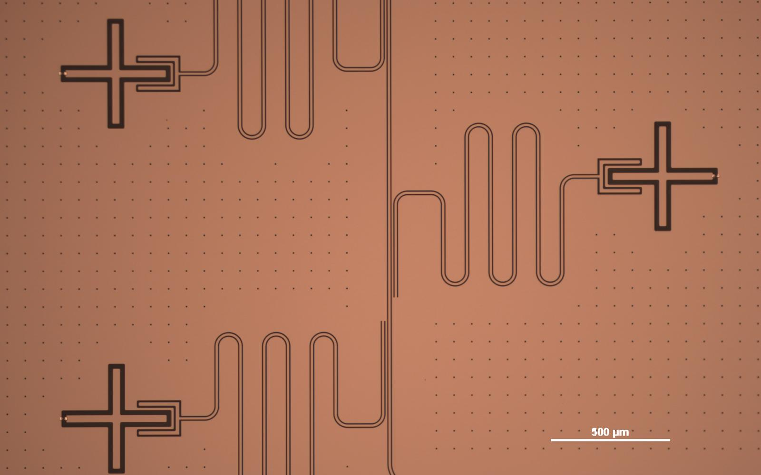
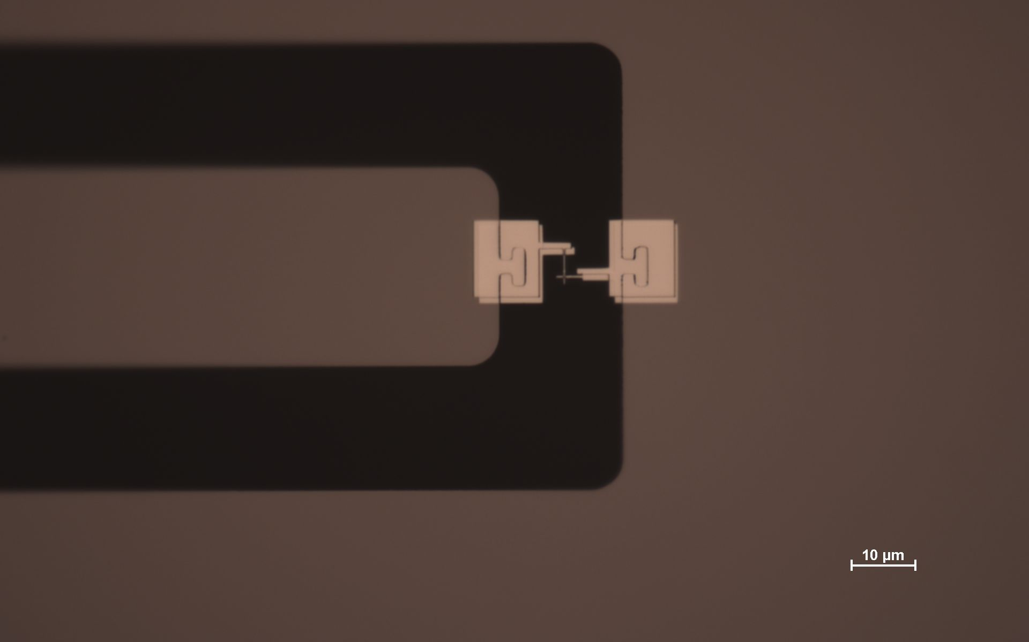
Quantum Computational Sensing for High Energy Physics
Aaron S. Chou
Fermilab and University of Chicago
IDM 2026, Zaragoza
June 3, 2026
SC Qubit = nonlinear LC oscillator
= artificial atom
Intro to Quantum 3.0
Single sensor readout – Saclay’s quantum data pipeline
Multi-sensor readout and quantum principal component analysis
Speed up interaction rates by entanglement
Broadband single photon detection using blackbody metamaterial

Slide 2




Hilbert space of N qubits or N sensors is exponentially large, encoding 2^{N}-1 complex variables
spin–up or spin-down,
ground state g or excited state e
A single qubit has basis vectors
and an arbitrary state is:
The basis for 2 qubits is
A 3-qubit system state can be written as
Each binary integer labels a new complex variable.
Compare to silicon bits: N bits stores a single integer with possible values 0 ... (2^{N}-1),
N qubits stores (2^{N}-1) complex numbers!

Slide 3
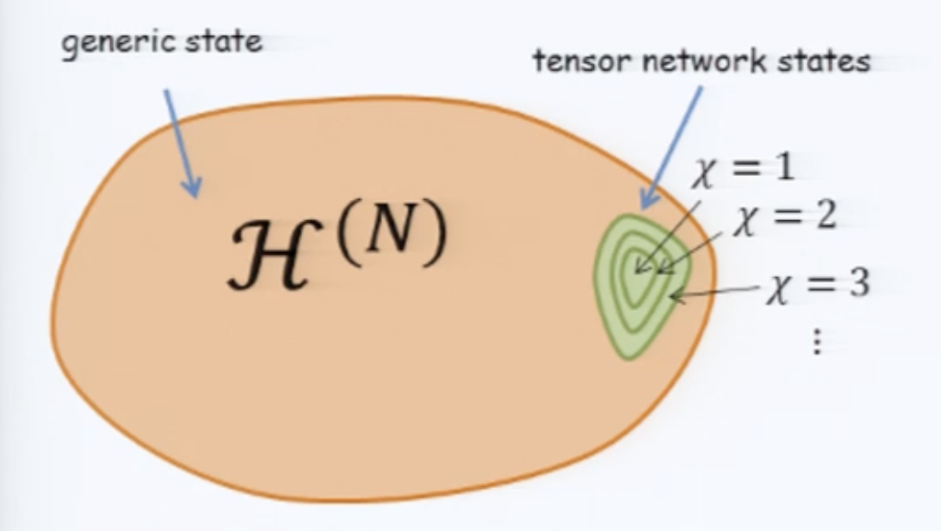
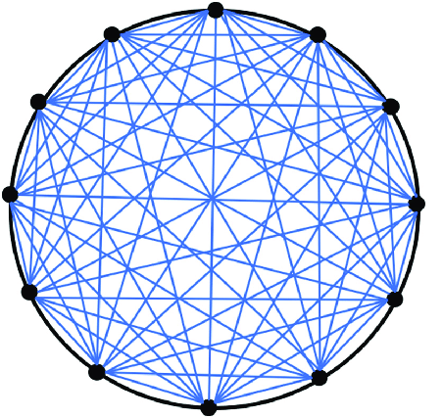
Quantum sensing of weak forces produces only small occupation of the exponentially large Hilbert space of N quantum sensors
The HEP sensing problem is thus rather simple and can benefit from the limited capabilities of near-term quantum processors and application-specific quantum circuits.
More advanced quantum computing problems:
Fully populated Hilbert spaces are needed to describe some quantum materials, and for black holes which maximize the von Neumann entropy
All-to-all connectivity in Sachdev-Ye-Kitaev holographic model

Slide 4
Quantum 3.0: Quantum sensor + quantum computer + artificial intelligence
Feedback: AI = Scientist
Classical supercomputer
AI
Quantum experiment
Quantum Computer
Output
Input/control
Unitary quantum link
classical link
N=300 channel quantum sensor array generates 2^{N} = 10⁸² GB of entanglement data, on demand
Accepts and processes the full stream of 10⁸² GB and filters it into a classically manageable data rate.
Uses real-time data stream to train. Controls experiment to test hypotheses.
The quantum computer allows us to probe nature in a way that has never before been possible by pre-processing quantum information prior to wavefunction collapse
Let AI choose which N measurements to make out of the 2^{N} possibilities and manage the back-action. No need for humans to curate the limited stream of classical data.

Slide 5
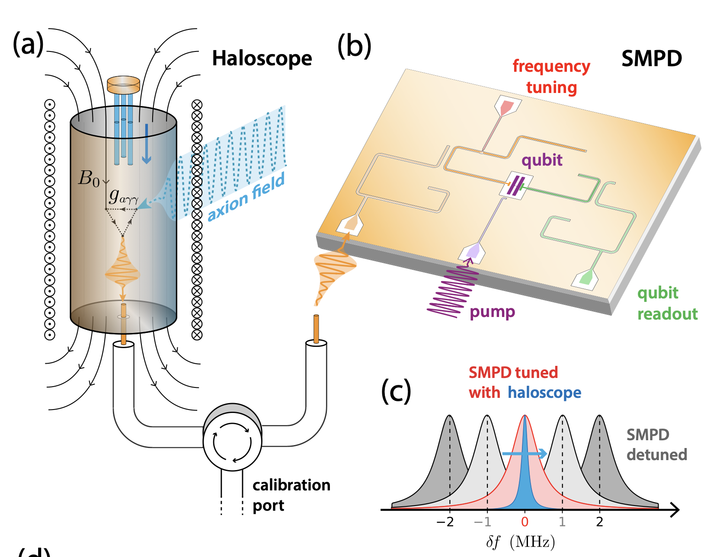
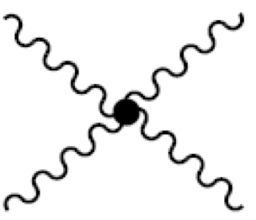
Start with 1 sensor: Single microwave photon counter evades quantum noise by measuring only wave amplitude $\sqrt{N}$ but not phase 𝜑
Qubit = single quantum 4-wave mixer:
f_{signal} + f_{pump} = f_{qubit} + f_{output}
Photon is detected via a controlled-X gate, exciting the qubit transition g→e only when a signal photon is present. No SQL noise penalty for unity-gain, unitary transduction operation.
7.37 GHz
Superconducting electronics located safely outside of the magnetic field
K. Inomata, ... Y. Nakamura, Nature Communications 7, 12303 (2016)
L. Balembois, et al., Phys.Rev.Applied 21 (2024) 1 014043
C. Braggio et al., Phys.Rev.X 15 (2025) 2 021031

Slide 6
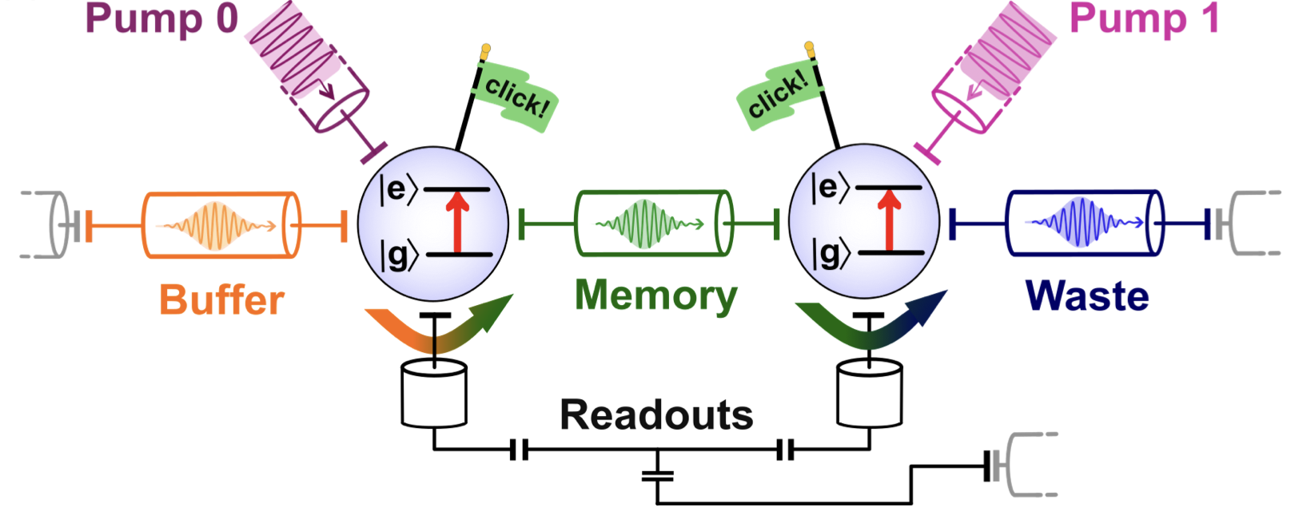
String of qubits can be used as a data processing pipeline, making repeated quantum non-demolition measurements of a single quantum of information
A. May et al., arXiv:2502.14804
A true single photon passes through the pipeline and excites the entire string of qubits.
Immune to single-qubit errors which do not produce the propagating single photon
Demonstrated DCR = 1 count/s of single photons at 7 GHz.
Compare to standard quantum limit ~ 10⁴ counts/s for 10 kHz bandwidth.

Slide 7
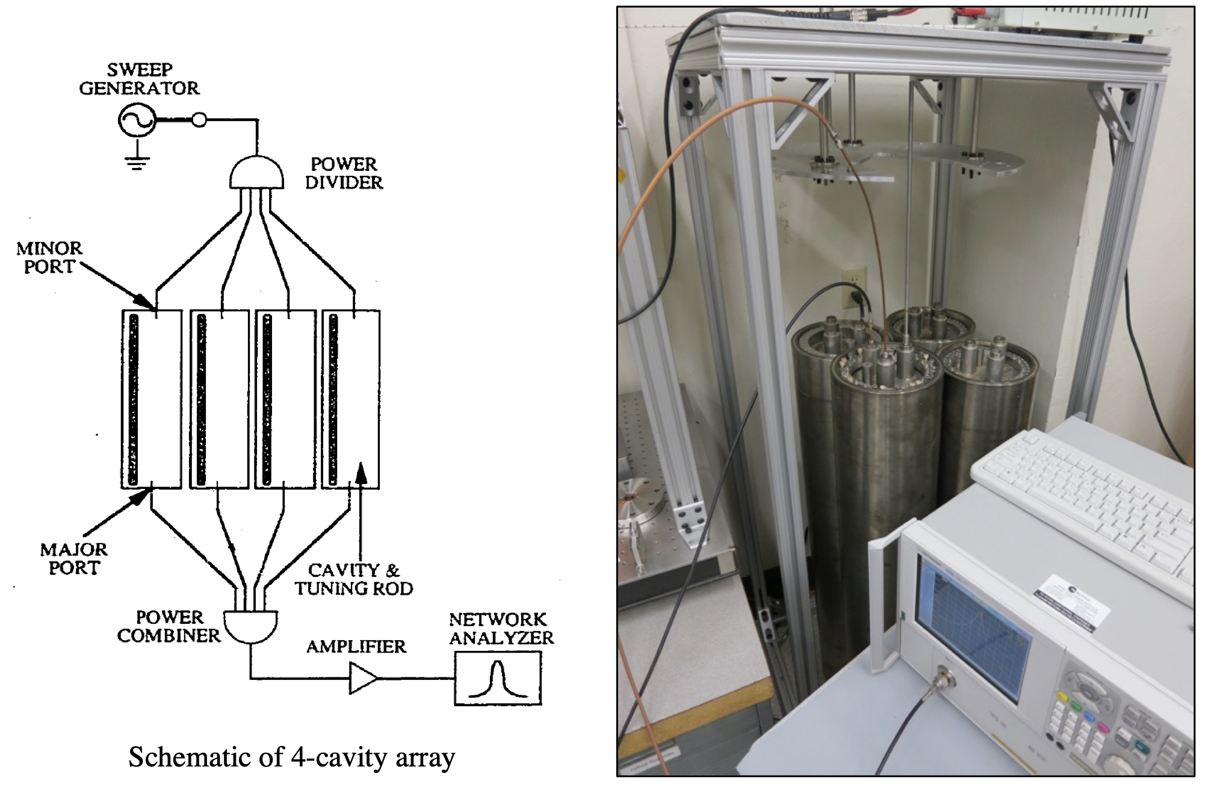
Example 2: ADMX increases target size by using multiple cavity sensors and combining signals
Analog power combining is difficult because sources must be amplitude and phase-matched to prevent reflections.
Cavities are not exactly identical, and tuning mechanisms can get stuck.

Slide 8
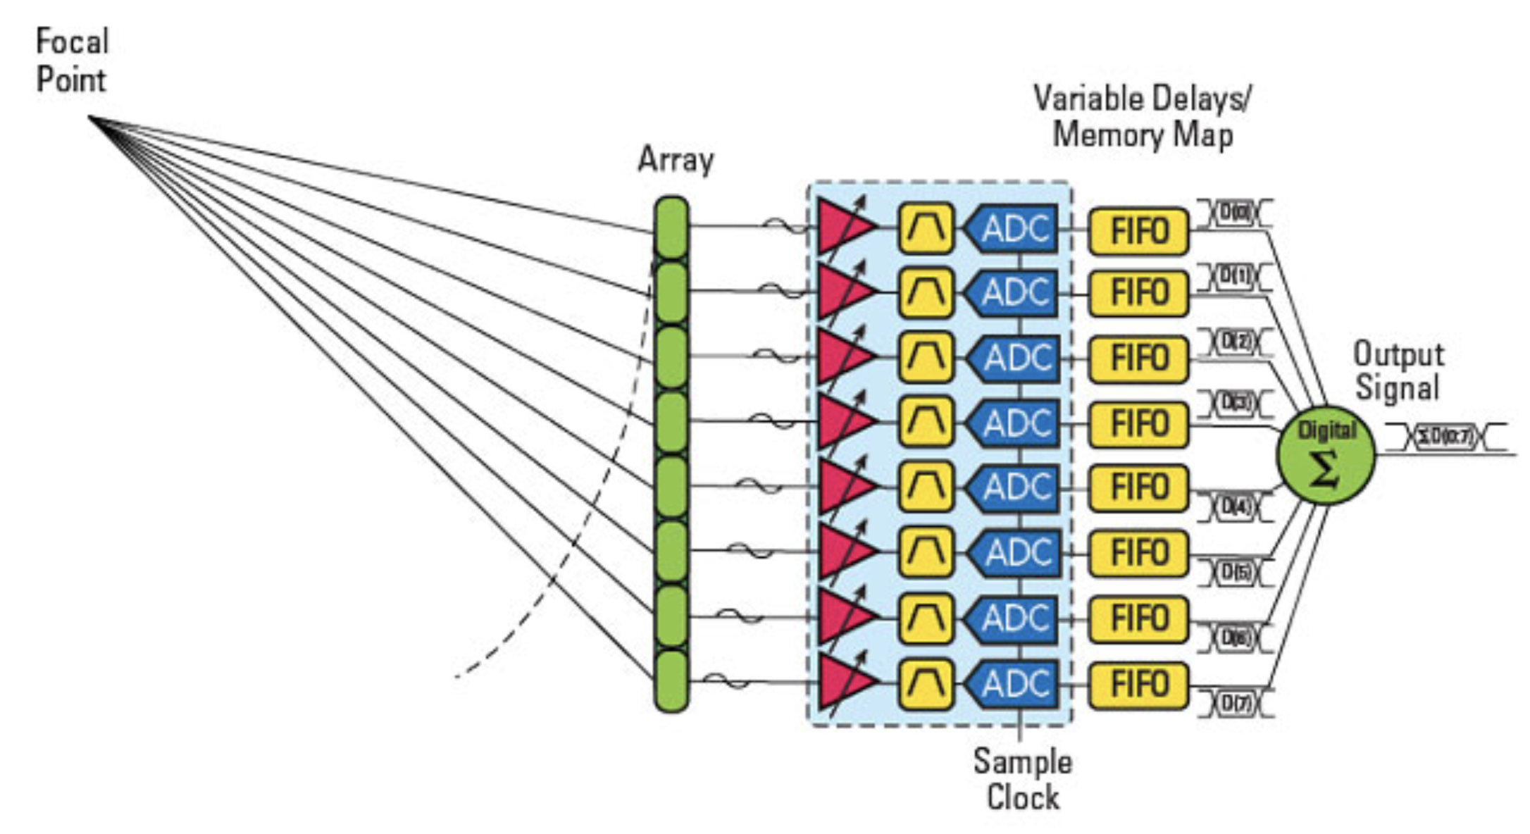
Classical beamforming for radio arrays
If signals are large enough: amplify, digitize, power-combine in the digital domain (with phase delays).
Total noise from N detectors is N times larger, but this is split into N orthogonal collective modes.
The selected detection mode only gets 1 copy of the noise, so no harm is done.

Slide 9

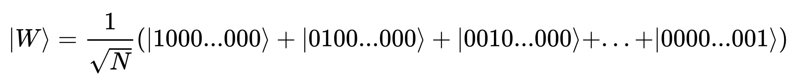
Quantum sensing becomes useful when the signal mode contains <1 quantum of information
In wave dark matter experiments, a single signal photon is coherently distributed amongst all N quantum detectors as a Dicke state:
S. Chen, et al., arXiv:2510.01816
We could read out the N detectors separately, but incur N times the quantum readout noise.
Can we instead perform common-mode readout using single photon counting to completely evade the noise???

Slide 10
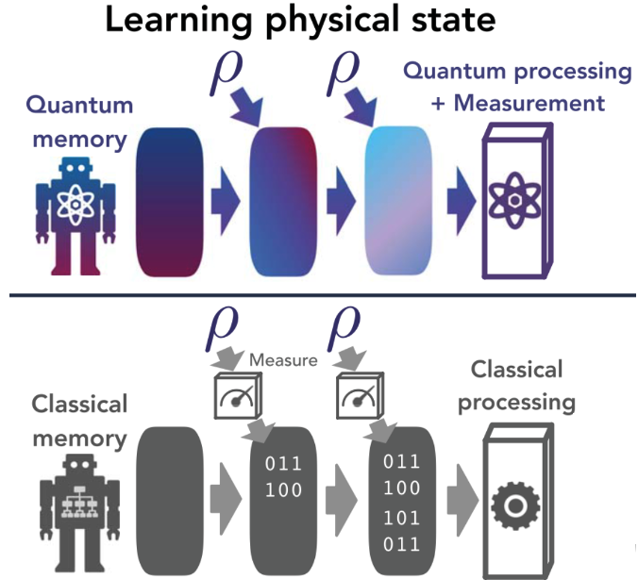
Quantum beamforming for radio arrays
Use quantum computer to aggregate the common-mode signal into a single readout node and perform QND measurement
Single photon in collective mode?
Yes/No
At a minimum, the quantum computer can be a programmable, analog power combiner.

Slide 11
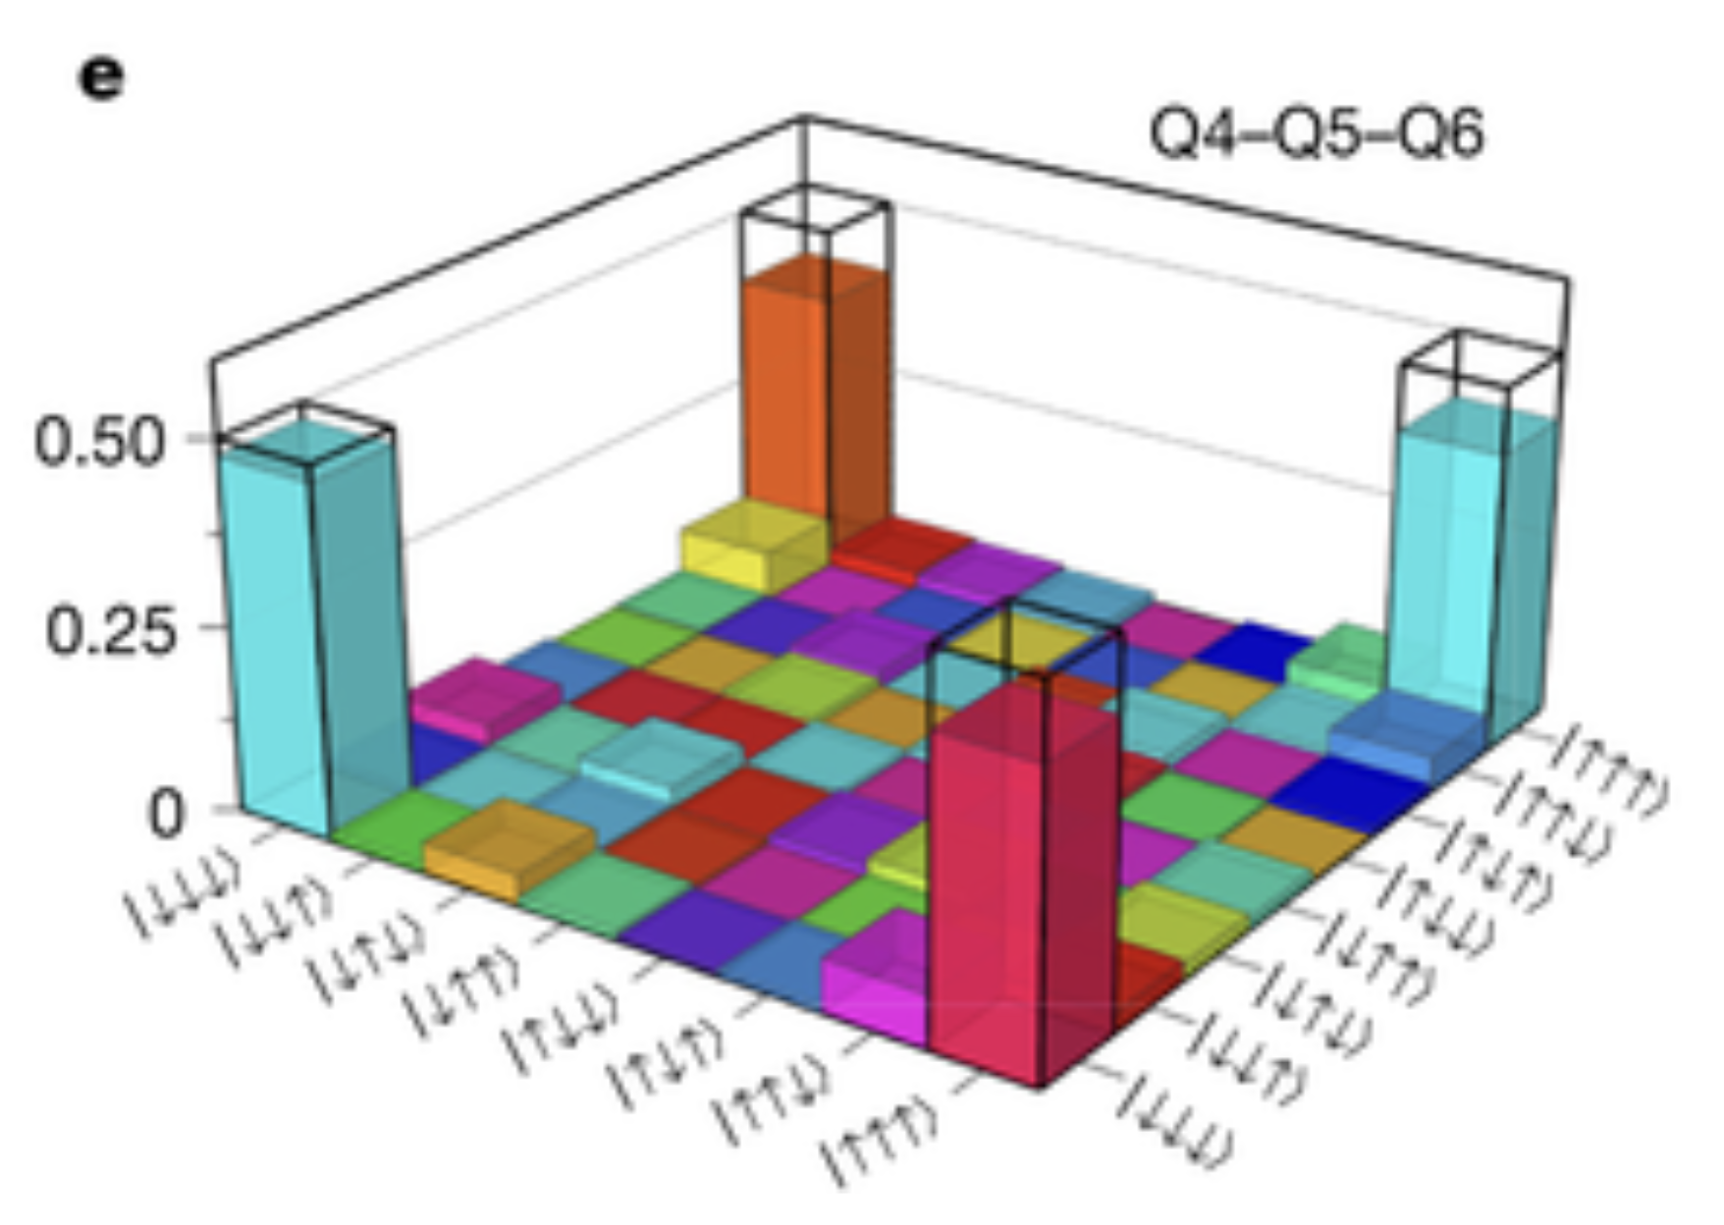
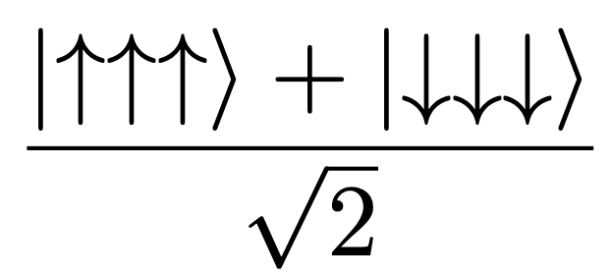
Ex. Quantum Principal Component Analysis
S. Lloyd, Mohseni, Rebentrost 2013,
H-Y Huang, et al., 2021
Where in the density matrix is the signal concentrated???
We do not need to assume that a signal is in the common mode W state. The quantum computer can analyze the density matrix to figure out where the non-zero elements are distributed.
Classical: Exponential resources needed to diagonalize a density matrix of size 2^{N} x 2^{N} and one needs at least 2^{N} experiments to obtain all of this classical data
Quantum Principal Component Analysis can be performed in linear N time using ~N copies of the density matrix from repeated experiments.
Example: 8x8 Density matrix of 3-qubit system in a Greenberger-Horne-Zeilinger (GHZ) state
S. G. J. Philips et al. (2022)

Slide 12
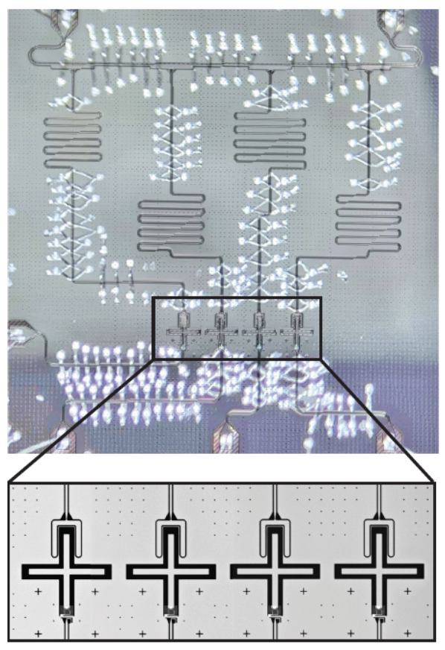
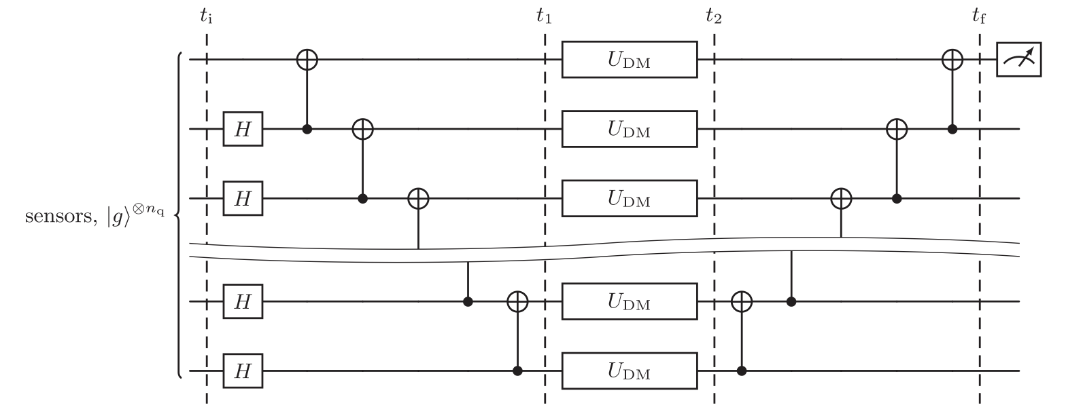
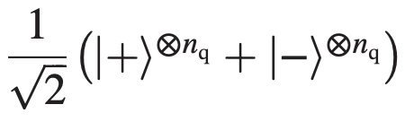
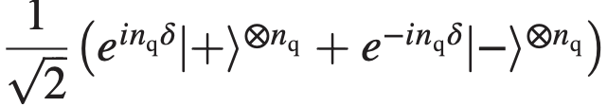
Ex. Initialize Greenberger-Horne-Zeilinger entangled state in a superconducting qubit sensor array
S. Chen, et al., PRL 133, 021801 (2024)
Fermilab-KEK collaboration
Dark matter creates phase errors in collective clock state, enhanced by factor n_{q} .
Chip from R. Ma (Purdue) operating at Fermilab

Slide 13
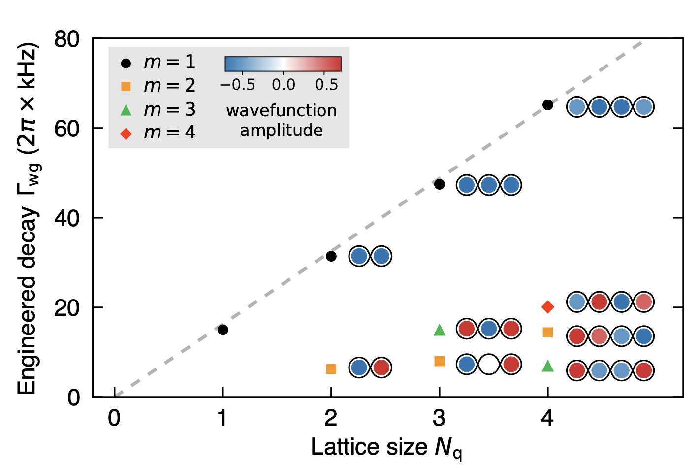
Entangling N qubits of the same frequency speeds up the dark matter interaction rate by a factor N. This is the Heisenberg limit.
However, rates for all processes are increased by the same factor → Example: superradiant decay.
B. Du, Q Guo, and Ruichao Ma, 2605.12442
Price paid for Heisenberg sensitivity is reduced coherent measurement time.
Coherence time is a quantum resource.
If a qubit or cavity’s lifetime is larger than needed, e.g., > dark matter’s coherence time, then use up the excess coherence time to create entangled states

Slide 14

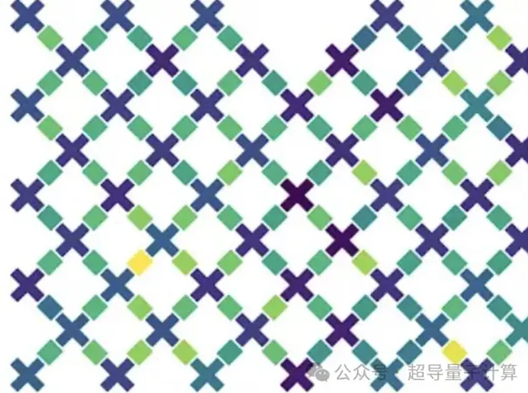
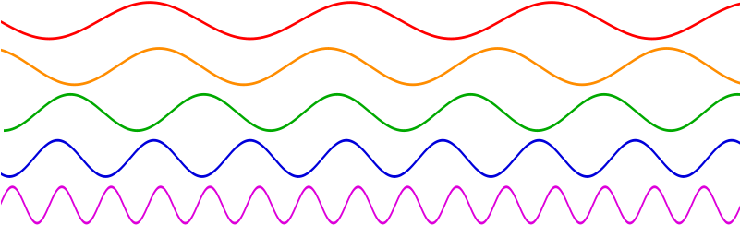
Dish antennas are broadband axion scattering targets, but we do not have any broadband single photon detector.
→ Engineer a qubit metamaterial blackbody
Absorptive quantum neutral density filter:
Different antenna sizes, different resonant frequencies,
different coherence times, ... but finite optical depth.
Aha! Orange wavelength is matched to the array periodicity.
Use a quantum computer to analyze this qubit metamaterial blackbody’s microstates. Use Grover-Heisenberg analysis in the time domain and principal component analysis in the space domain.
Can detect the single photon signal and also determine the photon’s wavelength.

Slide 15
Takeaways:
Useful quantum processors are on the horizon
  They are coming for your bitcoin!
Early quantum circuits are already being used for quantum sensing, creating breakthrough sensitivity improvements
  e.g., Saclay’s single microwave photon counter
Entanglement of N qubits states can speed up interaction rates, at the cost of coherence
Universal quantum computer can pre-process exponentially large amounts of data from quantum sensor arrays. This allows us to look at nature in completely new ways that were not possible before.

