Slide 1
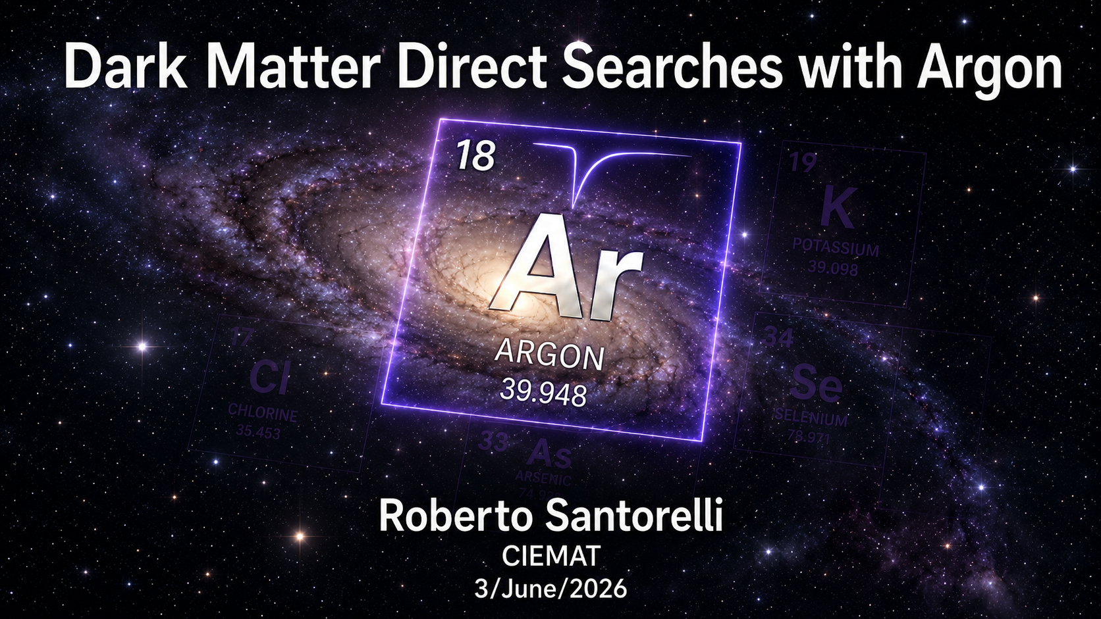
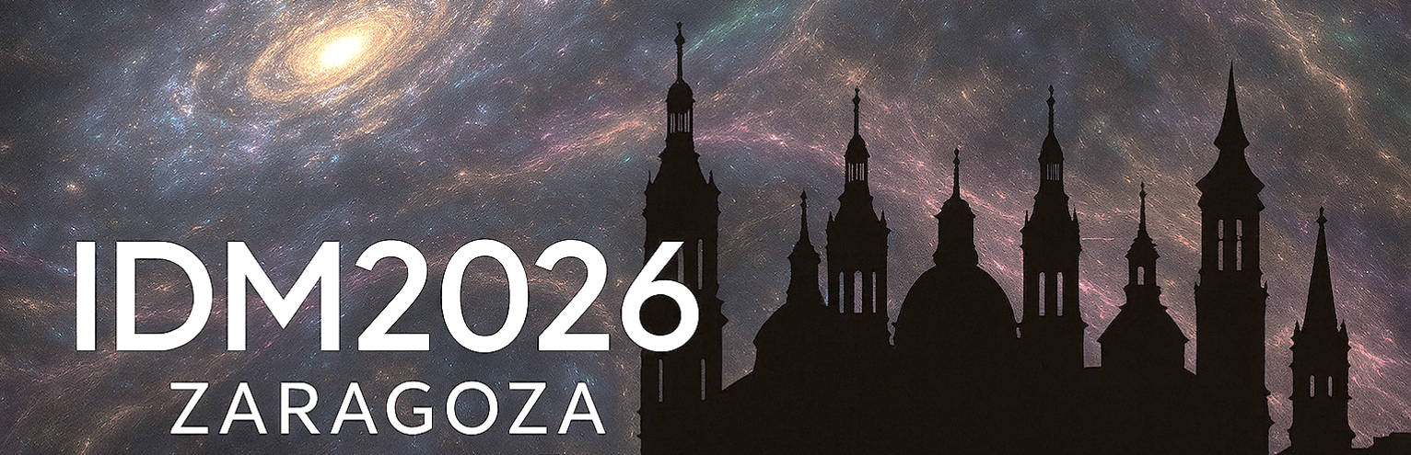



Slide 2
Outline:
Dark matter direct detection with Argon
where, why, how?
Technology
  Single-phase vs dual-phase
  Liquid and Gas
Physics
  High-Mass
  Low-Mass
  Exotic….
Current picture
Prospects

Slide 3

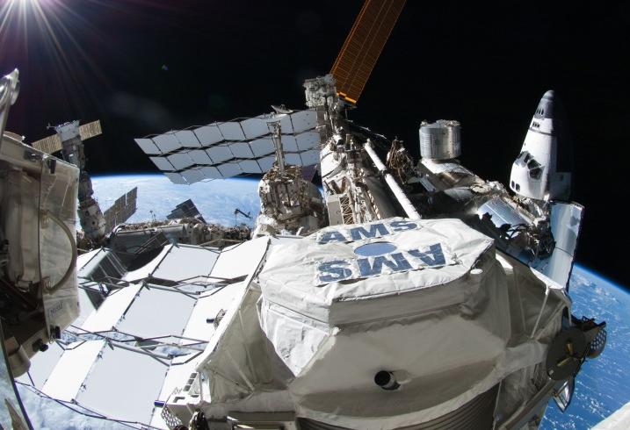
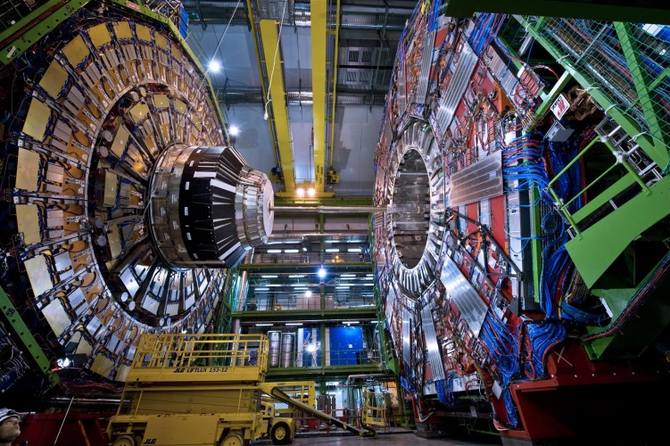
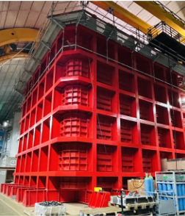

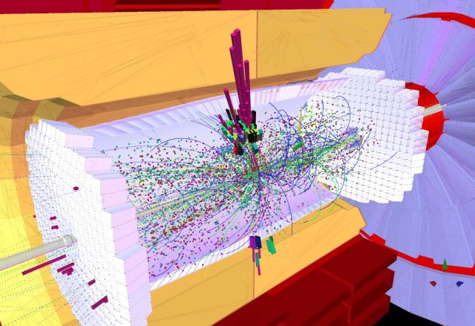
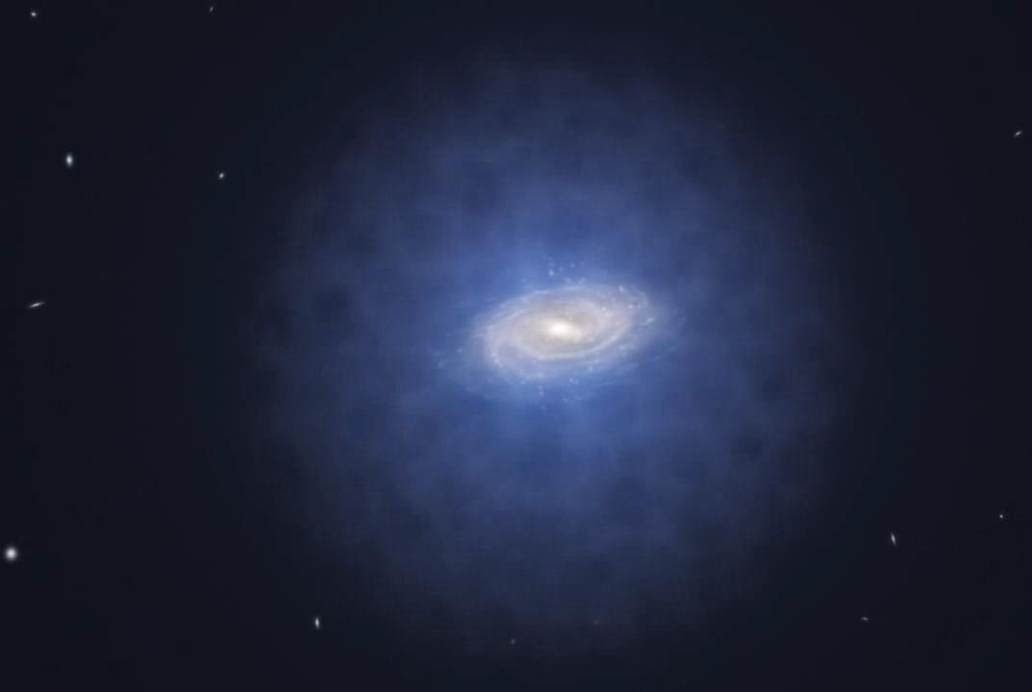
Argon…where
χ
χ
χ
χ
q
q
q
Above ground Collider Underground

Slide 4
Argon…why?
Two fundamental concepts :

Slide 5
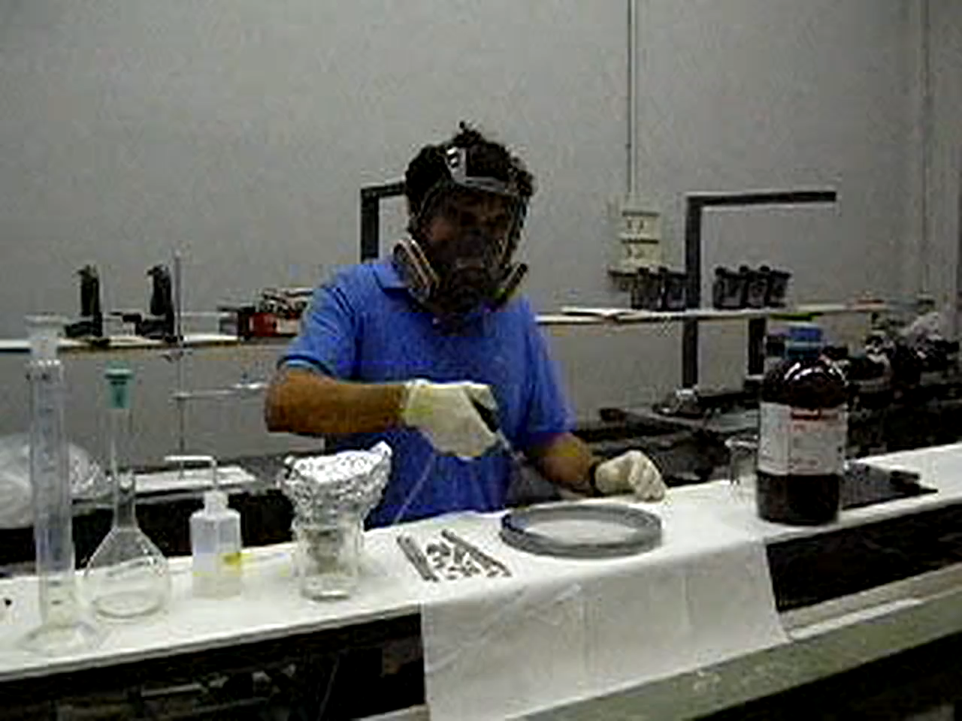
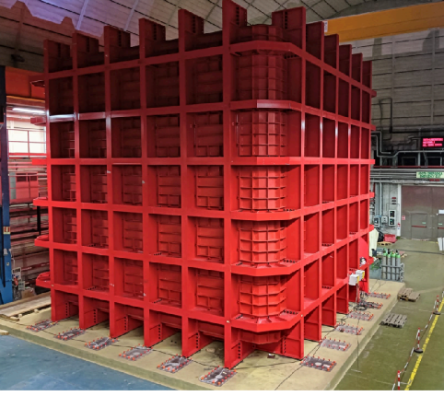
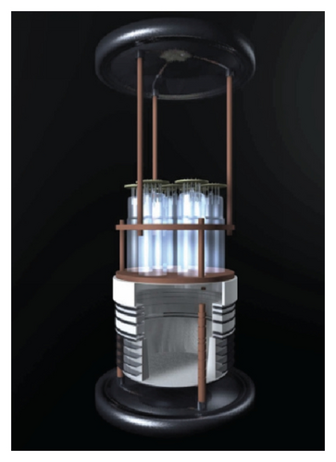
Argon…why?
Two fundamental concepts :
The speaker with pieces of an early DM-Ar detector in his hands
(circa 2003)
The speaker inside a DM-Ar detector
(circa 2026)

Slide 6
Argon…why?
Two fundamental concepts :
10³
Increase the active mass
10²
10¹
WARP DarkSide-20k

Slide 7
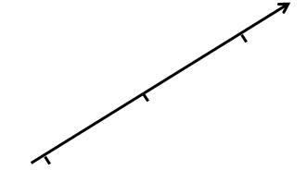
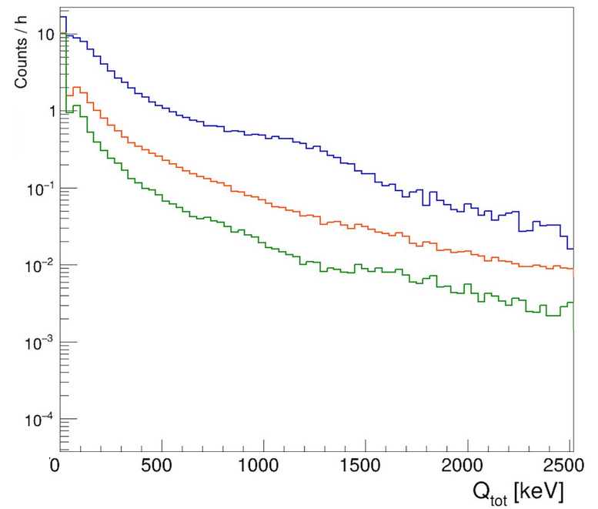
Argon…why?
Two fundamental concepts :
10³
10⁻¹
Increase the active mass
Reduce the background
10²
10⁻²
10¹
10⁻³

Slide 8
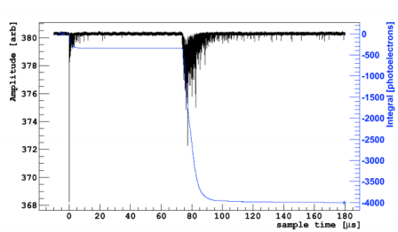
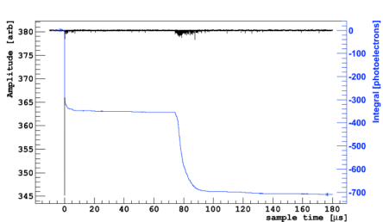
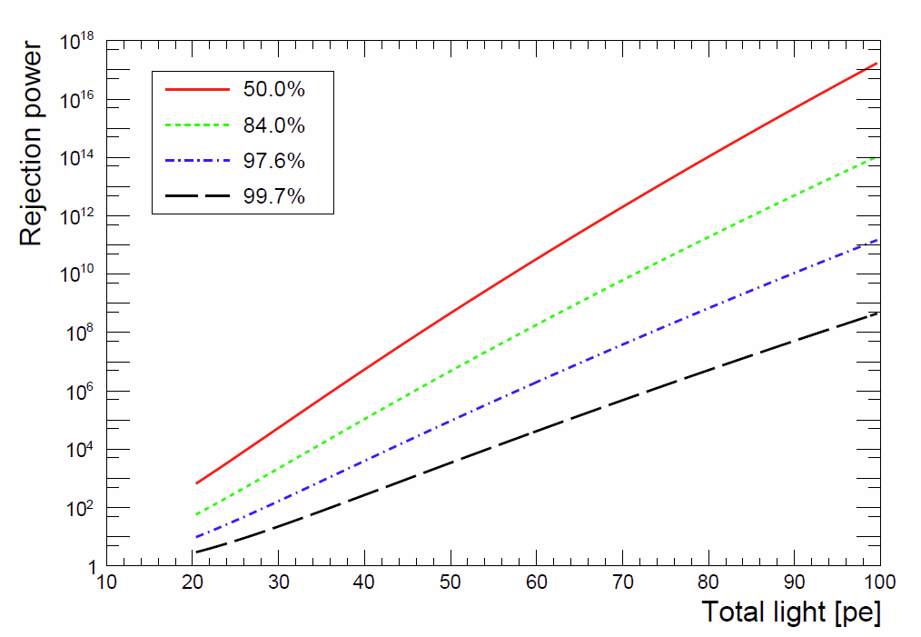
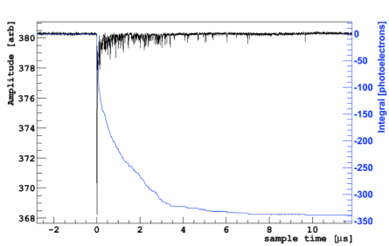
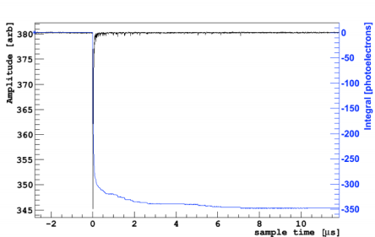
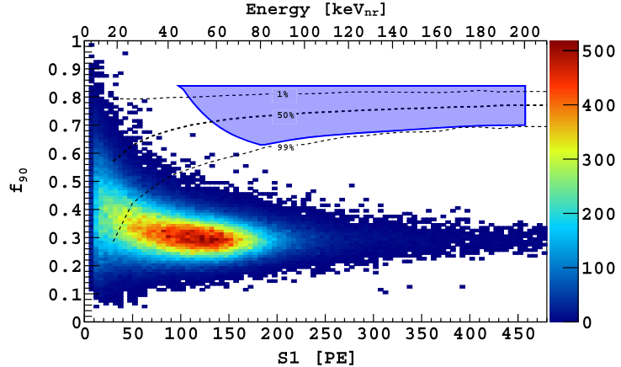
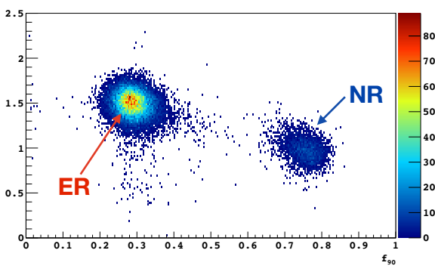
Argon…how?
ER-like event
NR-like event
ArDM @ LSC JCAP 12 (2018) 011
NR acceptance
S1/S2
Due to an enhancement of the recombination process
Phys.Rev.D 98 (2018), 102006
S1
only
Prompt fraction ≈ 30 %
Prompt fraction ≈ 70 %
Log₁₀(S2/S1)
f₉₀
Notes:
8

Slide 9
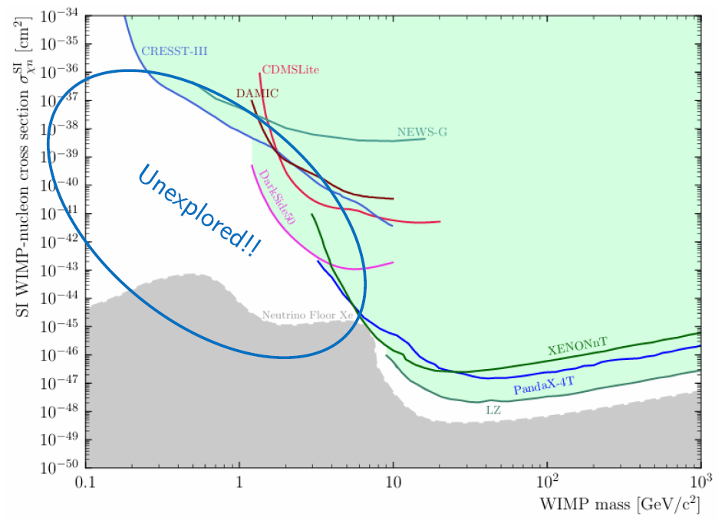
TREX-DM: DM (TPC for Rare Event eXperiments-Dark Matter)
High-pressure gaseous TPC for light WIMPs @ LSC
Detector: cylindrical copper HP-gas TPC, 20 L total active volume split into two 25 × 25 × 16 cm³ drift regions.
Target mixtures at 10 bar: about 0.3 kg Ar - 0.16 kg Ne with small isobutane quencher.
Shielding: 5 cm copper + 20 cm lead, with polyethylene and water neutron shielding around the system.
Two 25x25 cm² microbulk Micromegas readouts: the largest surface ever built with this technology.
from Merck
20 L
10 bar
512
2400 m.w.e.
active gas volume
Ar / Ne operation
Micromegas channels
Canfranc depth

Slide 10
Backgrounds studies and New Design
Design expectation: 1–10 dru in the 1–50 keV region, dominated by radiopurity of Micromegas, copper vessel activation and field-cage materials.
Radiopurity upgrade: chemical treatment of microbulk material reduces ⁴⁰K by about a factor 3, bringing the readout-plane contribution below 1 dru in the model.
Initial underground runs: radon dominated (about 600 dru in low-energy data)
Concept: improve gain adding a GEM stage on top of the Micromegas planes
→ bring voltages to the max. → lower energy threshold
The GEM stage multiplies the drifting electron cloud before entering the Micromegas gap, allowing higher effective gain without forcing a single amplification stage to breakdown.
Bench tests in Ar - 1% iC4H10 showed GEM extra gain factors around 80-90 at 1 bar, 50 at 4 bar and about 20 at 10 bar; full-size tests reached x80 at 1 bar.

Slide 11
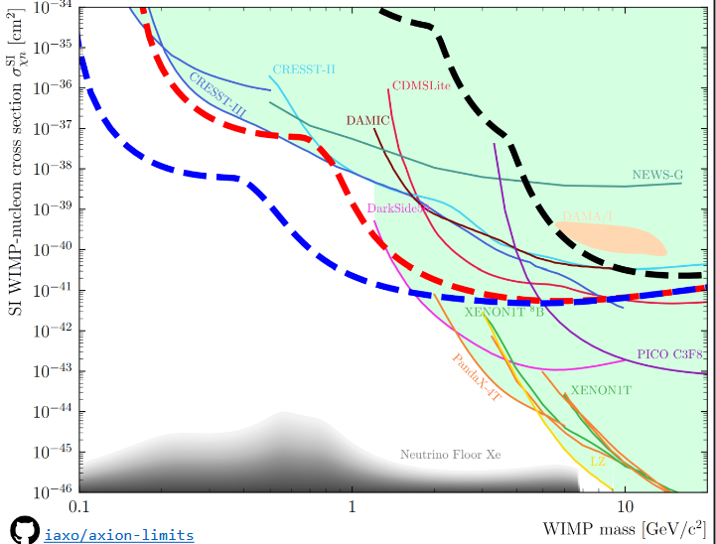
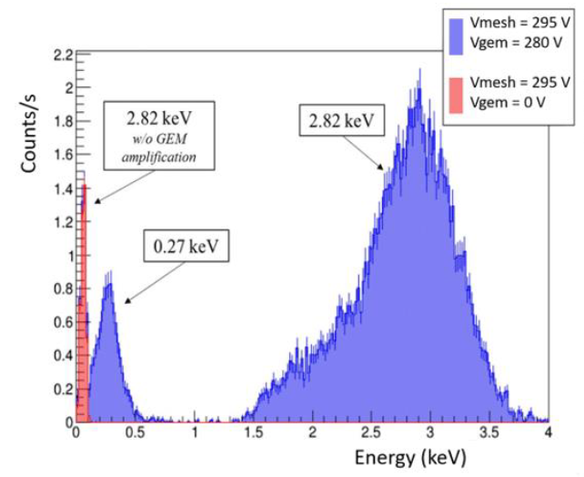
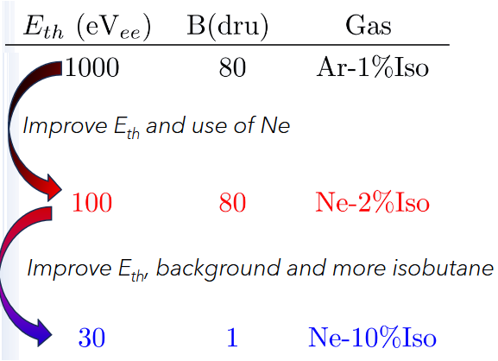
Recent results and prospects
The ³⁷Ar source provides a homogeneous in-gas calibration: K shell at 2.82 keV, L shell at 0.27 keV, directly relevant to the WIMP analysis threshold.
More details in Álvaro Ezquerro’s talk @IDM26
x80 at 1 bar
Low-energy spectrum: 0.27 keV peak
O(10) eV threshold?

Slide 12
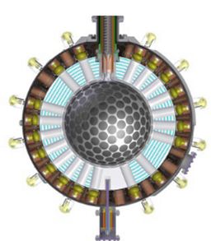
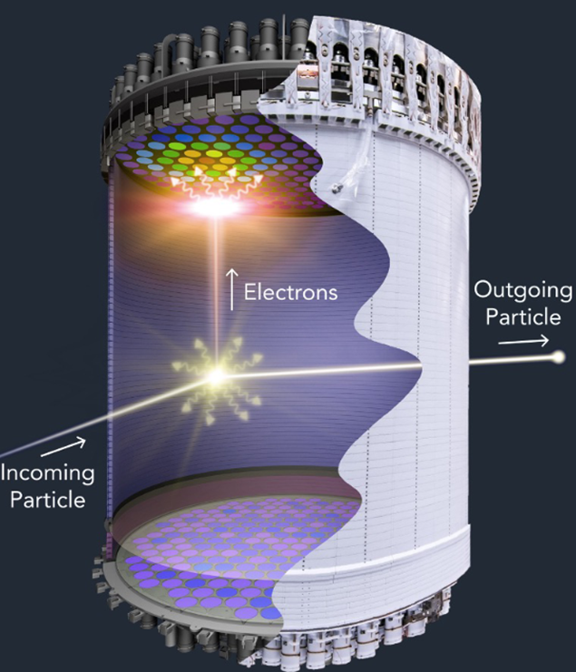
Single-phase vs Dual-phase
Simple approach/operations
Better control of the radiopurity
More scalable
Better position reconstruction
Lower energy threshold
Single site vs multi site rejection
Charge+light bkg rejection

Slide 13
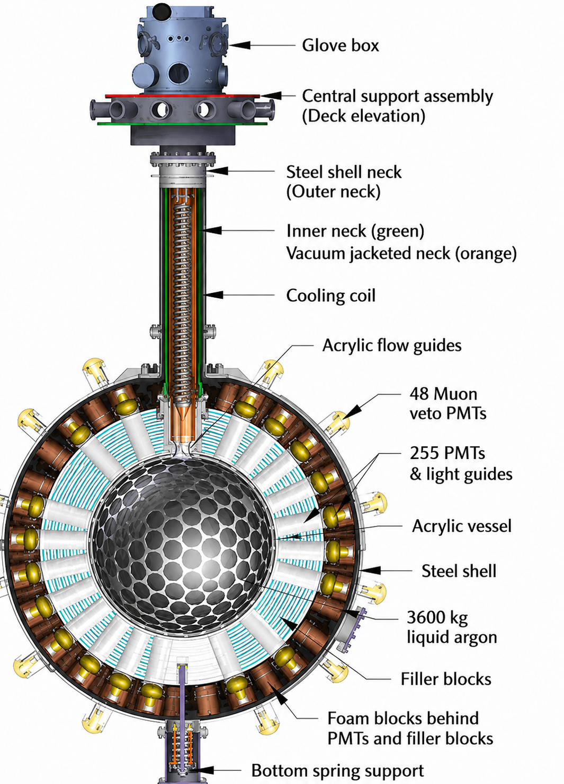
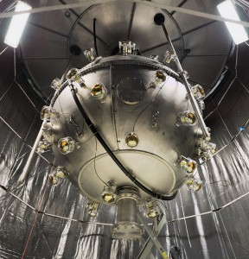
DEAP-3600 @ SNOLAB
Target : 3269±24 kg of LAr in acrylic vessel
Photon detection 255 PMTs: 8” - 32% QE - 75% coverage connected via acrylic light guides
Inner surface of vessel coated with TPB wavelength shifter
Shielding: Filler blocks between LGs used for thermal insulation and neutron shielding
Veto: Steel shell immersed in 300 tons of H₂O, viewed by 48 veto PMTs.

Slide 14
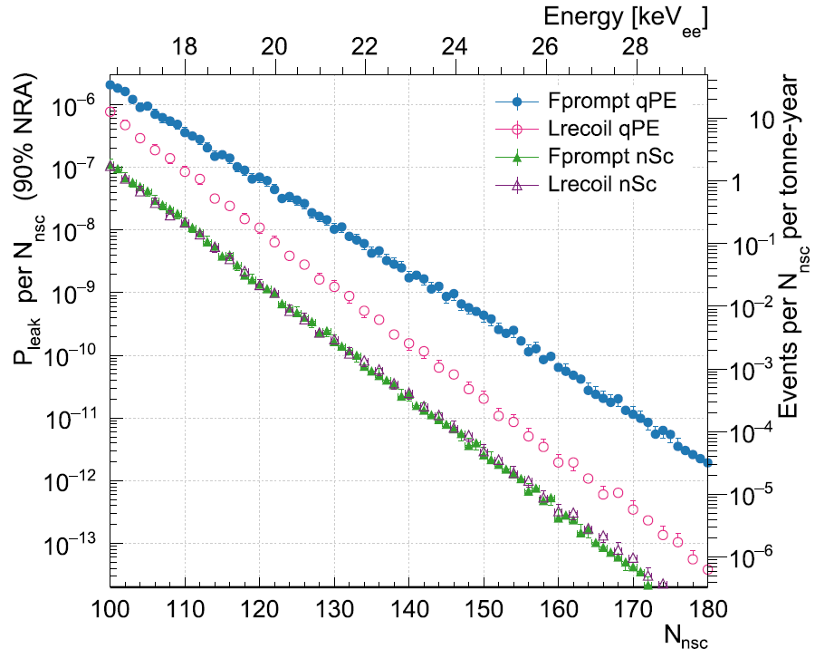
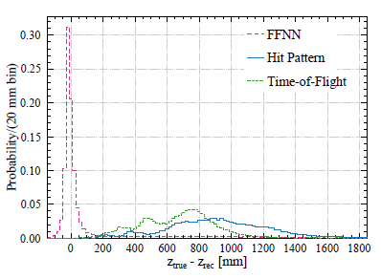
DEAP-3600 Backgrounds
Position reconstruction and fiducialization for surface and external background mitigation JINST 20 P07012 (2025)
Typical position resolution: ~50 mm, depending on event energy and reconstructed radius
PSD in LAr provides extremely powerful rejection of the dominant ³⁹Ar beta background:
Leakage probabilities down to ~10⁻⁹ at 16 keVee and 50% NR acceptance demonstrated in 4.5 tonne-years
Charge-pattern, time-of-flight, and feed-forward NN algorithms.
FFNN: identifying and reconstructing events originating in the detector neck region (much narrower z residual distribution than the likelihood-based methods).
JINST 20 P07012 (2025)
Eur. Phys. J. C 81,823 (2021)

Slide 15
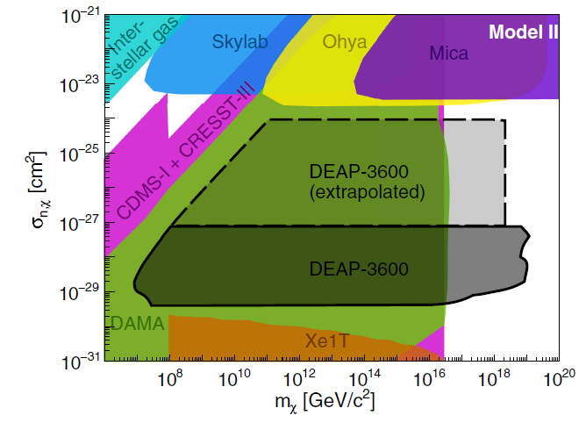
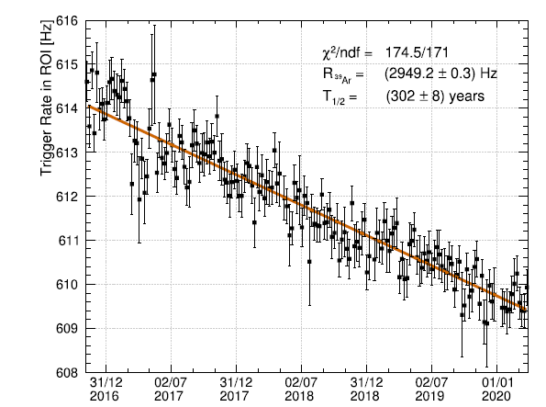
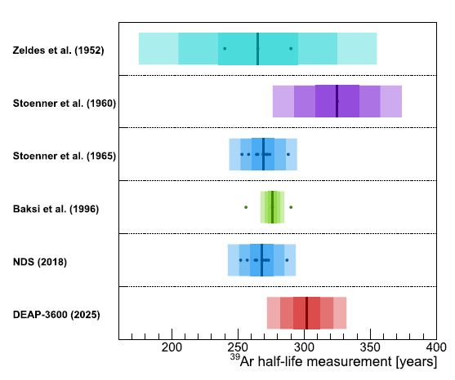
DEAP-3600 recent results
First direct-detection search for Planck-scale mass dark matter using multiple-scatter signatures in liquid argon (a few µs time-scale) :
813 live days and 0 observed candidates (0.5 MeV_{ee}to ~60 GeV_{ee})
leading constraints up to m_{χ} ~ 10¹⁹ GeV/c².
³⁹Ar half-life by monitoring the decay rate of atmospheric argon over 3.4 years (700–1200 PE) .
Result significantly longer than the commonly adopted value and relevant for future argon-based experiments ~268 yr
T_{1/2}​(³⁹Ar) = 302 ± 8 _{stat}​ ± 6_{sys}​ yr
(introduces a systematic correction in the ⁴⁰Ar/³⁹Ar dating)
.
Phys. Rev. Lett. 128, 011801 (2022)
Eur.Phys.J.C 85 (2025) 7, 728
Notes:
The analysis searches for high-energy scintillation signals, from 0.5 MeVee up to ~60 GeVee, using selections based on the number of time-separated peaks and on Fprompt
exclusion region for composite dark matter with the standard coherent nuclear scaling, extending direct-detection constraints up to the Planck-mass scale

Slide 16
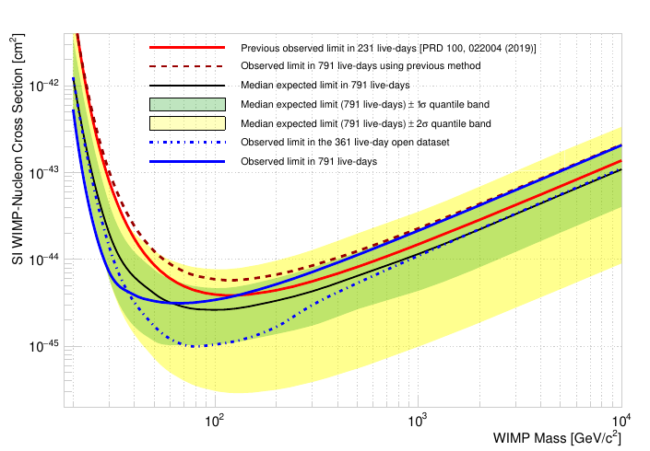
DEAP-3600 WIMP search with PLR
Profile-likelihood WIMP analysis with 790.8 live-days
Exposure: 790.8 live-days, 3269 kg LAr target, 1266 kg fiducial mass
ROI: 90–300 PE, Fprompt contour
PLR variables: PE, Fprompt, Rrec
arXiv 2603.13965
3.4 × 10⁻⁴⁵cm² at 100 GeV/c² (90% CL)
3.2 × 10⁻⁴⁵ cm² at 60 GeV/c² ⁽minimum)
Notes:
blind-data excess weakens the full-dataset limit, especially at high WIMP mass
Main limitation: the method gains acceptance, but the ROI is alpha-background dominated; the hardware upgrade is designed specifically to remove those limiting backgrounds

Slide 17
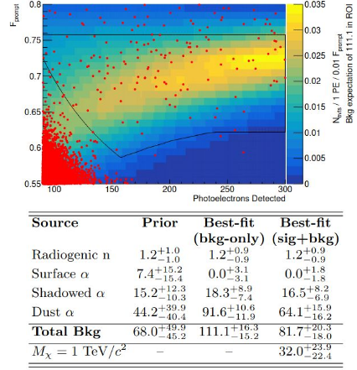
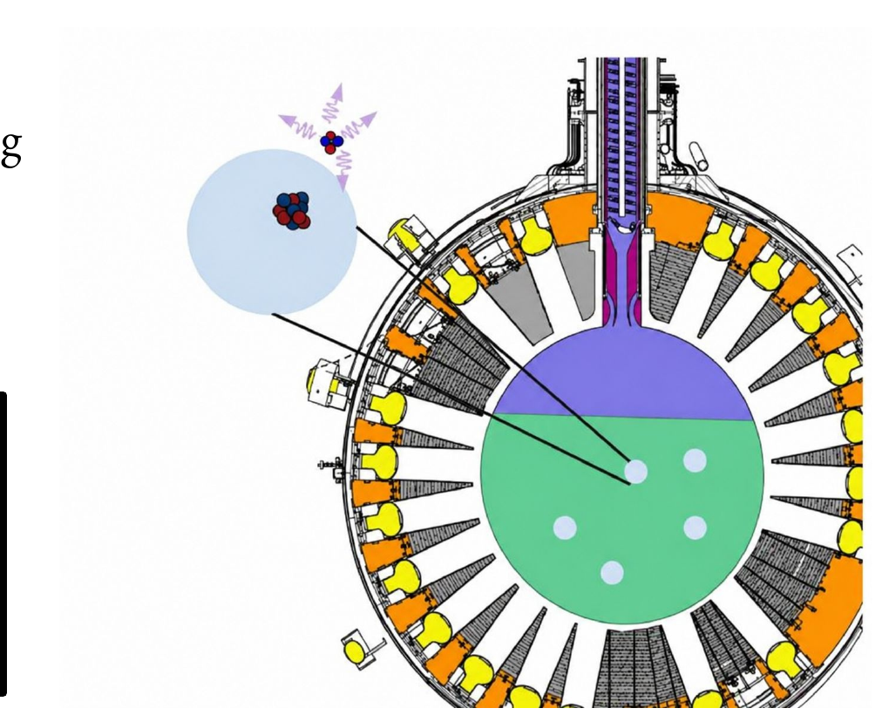
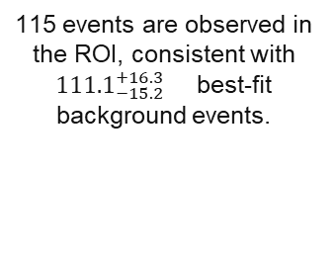
DEAP-3600 WIMP search with PLR
Profile-likelihood WIMP analysis with 790.8 live-days
115 events are observed in the ROI, consistent with ${111.1}_{−15.2}^{+16.3}$best-fit background events.
arXiv 2603.13965
Degraded alpha events from dust particulates best-fit dust contribution 91.6 events.
3.4 × 10⁻⁴⁵cm² at 100 GeV/c² (90% CL)
3.2 × 10⁻⁴⁵ cm² at 60 GeV/c² ⁽minimum)
Shadowed ²¹⁰Po α-decays from the neck remain relevant.
Increased WIMP acceptance by loosening several cuts
→ Larger fiducial volume and looser ROI/cuts increase signal
acceptance (removing the NPMT,FirstLAr cut gives +76% relative acceptance).
Gain in the exposure partially offset by an excess of α-induced bkgs
Degraded alpha events from dust particulates in the LAr
volume.
Hardware recovery: WLS-coated flowguides, external cooling, and dust filtration/recirculation aim to move neck/dust alpha backgrounds out of the ROI.
More details in Guillermo Vera’s talk @IDM26
Notes:
blind-data excess weakens the full-dataset limit, especially at high WIMP mass
Main limitation: the method gains acceptance, but the ROI is alpha-background dominated; the hardware upgrade is designed specifically to remove those limiting backgrounds

Slide 18
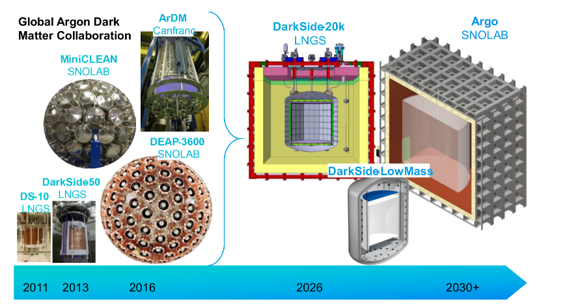
LAr- current scenario
A.B. McDonald: “Dark matter detection with liquid argon“Nucl. Phys. B 1003 (2024) 116436

Slide 19
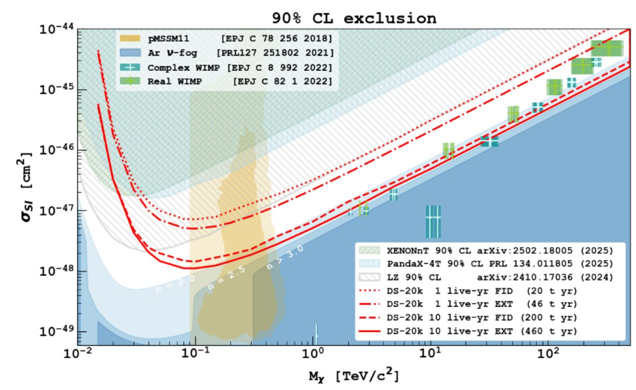
LAr- plans
DS-20k is designed to be essentially free of instrumental backgrounds
at the 10-year it starts to enter the neutrino-limited regime, with about 3.7 atmospheric-neutrino NR events expected

Slide 20
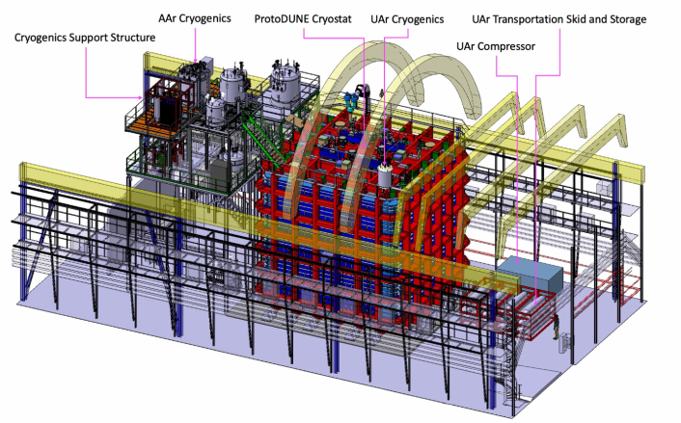
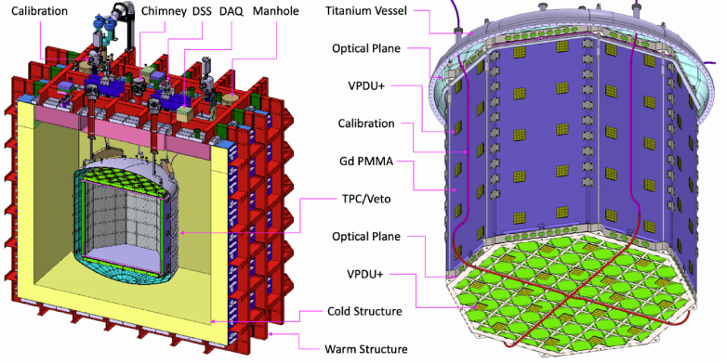
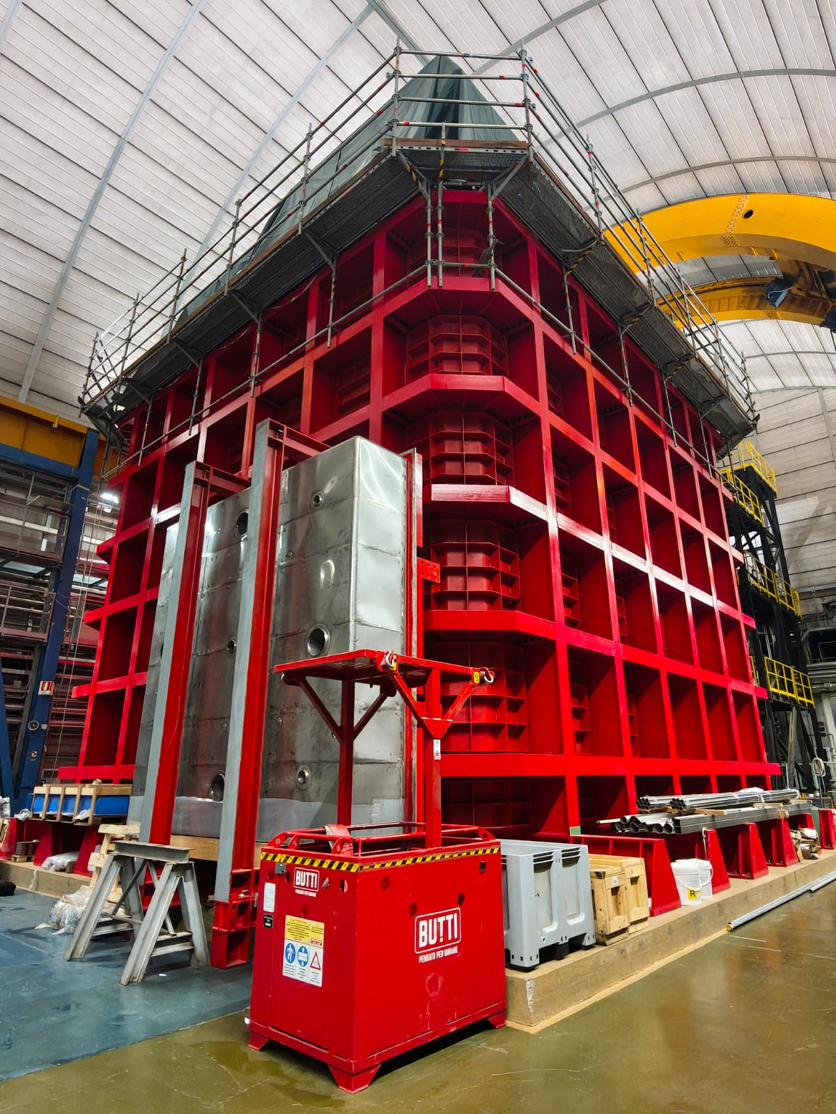
DarkSide-20k @ LNGS
Nested detector with
  ProtoDUNE-like cryostat: 8 x 8 x 8 m³ hosting 650 t of atm Ar (cosmogenic veto)
  SS vessel+structure hosting 99 t underground Ar
  UAr (32 t) + acrylic Veto for neutrons and γ.
  Central Dual-phase Ar TPC (50 t):
    51 t UAr (20 t fiducial)
    348 cm drift
    Cathode @ -73.4 kV
Notes:
To make this sensitivity real, two technologies have to work together:

Slide 21
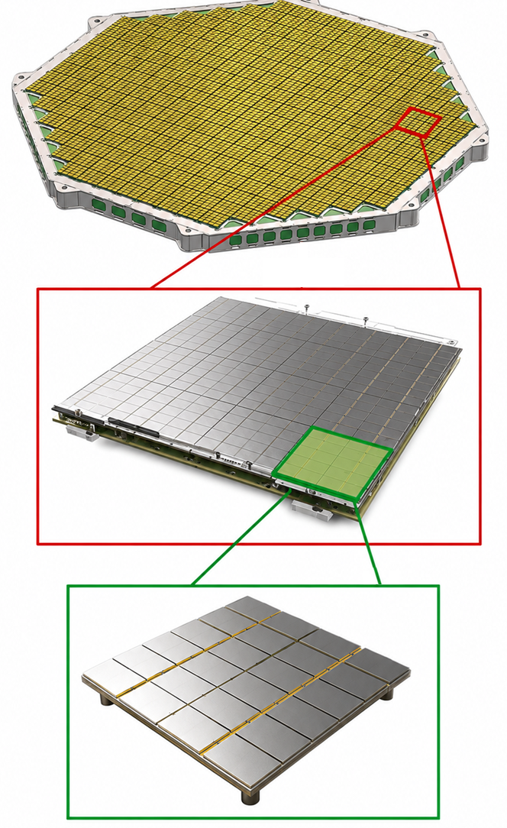
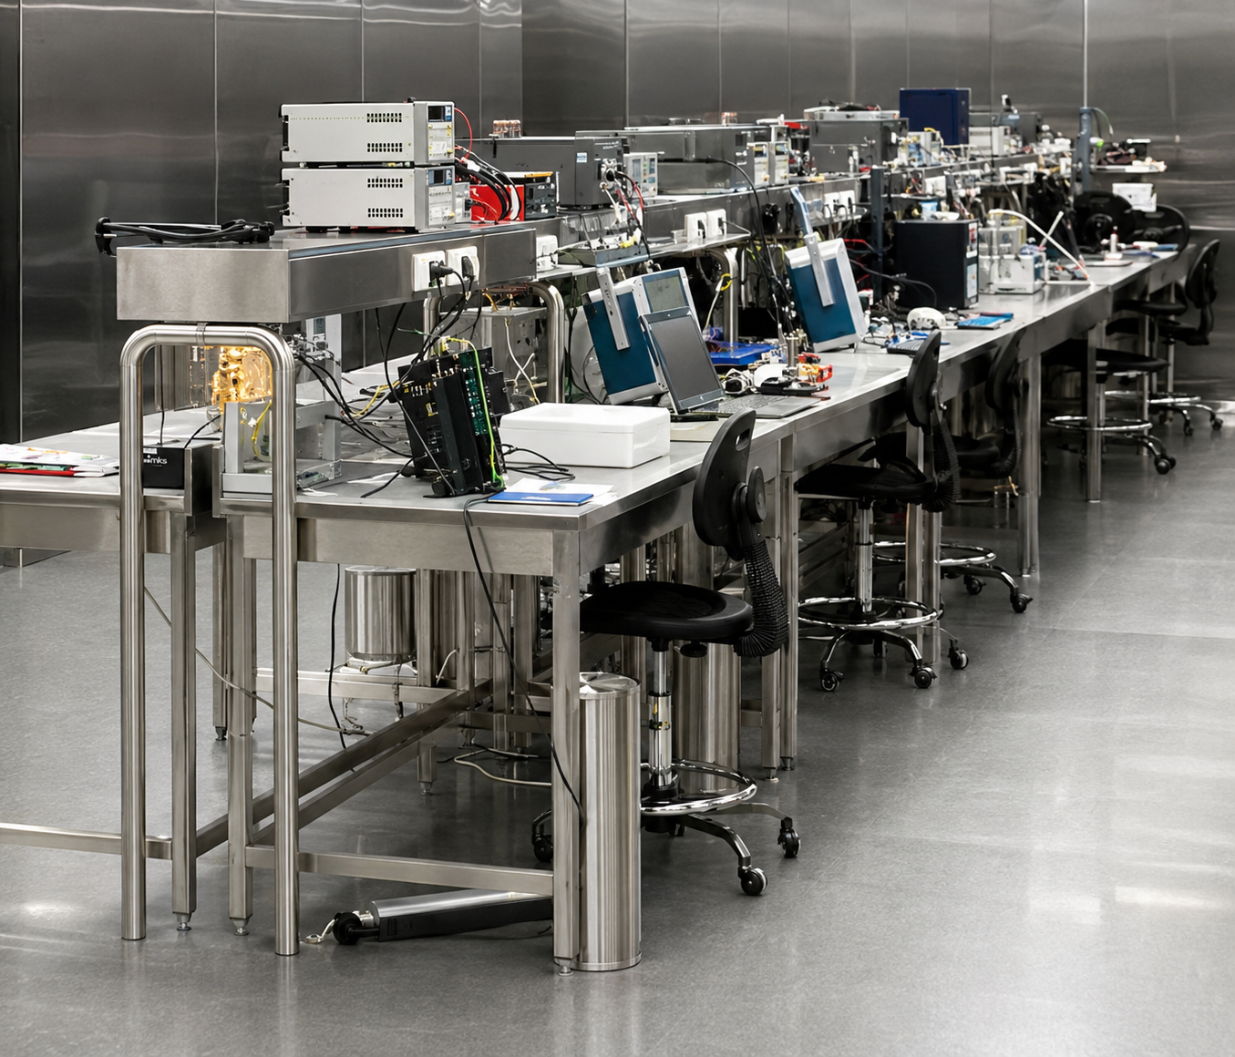
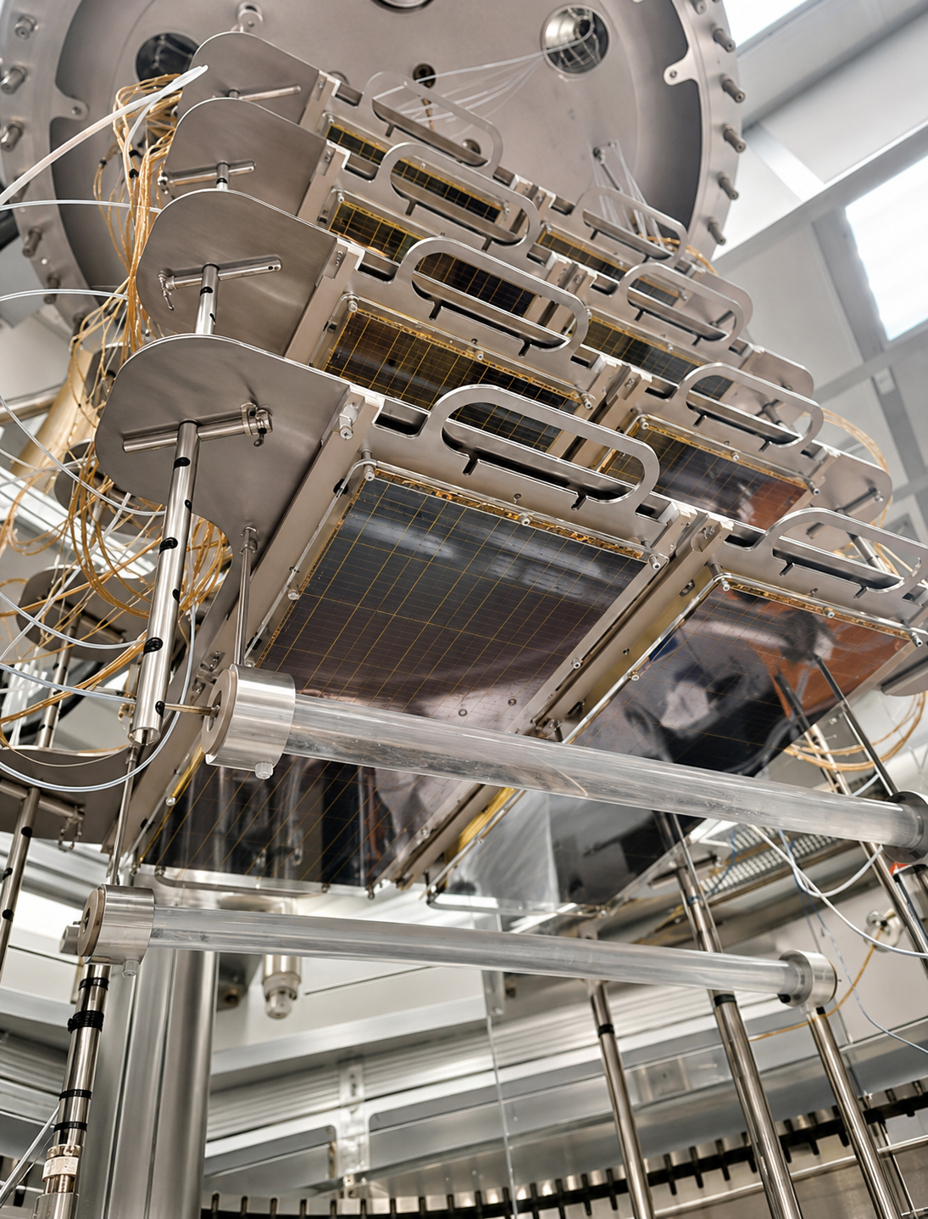
SiPMs
Custom cryogenic SiPMs developed with (FBK) and produced by LFoundry. Key features
Optical planes: ~2x10 m²
525 PDUs
PDU: 20x20 cm²
16 Tiles assembled on a MB
4 Readout Channels
Tile: 5x5 cm²
24 SiPMs directly
mounted on a FEB
Low radioactivity
Photon detection efficiency ~45%
Low dark-count rate < 0.01 Hz/mm at 77K (7 Volts OV)
Timing resolution ~ 10 ns
Production:
• TPC PDUs (~528)
• Veto PDUs (~128)
21 m² of SiPM + 5 m² in veto
Coverage in TPC Optical plane > 90%
Production in Nuova Officina Assergi (NOA)
420 m² ISO-6 with reduced Rn concentration
→ Includes cryoprobing & SiPM dicing for vPDUs
More details in V. Pesudo’s talk @IDM26

Slide 22
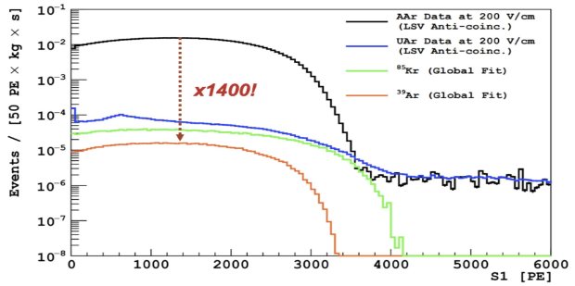
³⁹Ar in Atmospheric Argon (AAr)
β-emitter with 565 keV endpoint, T_{1/2}=269 y (cosmogenic) ⁴⁰Ar+n→ 2n + ³⁹Ar
No accompanying gamma radiation
∼17 mBq/m³ in atmosphere
Present in AAr due to the production process (isotopic abundance ∼ 8×10⁻¹⁶ g(³⁹Ar)/g(^{Nat}Ar)
Argon from underground gas reservoirs → shielded from cosmic rays
Production from natural radioactivity reactions (e.g. (α, n)-induced on ³⁹K) suppressed if the gas is from the mantle (ppb level of U and Th)
1400 ± 200 ³⁹Ar depletion factor in UAr with respect to AAr
Phys. Rev. D 93, 081101 (2016)

Slide 23
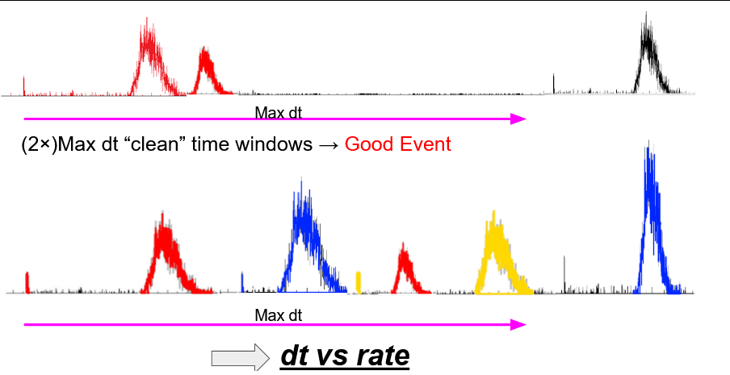
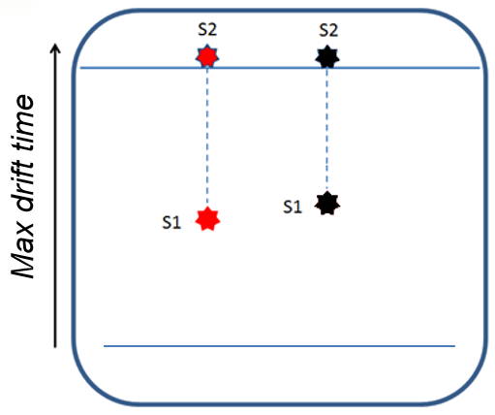
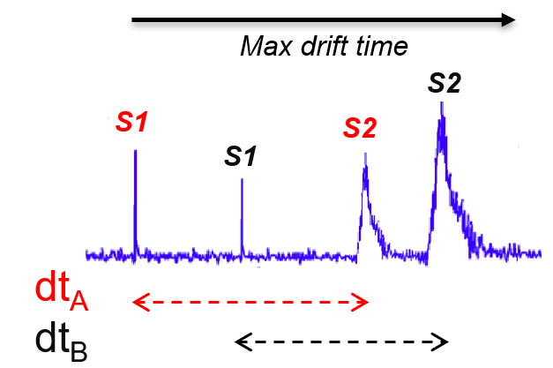
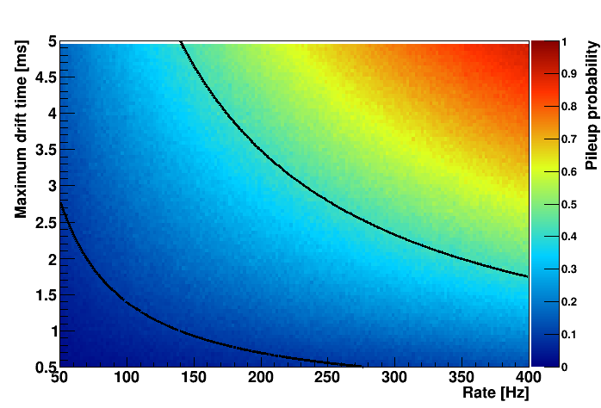
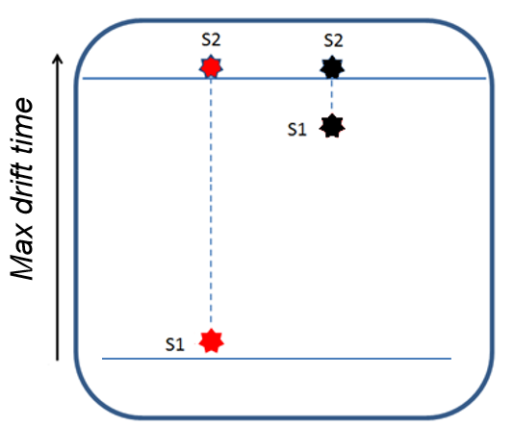

Pile-up in Dual-phase TPCs
Massive detectors with several meters drift:
S1 and S2 pile-up
→ misreconstruction of the interactions
Pile-up strongly limits the maximum allowed interaction rate in a TPC
→ setting very stringent limits on the material contamination (gamma)

Slide 24

GADMC: UAr
International effort underway to procure radiopure argon extracted from underground reservoirs
Three sites to extract, purify and measure the radiopure argon

Slide 25




The UAr production chain
URANIA project: Procurement of UAr extracted from the CO₂ wells in Cortez mine, Colorado (~230-300 kg/d, 99.99% purity) → Plant constructed
ARIA project: Ar chemical purification and isotopic separation by cryogenic distillation (Sardinia, Italy)
350 m height, 31.8 cm inner cryogenic distillation column
Argon distillation demonstrated in 2021 run - Eur. Phys. J. C 81 (2021) 4, 359
Production rate with ARIA in chemical purification mode (DarkSide-20k): ~1 ton/day

Slide 26




DArT-in-ArDM @ LSC
Main Lab under mount Tobazo
~850 m rock
~2500 mwe
1400 m²
ArDM detector:
850 kg active volume (≈2 t total)
  Cryogenic low rad. PMT arrays (R5912 2×12)
  50 cm passive neutron shield (Poly, 20 ton)
Data taken 2014-2018

Slide 27



DArT-in-ArDM @ LSC
Expected ³⁹Ar concentration in UAr ~ 10⁻¹⁹ g/g: beyond reach of ICP-MS
Sensitivity < 1 mBq/kg!
Before analysis
cuts!
JINST 15 (2020) 02, P02024
More details in
D. Mairena’talk @IDM26

Slide 28
DarkSide-20k “High-mass” WIMPs
Present projection based on a 1-10 yr run
Two volumes in analysis (20 - 46 t):
        Fiducial: low instrumental background
        rate < 0.3 events in ROI (30-200 keV_{nr}) with
        200 t-yr exposure
Extended: background dominated by
radiogenic neutrons from photosensors and
experimental Hall
Best projected 90% C.L. exclusion (460 t·yr) :
5.1 x 10⁻⁴⁸ cm² for 1 TeV/c²
4.8 x 10⁻⁴⁷ cm² for 10 TeV/c²
Pulse-shape discrimination
setting NR acceptance

Slide 29

DarkSide-20k “Low-mass” WIMPs
Commun Phys 7, 422 (2024)
S2-only analysis, no PSD
Single-S2 events: no other S2 within 3.7 ms maximum drift time
No z reconstruction; x-y fiducialization from the S2 light pattern
Exposure: 34.2 t fiducial UAr (51% livetime → 17.4 t·yr)
Background dominated by ³⁹Ar Er N_{e} ≥ 4 (SE dominates N_{e} ≤ 3)
Two scenarios:
• Conservative: Fit from N_{e}= 4 (DS-50 strategy)
• Ultimate: Fit from N_{e} = 2 assuming good control of the SE spectral shape in DS-20k
N_{e​} number of extracted electrons in S2
Spurious electrons (SE): delayed S2 signals (likely produced by electrons trapped and released later)

Slide 30

DarkSide-20k “Low-mass” WIMPs
Expected sensitivity:
Binned profile-likelihood fit in N_{e}
(with nuisance parameters for exposure, backgrounds
and detector-response systematics)
Commun Phys 7, 422 (2024)
×170
1-year DS-20k sensitivity:
up to ×40 improvement over DS-50 in the conservative scenario
×170 at m_{χ} ≈ 1.2 GeV/c² in the ultimate scenario;
σ_{SI} < 10⁻⁴² cm² for m_{χ} ≳ 0.8 GeV/c².
×40
Projected leading sensitivity for GeV-scale dark matter
Long-term reach: 10-year exposure improvement by ~×3 (reaching the LAr neutrino fog around m_{χ} ≈ 5 GeV/c²)

Slide 31


DarkSide-20k “Low-mass”
→ ionization-only S2 signals, spectrum analysis applied to alternative low-mass DM signatures
“Migdal-enhanced” WIMP–nucleon scattering
Light DM–electron scattering: DM couples to bound electrons through a dark-sector mediator
Expected 90% C.L. limits with Migdal effect and QF
Expected 90% C.L. DM–electron limits, heavy-mediator benchmark
DS-20k improves over DS-50 and probes new sub-GeV parameter space.

Slide 32

ARGO: next-generation liquid-argon observatory
GADMC concept: a multi-hundred-tonne argon detector
400 tonnes total low-radioactivity argon; 300 tonnes fiducial mass.
Preferred site: SNOLAB Cube Hall. Baseline concept: ultrapure acrylic vessel, LAr buffer, outer cryostat and large photodetector coverage.
Readout target: about 250 m² of pixelated digital photodetectors covering the acrylic vessel surface.
Very large exposure,
low-radioactivity argon,
imaging light readout
to push high-mass WIMP sensitivity into the neutrino-fog region, with added solar-neutrino and supernova reach.
from Merck
The central question is whether a 300-tonne fiducial LAr detector can stay effectively background-free in the WIMP ROI

Slide 33
ARGO: next-generation liquid-argon observatory
Design issues now under study
Increase inner dimension to reduce neutron backgrounds within fiducial volume
Surface and external backgrounds require strong position reconstruction and event-ID with pixelated photodetectors
ProtoDUNE-style cryostat vs vacuum cryostat + large water shield to reduce external neutrons.
Backgrounds calculations ongoing.
Primary concern is the reduction of external or surface background events
Xe doping for 0νββ considered

Slide 34

Argon and “spin-dependent” scattering :
a statement to update
Argon is not sensitive to canonical spin–spin SD scattering, but can respond to broader NREFT spin-dependent-like operators.
“Spin-dependent dark matter interactions at loop-level in Ar and Xe” JCAP 04 (2025) 066
In the N.R. Effective Field Theory for DM–nucleus scattering. The interaction is expanded in Galilean-invariant non-relativistic operators built from q, v⊥, S_{χ} and S_{N}
Several operators are spin-dependent-like but are momentum- or velocity-suppressed, so the “SD = only O4” shortcut is no longer sufficient.
Xe: O4 is already non-zero. The full NREFT treatment modifies the spectral shape and normalization.
Ar: O4 is essentially zero in ⁴⁰Ar. The full model produces a non-zero recoil spectrum, but it is softer and generally lower per kg than Xe in this benchmark.
N_{sig} = M T ∫ ε(E) · dR/dE · dE.
Exposure, threshold, efficiency, PSD and backgrounds can compensate a smaller per-kg rate.
Notes:
Classical SI/SD language Standard SD means the axial spin–spin operator O4 = Sχ · SN. For the dominant isotope 40Ar, Jπ = 0+, so this response is absent.
language

Slide 35

Projected sensitivities of DD exp. to SD-DM interactions
Argon becomes experimentally interesting
DS-20k scale
50 t total dual-phase LAr TPC; sensitivity studies use exposure, ionisation yield, efficiency and the S2-only background model.
ARGO scale
A 300 t fiducial argon target would make even suppressed channels worth testing if backgrounds and thresholds are controlled.
More details in A. Ritchie-Yates ‘s talk @IOP APP/HEPP Conference (08.04.2026)

Slide 36




Other interesting activities
ReD: Measurement of the LAr ionization yield for 2–10 keV NR compact dual-phase TPC + tagged ²⁵²Cf neutron scattering + BaF2–EJ276 for timing.
Spectroscopic analysis of the Ar scintillation light
S1
EL
Upgrade: ReD+ will extend the measurement to lower recoil energies
smaller scattering angles
larger source-detector distances,
improved shielding, and an upgraded TPC
targeting about 0.5 keV first and eventually about 0.2 keV with a DD neutron generator.
More details in M. Ave Perna’talk @IDM26

Slide 37




Other interesting activities
(α,n) x-sec measurement
in argon
” Review of neutron yield from (α, n) reactions: data, methods, and prospects” J.Phys.G
53 (2026) 2, 023001
More details in J.Canovas’talk @IDM26
On-site measurement of the environmental radiation
More details in L.Luzzi’talk @IDM26

Slide 38
Take home messages
Argon has become a mature and versatile technology for direct detection of Dark Matter.
DarkSide-20k offers exceptional prospects for high-mass, low-mass and exotic dark matter searches.
The field is moving toward a unified global argon program, from current DarkSide-20k to ARGO/GADMC.
Pile-up will matter for future very large TPCs
The decisive milestone is to demonstrate underground argon production, purification and assay at the required radiopurity and multi-tonne scale.

Slide 39

Thank you
from Merck

Slide 40
Bonus slides

Slide 41









𝒪₁ = 1_{χ} 1_{N}
𝒪₇ = $\vec{S_{N}}$· ${\vec{V}}^{\text{⊥}}$
The rate is model-dependent and must be compared operator by operator.
𝒪₃ = i $\vec{S_{N}}$· $\left(\frac{\vec{q}}{m_{N}} \text{×}{\vec{V}}^{\text{⊥}}\right)$
𝒪₈ = $\vec{S_{\text{χ}}}$ · ${\vec{V}}^{\text{⊥}}$
𝒪₉ = i $\vec{S_{\text{χ}}}$ · ($\vec{S_{\text{χ}}}$ × $\frac{\vec{q}}{m_{N}}$ )
𝒪₄ = $\vec{S_{\text{χ}}}$ · $\vec{S_{N}}$
𝒪₅ = i $\vec{S_{\text{χ}}}$ · $\left(\frac{\vec{q}}{m_{N}} \text{×}{\vec{V}}^{\text{⊥}}\right)$
𝒪₁₀ = i $\vec{S_{N}}$· $\frac{\vec{q}}{m_{N}}$
Argon becomes relevant for a broader class of spin-dependent-like operators, especially when very large exposures are included.
𝒪₁₁ = i $\vec{S_{\text{χ}}}$ · $\frac{\vec{q}}{m_{N}}$
𝒪₆ = $\left(\vec{S_{\text{χ}}}\text{·}\frac{\vec{q}}{m_{N}}\right)$ $\left(\vec{S_{N}}\text{·}\frac{\vec{q}}{m_{N}}\right)$
q = momentum,
v⃗⊥ = transverse velocity,
Sχ, Sₙ = spins of the dark matter and nucleon.

