Slide 1
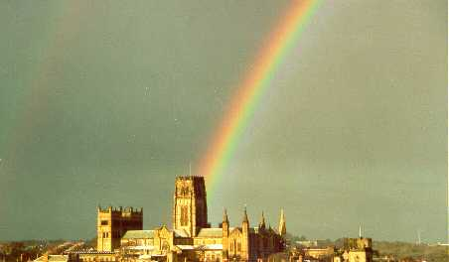

A health check on ΛCDM
Carlos S. Frenk
Institute for Computational Cosmology, Durham

Slide 2
The ΛCDM model of cosmogony
Cosmological constant
Cold dark matter
Proposed in 1980s, it is an ab initio, fully specified model of cosmic evolution and the formation of cosmic structure
Has strong predictive power and can, in principle, be ruled out
Has made a number of predictions that were subsequently tested empirically (e.g. CMB, LSS, galaxy formation)
Three Nobel Prizes in Physics since 2006

Slide 3
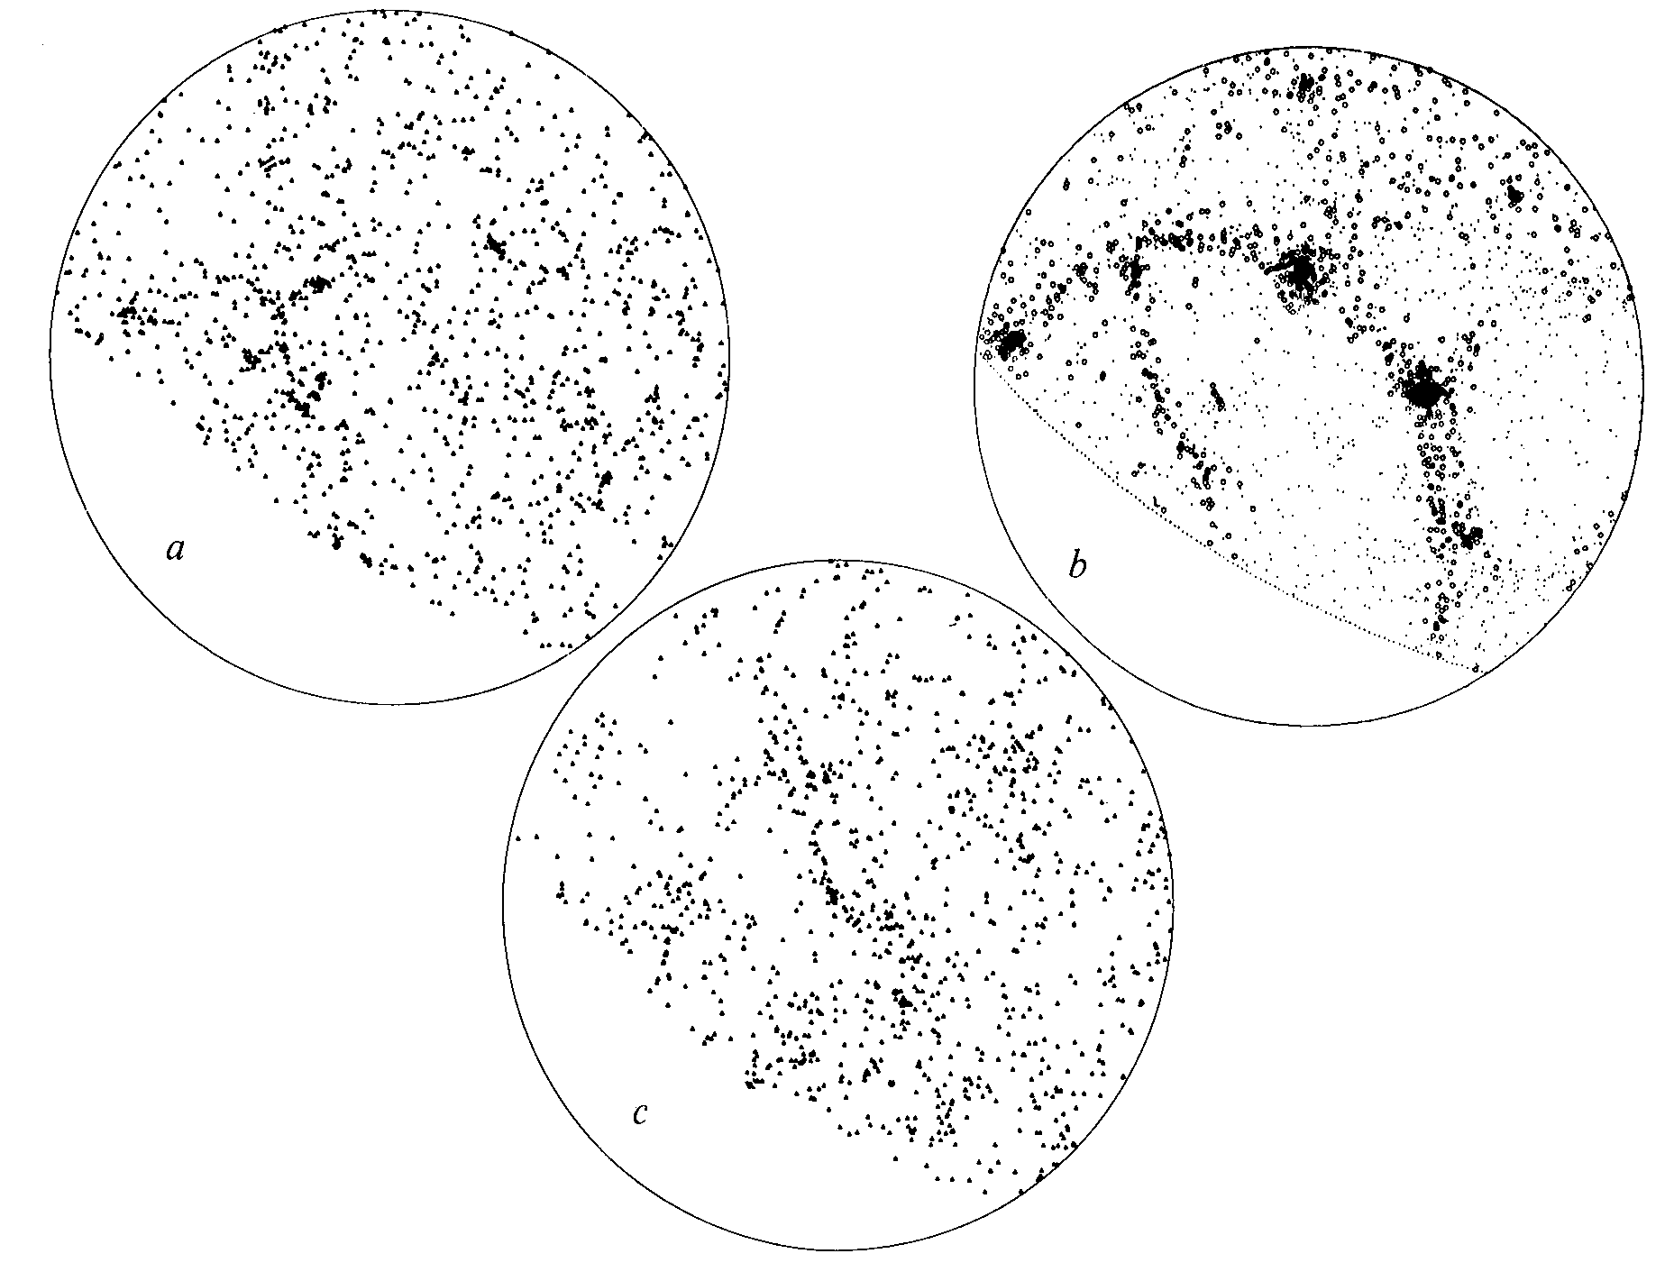
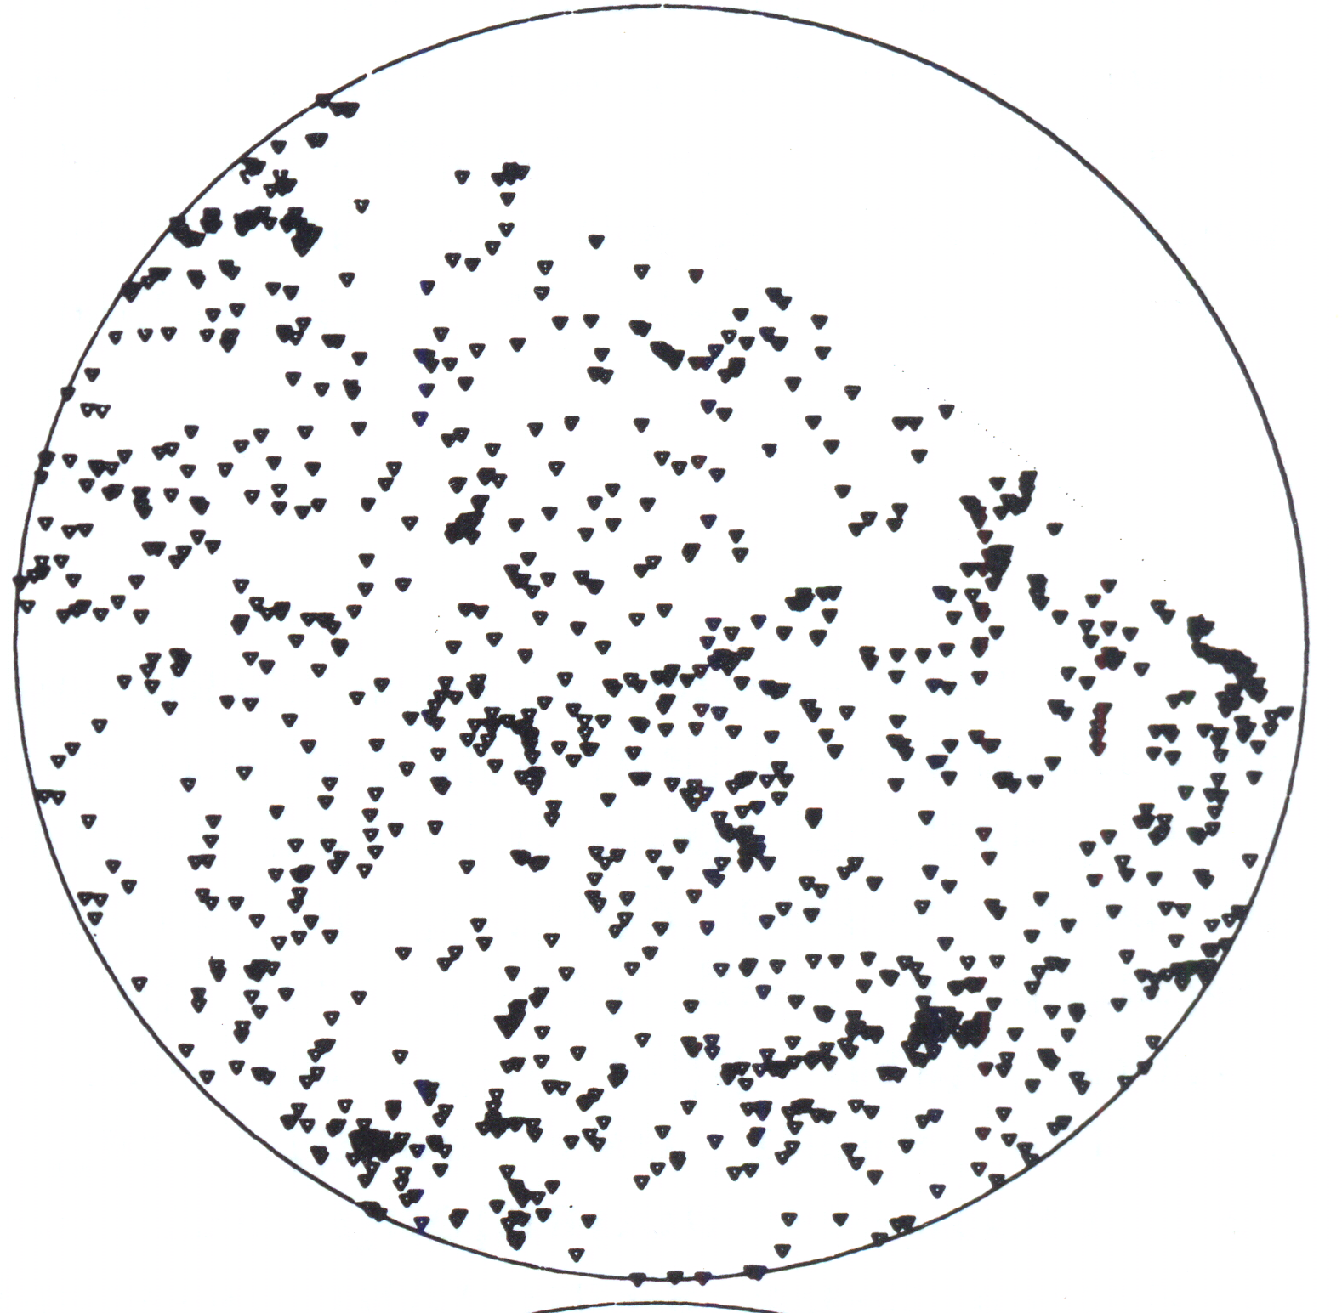
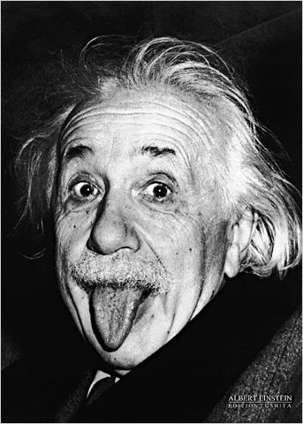
Non-baryonic dark matter cosmologies
ΛCDM gave the best match to the data
ΛCDM Ω=0.2
was inconceivable in 1985
CDM Ω=1
HDM Ω=1
CfA redshift survey
Davis, Efstathiou, Frenk & White‘85
Davis, Efstathiou, Frenk & White ‘85

Slide 4
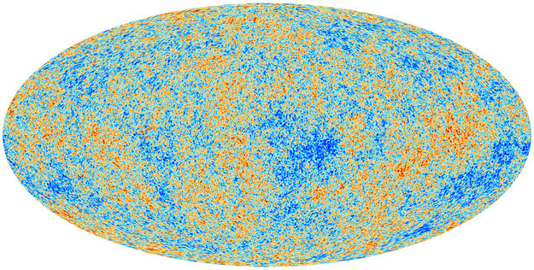
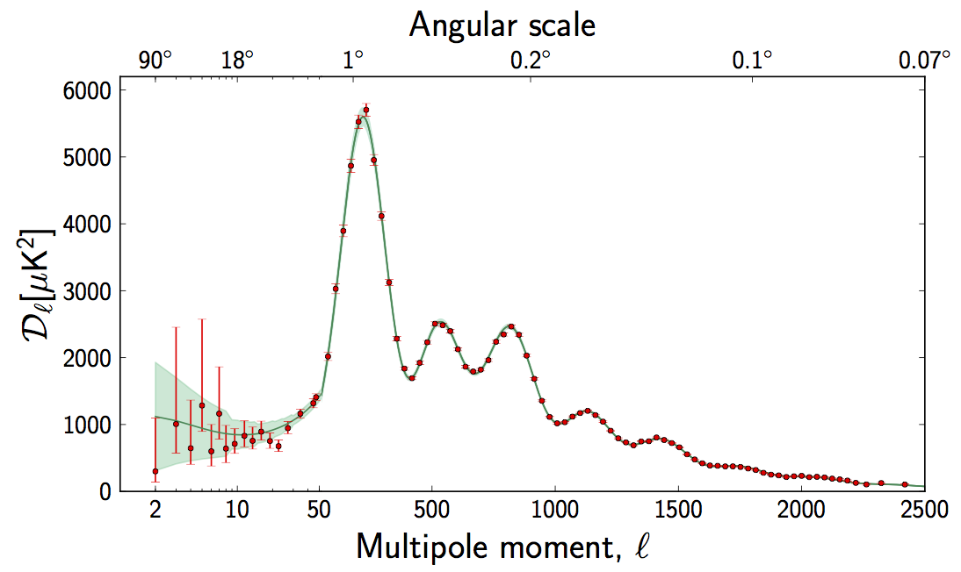
Planck: CMB temperature anisotropies
Fluctuation amplitude
The data confirm the theoretical predictions
ΛCDM
Planck coll. 2015
Peebles ‘82; Bond & Efstathiou‘84

Slide 5
Tests of ΛCDM
CDM: small scales
Λ: large scales
Neutrino mass
DESI survey

Slide 6
Planck: CMB temperature anisotropies
Fluctuation amplitude
The data confirm the theoretical predictions
ΛCDM
Accuracy ~ a few percent
Planck coll. 2015
Peebles ‘82; Bond & Efstathiou‘84

Slide 7
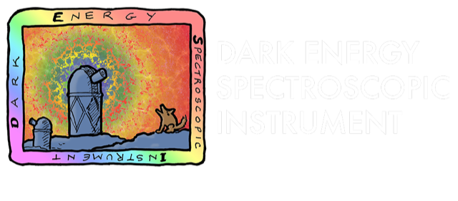
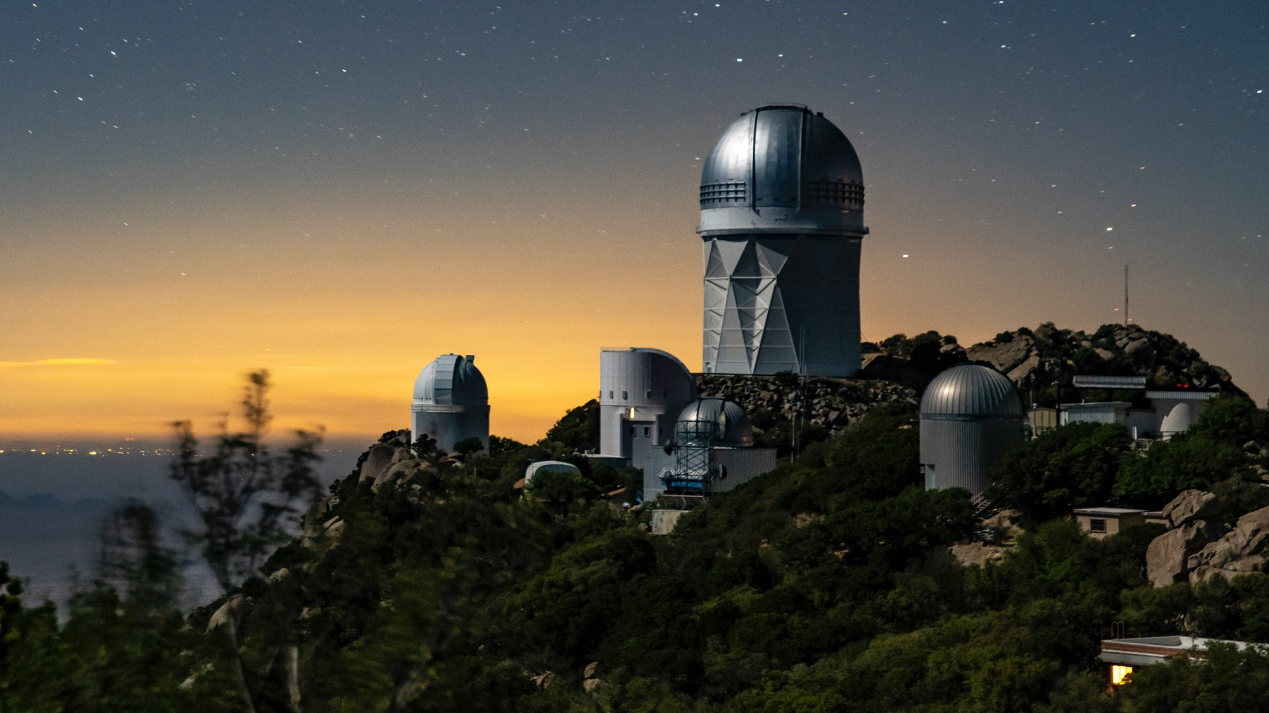









Tests of ΛCDM a subpercent accuracy?
72 participating institutions across the world

Slide 9
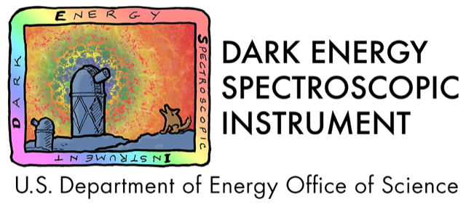
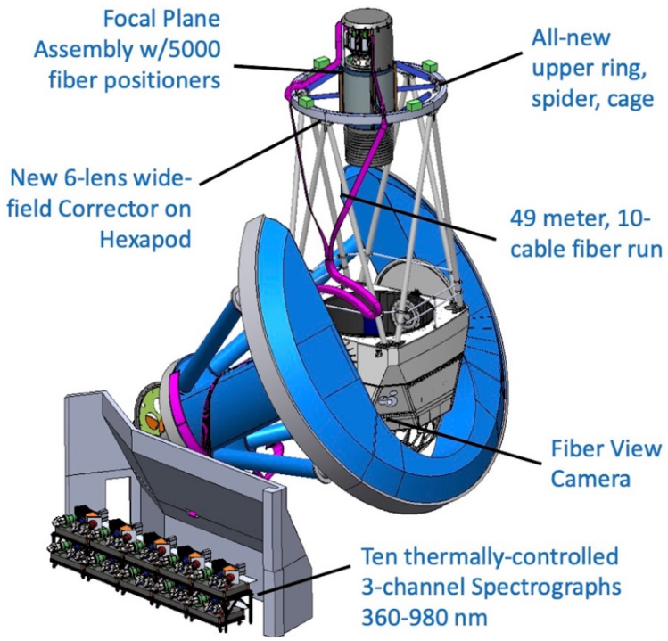
The Dark Energy Spectroscopic Instrument
DESI is a fiber-fed multi-object spectrograph, installed on the Mayall 4-meter telescope.
It uses 5000 robotic arms to position fibers on the focal plane.
The fibers are fed to ten 3-channel spectrographs.

Slide 10
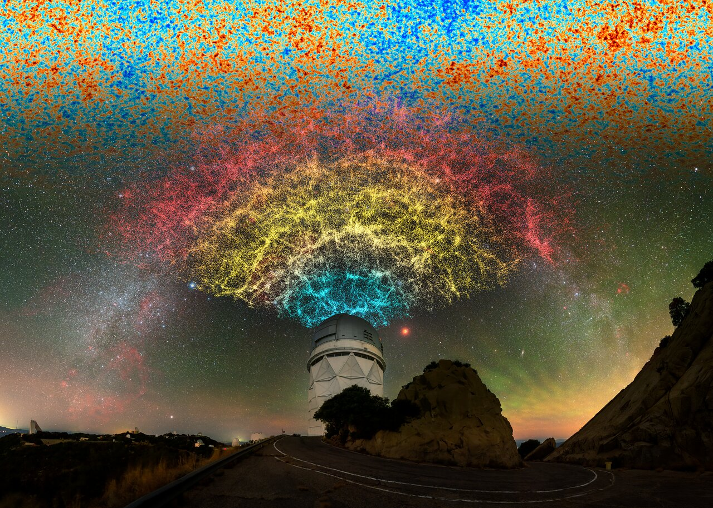
Tests of ΛCDM based on baryon acoustic oscillations
40 million spectra

Slide 11
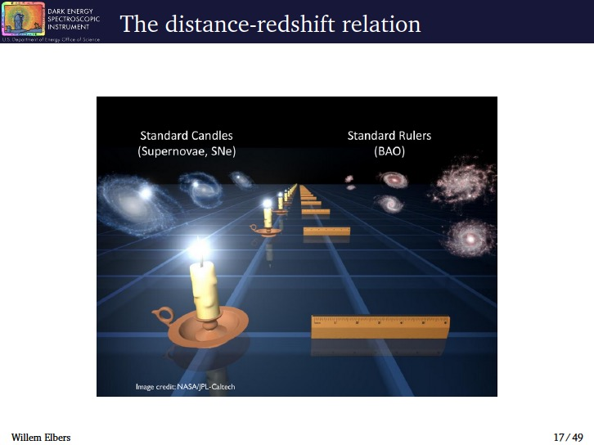
Planck: CMB temperature anisotropies
Fluctuation amplitude
ΛCDM
Baryon acoustic oscillations (BAO) coherent oscillations of γ-baryon fluid
Baryon acoustic oscillations (BAO) should be reflected in gal distribution
standard ruler
Frozen in a recombination
→ Baryons → halos → galaxies
Planck coll. 2015

Slide 13
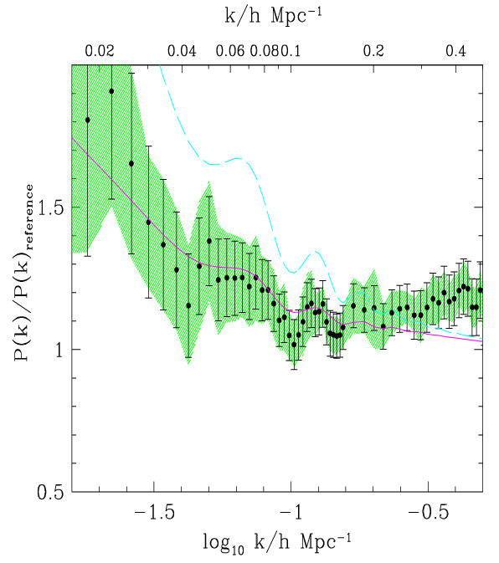
Baryon acoustic oscillations in 2dFGRS
P(k) / P_{ref}(Ω_{baryon}=0)
221,000 redshifts
ΛCDM model
Baryon oscillations conclusively detected in 2dFGRS!!!
Millennium sim
ΛCDM convolved with window
Cole, Percival, Peacock, Baugh, Frenk + 2dFGRS ‘05

Slide 14
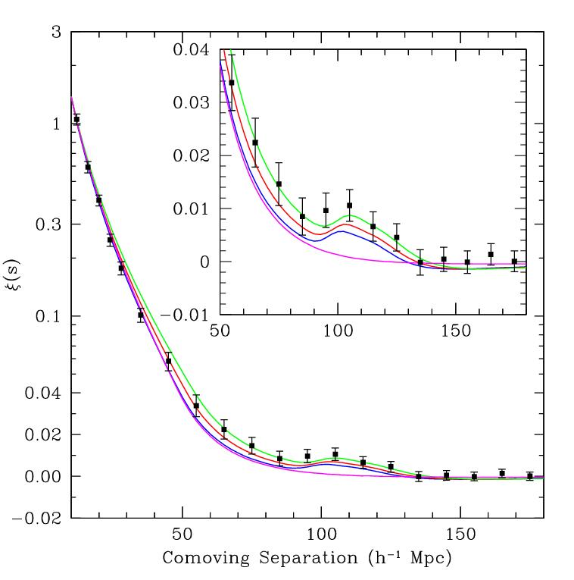

Baryon acoustic oscillations in SDSS
47,000 SDSS LRGs
0.72 cubic Gpc
Constraint on spherically averaged BAO scale
Constrain distance parameter:
Angular
diameter
distance
Eisenstein et al ‘05
Hubble
parameter

Slide 15
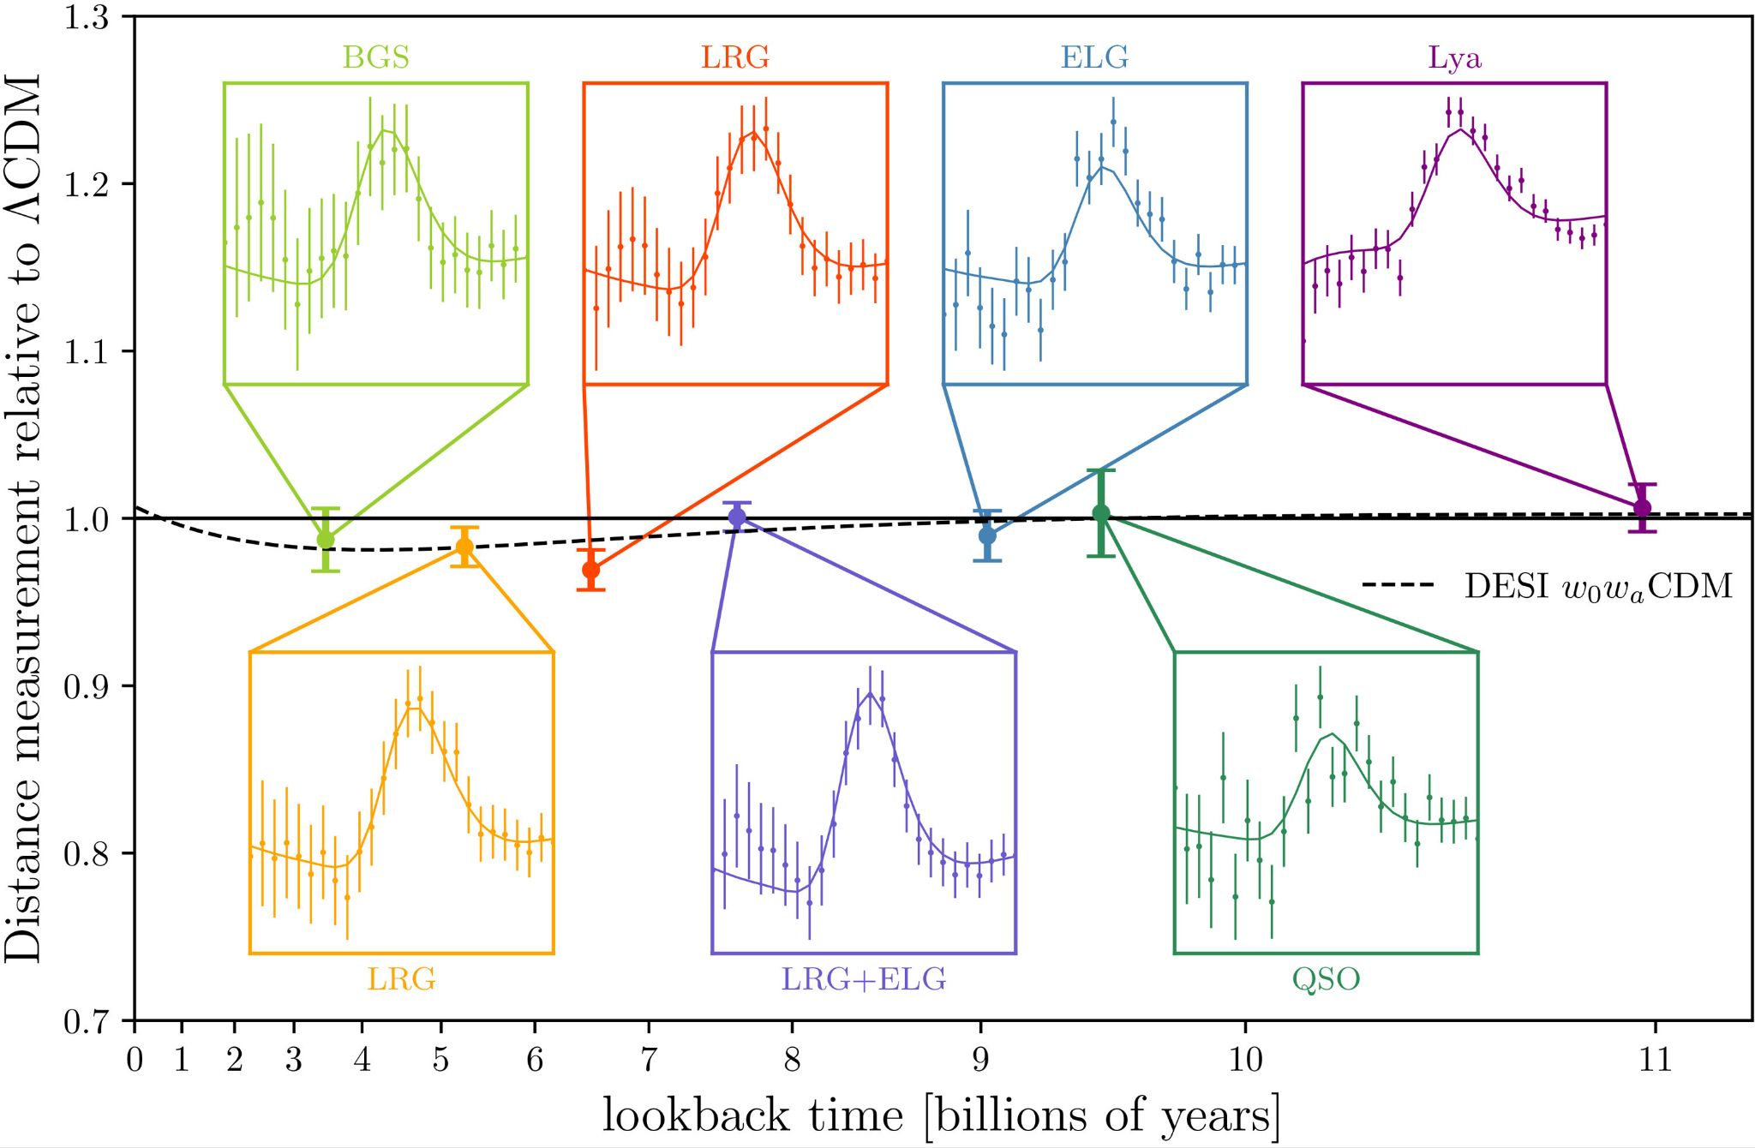
DESI BAO measurements
Can measure expansion history of universe

Slide 16
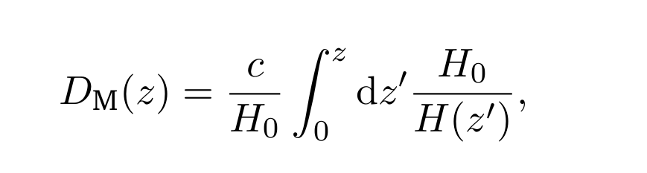
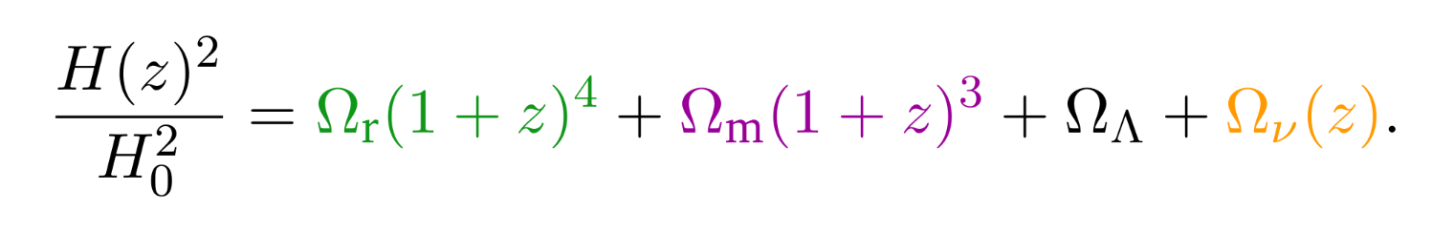
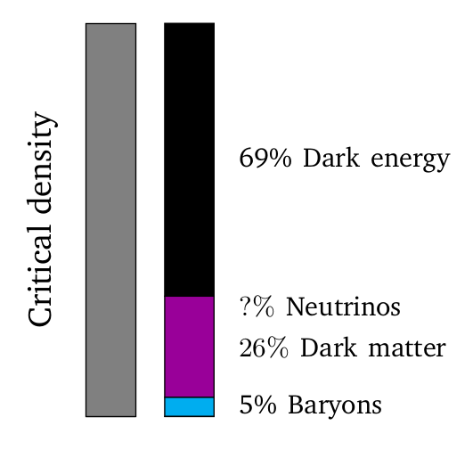
The distance-redshift relation
The distance-redshift relation depends on the energy density of various matter components, including massive neutrinos:
Radiation Matter Dark energy Neutrinos

Slide 17
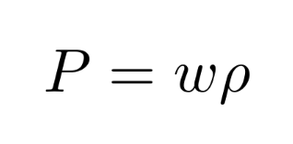
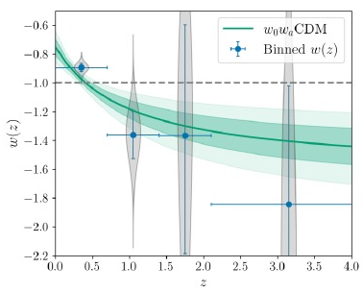
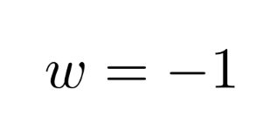

DESI BAO and dark energy
Dark energy has a negative pressure:
Binned reconstruction of ω (z)
Simplest case:
(Λ)
Λ
Introduce a time-varying equation of state:

Slide 18
DESI BAO and dark energy
Dark energy has a negative pressure:
Simplest case:
(Λ)
Introduce a time-varying equation of state:

Slide 19
DESI BAO and dark energy
Dark energy has a negative pressure:
Simplest case:
(Λ)
Introducing a time-varying equation of state:
—
3.2σ
3.4σ
3.2σ
—
—
DESI collaboration: Adame+ ‘24
Hoyt+ ‘26

Slide 20
10 minutes

Slide 22
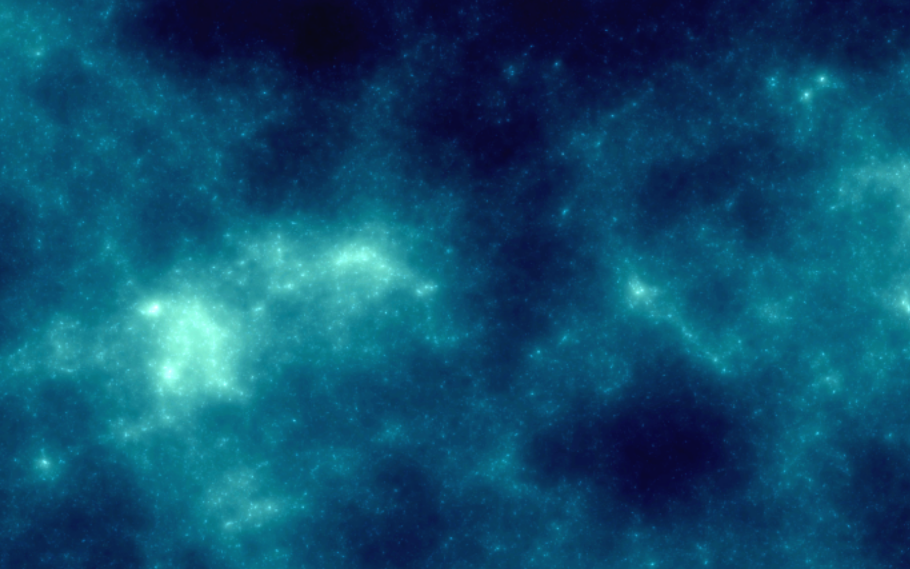
Neutrino masses from DESI
The BAO scale at various z → expansion history
→ depends on the sum of neutrino masses
Radiation Matter Dark energy Neutrinos

Slide 23
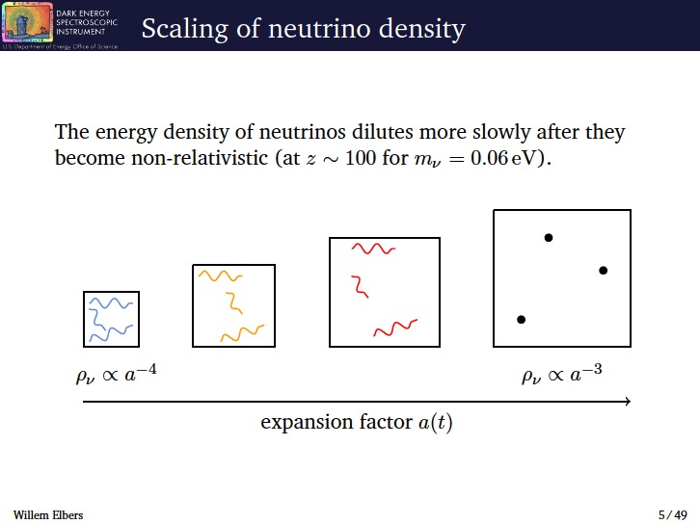

Slide 24
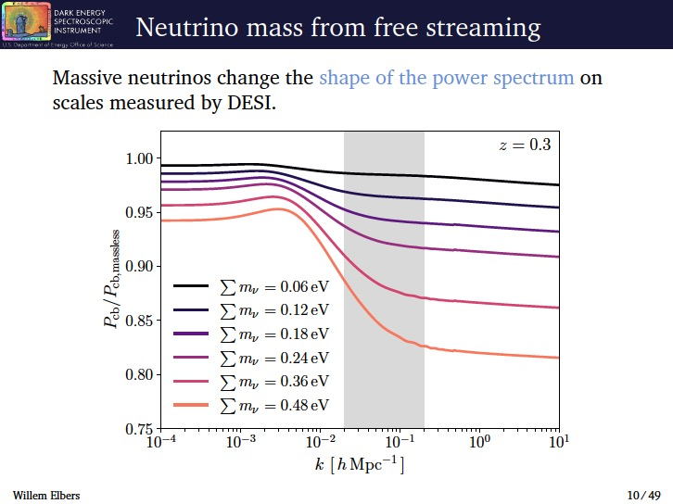

Slide 25
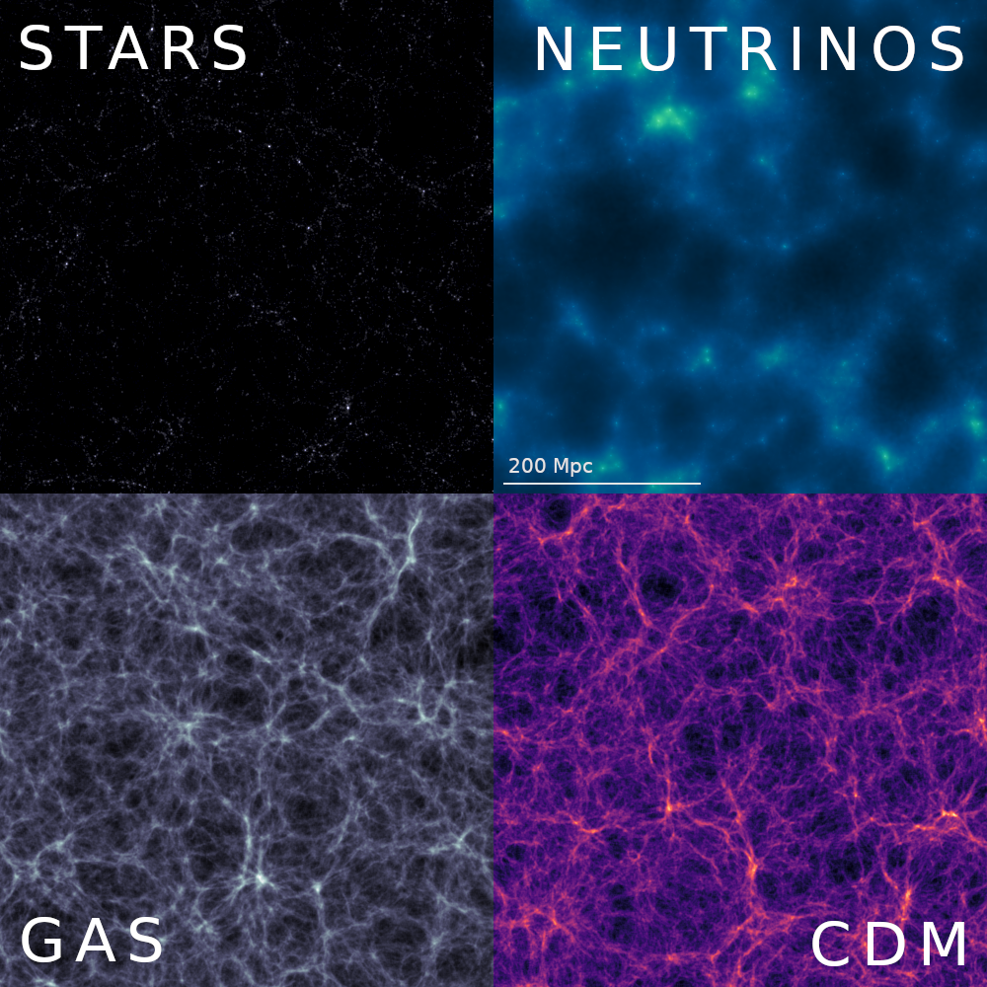
Neutrinos make up < 1% of total dark matter
DESI is able to measure the mass of the neutrino
Can simulate their distribution with 1% accuracy
Elbers, Frenk, Jenkins, Li, Pascoli ‘23

Slide 26
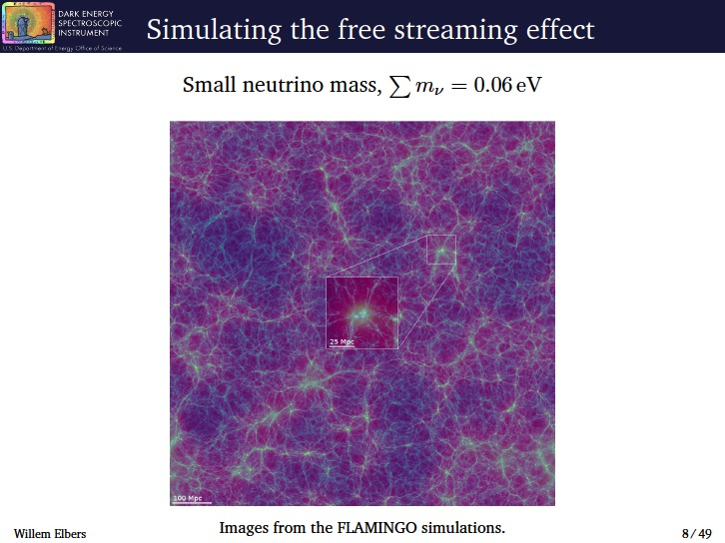

Slide 27
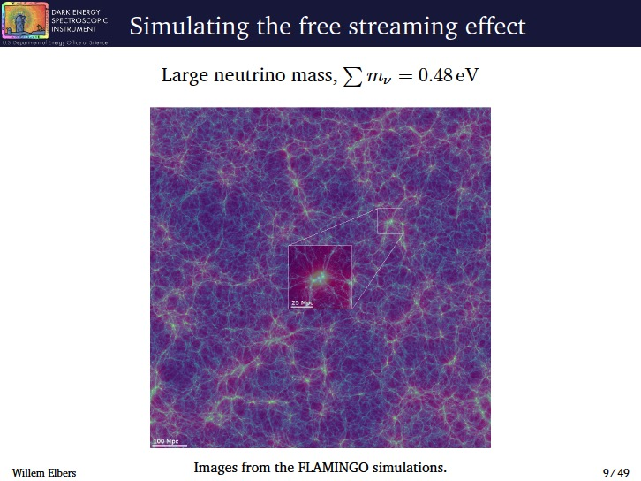

Slide 28
Non-baryonic dark matter cosmologies
Neutrino DM → wrong clustering
ΛCDM Ω=0.2
Neutrinos cannot make appreciable contribution to Ω → m_{ν}<< 30 ev
Neutrinos Ω=1
Early CDM N-body simulations gave promising results
HDM Ω=1
CfA redshift survey
Davis, Efstathiou, Frenk & White‘85
Frenk, White & Davis ‘83
Davis, Efstathiou, Frenk & White ‘85
In CDM structure forms hierarchically

Slide 29
Constraints on neutrino masses
→ Neutrino oscillations (upper limit on m_{ν} )
Normal hierarchy (m₁ < m₂ < m₃): Σ m_{ν} > 0.06 ev
Inverted hierarchy (m₃ < m₁ < m₂): Σ m_{ν} > 0.1 ev
→ Katrin experiment (endpoint of tritium beta decay)
electron antineutrino mass of m < 0.45 eV

Slide 30
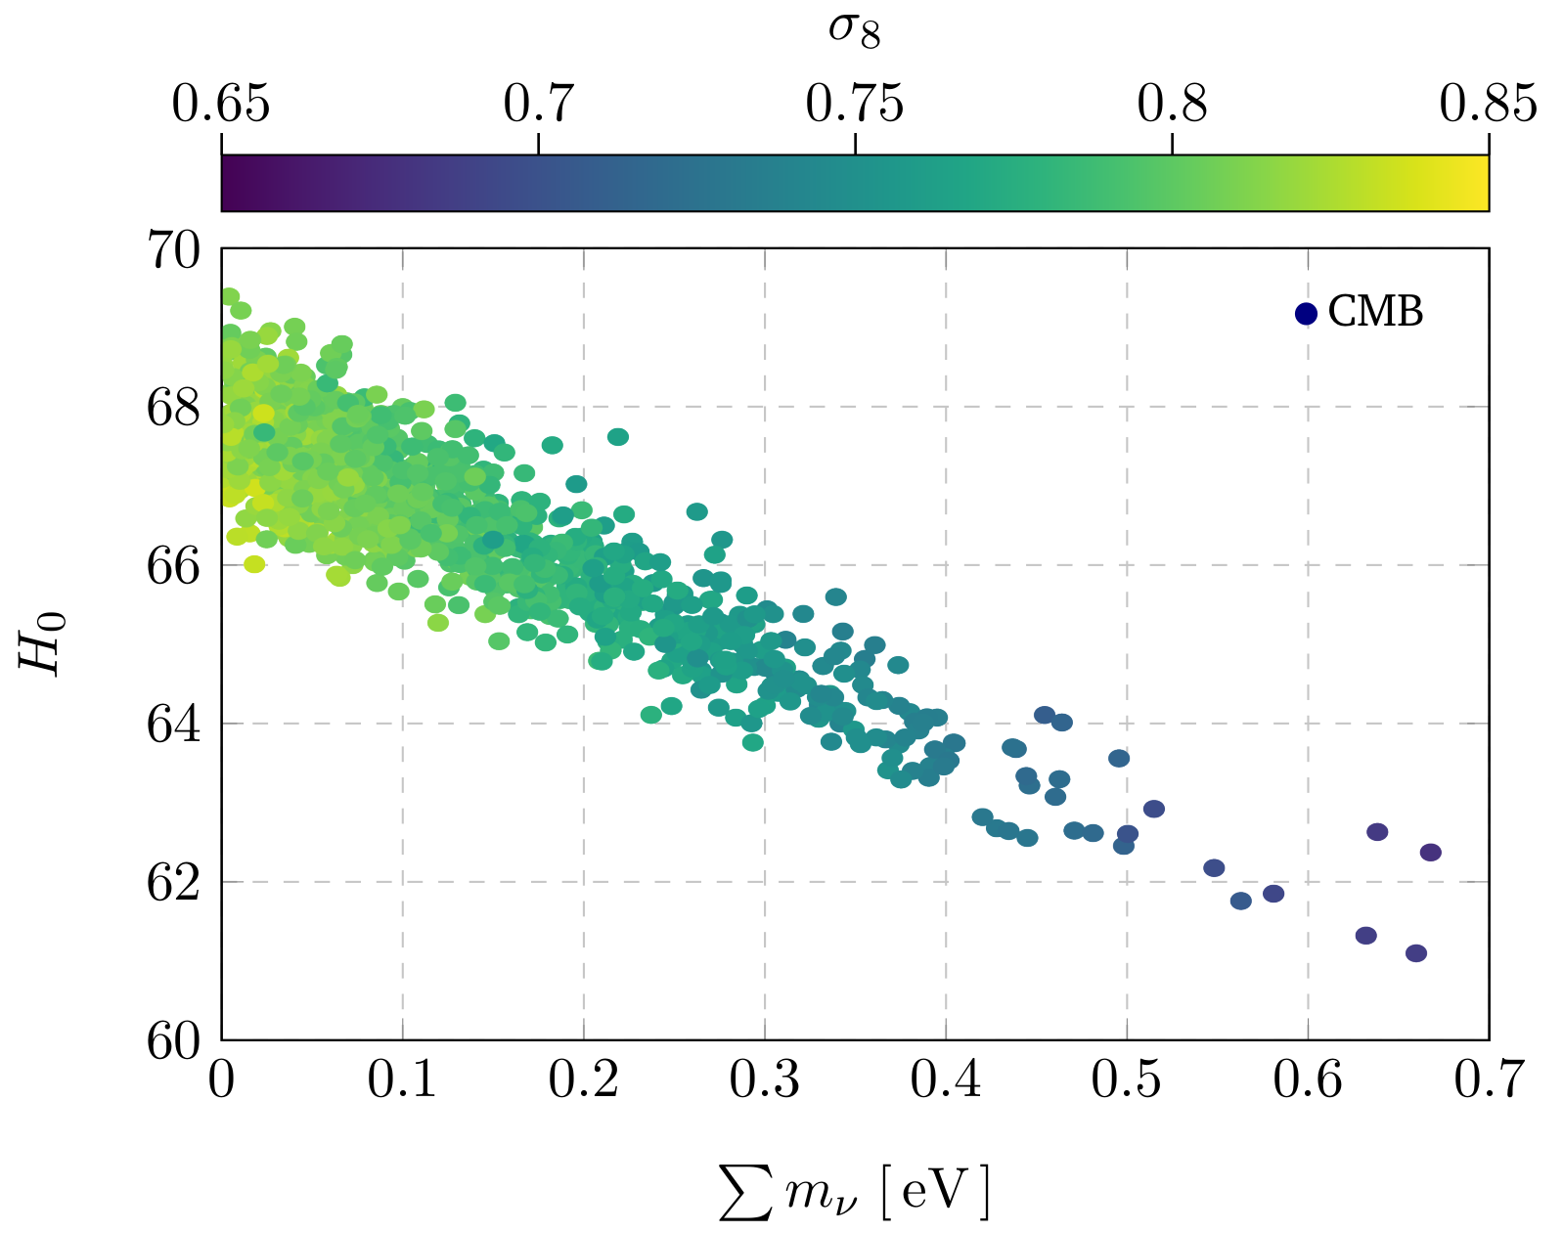
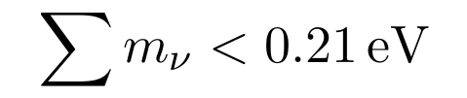
Constraints on sum of ν masses
From CMB:
assuming ΛCDM

Slide 31
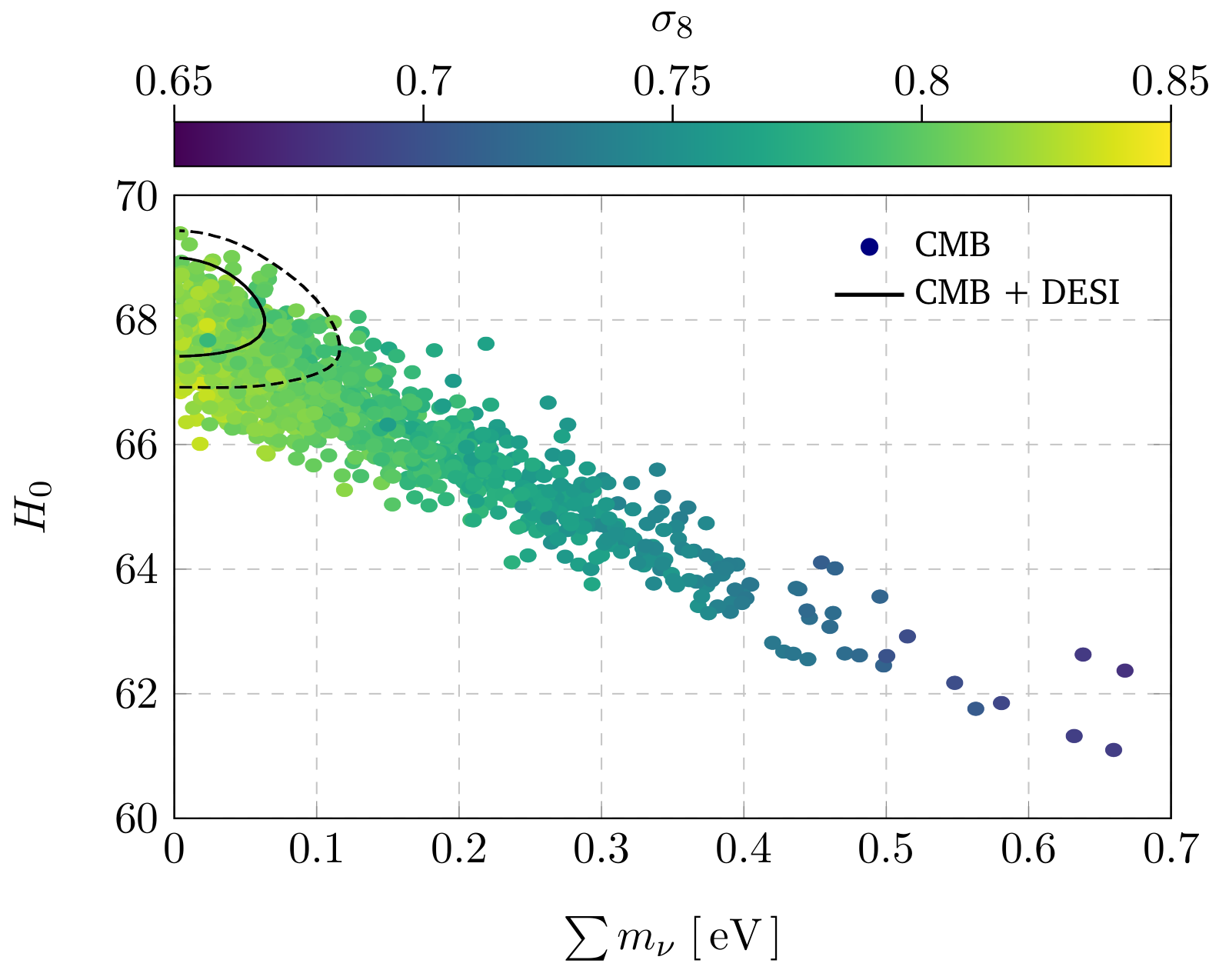
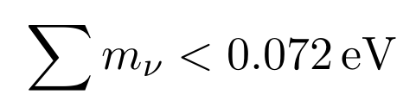
Constraints on sum of ν masses
From CMB + DESI:
assuming ΛCDM
< 0.064
From atmospheric ν oscillations
> 0.060
Normal hierarchy

Slide 32
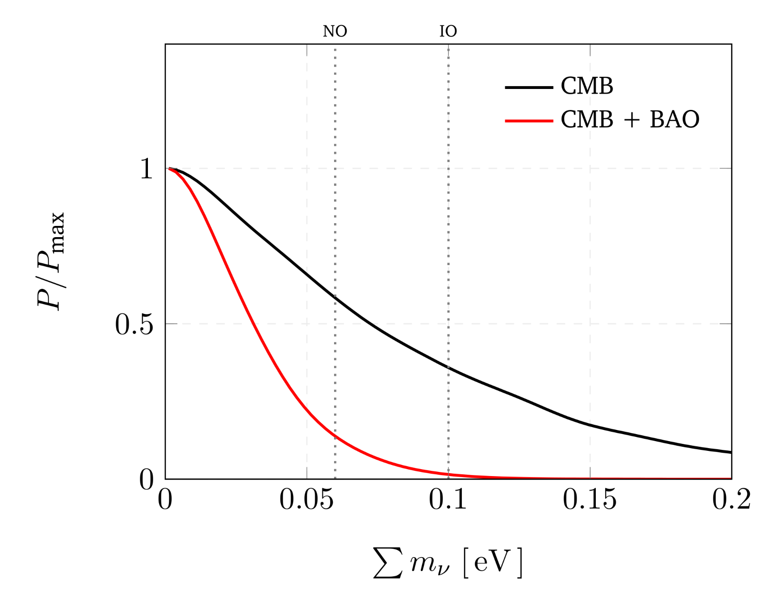
Constraints on sum of ν masses
Posterior distribution of ν masses in ΛCDM
From CMB:
From CMB + DESI BAO:
< 0.064
(Both at 95%)
(Prior Σ m_{ν} >0)
Posterior distribution peaks at 0

Slide 33
Constraints on sum of ν masses
Relax the prior: introduce an effective neutrino mass, Σm_{ν,eff}, that coincides with the physical Σm_{ν} for Σm_{ν,eff} > 0 and extend to negative values in data space
Elbers, CSF, Jenkins, Li & Pascoli ‘24
Any evidence for negative values should be interpreted as a signature of unidentified systematic errors or possibly of new physics which may be unrelated to neutrinos
See also:
eBOSS Collaboration (2021; 2007.08991)
Craig et al. (2024; 2405.00836)

Slide 34
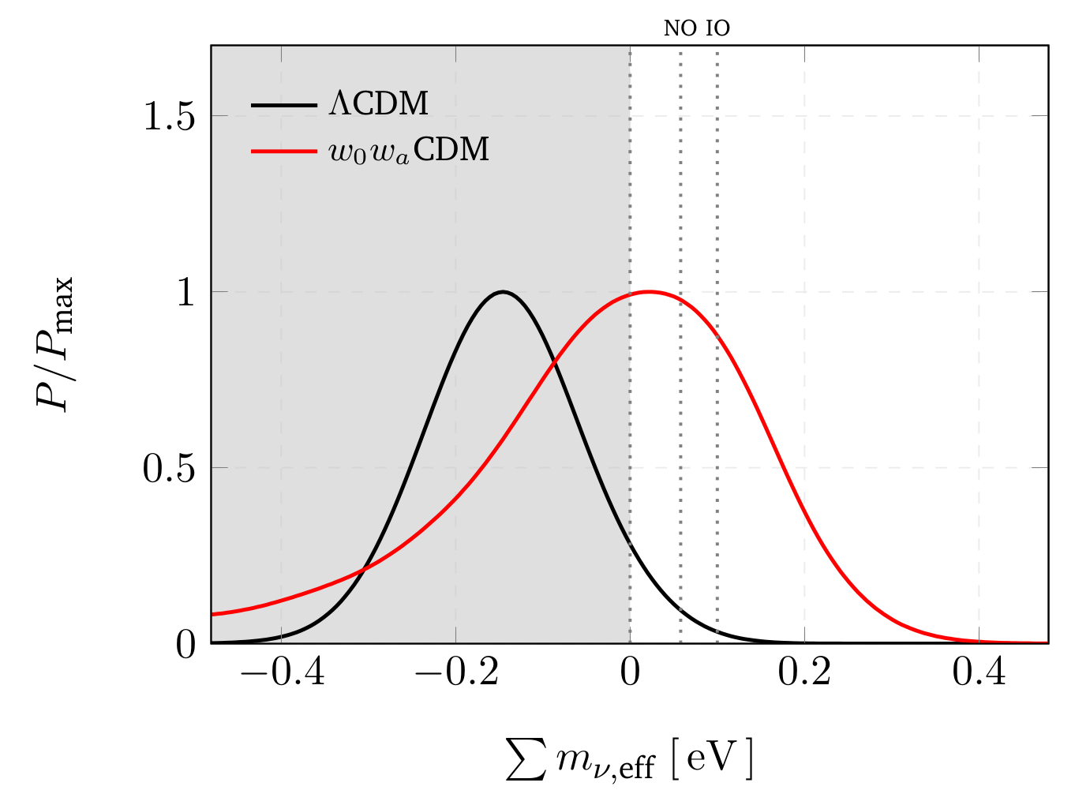
Constraints on sum of ν masses
Posterior distribution of ν masses
  In ΛCDM, posterior peaks at
Σm_{ν, eff} < 0
Inconsistent with ν oscillations at 2.6σ
Further semi-independent support for w₀w_{a}CDM
ΛCDM
w₀w_{a}CDM
In w₀w_{a}CDM posterior peaks at
Σm_{ν, eff} > 0
In w₀w_{a} CDM, bound on physical neutrino mass Σm_{ν} <0.195 eV
Elbers, CSF + ‘24
Consistent with ν oscillations

Slide 35
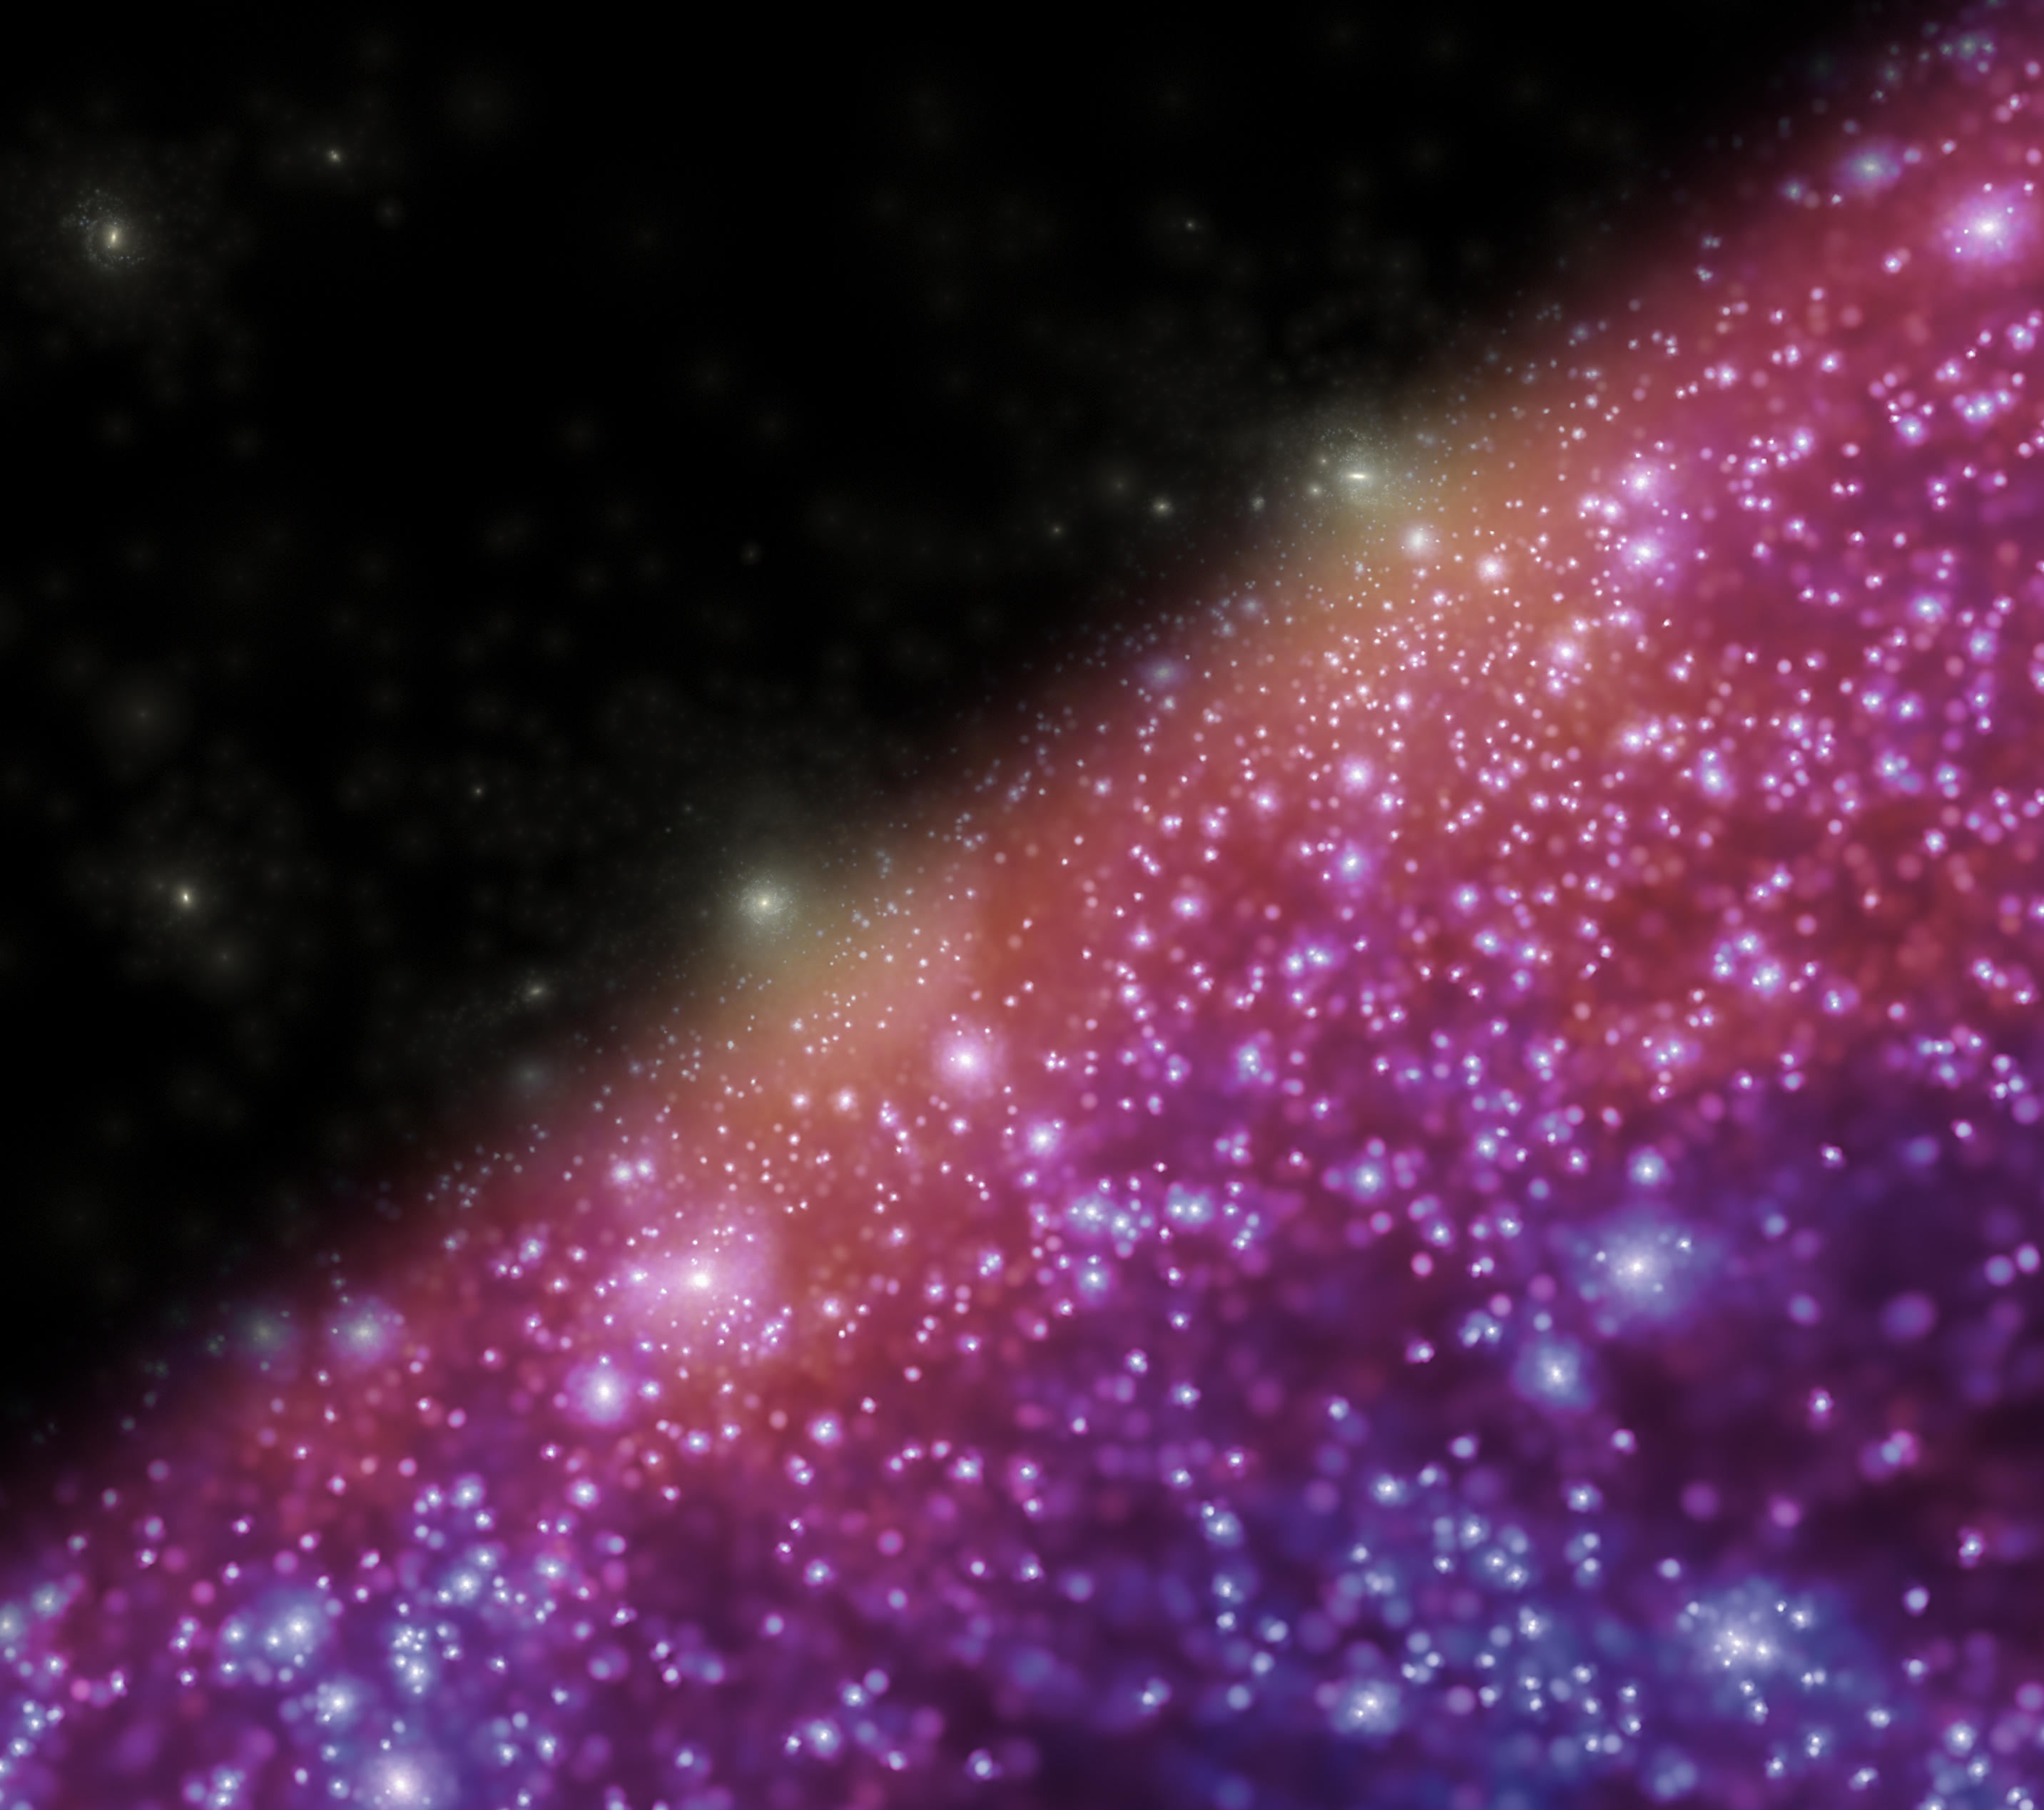
Conclusions
Cosmology
● Great precision of DESI BAO → ΛCDM ruled out at 3.4σ;
Data well described by w₀w_{a}CDM varying DE model
We may be on the verge of a paradigm shift in cosmology!
Neutrino masses
In ΛCDM, Σm_{ν} < 0.064 eV - likelihood peaks at negative mass
In w₀w_{a}CDM, Σm_{ν} < 0.195 eV - likelihood peaks at positive mass

Slide 36
17 minutes

Slide 37
Tests of ΛCDM
CDM: small scales
Λ: large scales
Neutrino mass
DESI survey

Slide 38
The small-scale “crisis” of ΛCDM
Four (supposed) problems:
“Solved” in:
2002
2015
1996
2023
“Missing satellites”
“Too-big-to-fail”
“Core-cusp”
“Plane of satellites”
baryon effects
→ Cosmic web + statistics
5. Galaxies at z > 10 discovered by JWST

Slide 39
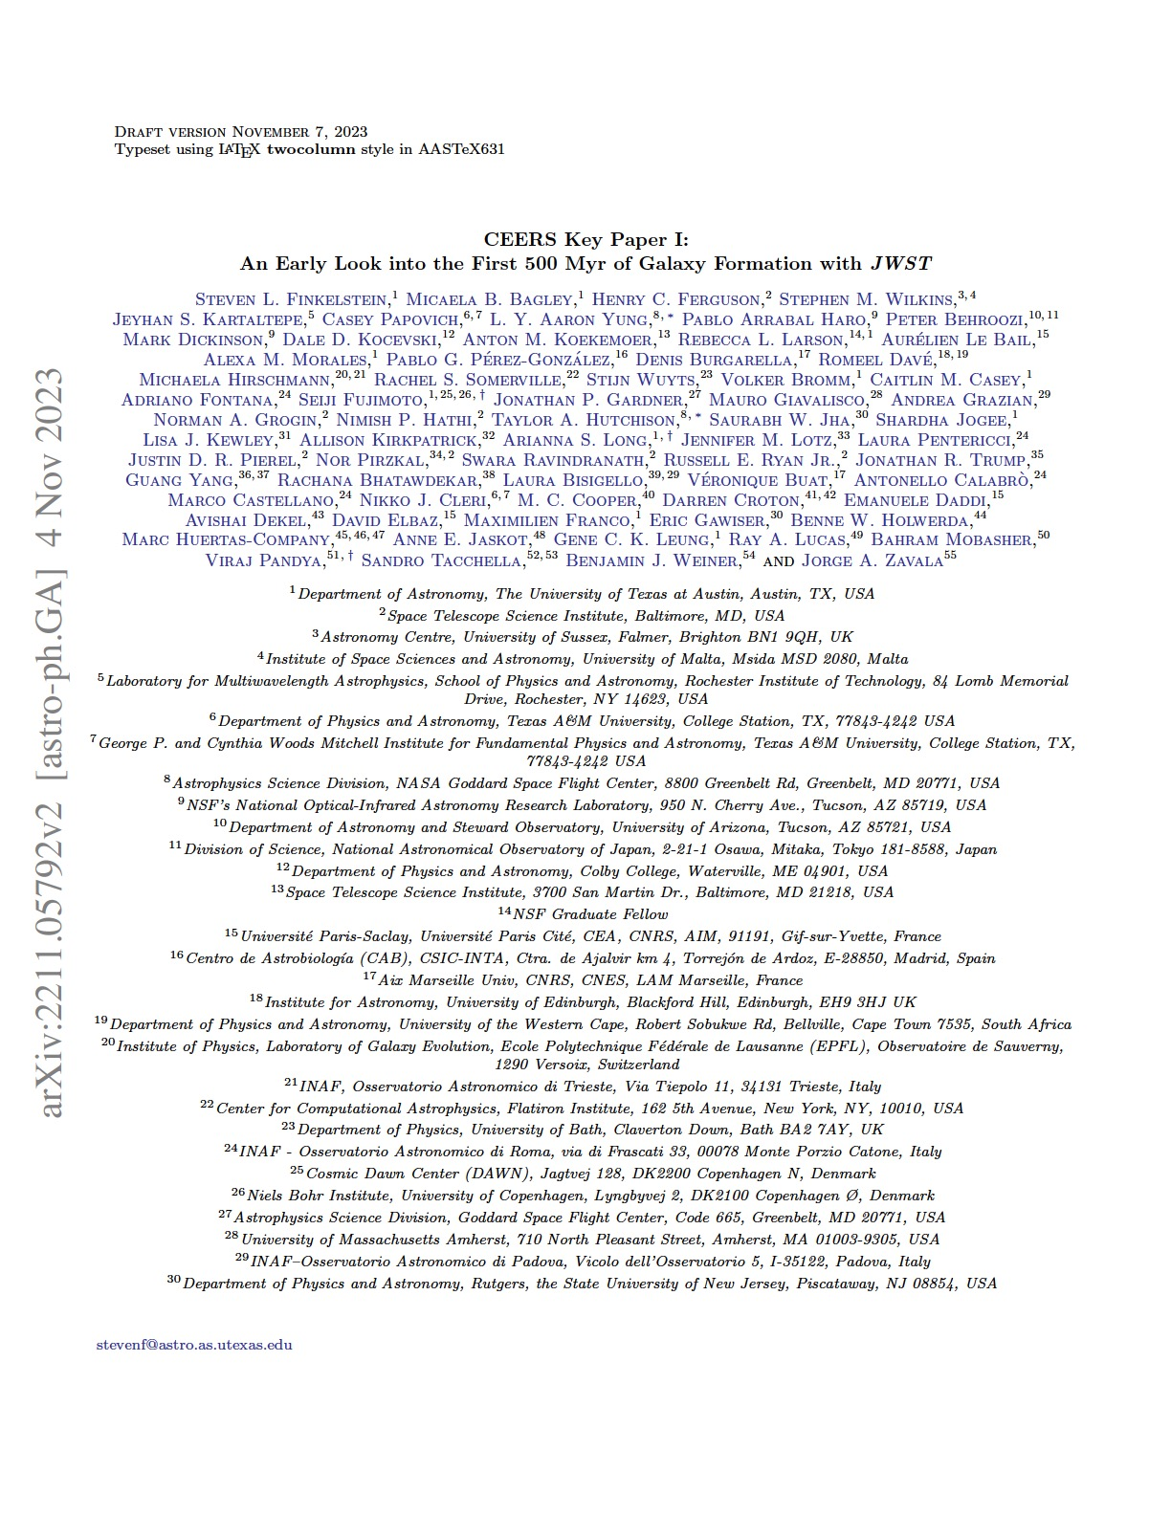
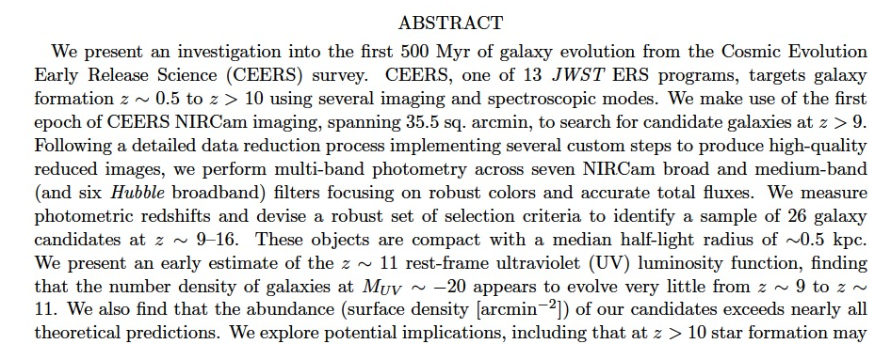
JWST galaxies at z= 8 -15

Slide 40
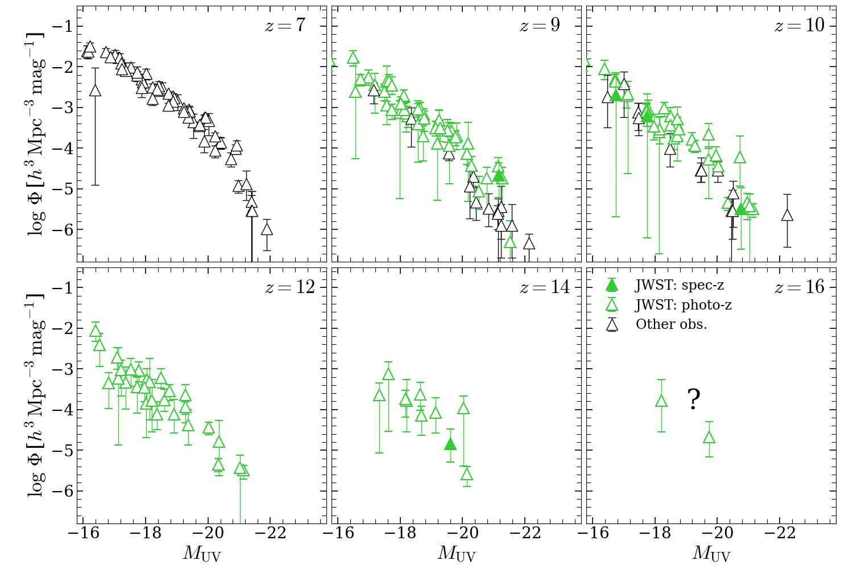
JWST galaxies at z=7-16

Slide 41
JWST galaxies at z= 8 -16

Slide 42
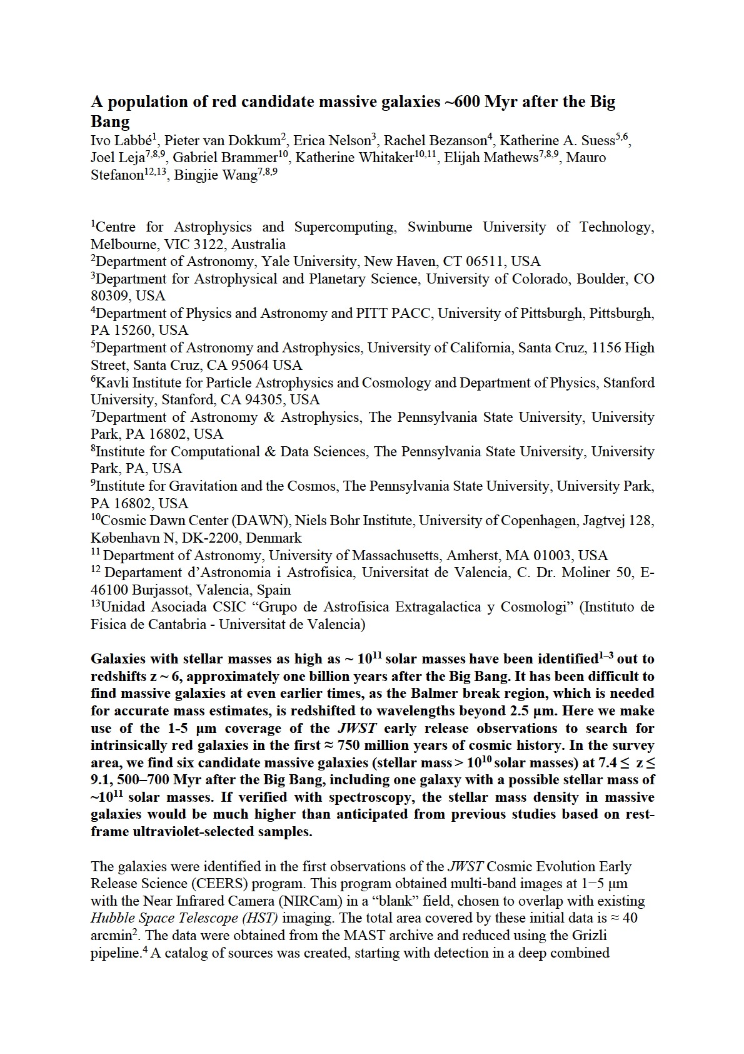
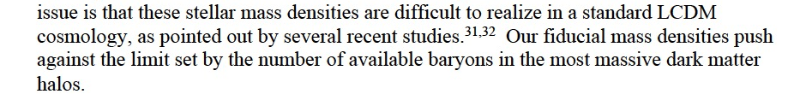
JWST galaxies at z= 8 -16

Slide 43
JWST galaxies at z= 8 -16
Were there any predictions for the high-z UVLFs pre-JWST launch?
→ Ask ChatGPT!

Slide 44
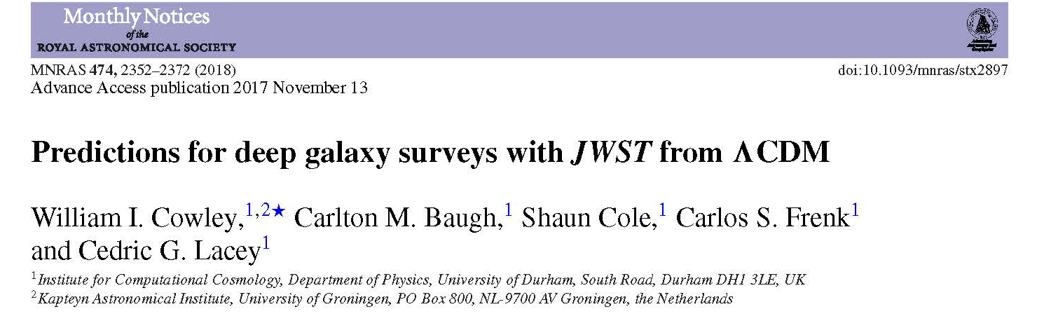
JWST galaxies at z=15
Pre-JWST-launch predictions from GALFORM
2018
GALFORM applied to Milennium XXL N-body simulation
→ Has enough resolution and volume!

Slide 45
JWST galaxies at z=7-16
Two crucial components of GALFORM
A top-heavy IMF in starbursts (only)
A detailed dust obscuration model

Slide 46
JWST galaxies at z=7-16

Slide 47
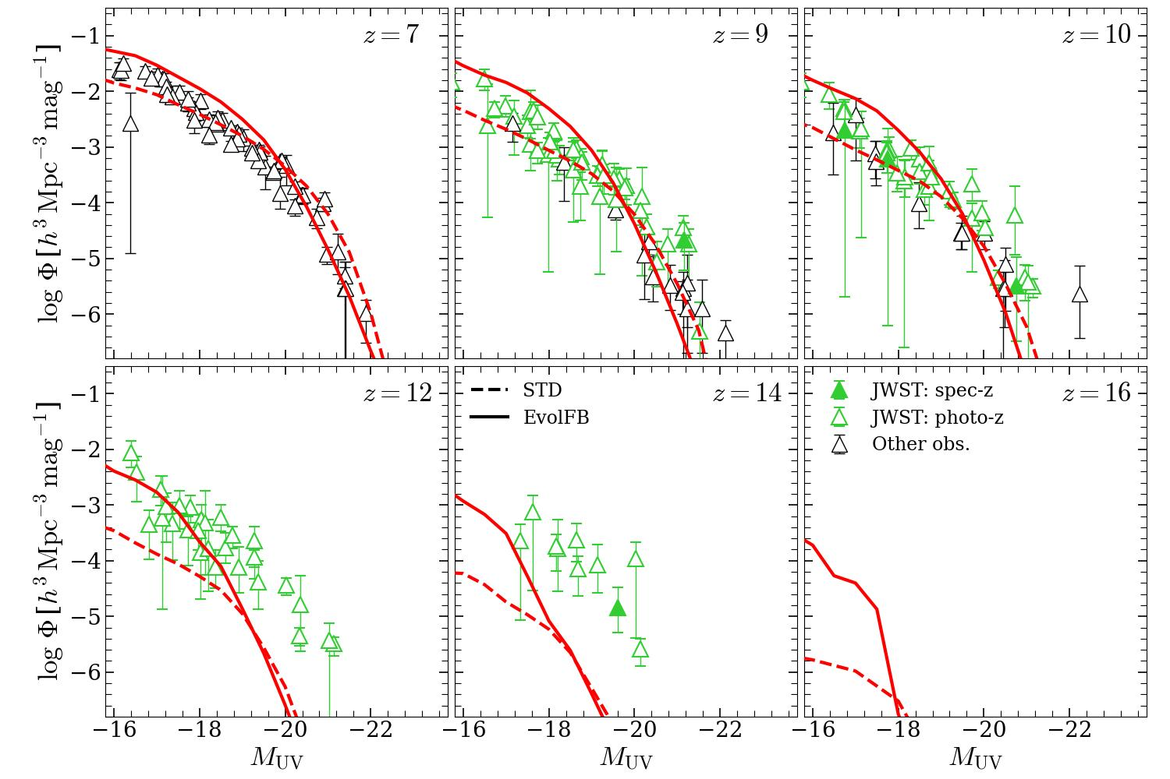
JWST galaxies at z=7-16
Key – top heavy IMF in bursts
Theoretical predictions precede data (Cowley + ‘18)
372 M yrs
300 M yrs
Shengdong Lu, CSF, Bose, Lacey, Cole,Baugh , Helly ‘25

Slide 48
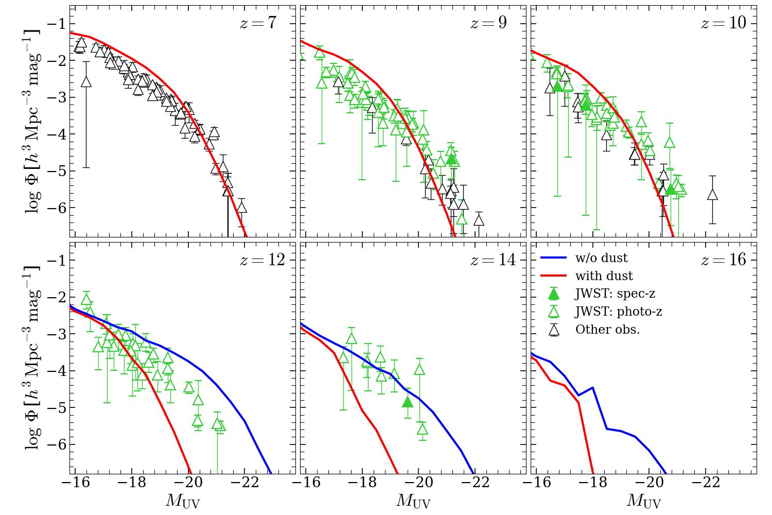
JWST galaxies at z=7-16
Key – top heavy IMF in bursts
Theoretical predictions precede data (Cowley + ‘18)
372 M yrs
300 M yrs
No dust
Shengdong Lu, CSF, Bose, Lacey, Cole,Baugh , Helly ‘25

Slide 49
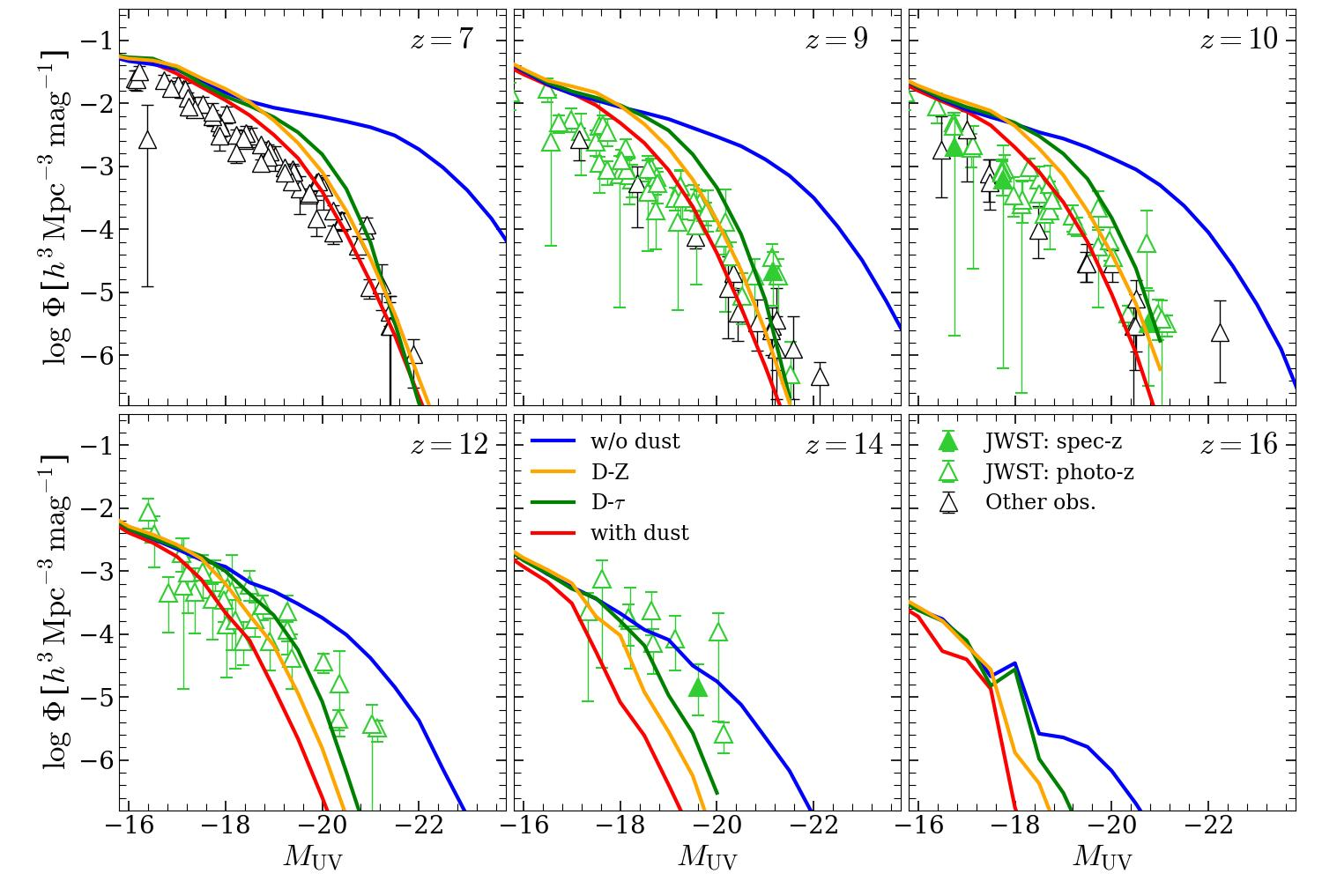
JWST galaxies at z=7-16
Key – top heavy IMF in bursts
Theoretical predictions precede data (Cowley + ‘18)
372 M yrs
300 M yrs
No dust
Schneider & Maiolino ‘24
Shengdong Lu, CSF, Bose, Lacey, Cole,Baugh , Helly ‘25

Slide 50
JWST galaxies at high z
UV luminosity function of JWST galaxies at z = 7 – 14 → just as predicted in ΛCDM in 2018 (with dust grains forming gradually at z>12)!
Lu, CSF+ ‘24
Key to this success
1. Top-heavy IMF in starbursts
2. Proper modelling of dust

Slide 51
JWST galaxies at z= 8 -16

Slide 52
JWST galaxies at z=7-16
 | z | Stellar mass | Halo mass
 | 12 | 2 x 10⁸ M_{o} (~Sagittarius) | 6 x 10¹⁰ M_{o} (~Sagittarius)
 | 16 | 10⁷ M_{o} | 2 x 10¹⁰ M_{o}
brightest galaxy:
LMC: M* = 3x10⁹M_{0;} M_{halo}= 2x10¹¹M_{o}
Could be the progenitors of galaxies like the Milky Way today
Lu, CSF + ‘24

Slide 53
21 minutes

Slide 54
Testing ΛCDM on small scales
Most fundamental predictions of ΛCDM on small scales:
* Halo mass function, n(M)
* Halo density profile, ρ(r)
Follows directly from primordial PS of density perturbations + random phases

Slide 55
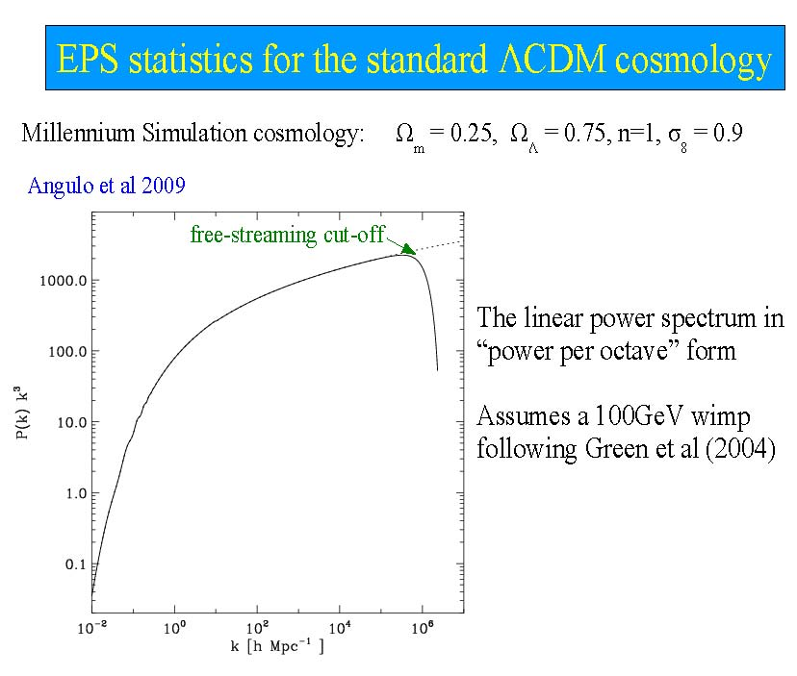
The cold dark matter power spectrum
k³ P(k)
z~1000
The linear power spectrum (“power per octave”)
Assumes a 100GeV wimp Green et al ‘04
Earth mass
Gal clusters
Fluctuation amplitude
22 orders of magnitude in mass
Large scales
Log k
Small scales

Slide 56
Mass function of CDM halos over 22 orders of magnitude in mass
Wang, Bose, CSF, Gao, Jenkins, Springel, White, Nature ‘20
The VVV project
CDM

Slide 57
Mass function of CDM halos over 22 orders of magnitude in mass
Wang, Bose, CSF, Gao, Jenkins, Springel, White, Nature ‘20
The VVV project
CDM
A fundamental prediction of CDM

Slide 58
Density profiles of ALL halos
VVV
Slope of density profile
Over 25 orders of magnitude in halo mass and 4 orders of magnitude in density, the mean density profiles of halos are fit by NFW to within 20% and by Einasto (α =0.16) to within 7%
Wang, Bose, CSF + ‘20

Slide 59
Mass function of CDM halos over 22 orders of magnitude in mass
The VVV project
CDM
WDM
/ M_{o}
Wang, Bose, CSF, Gao, Jenkins, Springel, White - Nature 2020

Slide 60
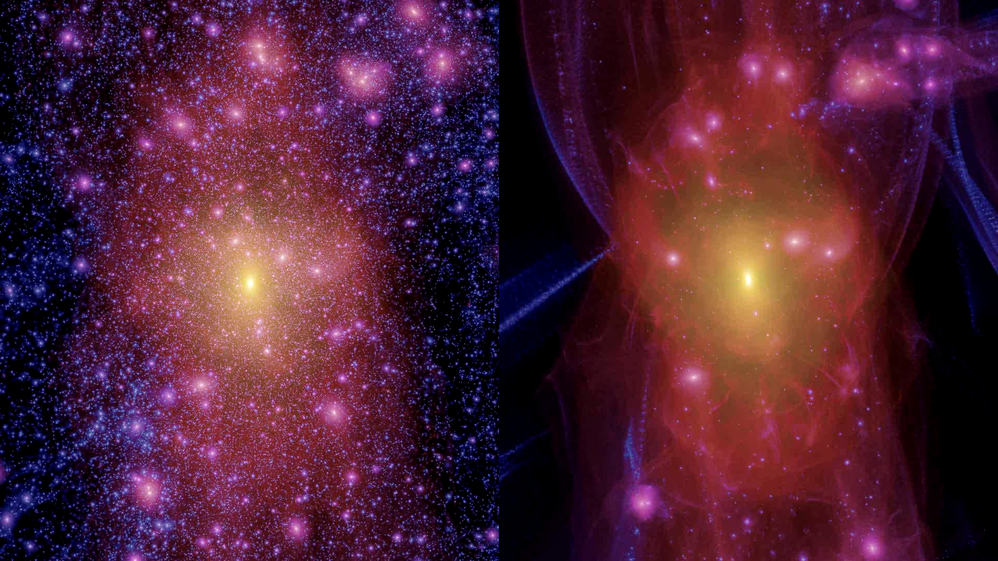
cold dark matter
warm dark matter
Lovell, Eke, Frenk, Gao, Jenkins, Wang, White, Theuns, Boyarski & Ruchayskiy ‘12

Slide 61
Mass function of CDM halos over 22 orders of magnitude in mass
The VVV project
Dark halos/subhalos
CDM
visible
WDM
/ M_{o}
Wang, Bose, CSF, Gao, Jenkins, Springel, White - Nature 2020

Slide 62
Mass function of CDM halos over 22 orders of magnitude in mass
The VVV project
Dark halos/subhalos
CDM
visible
WDM
/ M_{o}
Wang, Bose, CSF, Gao, Jenkins, Springel, White - Nature 2020

Slide 63
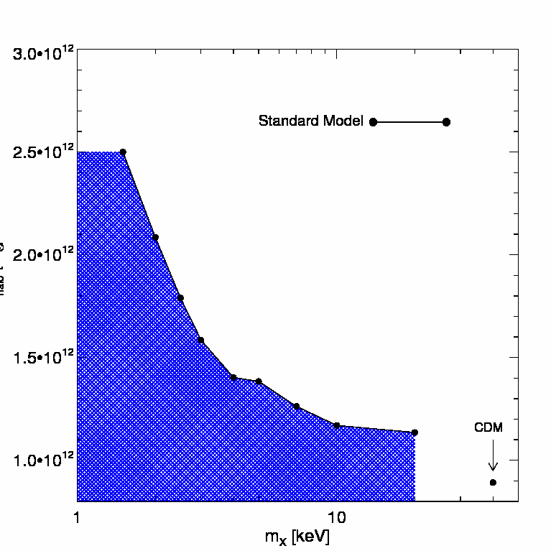
Limits on WDM particle mass
Minimum halo mass consistent (95%) with observed no. of sats for given m_{WDM}
Lyman-α forest (Viel et al. ‘13)
For standard galaxy formation model, if M_{halo}< 2 x10¹² M_{o}
→ m_{WDM} > 2.2 keV
M_{halo} /M_{o}
allowed
Kennedy, Cole & Frenk ‘14
Not allowed
Polisensky & Ricotti ‘11 Lovell, CSF+ ‘13
Nadler+ ‘21
m_{WDM}/keV

Slide 64
Limits on sterile neutrino mass
Lovell, Bose, CSF+ ’16
Newton, Lovell, CSF+ ’24

Slide 65
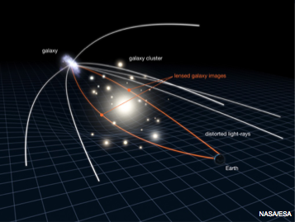
Gravitational lensing: Einstein rings
When the source and the lens are well aligned → strong arc or an Einstein ring

Slide 66
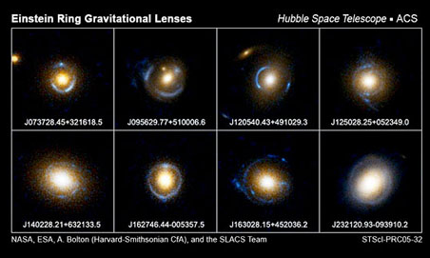
SLAC sample of strong lenses

Slide 67
Gravitational lensing: Einstein rings
Additional lensing by line-of-sight halos perturb image
When the source and the lens are well aligned → strong arc or an Einstein ring

Slide 68
Gravitational lensing: Einstein rings
Halos projected onto an Einstein ring distort the image
m_{sub} = 2.8 x 10¹⁰ M_{o}
Vegetti et al ‘10

Slide 69
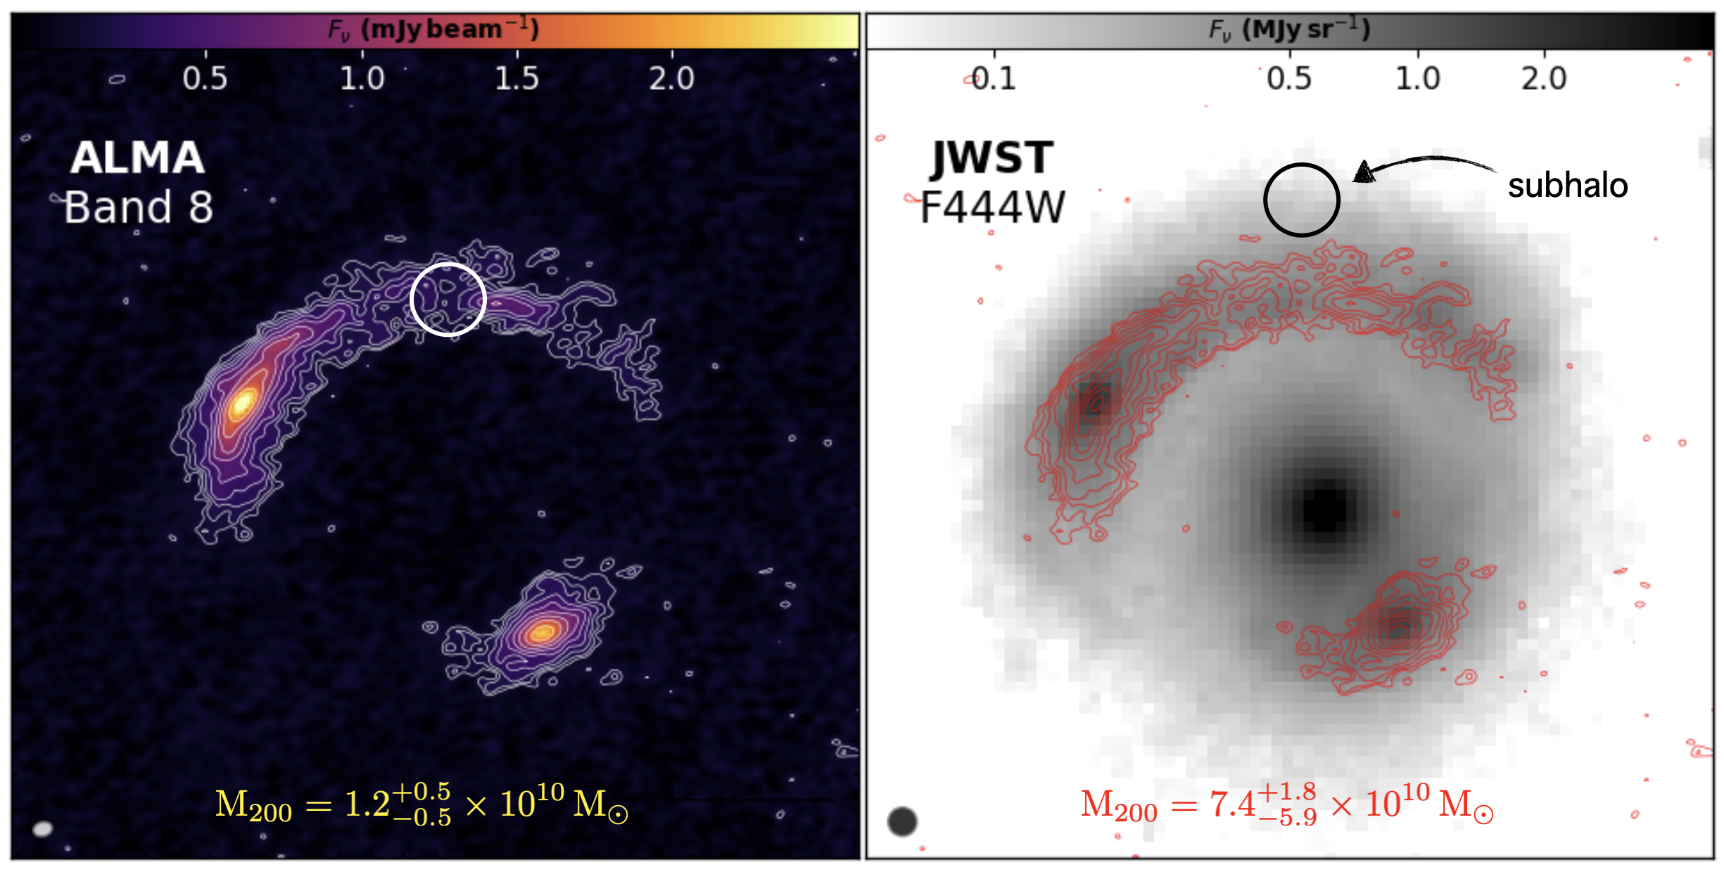
Gravitational lensing: substructures
A substructure found in both ALMA and JWST!
Amvrosiades, Lang, Nightingale, CSF + ‘24

Slide 70
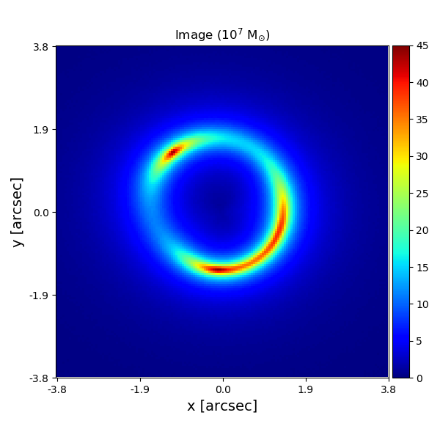

Detecting halos w. strong lensing
Can detect halos as small as 10⁸M_{o}
If WDM is right, should find NO 10⁸ M_{o} halos
If CDM is right, should find MANY 10⁸ M_{o} halos
He, Li, CSF et al ‘19

Slide 71
Conclusions
Large scales
● DESI BAO (>1% precision) → ΛCDM ruled out at 3.4 σ ● Evolving DE model (w₀w_{a}CDM) favoured
● In w₀w_{a}CDM, Σm_{ν} < 0.195 eV
Small scales
Abundance of JWST galaxies at z<14 → as predicted in CDM
MW satellites → Strong constraints on WDM particle mass
Ultimate test of CDM → small halos by gravitational lensing

