Slide 1

Xe Dark Matter Experiment Status and Future
May 21, 2026
Rick Gaitskell, Brown University
Spokesperson for LZ Experiment
Funded by US DOE
IDM2026, June 3, 2026
25 min Summary
260603 v4.2

Slide 2


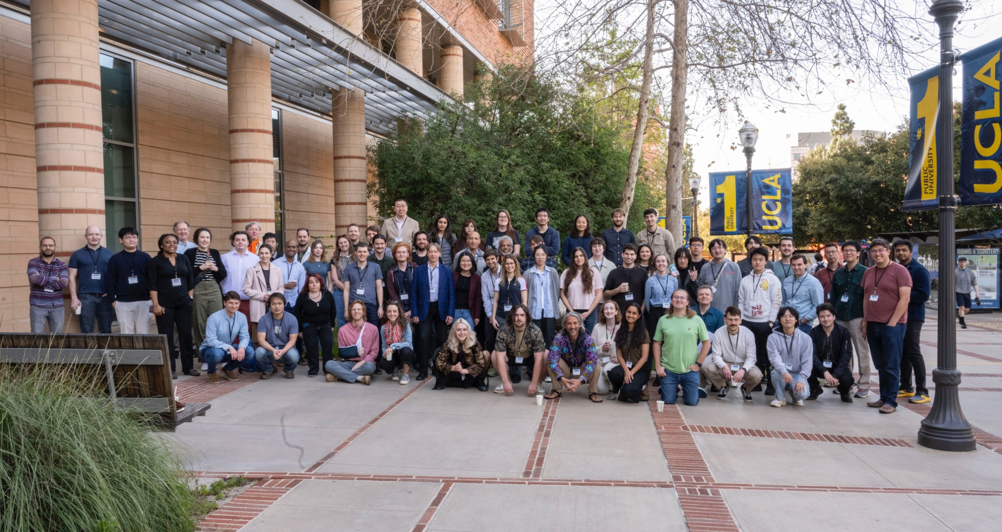







Acknowledge my membership of LZ (LUX-ZEPLIN) Collaboration, 38 institutions
250 scientists, engineers, and technical staff
@lzdarkmatter
Black Hills State University
Brookhaven National Laboratory
Brown University
Center for Underground Physics
Edinburgh University
Fermi National Accelerator Lab.
Imperial College London
King’s College London
Lawrence Berkeley National Lab.
Lawrence Livermore National Lab.
LIP Coimbra
Northwestern University
Pennsylvania State University
Royal Holloway University of London
SLAC National Accelerator Lab.
South Dakota School of Mines & Tech
South Dakota Science & Technology Authority
STFC Rutherford Appleton Lab.
Texas A&M University
University of Albany, SUNY
University of Alabama
University of Bristol
University College London
University of California Berkeley
University of California Davis
University of California Los Angeles
University of California Santa Barbara
University of Liverpool
University of Maryland
University of Massachusetts, Amherst
University of Michigan
University of Oxford
University of Rochester
University of Sheffield
University of Sydney
University of Texas at Austin
University of Wisconsin, Madison
University of Zürich
US Europe Asia Oceania
LZ Collaboration Meeting at UCLA, March 2025
https://lz.lbl.gov/
US Department of Energy
Thanks to our sponsors and participating institutions!
Notes:
250528 Paulo Bras - submitted
251202 [RG] Did not add University of Melbourne / on paper, but not formal member
{RG} Do we want Map or Another way to better ensure the Institutions are most clearly credited?
Looks like we are hiding names
RG - IS THERE AN ISSUE WITH SHOWING DOE BADGE? This has been challenged in past.

Slide 3

LZ (LUX-ZEPLIN) Collaboration, 38 Institutions
250 scientists, engineers, and technical staff
@lzdarkmatter
Black Hills State University
Brookhaven National Laboratory
Brown University
Center for Underground Physics
Edinburgh University
Fermi National Accelerator Lab.
Imperial College London
King’s College London
Lawrence Berkeley National Lab.
Lawrence Livermore National Lab.
LIP Coimbra
Northwestern University
Pennsylvania State University
Royal Holloway University of London
SLAC National Accelerator Lab.
South Dakota School of Mines & Tech
South Dakota Science & Technology Authority
STFC Rutherford Appleton Lab.
Texas A&M University
University of Albany, SUNY
University of Alabama
University of Bristol
University College London
University of California Berkeley
University of California Davis
University of California Los Angeles
University of California Santa Barbara
University of Liverpool
University of Maryland
University of Massachusetts, Amherst
University of Michigan
University of Oxford
University of Rochester
University of Sheffield
University of Sydney
University of Texas at Austin
University of Wisconsin, Madison
University of Zürich
US Europe Asia Oceania
https://lz.lbl.gov/
LZ Collaboration Meeting at UCLA, March 2025
Thanks to our sponsors and participating institutions!
Notes:
250528 Paulo Bras - submitted

Slide 4
Etymology
PARANINFO
Greek word paránymphos, originally meaning a "matchmaker", which evolved in universities to represent the messenger who formally announced the conferral of a degree

Slide 5
As will become very obvious
NO AI
WAS USED IN THE PREPARATION
OR PRETTIFICATION
OF THESE SLIDES

Slide 6
IDM Veteran, first attended in York in 2000
Although I have been working in field since 1989
We hosted IDM at Brown in 2018
LTD IV (Oxford)

Slide 7
I started looking for dark matter using Low Temperature Detectors
Superconducting Niobium Single Crystal 99.9999% pure ~10 g
Goal was to Trap Quasiparticles from bulk Nb using Al layer and detect trapping photons using Al STJ Arrays
Sixth sense required for dilution fridge diagnostics

Slide 8
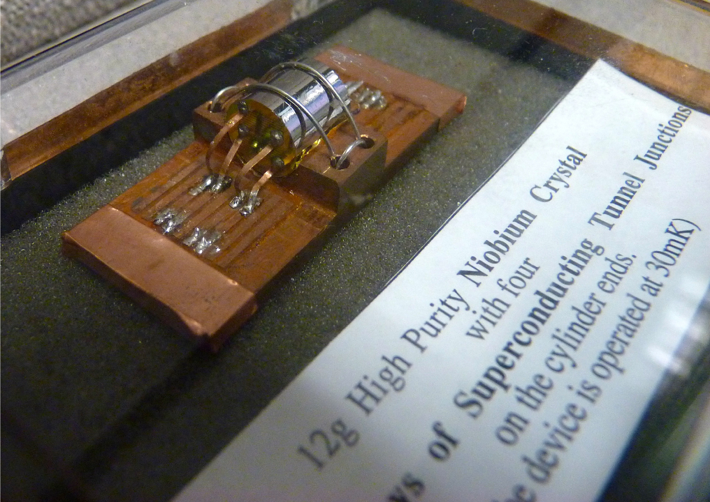
Gaitskell (Graduate Work) Superconducting Nb Single Crystal Detector
1 cm long - 12 g - 250 eV Threshold - “State of the Art in 1991”
  Superconducting Tunnel Junction arrays detecting phonons and quasiparticles from Nb
In Early 1990’s we studied exotic lattice photon and quasiparticle states to build sensitive dark matter detectors - today we appear to be coming full circle as see new proposals for MeV DM search experiments based on meV excitons
  LUX Dark Matter Experiment / Sanford Lab
Rick Gaitskell (Brown)

Slide 9
Movie of a dilution refrigerator when the vacuum goes soft

Slide 10
How does Sensitivity Improve?
You might just say Target Size
Energy Threshold compared to DM Characteristic KE (adjusted for mass)
Time
If competing with (subtracting) Backgrounds T^½
Systematics may inhibit our ability to identify clear signal

Slide 11
Recoil Energy?
WIMPs go at the same characteristic speed as everything else in Milky Way 230 km/s
v/c ~ 0.7 x 10^-3
½ m (v/c)^2 ~ ½ (100 GeV) (0.7 10^-3)^2 ~ 25 GeV MeV keV
If masses are matched then
If target and WIMP are not matched then r = 4 M1 M2/(M1+M2)^2
This is 1 when matched and < 1 as M1 ≠ M2
The lighter of the two objects sets the mass characteristic for KE

Slide 12
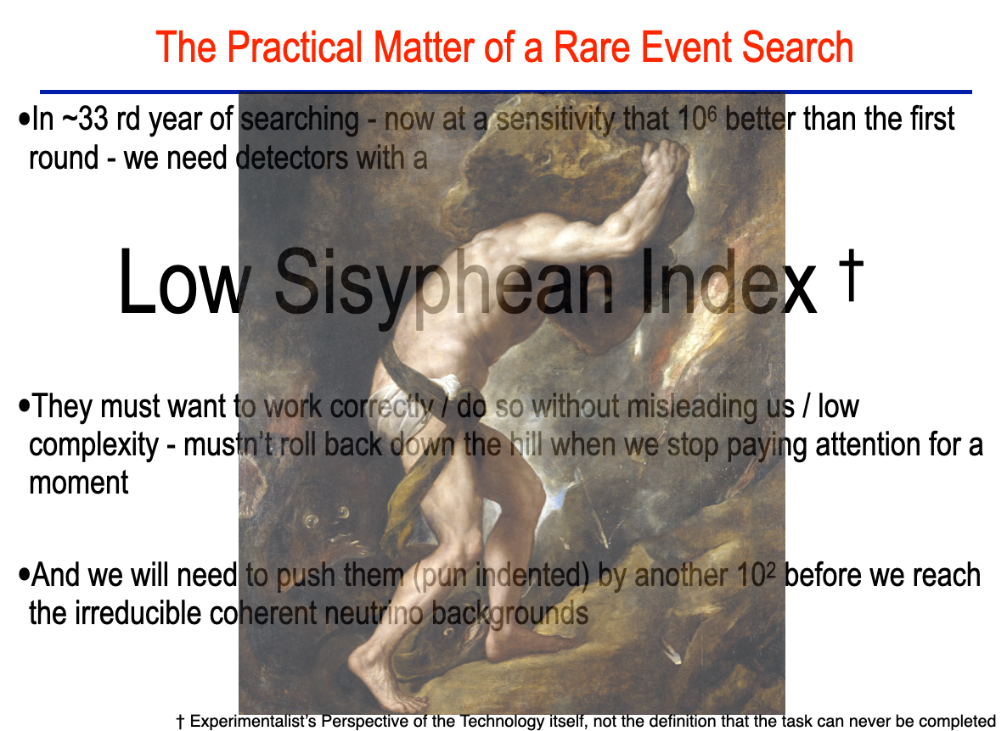

Slide 13
Xe
My colleagues on CDMS thought I was daft when I left that world-leading experiment in 2003 to pursue a new design… bucket detectors using liquid targets
TPC’s are quantum detectors…
We count excitons … photons and electrons from the interaction site
The energy to create an excitation is ~14 eV (for low energy electron event)
This value rises for a nuclear recoils ~70 eV (for low energy nuclear event)
Scintillation is 175 nm (this is conveniently above the edge 160 nm for synthetic quartz/silica/SiO2)
Traditional Xe TPCs don’t make any use of the Heat (but … see SBC)

Slide 14
Quantum Detectors
We typically convert ~10% of scintillation photons into a (single) photon pulse in the photo detectors
that is 33% of photons hit a photodetector and 33% of those are converted to a signal “QE”
Teflon is a miracle reflector in liquid Xe for VUV (170 nm) light
In Xe the purity regularly leads to close to >90% drift survival probability for >2 m and >90% liquid-gas extraction
Electrons in gas light up like a Christmas Tree (detect ~40 photons/electron in gas) so we can count individual electrons from 100 tonne targets

Slide 15
Historical Point
Back in 2003 we didn’t even know if low energy nuclear recoils in Xe generated any detectable ionization in LXe

Slide 16
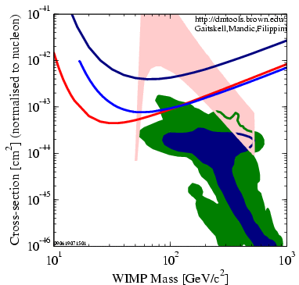
Testing Models of Particle Dark Matter in 2008
Lines show sensitivity limits of then active direct detection experiments - CDMS, XENON10, ZEPLIN III …
Shaded Areas are Regions from Different Theories that include Dark Matter Particles
(Red) Ellis et al MSSM
(Blue, Green) Trotta et al
Notes:
Example from 2008 -
light red - Original (Ellis et al.) forecast
blue and green regions (Trotta et al. 2008) forecast

Slide 17
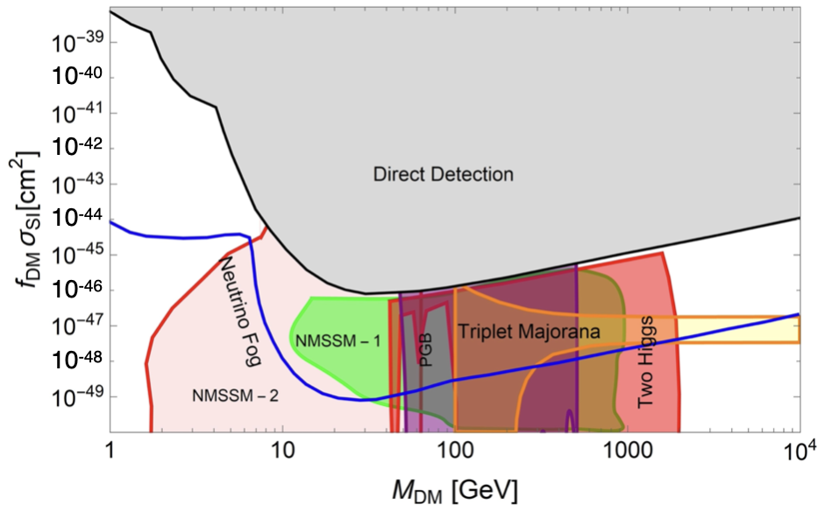
Testing Models of Particle Dark Matter (2008 -> 2016)
Notes:
Motivating Dark Matter Science Search - Covers Large Range of Cross Sections
What suitable graphic do we have that contain SUSY and Dark Sector Models and show what has been tested over last 30 years - field/LZ is testing?
Is important to emphasize large range of cross sections for valid models
{Can someone advise … I would like a plot which shows models from 10^-42 cm2 (the ones we have tested) down to 10^-49 cm2
Doesn’t need to show Direct Sensitivity
Needs to cover masses ~1 GeV as well as high mass range
}

Slide 18
Testing Models of Particle Dark Matter in 2016
XENON100, LUX, PandaX Search Results
Notes:
Motivating Dark Matter Science Search - Covers Large Range of Cross Sections
What suitable graphic do we have that contain SUSY and Dark Sector Models and show what has been tested over last 30 years - field/LZ is testing?
Is important to emphasize large range of cross sections for valid models
{Can someone advise … I would like a plot which shows models from 10^-42 cm2 (the ones we have tested) down to 10^-49 cm2
Doesn’t need to show Direct Sensitivity
Needs to cover masses ~1 GeV as well as high mass range
}

Slide 19
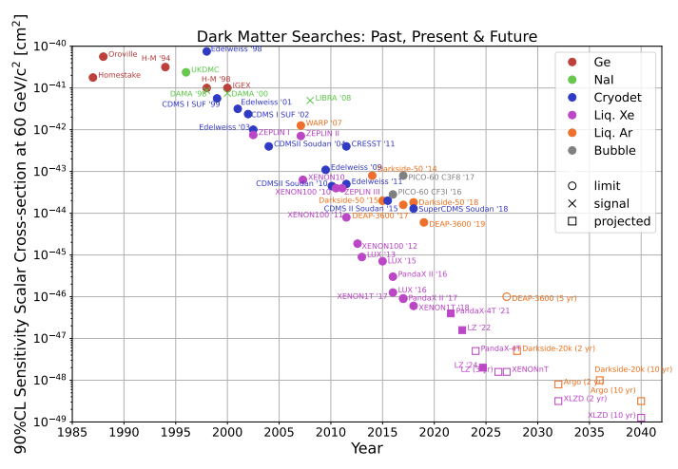
Search for WIMP Dark Matter 1986-2026 and Beyond
R.J.Gaitskell, "Direct Detection of Dark Matter'', Annu. Rev. Nucl. and Part. Sci. 54 (2004) 315-359 (updated by R.J. Gaitskell et al., Private Communication, 2026)
Notes:
History and Rate of New Science
indicate power law improvement; monumental effort leading up to where we are now (decades of work accomplishing a factor of several million in sensitivity improvement); if like a treasure hunt, done not by digging w/ more shovels but by inventing new devices -> constant innovation required!
How the field has set about testing models
Mention the cross section in units of expected range through Pb
[251130 RG]
We maintain the original version of this:
LZ/Gaitskell Maintained Version is in https://drive.google.com/drive/folders/1cTAEmKjL2rvqRHDAzWhaSLjtmdVSv_eO
See Slack https://luxzeplin.slack.com/archives/C019LRZRZV3/p1746021625952019
Where does originally pasted version come from?

Slide 20
Search for WIMP Dark Matter 1986-2026 and Beyond
Moore’s Law for dark matter searches (2x every 1.5 yrs)
beating Moore’s Law for Compute
(2x every 2 yrs)
Notes:
History and Rate of New Science
indicate power law improvement; monumental effort leading up to where we are now (decades of work accomplishing a factor of several million in sensitivity improvement); if like a treasure hunt, done not by digging w/ more shovels but by inventing new devices -> constant innovation required!
[251130 RG]
We maintain the original version of this:
LZ/Gaitskell Maintained Version is in https://drive.google.com/drive/folders/1cTAEmKjL2rvqRHDAzWhaSLjtmdVSv_eO
See Slack https://luxzeplin.slack.com/archives/C019LRZRZV3/p1746021625952019
Where does originally pasted version come from?

Slide 21
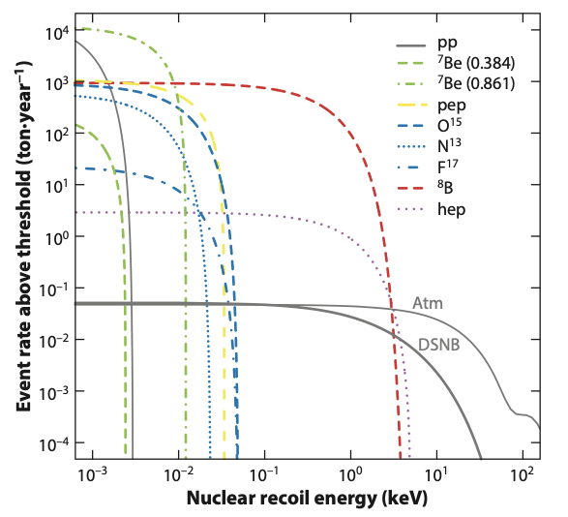
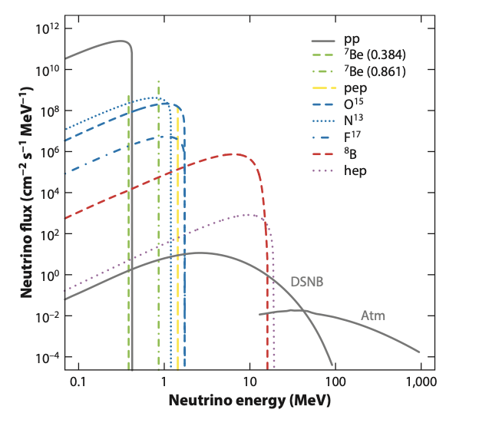
8B Detection / Subsequent Atm Neutrino Fog
CEvNS Coherent Scattering of Neutrinos on Xe LZ 5.7 tonne-year
8B measurement - LZ (4.5σ), XENONnT (2.7σ), PandaX (2.6σ)
Ultimately Neutrino Fog as exposure reach 1000 tonne-year
/annurev-nucl-101918-023450
/annurev-nucl-101918-023450
Xe
Notes:
https://www.annualreviews.org/docserver/fulltext/nucl/69/1/annurev-nucl-101918-023450.pdf?expires=1780460975&id=id&accname=guest&checksum=E8840379A4FFD39307CC389018167B5A

Slide 22
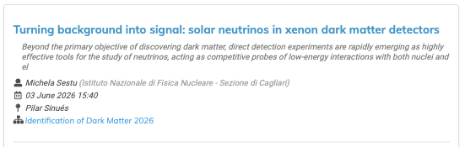
8B Additional Talk

Slide 23
Cost of Xenon Targets
The reference cost is $6/stp liter == $1M/tonne
The commodity price can vary from 0.5x to 5x of this
The target is not destroyed, so it is possible to warehouse it (rent it rather than buy)
However, if isotopically separating 136Xe from 9% natural abundance it is the separation cost that will dominate
It is 0.1 ppm, rarest of all gases in air
0.5 tonnes Xe in 1 km^3
For a hurricane wind of 50 m/s down a 4x4 m corridor that would take ~1 month/tonne
Fortunately the steel industry (oxygen) / fertilizer (nitrogen) extracts

Slide 24
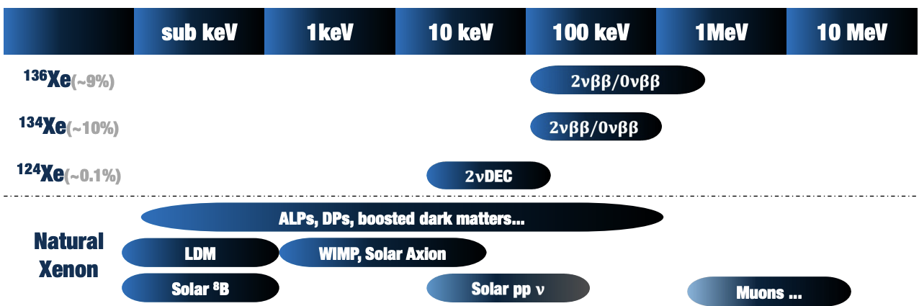
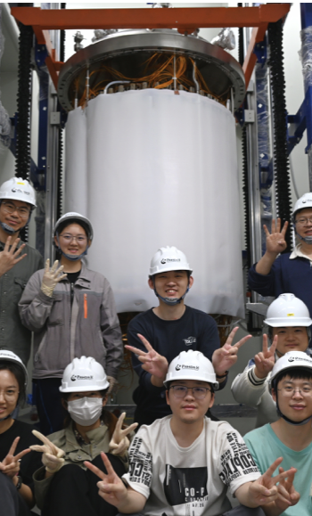
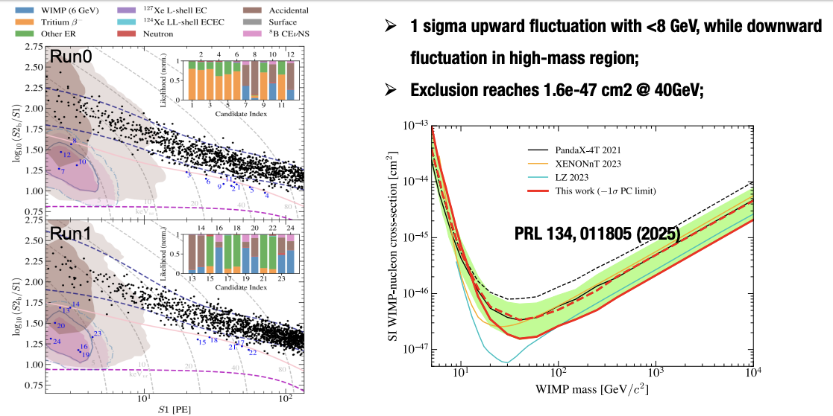
PandaX-4T @ CJPL (2020-2026)
We heard from Xiaopeng Zhou (Beihang University, Beijing) on Tuesday (link)
Notes:
https://indico.capa.unizar.es/event/40/contributions/854/attachments/693/1230/PandaX-20T_XiangXiao_IDM.pdf

Slide 25
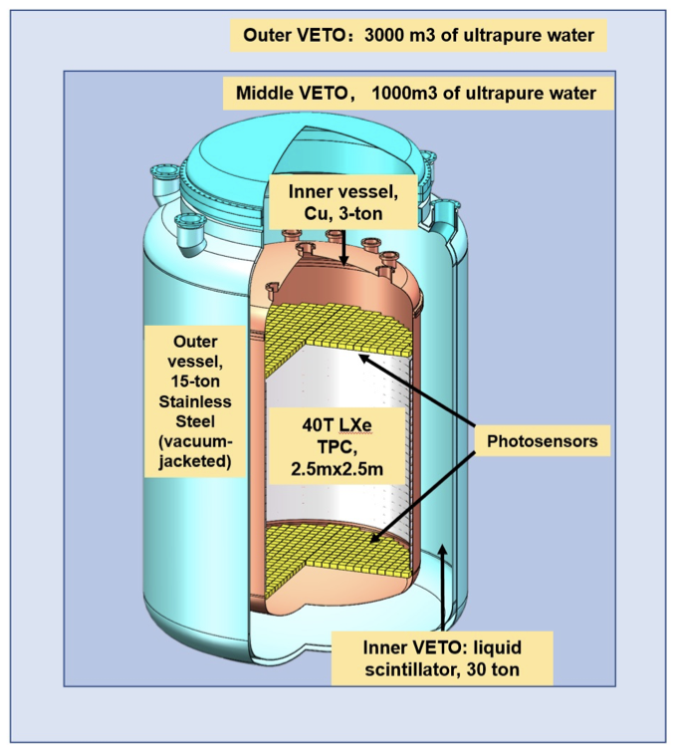
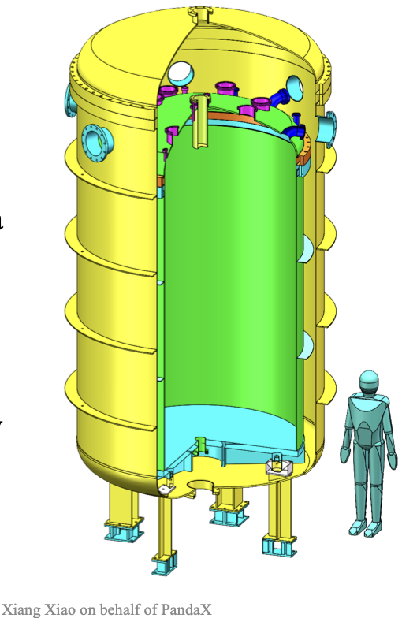
PandaX-20t (Fully funded/target purchased)
We heard from Xiang Xiao (Sun Yat-sen University) on Tuesday (link)
Goal to start science with 20t in early 2028
Notes:
https://indico.capa.unizar.es/event/40/contributions/854/attachments/693/1230/PandaX-20T_XiangXiao_IDM.pdf

Slide 26
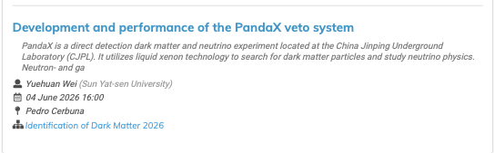
PandaX Additional Talks

Slide 27
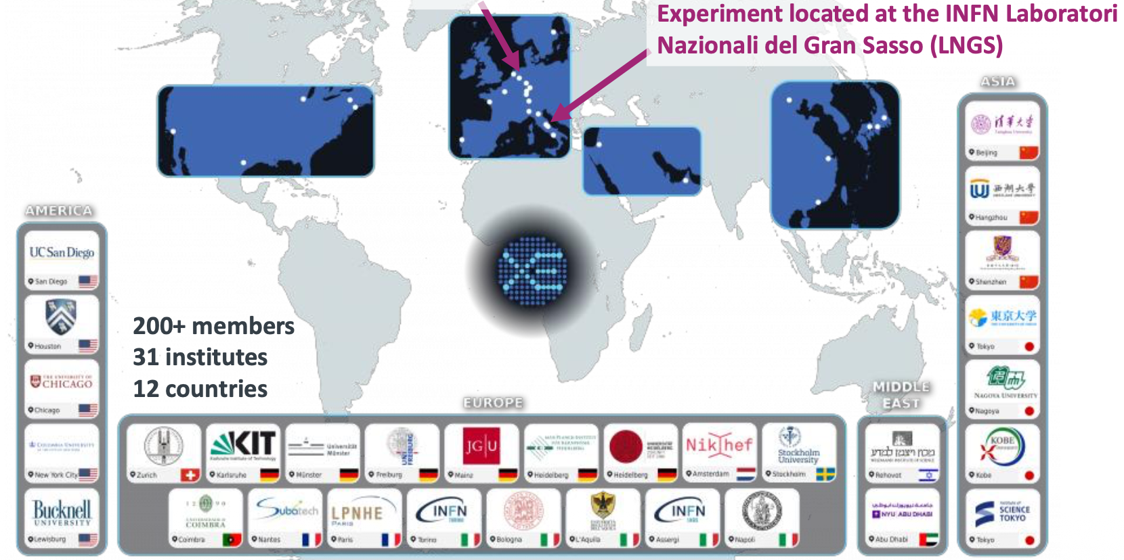
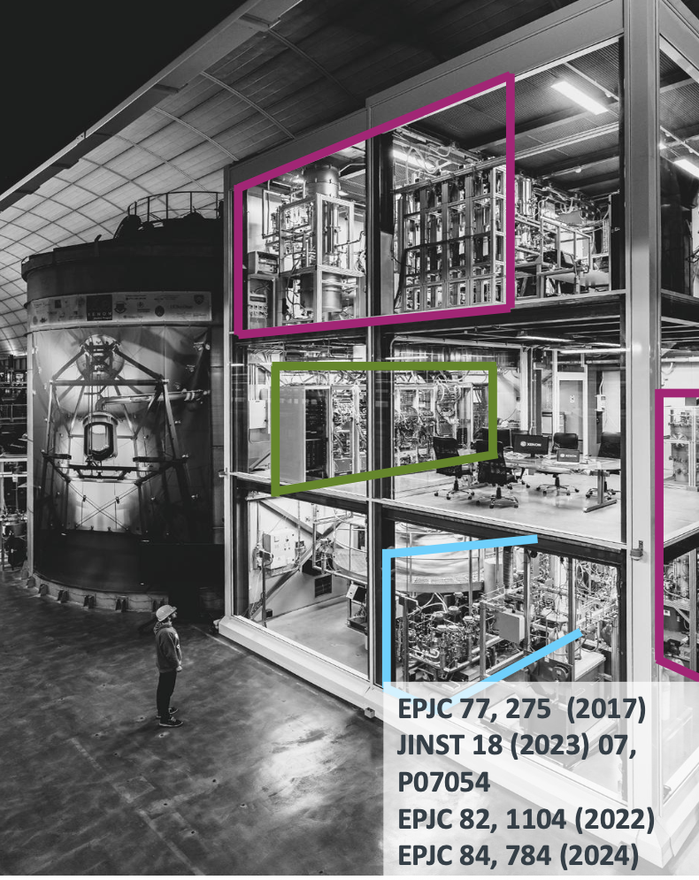
XENONnT (“n” makes it more mysterious)
We heard from Maxime Pierre (Nikhef, Amsterdam) on Tuesday (link)
Notes:
https://indico.capa.unizar.es/event/40/contributions/854/attachments/693/1230/PandaX-20T_XiangXiao_IDM.pdf

Slide 28
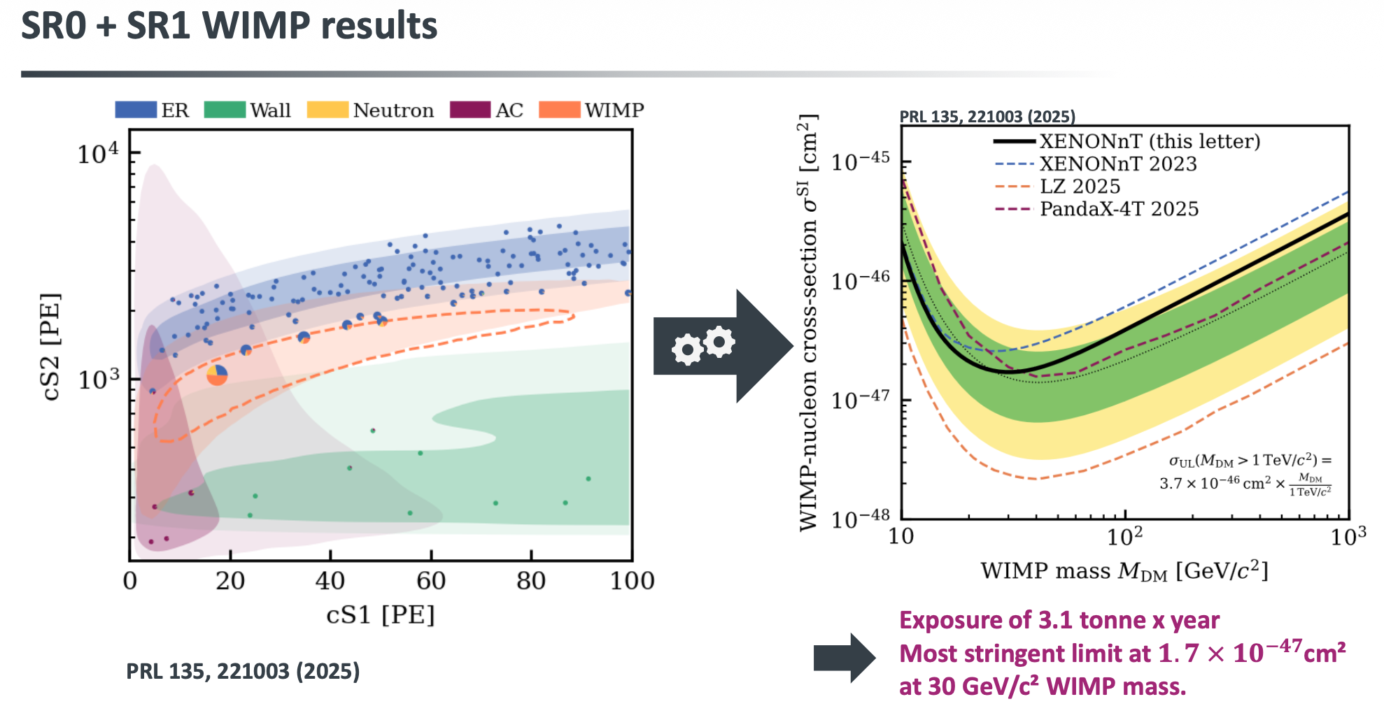
XENONnT @ LNGS
XENON is 6 tonne LXe TPC science search since 2021
XENON was warmed up and detector opened in 2025 to repair grids
  Low electron drift field was significantly hampering progress in DM sensitivity
Repairs completed, detector is now cold and re-commissioning is taking place
Plan is continue operations 2026–2029

Slide 29
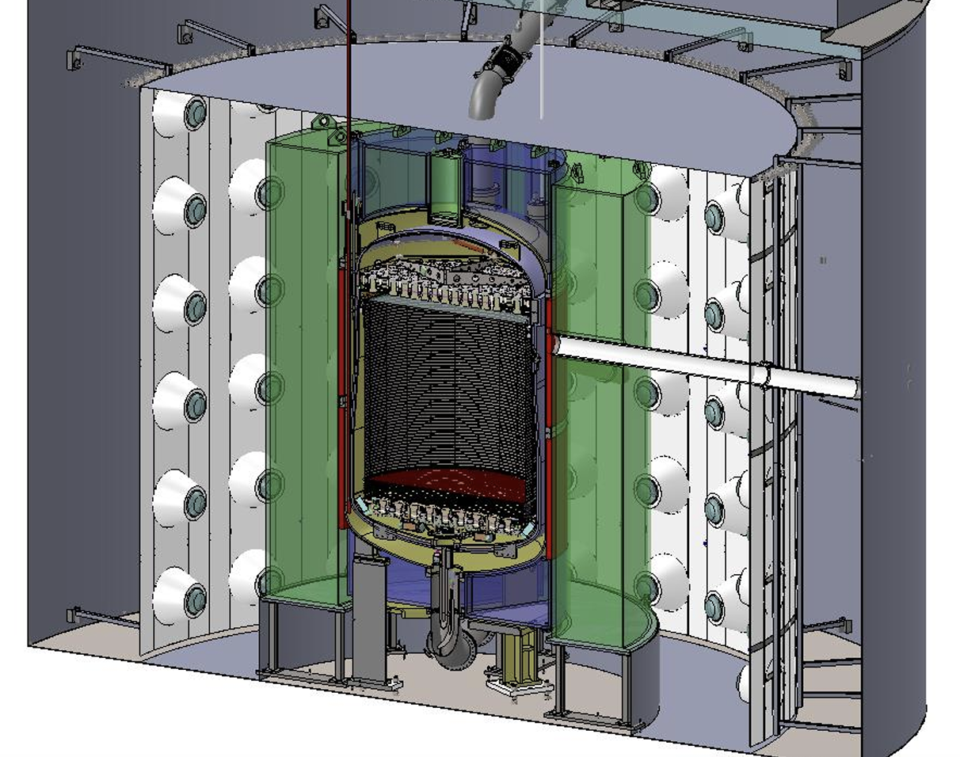
LZ 8t @ SURF
We heard from Alberto Uson (Edinburgh) on Tuesday (link)
Notes:
https://indico.capa.unizar.es/event/40/contributions/854/attachments/693/1230/PandaX-20T_XiangXiao_IDM.pdf

Slide 30
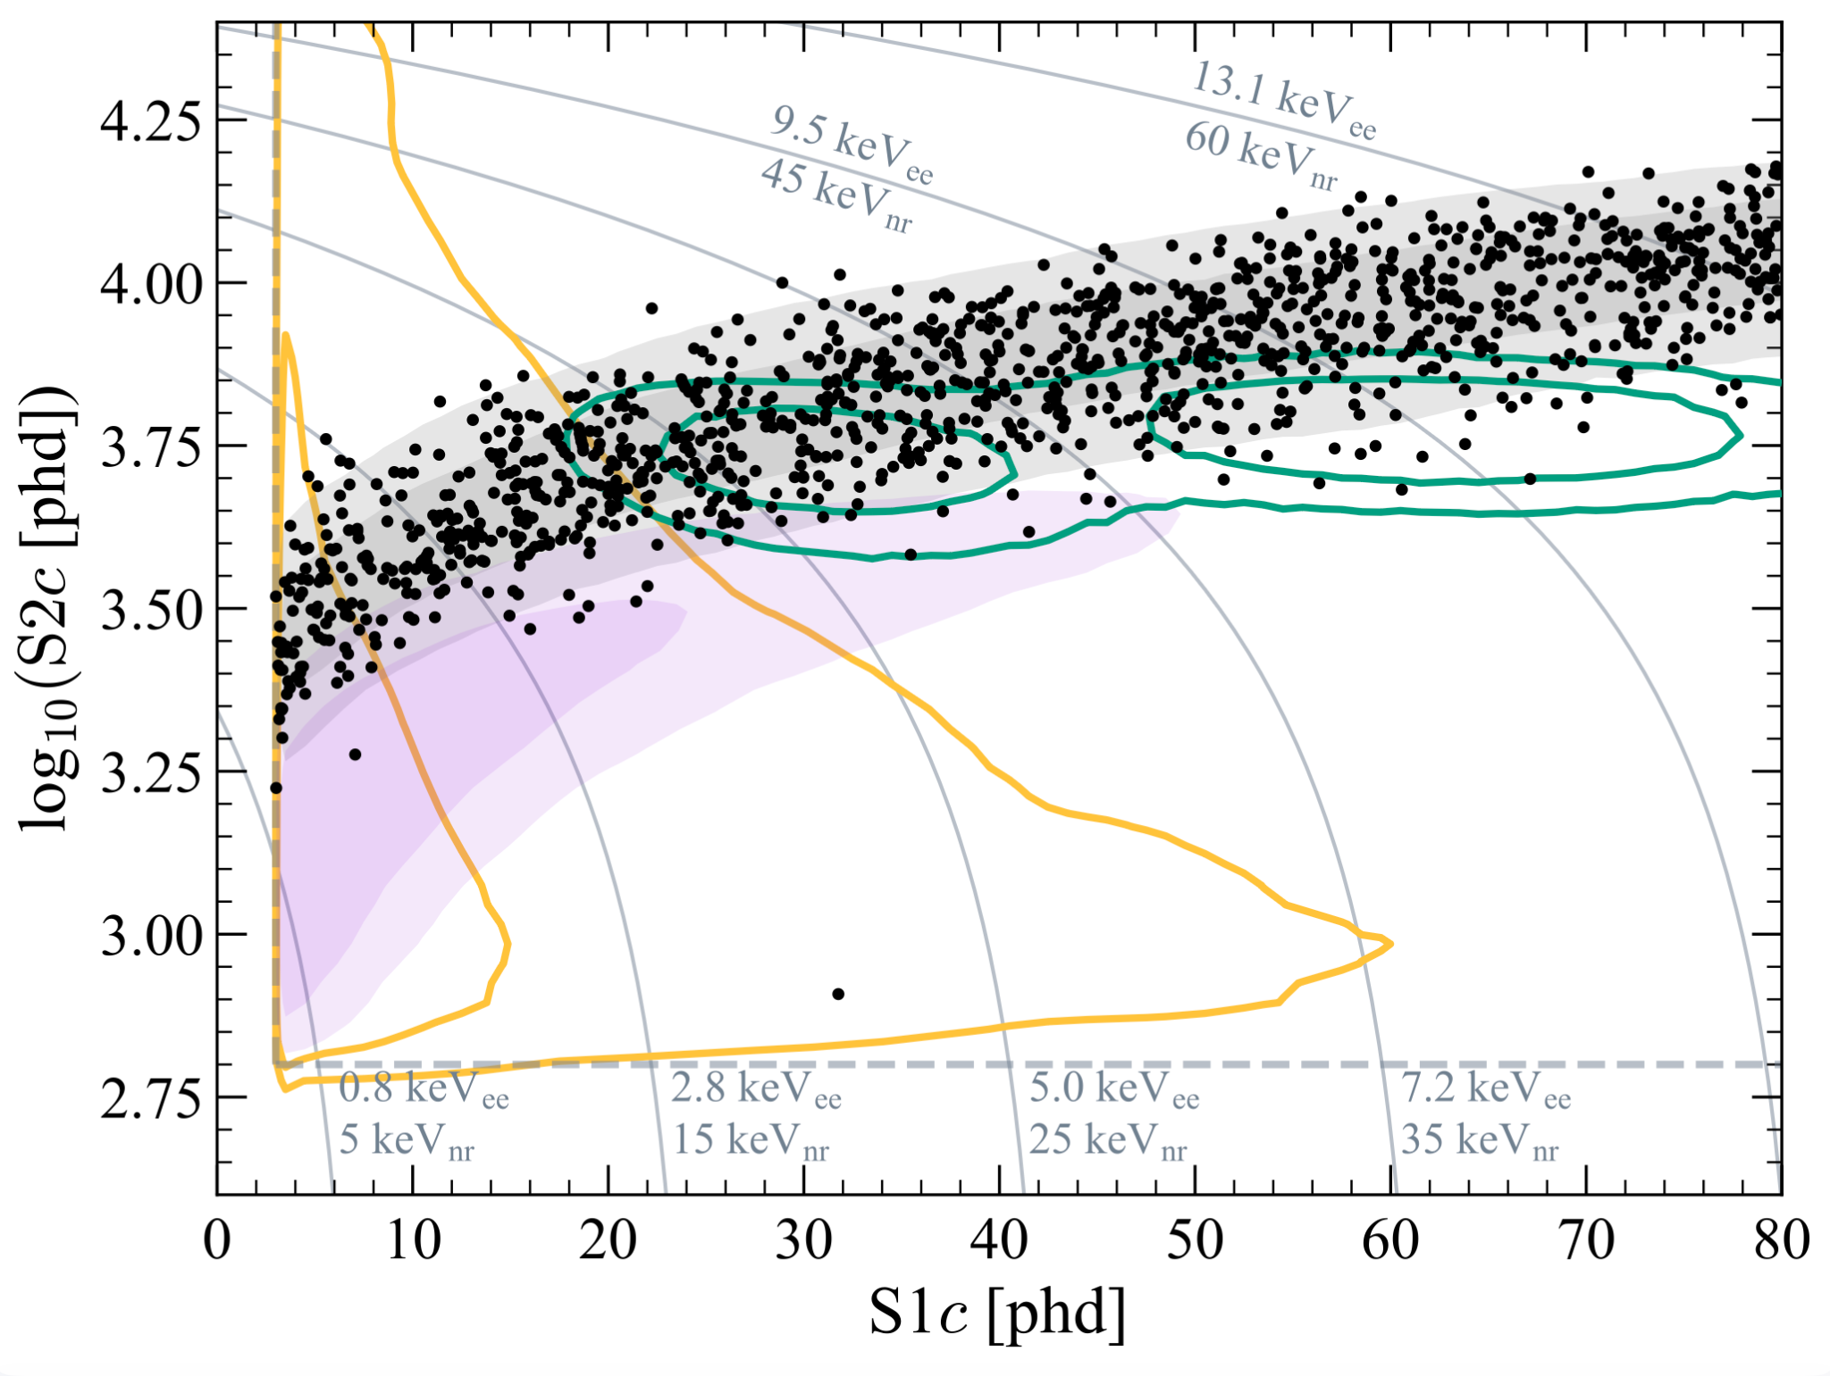
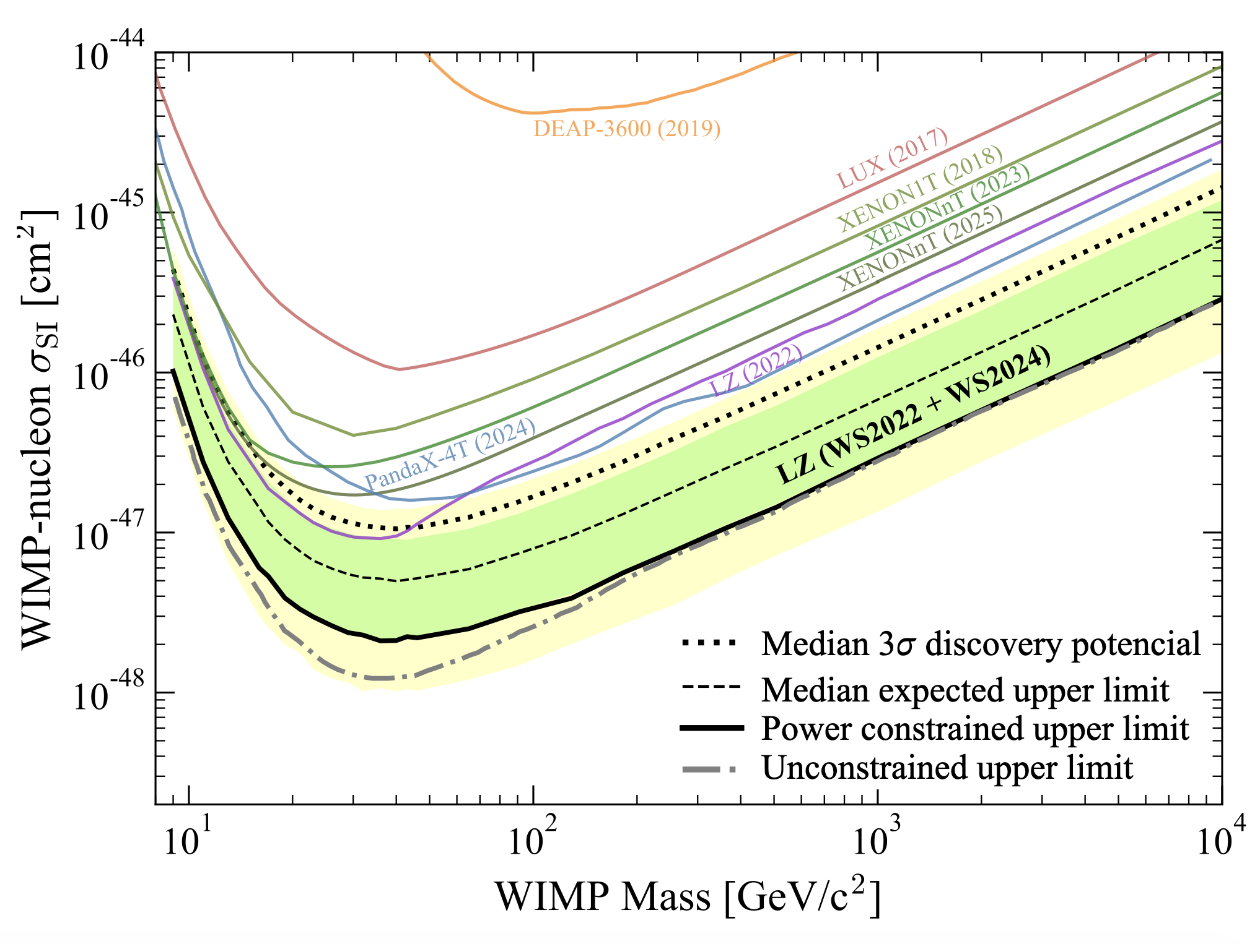
WS2024 result
WS2024 results
Phys. Rev. Lett. 135, 011802
ROI targeted ≥9 GeV/c² DM masses
Novel features incorporated into the analysis:
  Rn-tag reduced 60% primary ER BGs
  Charge yield suppression modelled and measured in EC and DEC
Bias mitigation technique
Final exposure included in PLR: 4.2 tonne·yr
  WS2022: 60 days x 5.5 t = 0.9 tonne·yr exposure
  WS2024: 220 days x 5.5 t = 3.3 tonne·yr exposure
WS2024 ROI
WS2025 ROI
Result: world leading constraints → 2.2 ⨉ 10⁻⁴⁸ cm² for 40 GeV/c² WIMP
What’s next? Shift to lighter DM masses → WS2025
New set of challenges

Slide 31
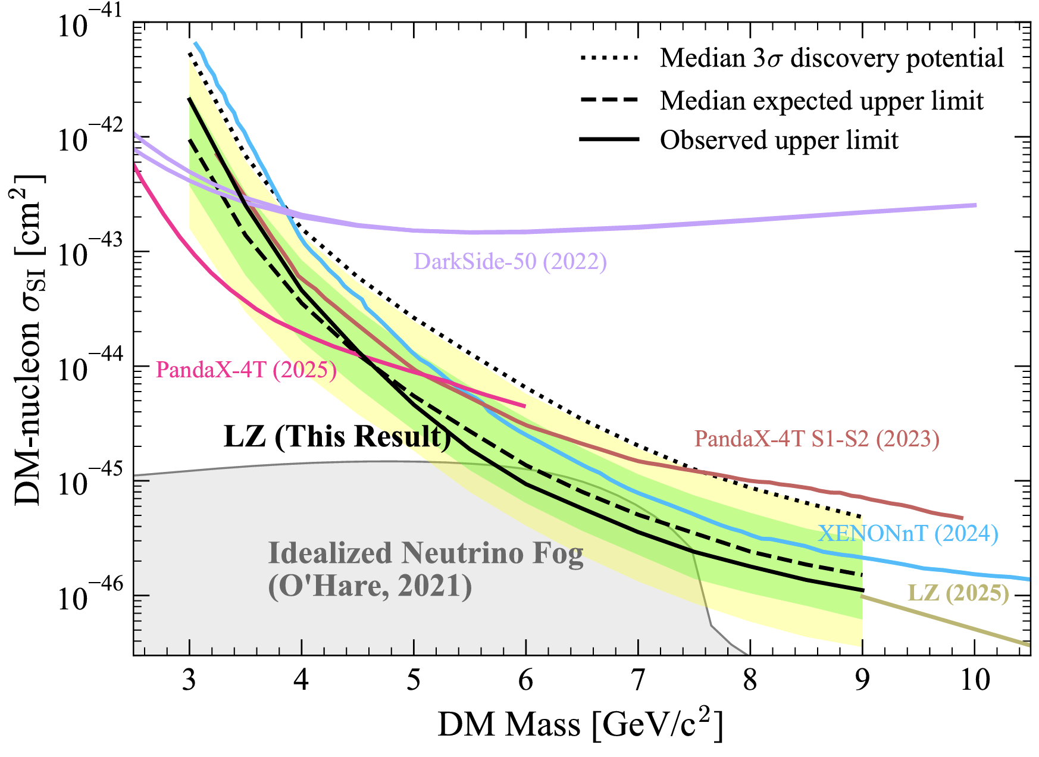
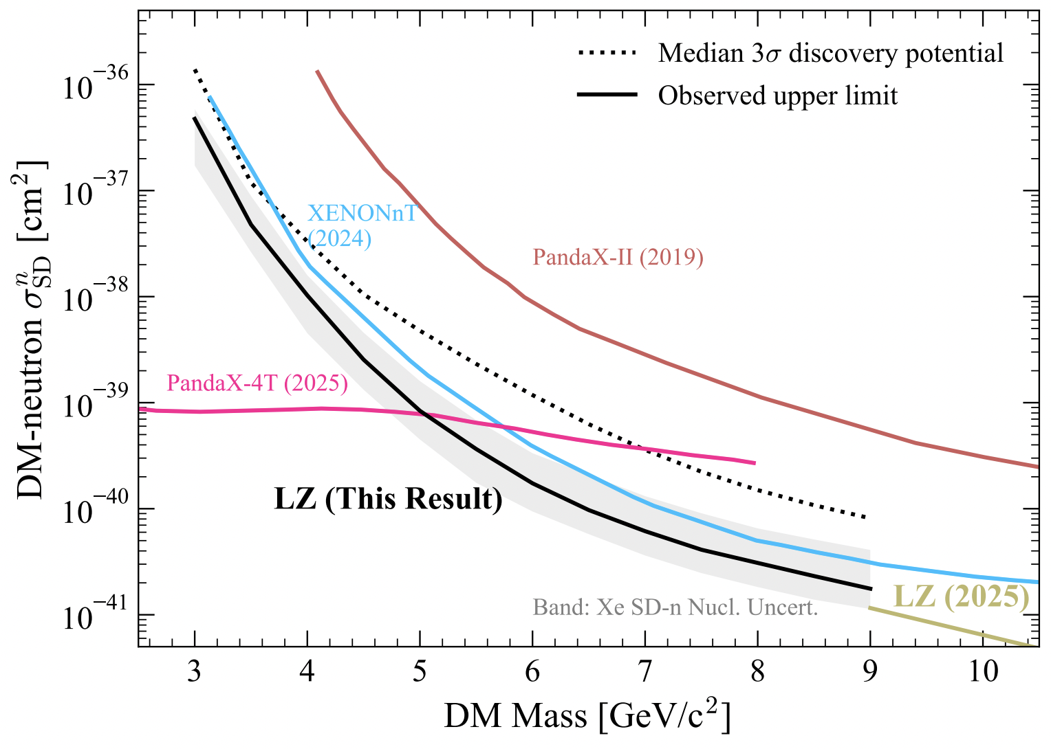
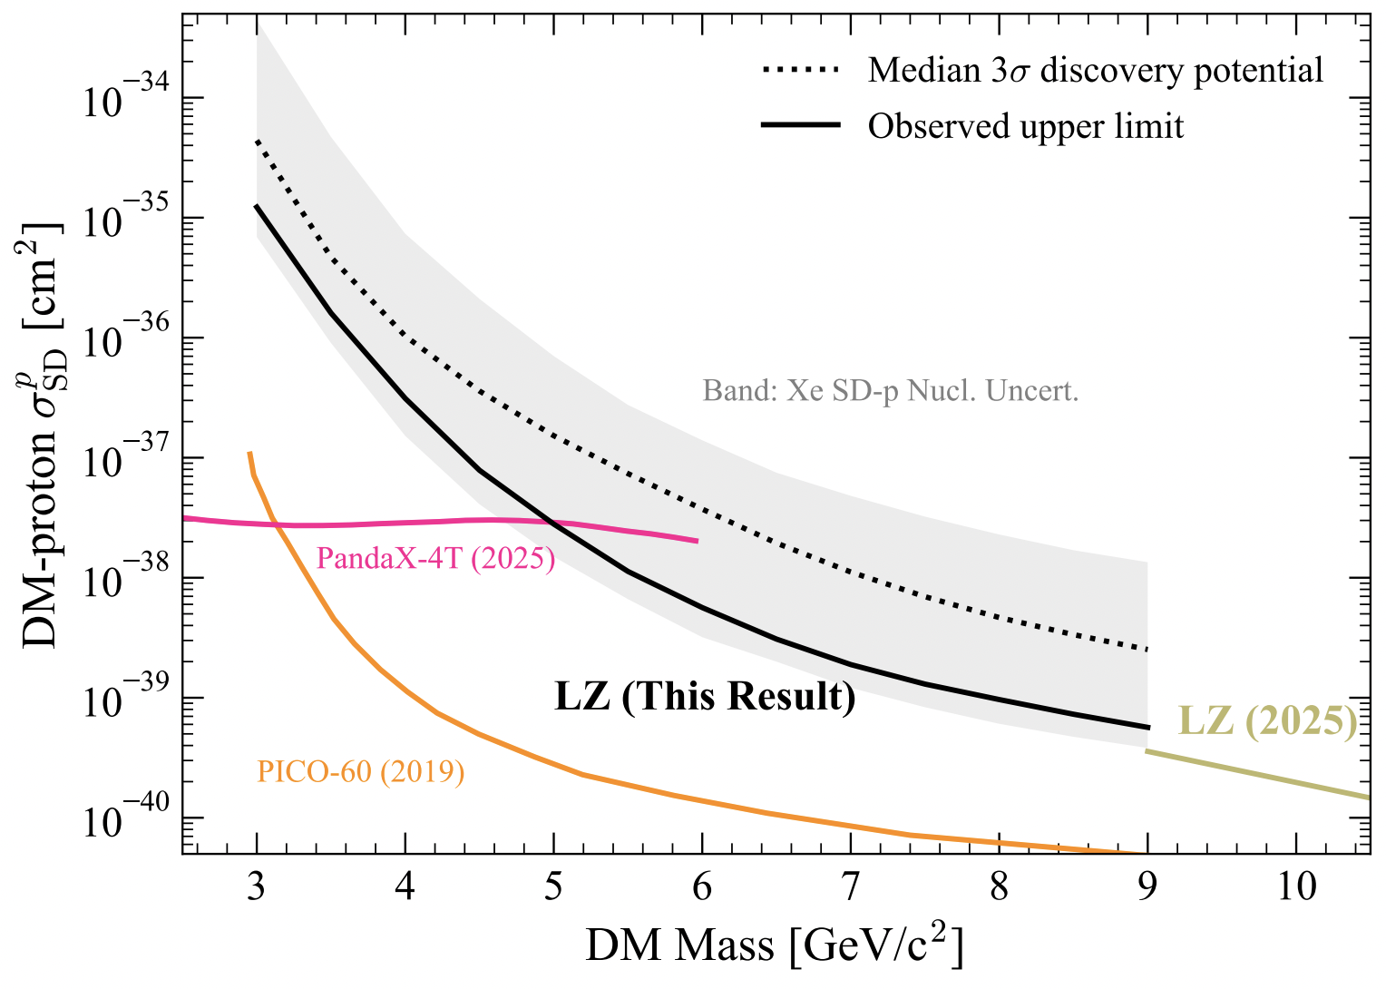
LZ WS2025 Low-mass WS search
Exclusion limit with two-sided test statistic
Factor of two improvement in sensitivity over existing limits between 5-9 GeV/c2
World-leading limits > 5 GeV/c2
Limits on SD neutron-only and proton-only:

Slide 32
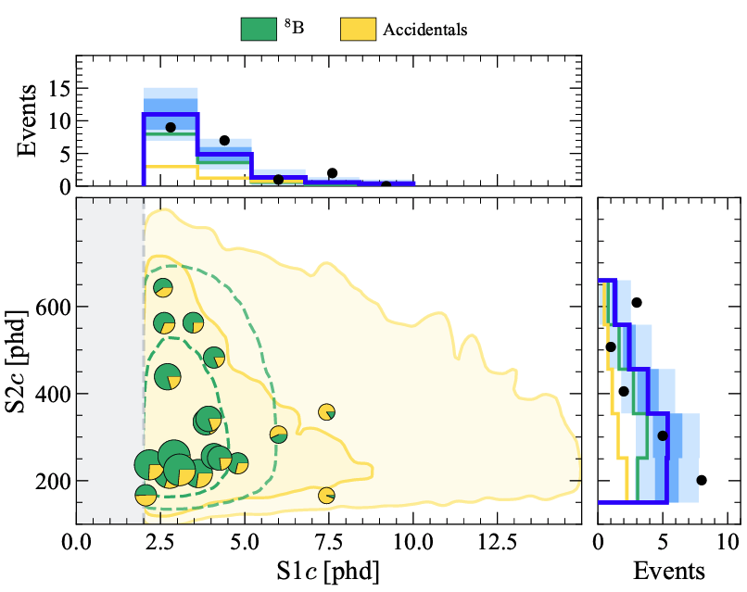
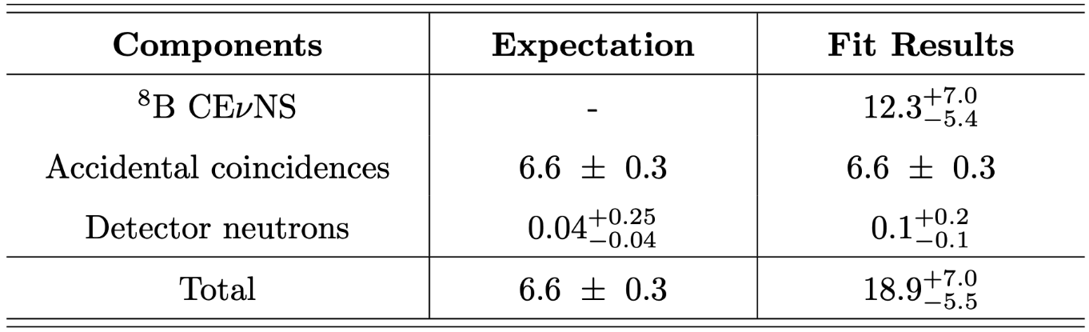
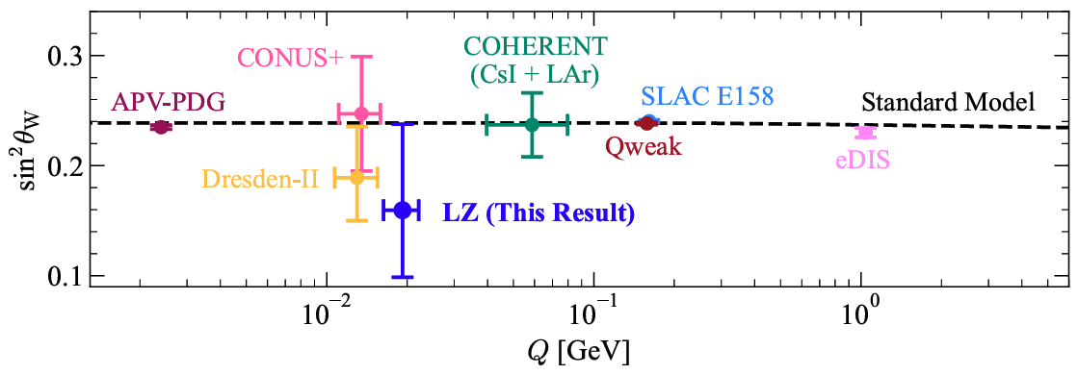
LZ WS2025
8B CE𝜈NS measurement
PLR test statistic to reject background-only model
Assumed no DM events
Unconstrained 8B CE𝜈NS rate
Background-only model rejected with 4.5𝞂 significance (expected 6.7σ)
Measure weak-mixing angle (sin2𝛳W) at low momentum transfer (Q), consistent with SM
Notes:
unconstrained 8B CE𝜈NS rate, floating freely in fits

Slide 33
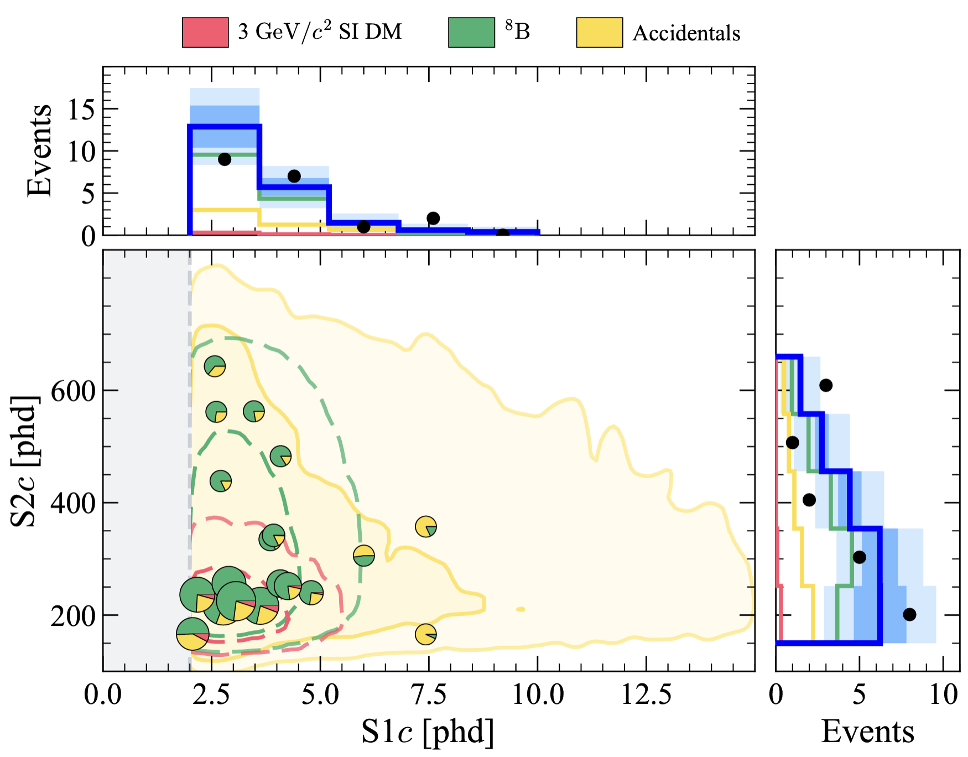
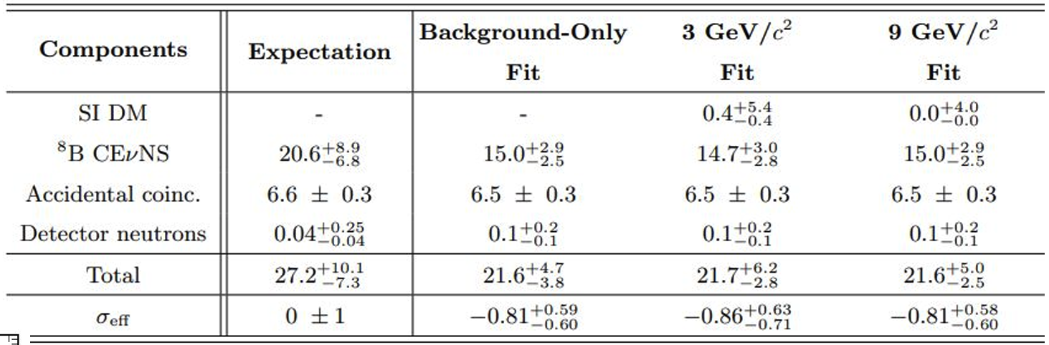
LZ Low-mass WS search and 8B Signal
arXiv:2512.08065
Backgrounds: ⁸B CE𝜈NS, accidental coincidences, and detector neutrons
⁸B CE𝜈NS rate constrained based on predictions using SNO measurement*
Best-fit number of DM events consistent with 0 at all DM masses tested
*Phys. Rev. C 88, 025501 (2013)
Thanks to Alberto Uson, Tuesday LZ Results Talk

Slide 34
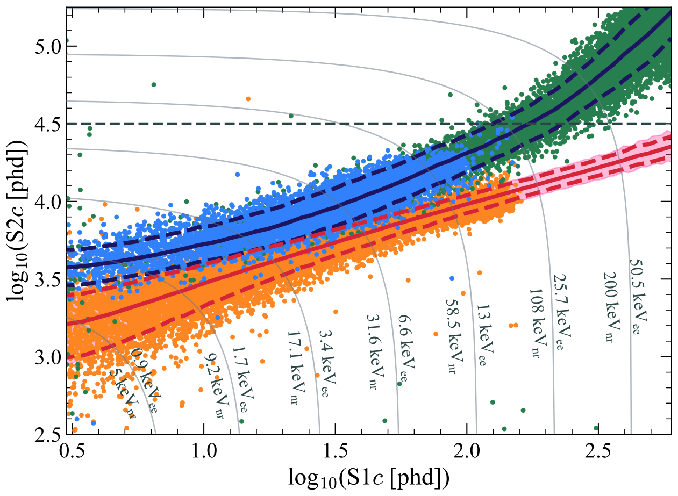
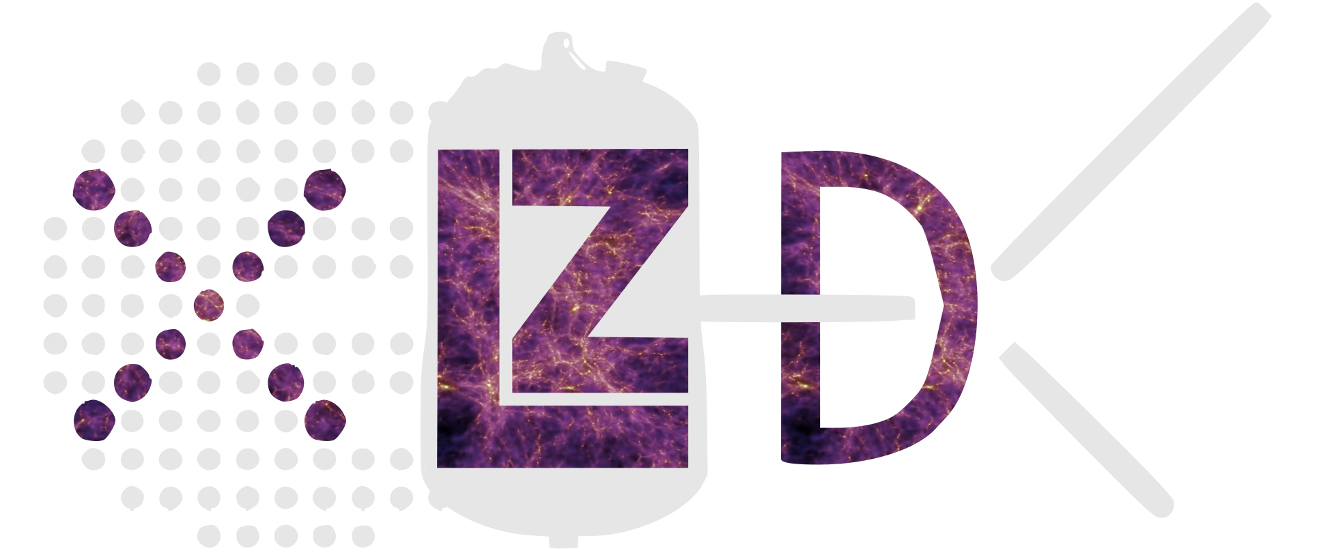
Other LZ DM searches and prospects
LZ can search for alternative candidates and in different energy regimes:
Low-energy ER
High-energy ER
LEER searches (Phys.Rev.D 108,072006 (2023))
Atmospheric millicharge particles (PRL 134, 241802 (2025))
e.g. Lightly Ionizing Particle searches
Low-energy NR
High-energy NR
Cosmic ray-boosted Dark Matter - PRL 134, 241801 (2025)
WIMP-pion - Commun Phys 7,292 (2024)
WIMP-nucleon EFT - PRL 133, 221801 (2024)
Ultraheavy DM - Phys. Rev. D 109, 112010 (2024)
Plus other non-DM searches in the horizon → 0𝜈𝛽𝛽
Further into the future, much larger exposures needed to fully cover the space parameter until the neutrino fog at larger DM masses…
arXiv:2410.17137

Slide 35
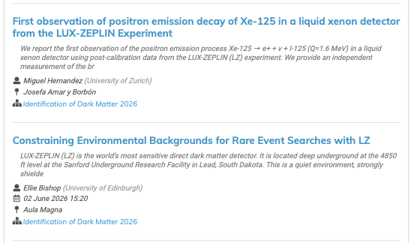
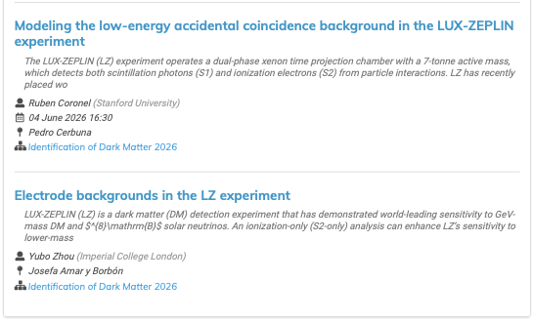
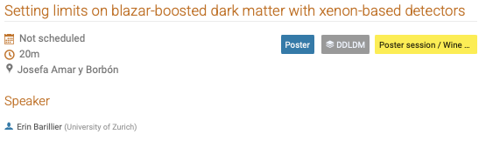
LZ Related Talks
Notes:
Erin Barillier (University of Zurich) - https://indico.capa.unizar.es/event/40/contributions/929/

Slide 36
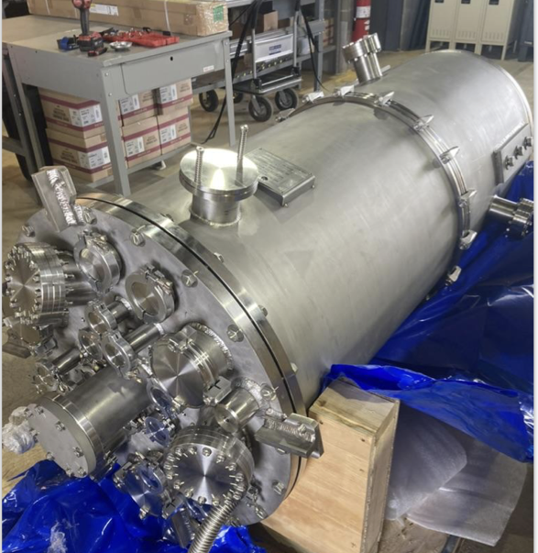
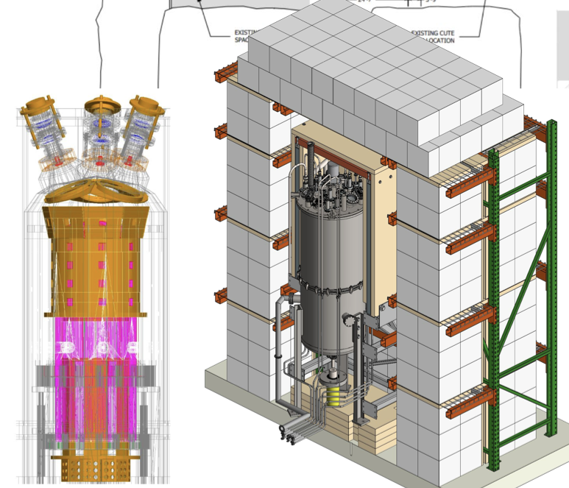
SBC - Scintillating Bubble Chamber Experiment
We heard from Ben Broerman (Queen’s U, Kingston, Ontario) on Monday (link)
Target fluid flexibility (Xe, Ar, N2, etc.)
Fermilab 6 months of stable operation with Ar
nucleation thresholds
from 0.46 – 3 keV
Simultaneous measurement of
scintillation and
bubble nucleation
observed
Outer vessel arrives at SNOLab
Notes:
https://indico.capa.unizar.es/event/40/contributions/854/attachments/693/1230/PandaX-20T_XiangXiao_IDM.pdf

Slide 37
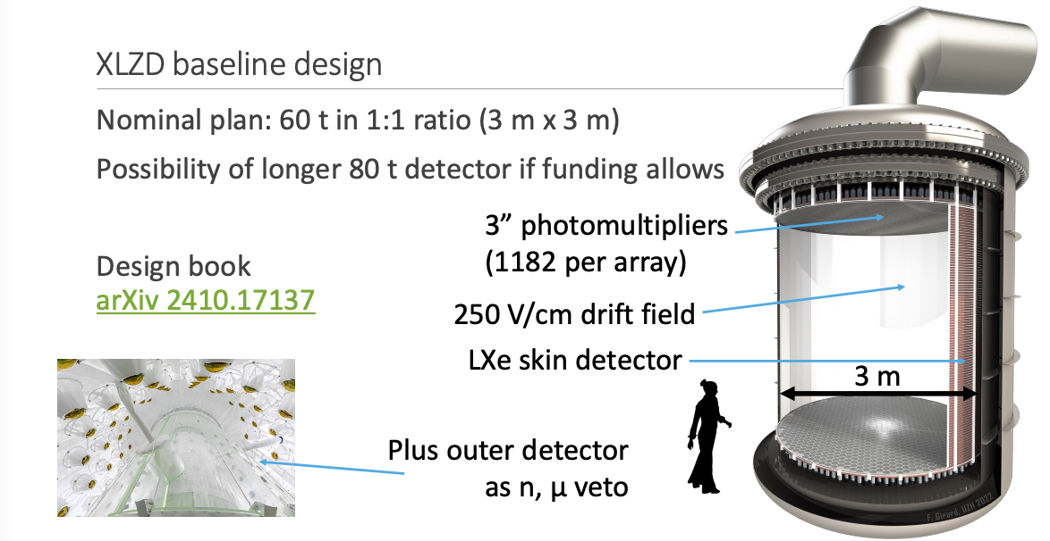
XLZD 60-80t Future Detector
We heard from Adam Softley-Brown (U Sheffield) on Tuesday (link)
( XENONnT, LZ, Darwin ) A Generation 3 DM Experiment

Slide 38

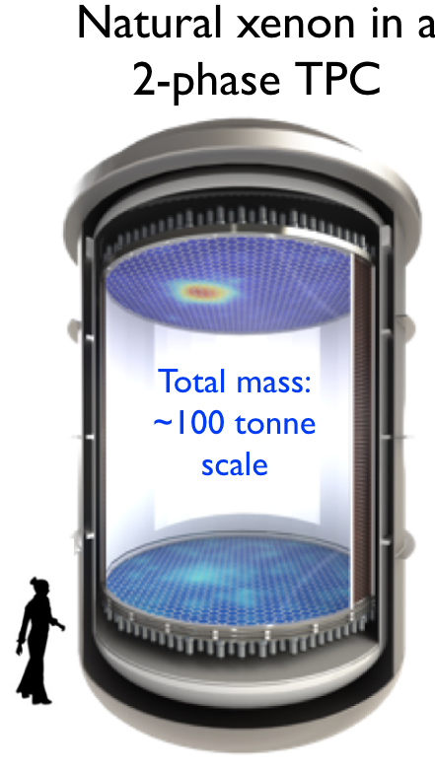
XLZD history, status and related events
July 2021: Consortium MOU signed by XENONnT, LUX-ZEPLIN, DARWIN
Oct 2023: NSAC LRP recommends pursuit of 0vbb in multiple isotopes at the ton-scale
Dec 2023: P5 recommends Generation 3 DM (G3DM) search to neutrino fog limit
Sept 2024: XLZD Collaboration agreement signed
Dec 2024: DOE NP announces indefinite pause of nEXO project due to funding constraints
Dec 2025: DOE HEP announces deferring of G3DM until early 2030’s due to funding constraints
Key activities in 2026:
  International partners continue to vigorously pursue XLZD; working towards CDR for early 2027, with ongoing US engagement
  Significant engagement from DM and 0vbb community in Canada: 11 institutions join XLZD, bid for SNOLAB hosting
  Technical evaluation of 4 sites to complete in the coming months: Boulby, LNGS, SURF, SNOLAB
  US participation is a critical part of the technology base and needed to realize the full scientific reach of 80-t active target on a competitive timeline

Slide 39
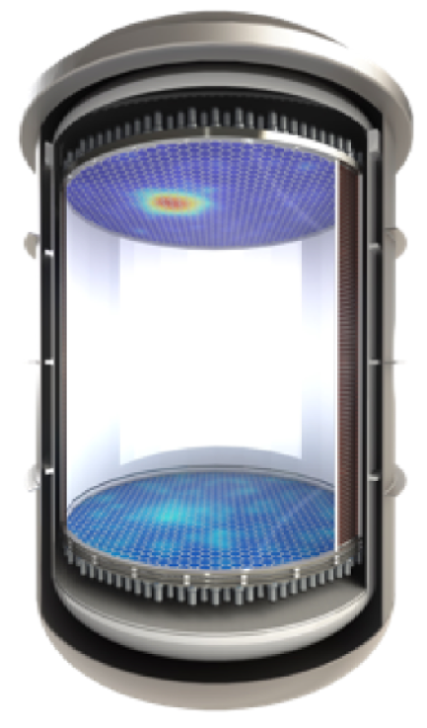
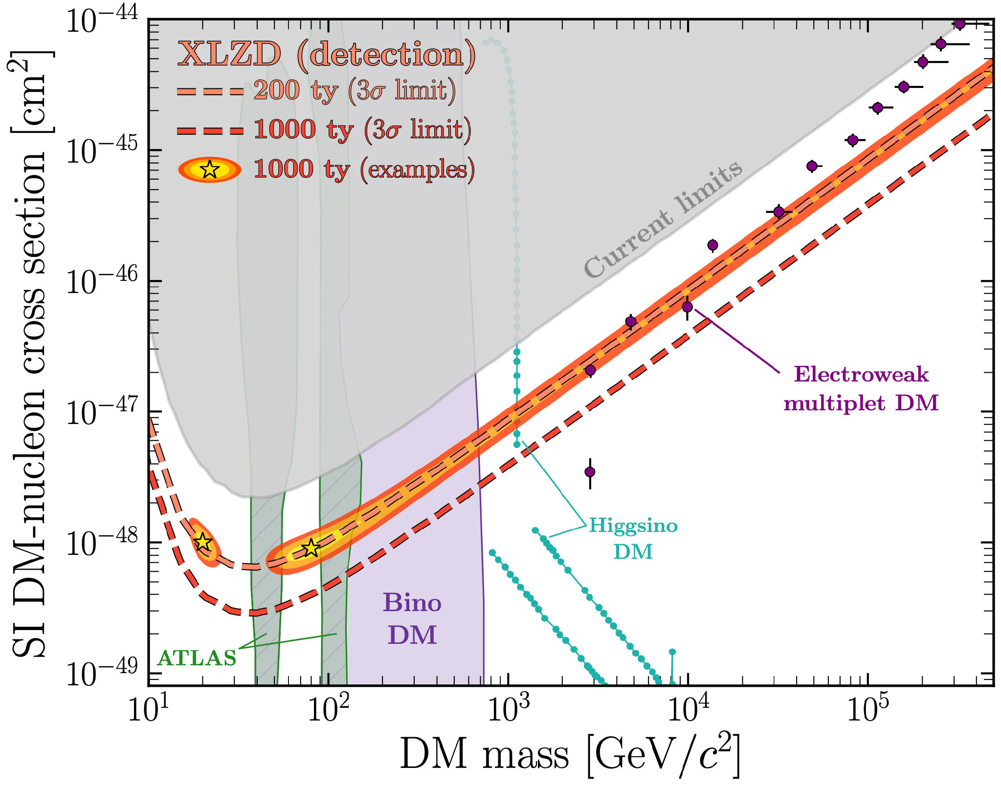
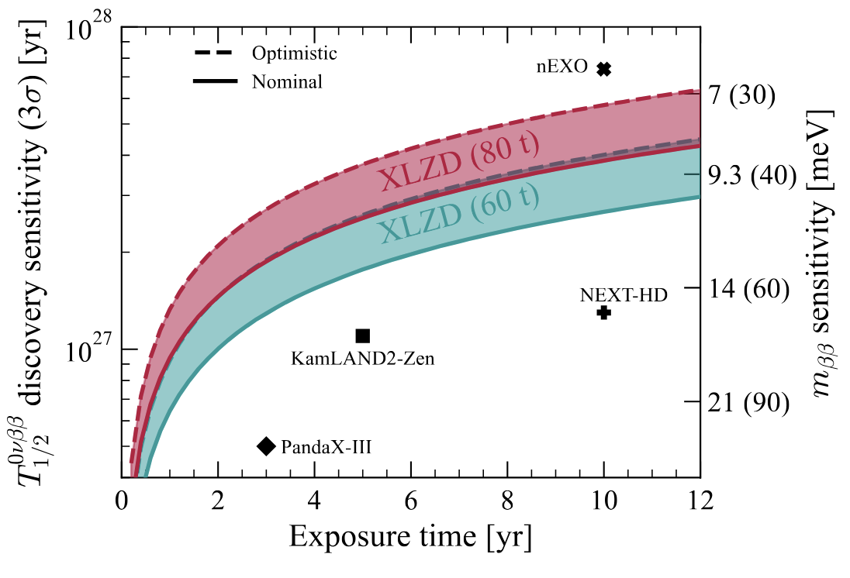
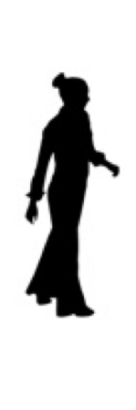
XLZD: liquid xenon observatory at the 100-tonne scale
Natural xenon in a
2-phase TPC
Probe WIMP Dark Matter to
neutrino fog systematic limit
DM detector w/natural xenon:
Competitive sensitivity for 0𝜈𝛽𝛽
arxiv.org/2410.17137
arxiv.org/2410.19016
Total mass:
~100 tonne scale
Definitive WIMP search: systematics limited by 𝜈 fog at ~1000 tonne-years of exposure sets scale for ~100-tonne detector
Xe-136 is 9% of the natural abundance, allowing a search for 0𝜈𝛽𝛽 with the potential to approach the nEXO design sensitivity
  Optimization to push sensitivity to T^{1/2} ~ 10²⁸ years is under study

Slide 40
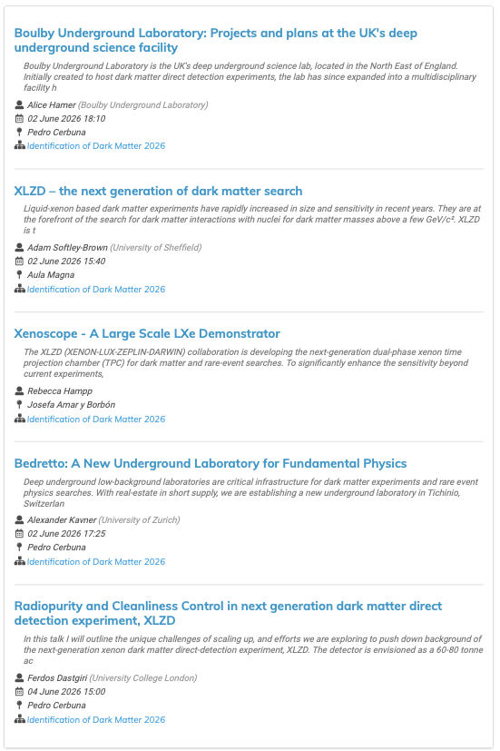
XLZD Related Talks

Slide 41
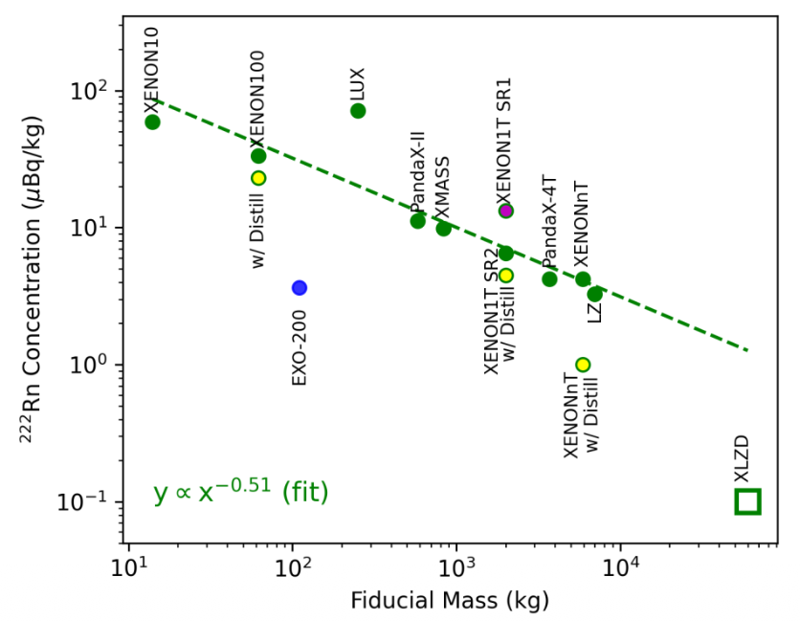
Backgrounds/Radon Levels inside Xe TPC
Backgrounds
Material backgrounds factor 4-10 lower than current generation
Intrinsic backgrounds at low-E subdominant to solar neutrinos
Rn concentration < 0.1 μBq/kg
Screening, low-activity materials,
active removal – on target
Adam Softley Brown, Tuesday
Ferdos Dastgiri, Thursday at 15:00

Slide 42
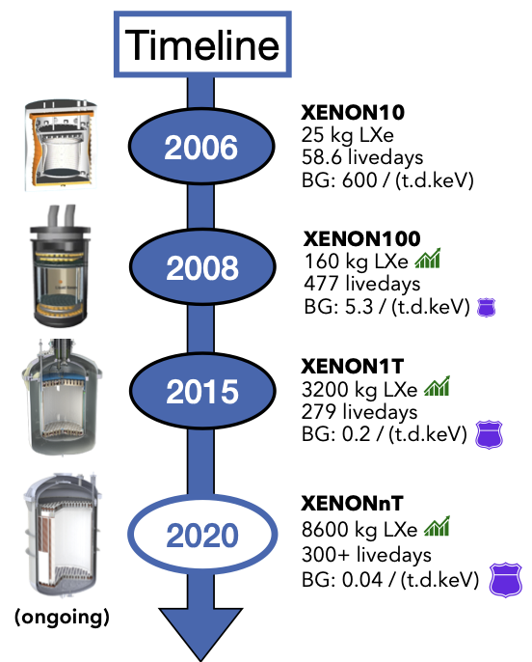
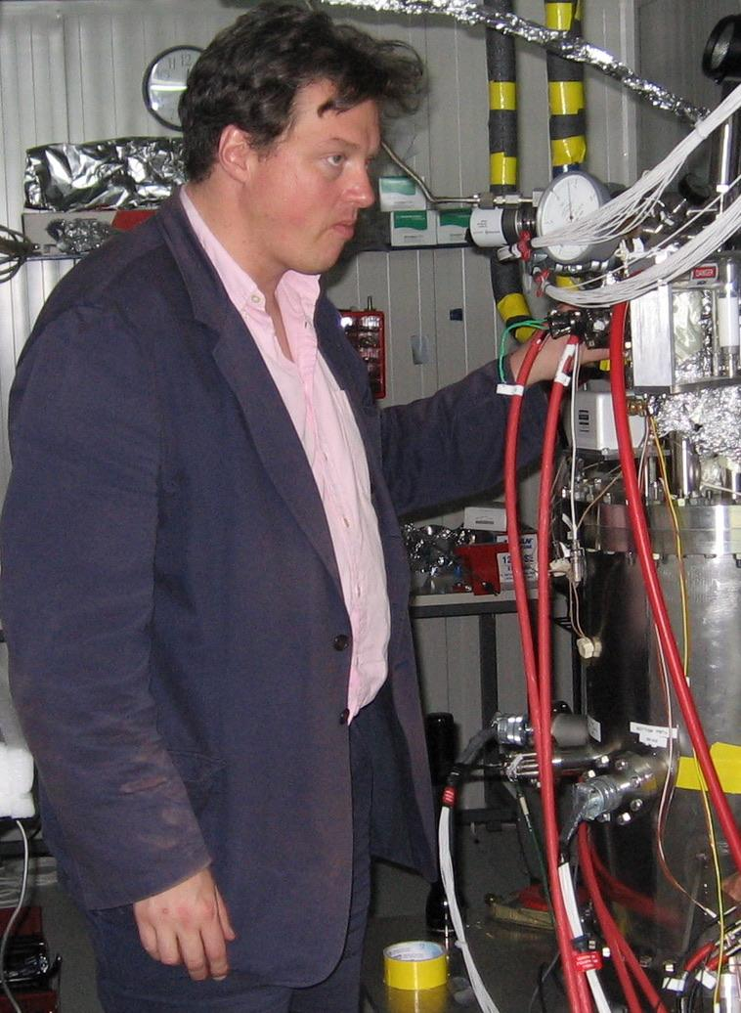
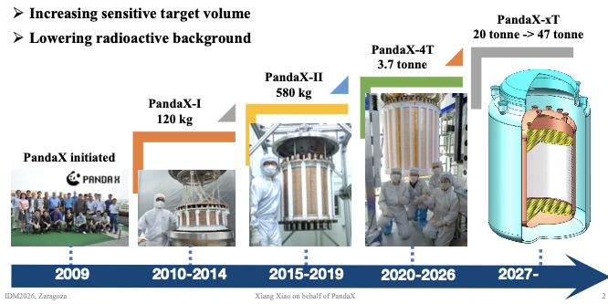
Xe Major Running >10 live-years Science
LUX
Science 2013-2016
>400 live days
>800 live days
LZ
Science 2020-
XENON10 (2005)

Slide 43
(This slide intentionally left blank)

Slide 44
Strong Guidance from DOE HEP FY27-FY31
Dec 2025: Gina Rameika, Associate Director (Head) of Science for High Energy Physics & Associate Director of Science for Nuclear Physics
DOE - No New Starts for coming 5 years
HEP includes the High Energy and Cosmic Frontiers
What does this mean?
Existing programs can continue on operations. Extensions of existing searches are being considered.
We cannot submit new construction/project proposals.
In the language of DOE we are unable to start a CD-0 - Critical Decision 0 which is referred to as Mission Need for a Next Generation Dark Matter Experiment
( Offices of High Energy Physics and Nuclear Physics are merging )
Notes:
https://science.osti.gov/hep/About/-/media/hep/pdf/about/HEP-ORG-CHART032526.pdf
https://www.aip.org/gina-rameika

Slide 45
Proposal for LZ+ for 2028–2032
May 2026

Slide 46
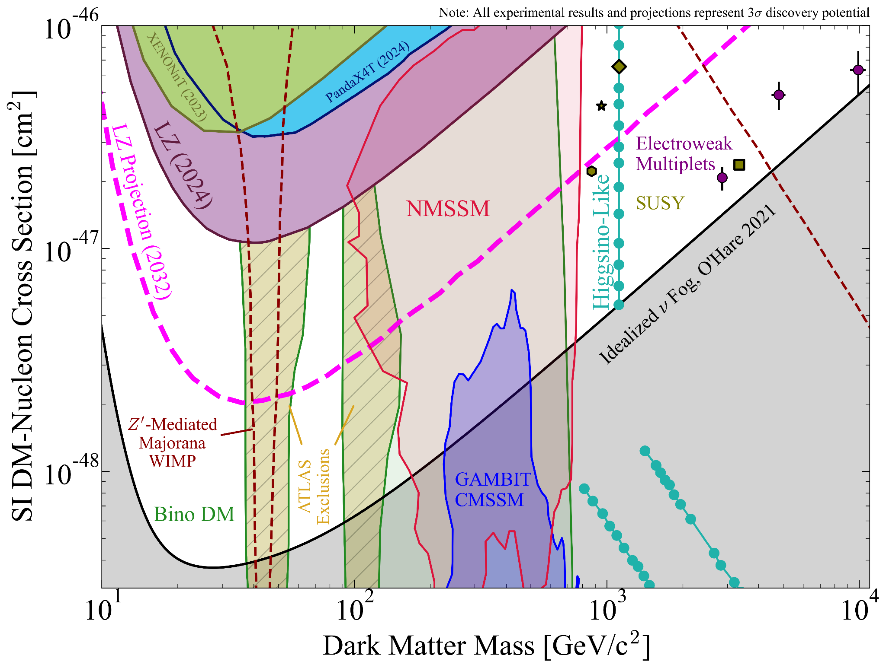
LZ+ Step 1: Continued LZ running for Pillar 1 science
3σ Discovery
ATLAS Bino DM: JHEP 05 106 (2024)
Z’-Mediated Majorana WIMP: JCAP11 024 (2019)
GAMBIT CMSSM: Eur. Phys. J. C. 77, 824 (2017)
NMSSM: JHEP 2024, 212 (2024)
EW Multiplet DM: Eur.Phys.J.C 82 1, 31 (2022)
Higgsino-Like: Eur. Phys. J. C. 83, 246 (2023)
SUSY electroweakinos: Ann.Rev.Nucl.Part.Sci. 70 425-454 (2020)
Neutrino Fog: Phys.Rev.Lett. 127, 251802 (2021)

Slide 47
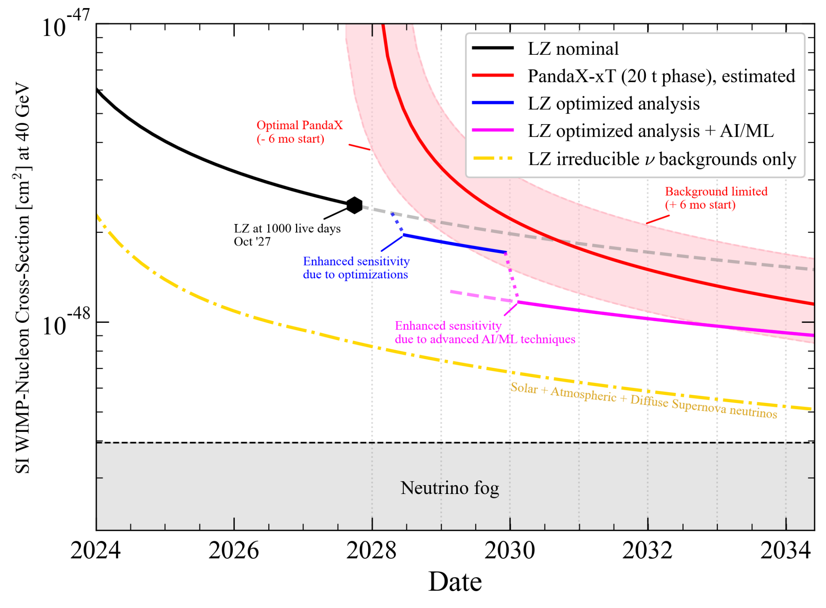
LZ+ Step 1: Continued LZ running for Pillar 1 science
PandaX 20 tonne
LZ
LZ+

Slide 48
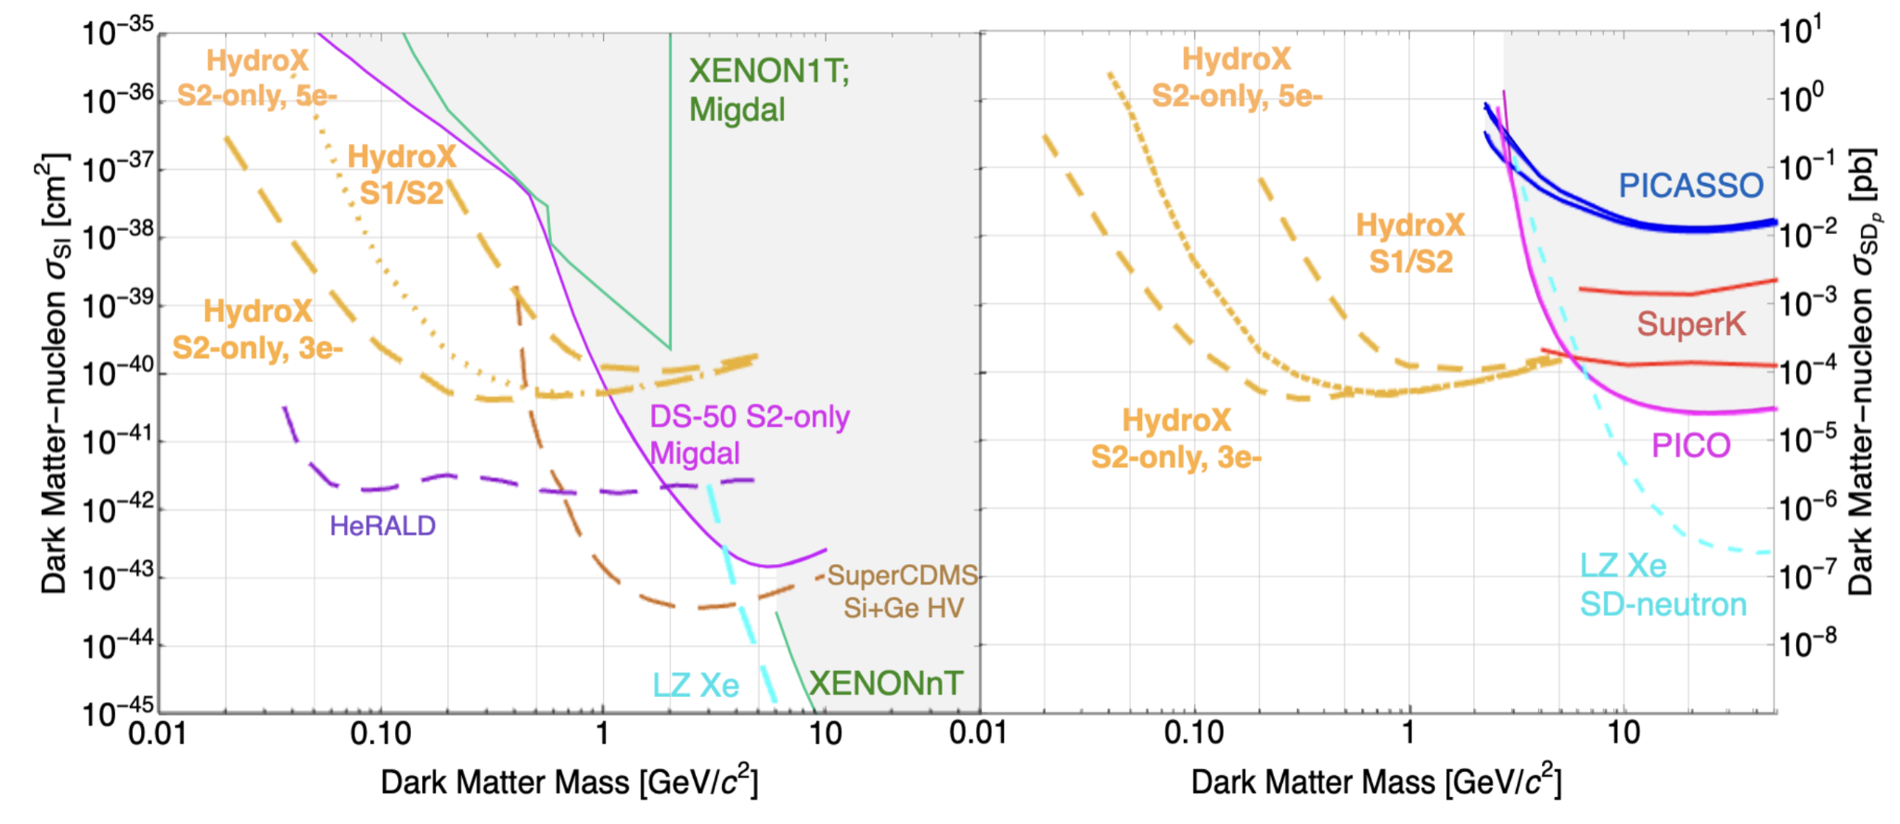
LZ+ Step 2: Continued dark matter science with HydroX
Get the benefit of simple LZ extension through ~2031, maintain Pillar 1 focus until LZ is no longer world-leading, then:
Shift focus leveraging sensitivity to lower masses DM using low-Z dopant >kg
  HydroX: sensitivity to low-mass dark matter (10 MeV to 1 GeV mass range).
  Basic technical feasibility of low-Z doping of xenon: solubility, signal size
    Under investigation now with dedicated setups
    Technical solution for adding and removing a dopant in LZ while maintaining purification
  Unique and complementary science goals to other DOE programs.
  Simultaneous sensitivity to Spin-Independent and Spin-Dependent interactions; unique and complementary to other DOE programs.
  Repurpose the LZ instrument for a different goal, still world-leading dark matter science
HydroX is compelling:
  LZ would be sensitive to both spin-independent and spin-dependent interactions at the same time.
  Complementary to other experiments:
    If a signal is seen in another low-mass DM experiment (e.g. TESSERACT), the signal in LZ/HydroX could reveal the nature of the dark matter.

Slide 49
LZ+ Summary
LZ should do “Pillar 1 Science”; searches for dark matter with mass > 1 GeV.
  Our Step 1 will maintain LZ as the world’s leading experiment in this regime. We propose to keep running LZ, while improving our software and analysis capabilities, with a strong focus on AI/ML in line with the GENESIS mission.
  Only after world-leading Pillar 1 science is no longer viable with the LZ instrument, our Step 2 unlocks a unique dark matter space that only LZ can explore, complementary to other experiments in the DOE program.
The plan has support from senior leaders within the collaboration and maintains US expertise in the Xe technology
  Step 2 scope has emerged internally as the most appropriate extension to LZ which both brings new science reach and maintains technological progress in the community. It builds on existing efforts from the last several years and has buy-in from most major LZ institutions - HydroX workshop.

Slide 50
US Dark Matter (Higher Mass) Xe/Ar Summary
US Has Maintained Leadership in DOE Pillar 1 High Mass Dark Matter Search Sensitivity
  LZ World leading limits for WIMP dark matter >5 GeV, LZ science running since start of 2022
  Current LZ Schedule - Science Running to end CY2027
Under DOE HEP No New Starts Scenario
  LZ+ Proposal
    DOE DM Pillar 1: Extend Sensitivity FY28, FY29, FY30…
      Improved BG through technical upgrade/analysis
      AI/ML Analysis Impact / via GENESIS and Direct Support
    Additional Option if Technology Demonstrated: Could transition to HydroX FY31-FY33
      Dope Xe with low-Z material, Leverages low mass DM sensitivity
  Current Experiments with Existing US Component
    XENONnT @LNGS (Xe 6 tonne)
      Started science 2021, now being recommissioned 2026 for operation to 2028
    Darkside DS20k @LNGS (Ar 20 tonne)
      Under construction for commissioning start before end 2028
XLZD
  Site TBC, Xe 60-100 tonne / Originally formed as a combination of Xe Groups from XENON, LZ and Darwin
  US Participation in G3 Experiment directly impacted by DOE no new starts
  UK has development funds to plan the hosting of XLZD in a major new underground facility at Boulby
  Europe Awaiting the APPEC Roadmap which is released later this year

Slide 51
Summary Xe Detectors for DM Future
Prospects for new discoveries with existing LXe TPC are very strong - searching new parameter space, systematics well under control
Major accumulation of science running over last 20 years
Design Scales for 20-80 tonne operation sensitive to ~100% single electrons and 10% photons from interaction in bulk - excellent discovery potential
LZ running with goal of 1000 live days by 2021-2027
LZ+ proposal for running 2028-2032 include doping with low mass target
XENONnT has been repaired and has started running again 2026-2028
XLZD heavily impacted by DOE no new starts
PandaX-4t ended 2026, will be replaced by PandaX-20t start science in 2028
SBC 10kg (Ar) assembling at SNOLab (could run with Xe)

Slide 52
--- END ---

Slide 53
Sizes of the Future Collaborations
XLZD 60-80t 400+ members from 80+ institutions (includes large US component)
PandaX-20/40t

Slide 54
ADDITIONAL SLIDES

Slide 55
LZ

Slide 56
WS2024 result
Phys. Rev. Lett. 135, 011802
ROI targeted ≥9 GeV/c² DM masses
Novel features incorporated into the analysis:
  Rn-tag reduced 60% primary ER BGs
  Charge yield suppression modelled and measured in EC and DEC
Bias mitigation technique
Final exposure included in PLR: 4.2 tonne·yr
  WS2022: 60 days x 5.5 t = 0.9 tonne·yr exposure
  WS2024: 220 days x 5.5 t = 3.3 tonne·yr exposure
WS2024 ROI
WS2025 ROI
Result: world leading constraints → 2.2 ⨉ 10⁻⁴⁸ cm² for 40 GeV/c² WIMP
What’s next? Shift to lighter DM masses → WS2025
New set of challenges

Slide 57
Low-mass WS search
Exclusion limit with two-sided test statistic
Factor of two improvement in sensitivity over existing limits between five and nine GeV/c2
World-leading limits > 5 GeV/c2
Limits on SD neutron-only and proton-only:

Slide 58
8B CE𝜈NS measurement
PLR test statistic to reject background-only model
Assumed no DM events
Unconstrained 8B CE𝜈NS rate
Background-only model rejected with 4.5𝞂 significance (expected 6.7σ)
Measure weak-mixing angle (sin2𝛳W) at low momentum transfer (Q), consistent with SM
Notes:
unconstrained 8B CE𝜈NS rate, floating freely in fits

Slide 59
Other LZ DM searches and prospects
LZ can search for alternative candidates and in different energy regimes:
Low-energy ER
High-energy ER
LEER searches (Phys.Rev.D 108,072006 (2023))
Atmospheric millicharge particles (PRL 134, 241802 (2025))
e.g. Lightly Ionizing Particle searches
Low-energy NR
High-energy NR
Cosmic ray-boosted Dark Matter - PRL 134, 241801 (2025)
WIMP-pion - Commun Phys 7,292 (2024)
WIMP-nucleon EFT - PRL 133, 221801 (2024)
Ultraheavy DM - Phys. Rev. D 109, 112010 (2024)
Plus other non-DM searches in the horizon → 0𝜈𝛽𝛽
Further into the future, much larger exposures needed to fully cover the space parameter until the neutrino fog at larger DM masses…
arXiv:2410.17137

Slide 60
Step 2: Continued dark matter science with HydroX
Motivation:
  Only after LZ is no longer the world-leading experiment for pillar 1; what other dark matter science can we do?
  HydroX: sensitivity to low-mass dark matter (10 MeV to 1 GeV mass range).
  Simultaneous sensitivity to Spin-Independent and Spin-Dependent interactions; unique and complementary to other DOE programs.
R&D needs:
  Basic technical feasibility of low-Z doping of xenon: solubility, signal size
    Under investigation now with dedicated setups
  Technical solution for adding and removing a dopant in LZ while maintaining purification
LZ Modification needs:
  Requires modification to circulation system
  Unproven technology update (loading of sufficient low Z mass). Mitigation: includes a go/no-go milestone
Notes:
Degradation of High-mass WIMP signal is NOT a risk because in our logic, pillar 1 science has run its course by the time HydroX is implemented

Slide 61
XLZD: A next generation
observatory for rare events
Prepared for Rick Gaitskell on behalf of XLZD

Slide 62
XLZD: liquid xenon observatory at the 100-tonne scale
Natural xenon in a
2-phase TPC
Probe WIMP Dark Matter to
neutrino fog systematic limit
DM detector w/natural xenon:
Competitive sensitivity for 0𝜈𝛽𝛽
arxiv.org/2410.17137
arxiv.org/2410.19016
Total mass:
~100 tonne scale
Definitive WIMP search: systematics limited by 𝜈 fog at ~1000 tonne-years of exposure sets scale for ~100-tonne detector
Xe-136 is 9% of the natural abundance, allowing a search for 0𝜈𝛽𝛽 with the potential to approach the nEXO design sensitivity
  Optimization to push sensitivity to T^{1/2} ~ 10²⁸ years is under study

Slide 63


XLZD: liquid xenon observatory at the 100-tonne scale
Probe WIMP Dark Matter to
neutrino fog systematic limit
DM detector w/natural xenon:
Competitive sensitivity for 0𝜈𝛽𝛽
Natural xenon in a
2-phase TPC
Total mass:
~100 tonne scale
arxiv.org/2410.17137
arxiv.org/2410.19016
2
Notes:
* Definitive WIMP search: systematics limited by 𝜈 fog at ~1000 tonne-years of exposure sets scale for ~100-tonne detector
* Xe-136 is 9% of the natural abundance, allowing a search for 0𝜈𝛽𝛽 with the potential to approach the nEXO design sensitivity
* Optimization to push sensitivity to T1/2 ~ 1028 years is under study

Slide 64

XLZD: liquid xenon observatory at the 100-tonne scale
Probe WIMP Dark Matter to
neutrino fog systematic limit
DM detector w/natural xenon:
Competitive sensitivity for 0𝜈𝛽𝛽
Natural xenon in a
2-phase TPC
Total mass:
~100 tonne scale
arxiv.org/2410.19016
ab initio models: 80-t XLZD
could explore full IH
A. Belley, PhD thesis (2024)
arxiv.org/2410.17137
2
Notes:
* Definitive WIMP search: systematics limited by 𝜈 fog at ~1000 tonne-years of exposure sets scale for ~100-tonne detector
* Xe-136 is 9% of the natural abundance, allowing a search for 0𝜈𝛽𝛽 with the potential to approach the nEXO design sensitivity
* Optimization to push sensitivity to T1/2 ~ 1028 years is under study

Slide 65


XLZD 0ν-DBD Sensitivity (Double Beta Decay)

Slide 66
DS20k Reference

Slide 67


DS20k Science Reach - High Mass Searches
DS-20k sensitivity (left: 90 % C.L. exclusion; right: 3 σ significance evidence for a signal) to spin-independent WIMPs for different live-times, 1 and 10 yr, and for different target volumes, fiducial and extended volume. The DS-20k projected 90 % C.L. exclusion is compared with the world-leading dark matter results published by LZ, XENONnT, and PandaX-4T. The DS-20k 3 σ detection sensitivity is instead compared against the published values of the ultimate projected sensitivities of the two U.S. experiments: for LZ, 2.7 yr run, 15.3 t yr exposure; for XENONnT, 5 yr run, 20.2 t yr exposure. Also represented are the neutrino “fog” for an argon detector, shown by the blue-shaded regions of different density, and the 1-, 2-, and 3-σ favored regions from the pMSSM11 model constrained by astrophysical measurements and the ∼36/fbarn LHC dataset at 13 TeV, shown by the ochre-filled contours. Green and blue rectangles identify regions where complex and real WIMPs can be thermally produced at the relic abundance, subject to current constraints from indirect and collider searches.

